Slide 1


Slide 2
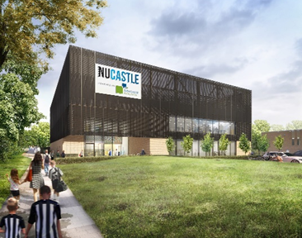
SOCIAL VALUE IN CONSTRUCTION
Delivering NUCASTLE
The new community sports hub for Newcastle United Foundation
Introduction Michael Henning : Todd Milburn
Project Manager/Employer’s Agent
Newcastle United Sarah Medcalf
Foundation Deputy Head of Foundation
Procurement Process Michael Henning
Social Value Delivery Terry Hanlon : Robertson Group
Community Impact Lead
Questions

Slide 3

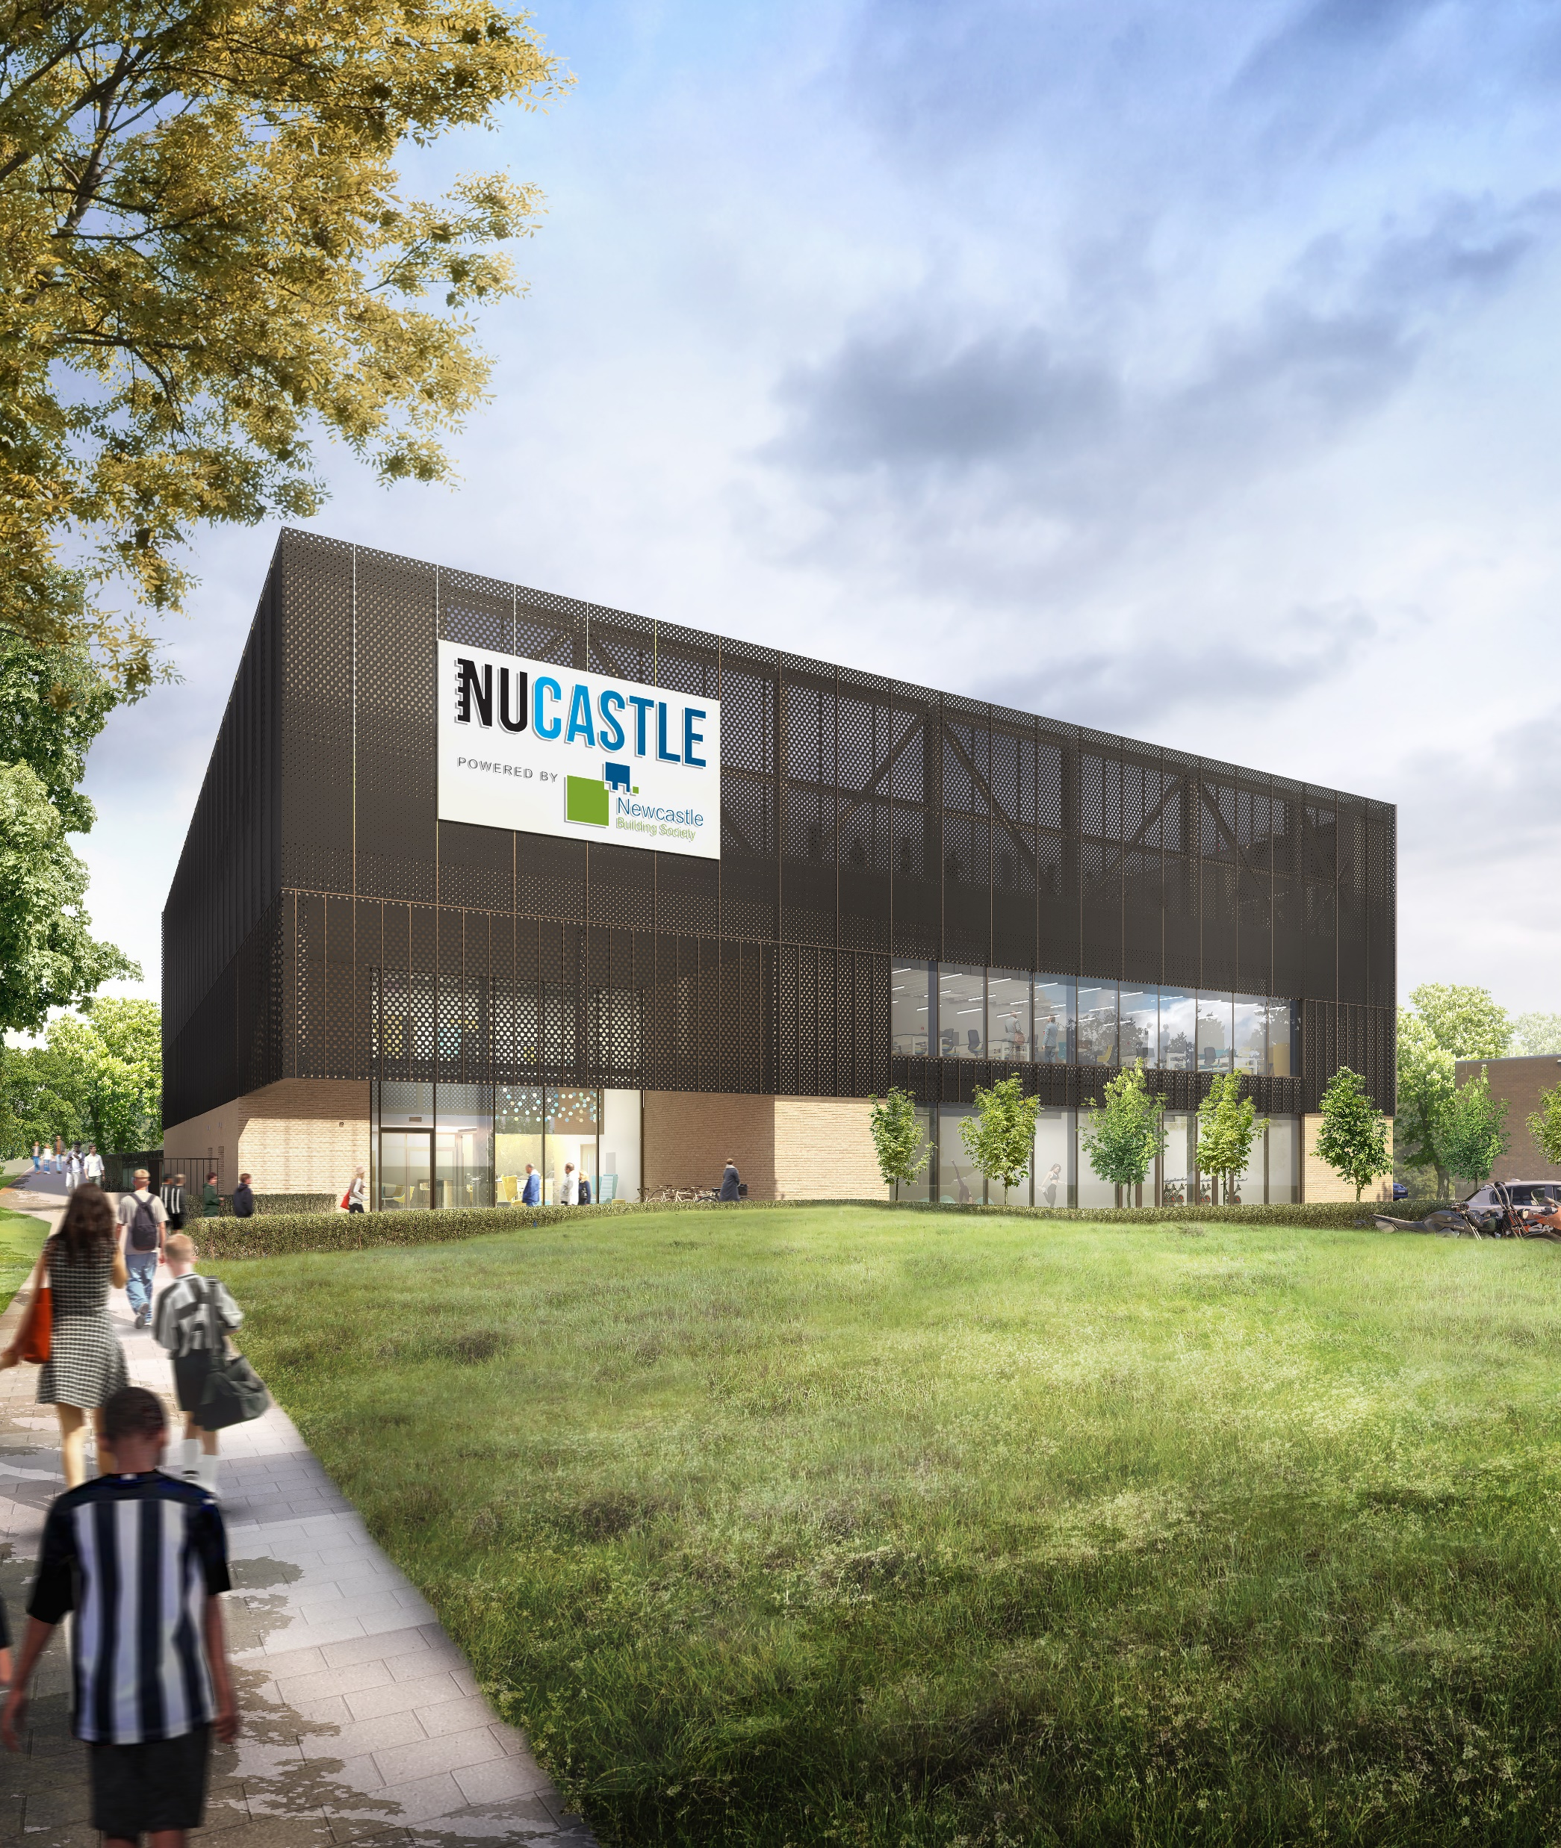
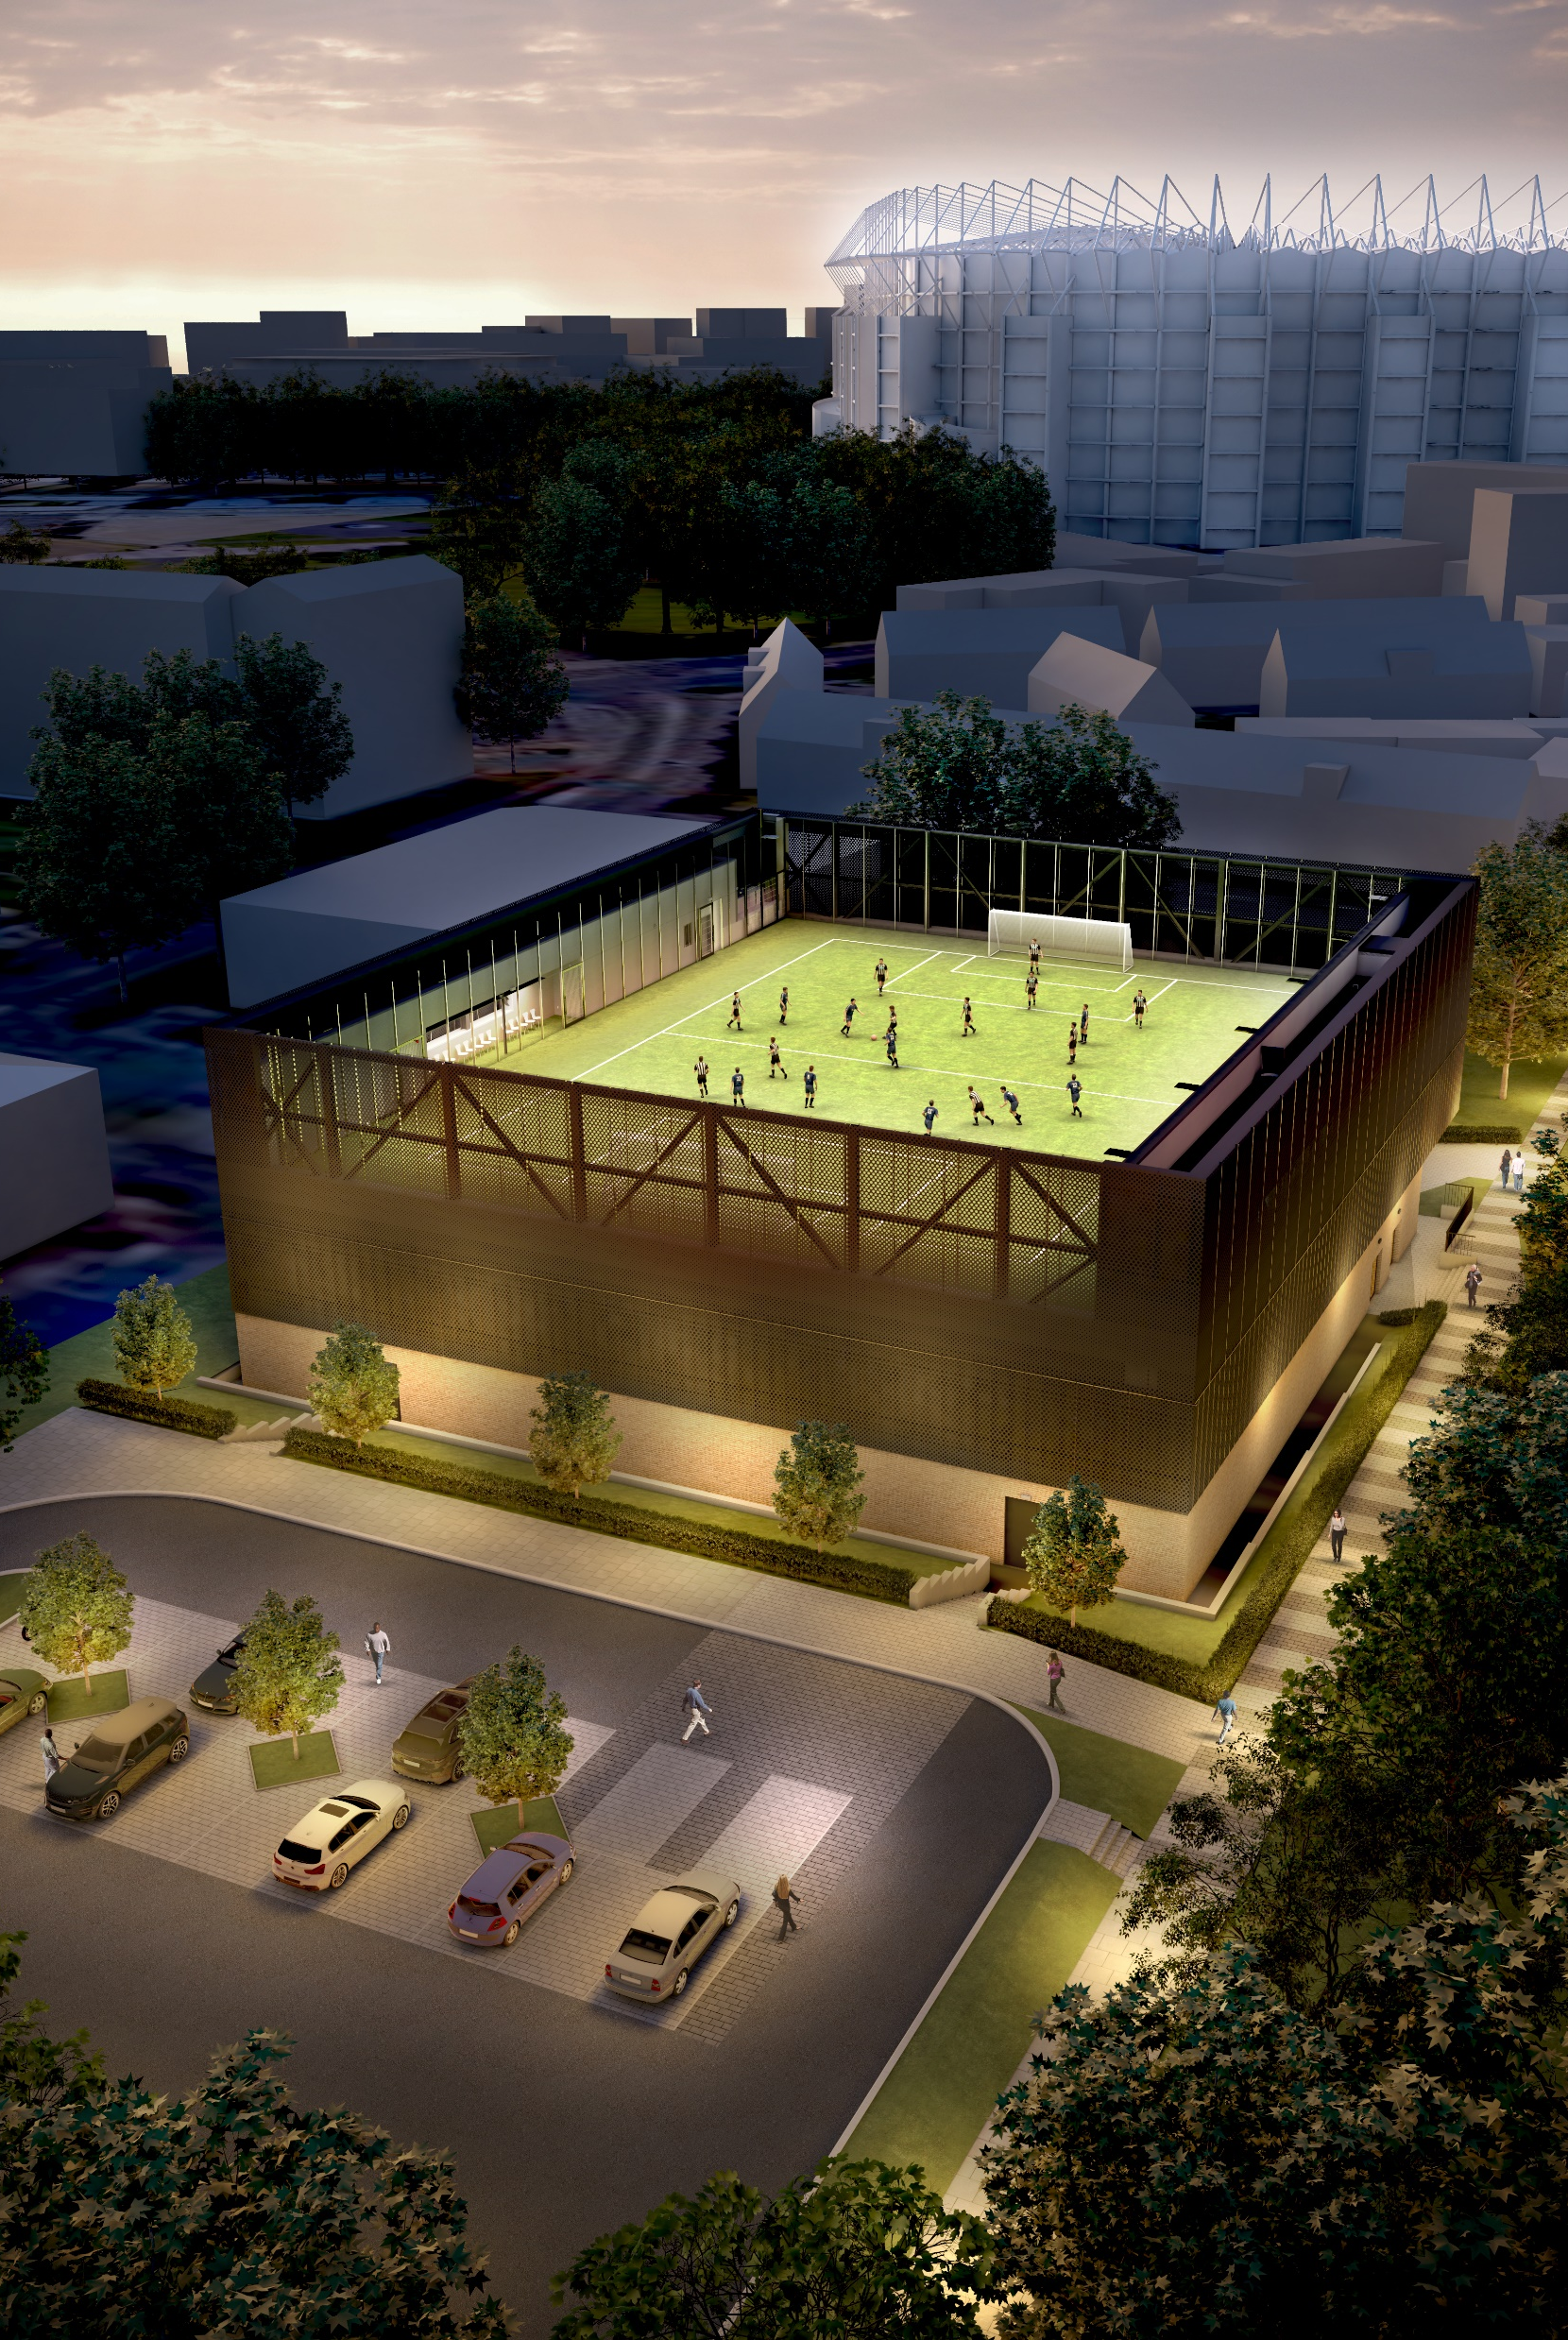

Newcastle United Foundation and
NUCASTLE
A UNITED VISION

Slide 4
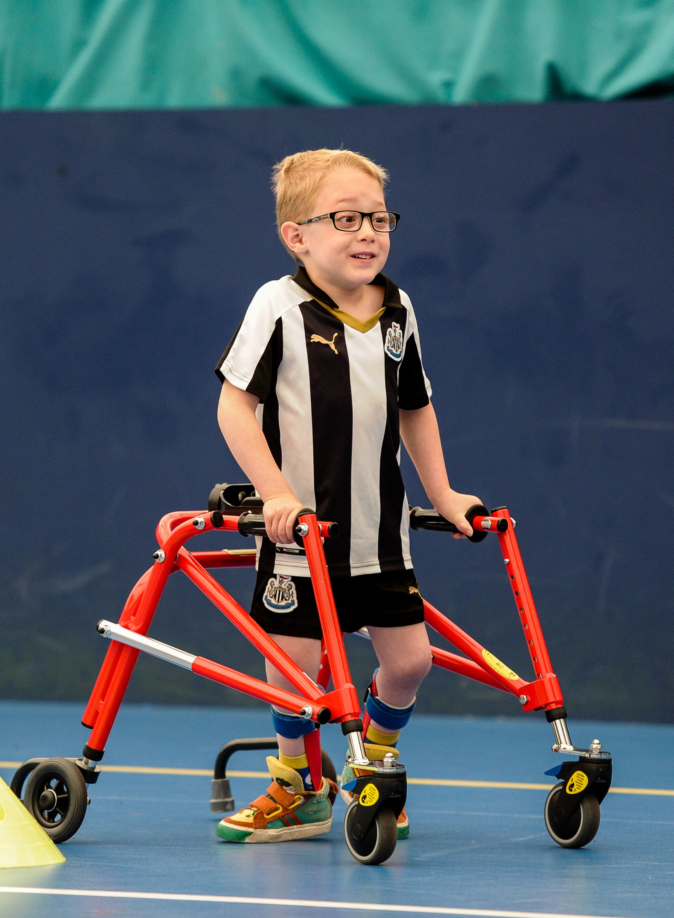
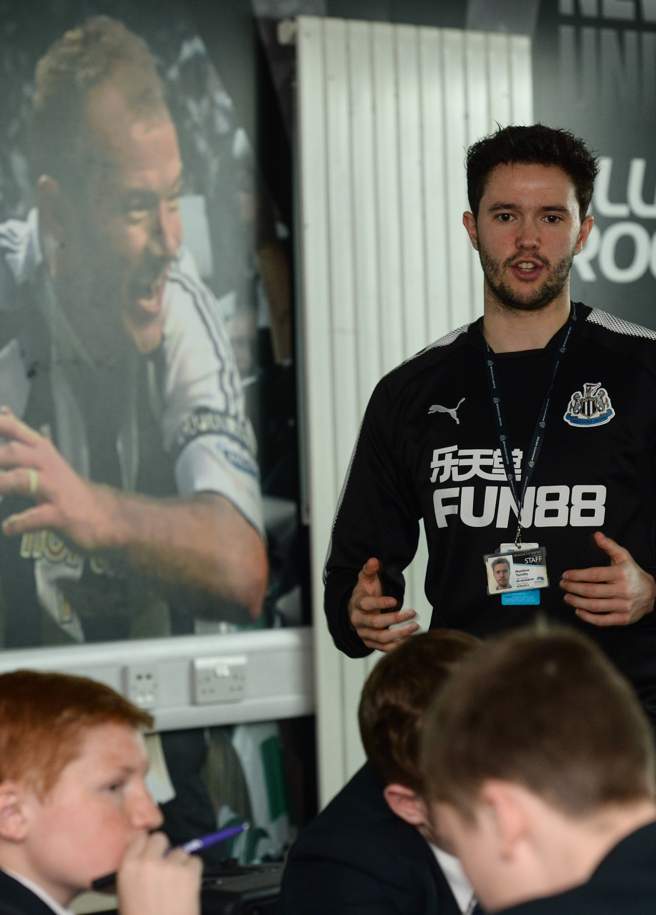
Heart of the Community
We use the power of football to motivate people to:
  be more active and participate in a wide range of sports
  learn
  be more employable
  be healthier
  overcome obstacles
  respect themselves and each other
  have fun and to reach their potential
Why we are different
Our ability to engage people that others cannot reach using the Newcastle United brand
Committed and motivated staff who are skilled at helping people realise their potential
Strong partnerships that compliment and strengthen our work
An established provider with 13 years of working at the heart of our local community helping over 64,000 people annually

Slide 5
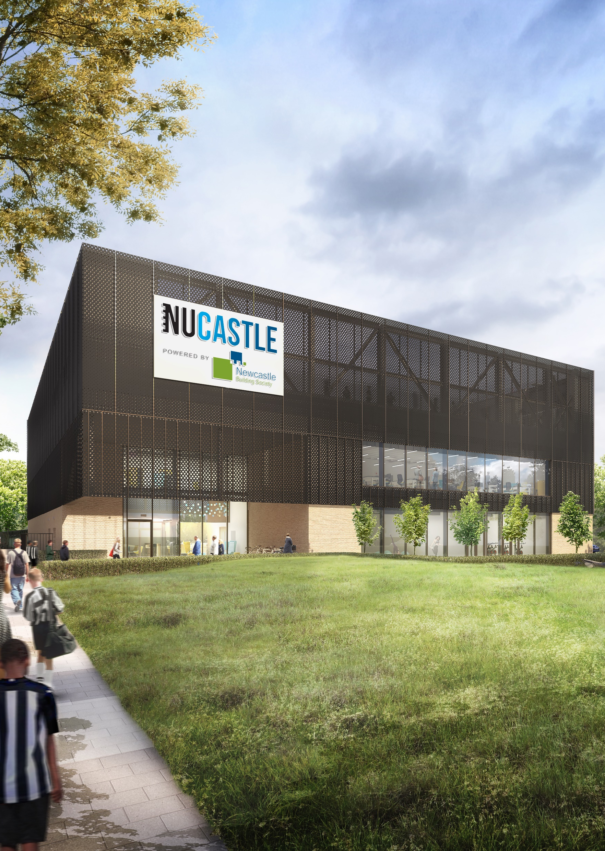

Working in Partnership
Newcastle United Foundation is an award winning regional charity, with a national reputation for delivering excellence in community sport, learning and wellbeing.
With excellent links to Newcastle United Football Club, a partnership with the Foundation brings status, prestige and exposure.
The Foundation has a 13 year track record of supporting organisations to deliver their CSR strategies, build meaningful community connexions and demonstrate social impact.
The Foundation also has excellent relationships with North East schools, delivering in 25% of Primary Schools and key Secondary Schools across the region.

Slide 6

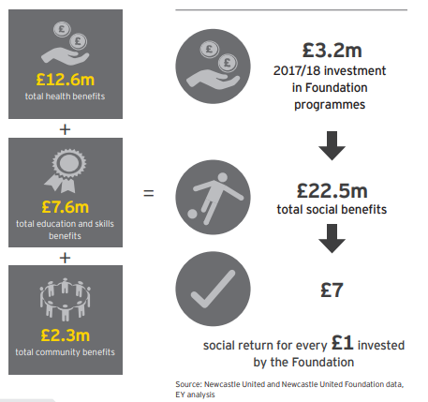

Slide 7
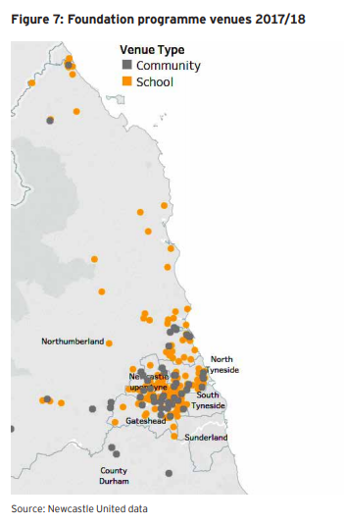
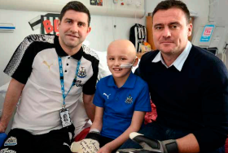
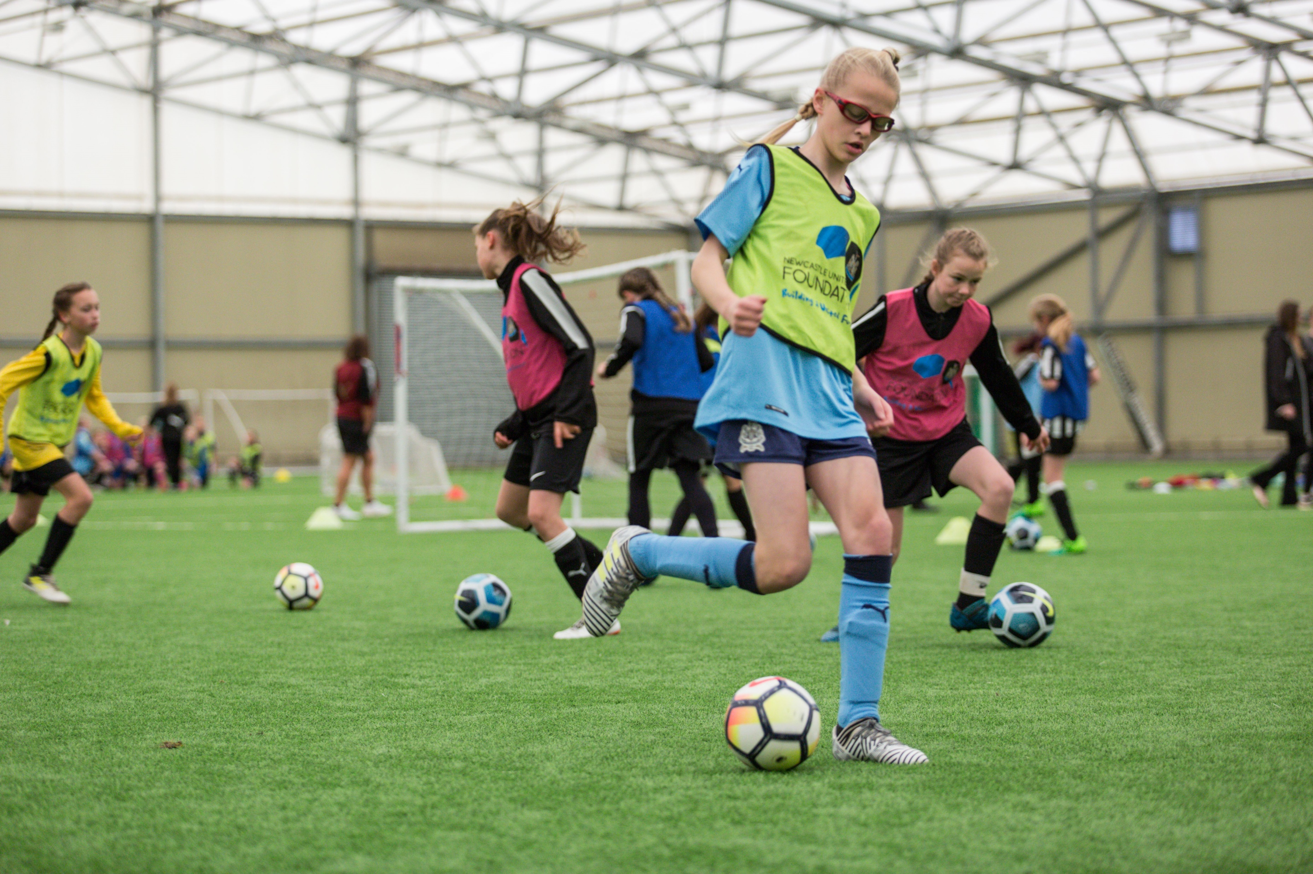
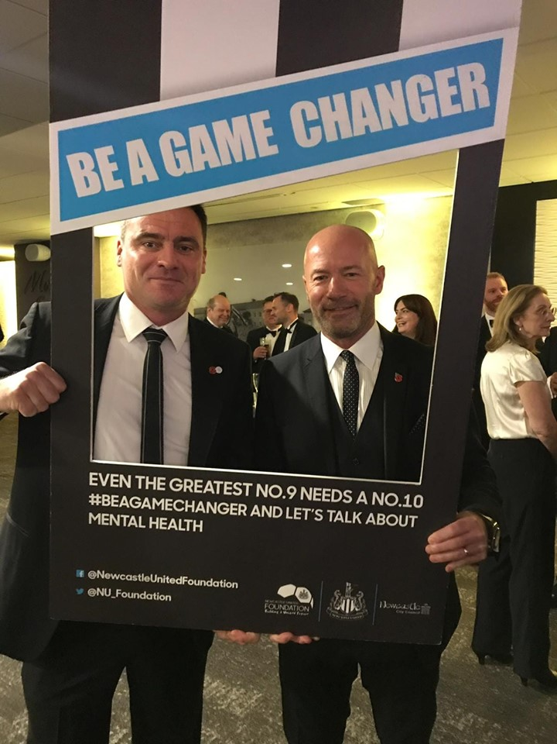
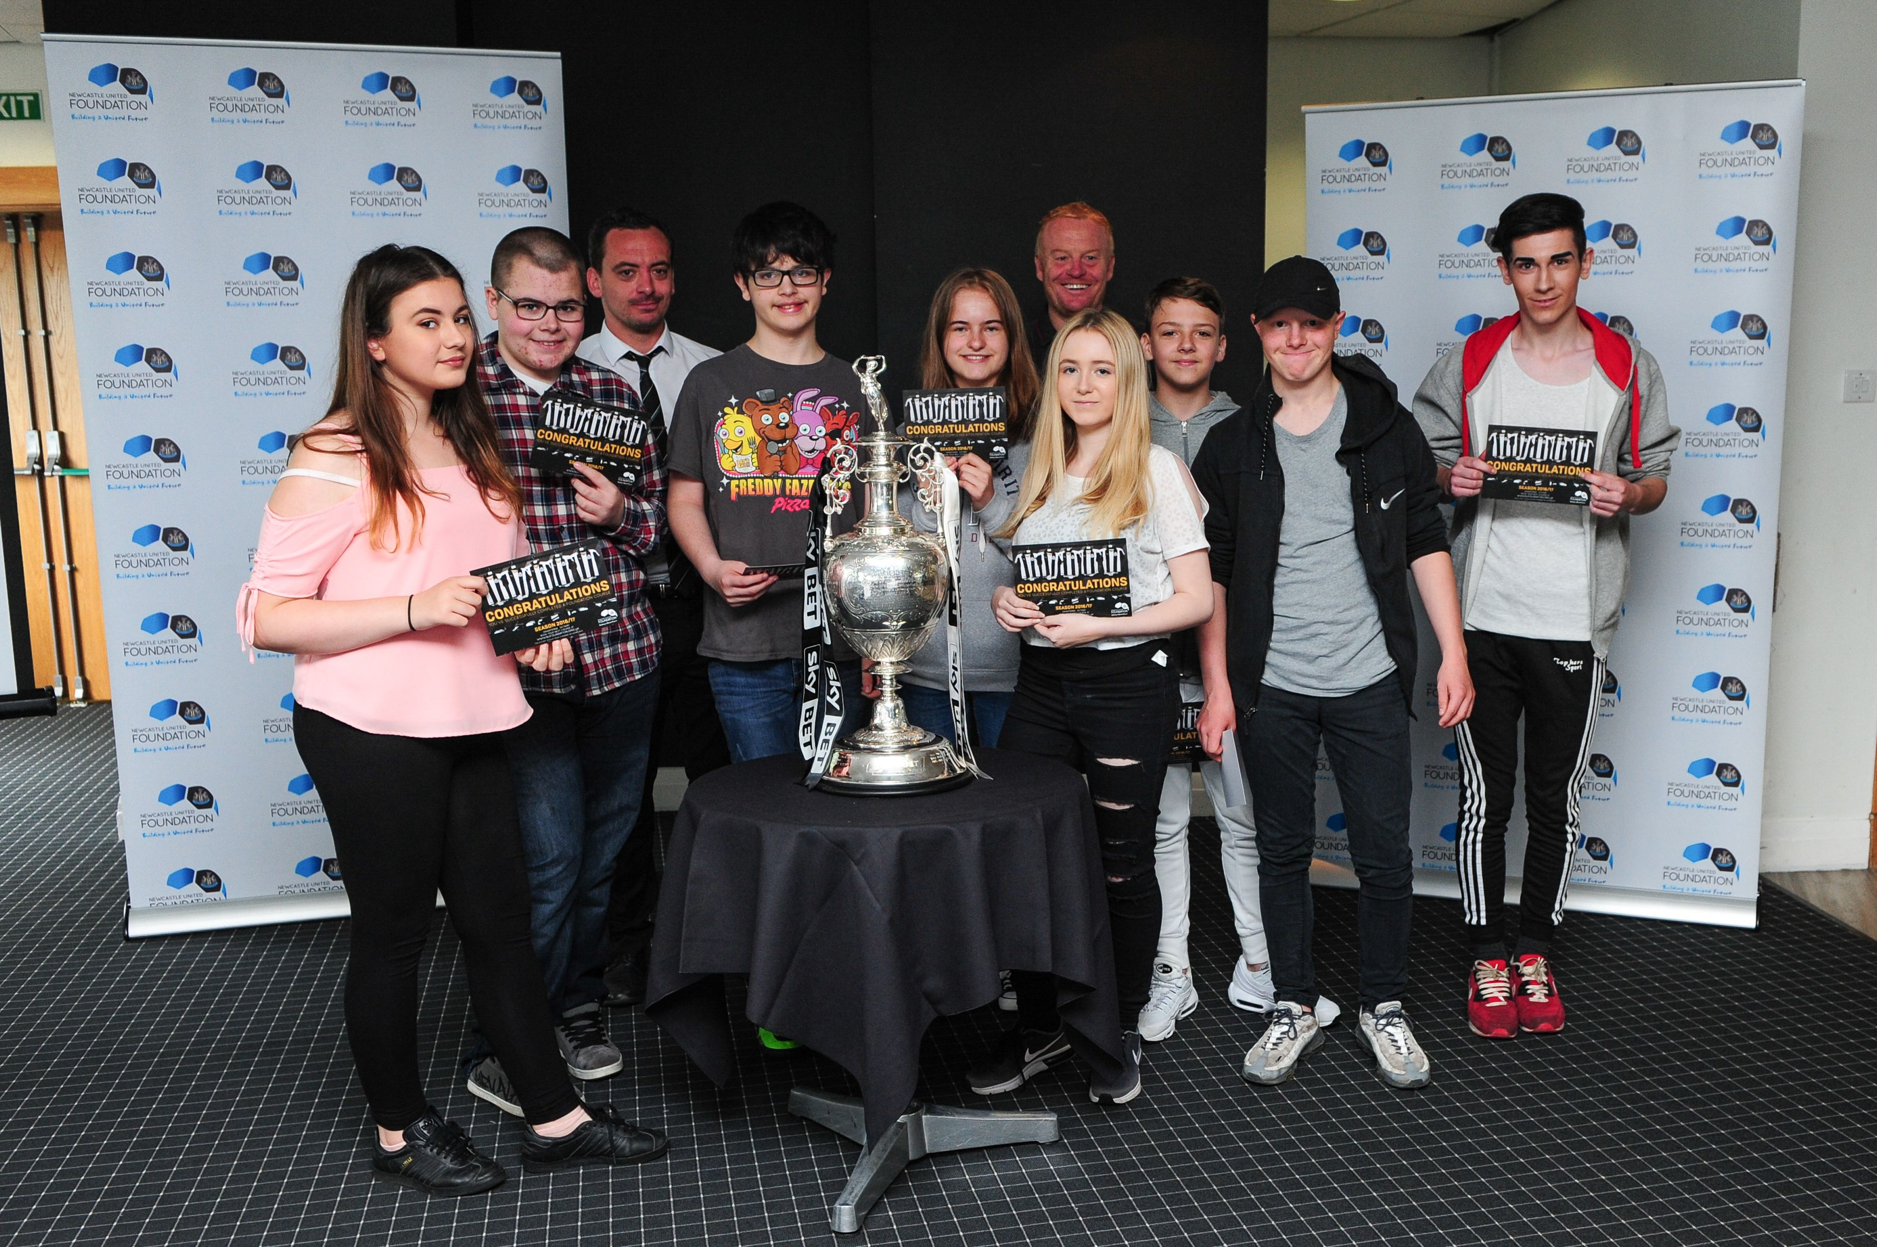

Slide 8
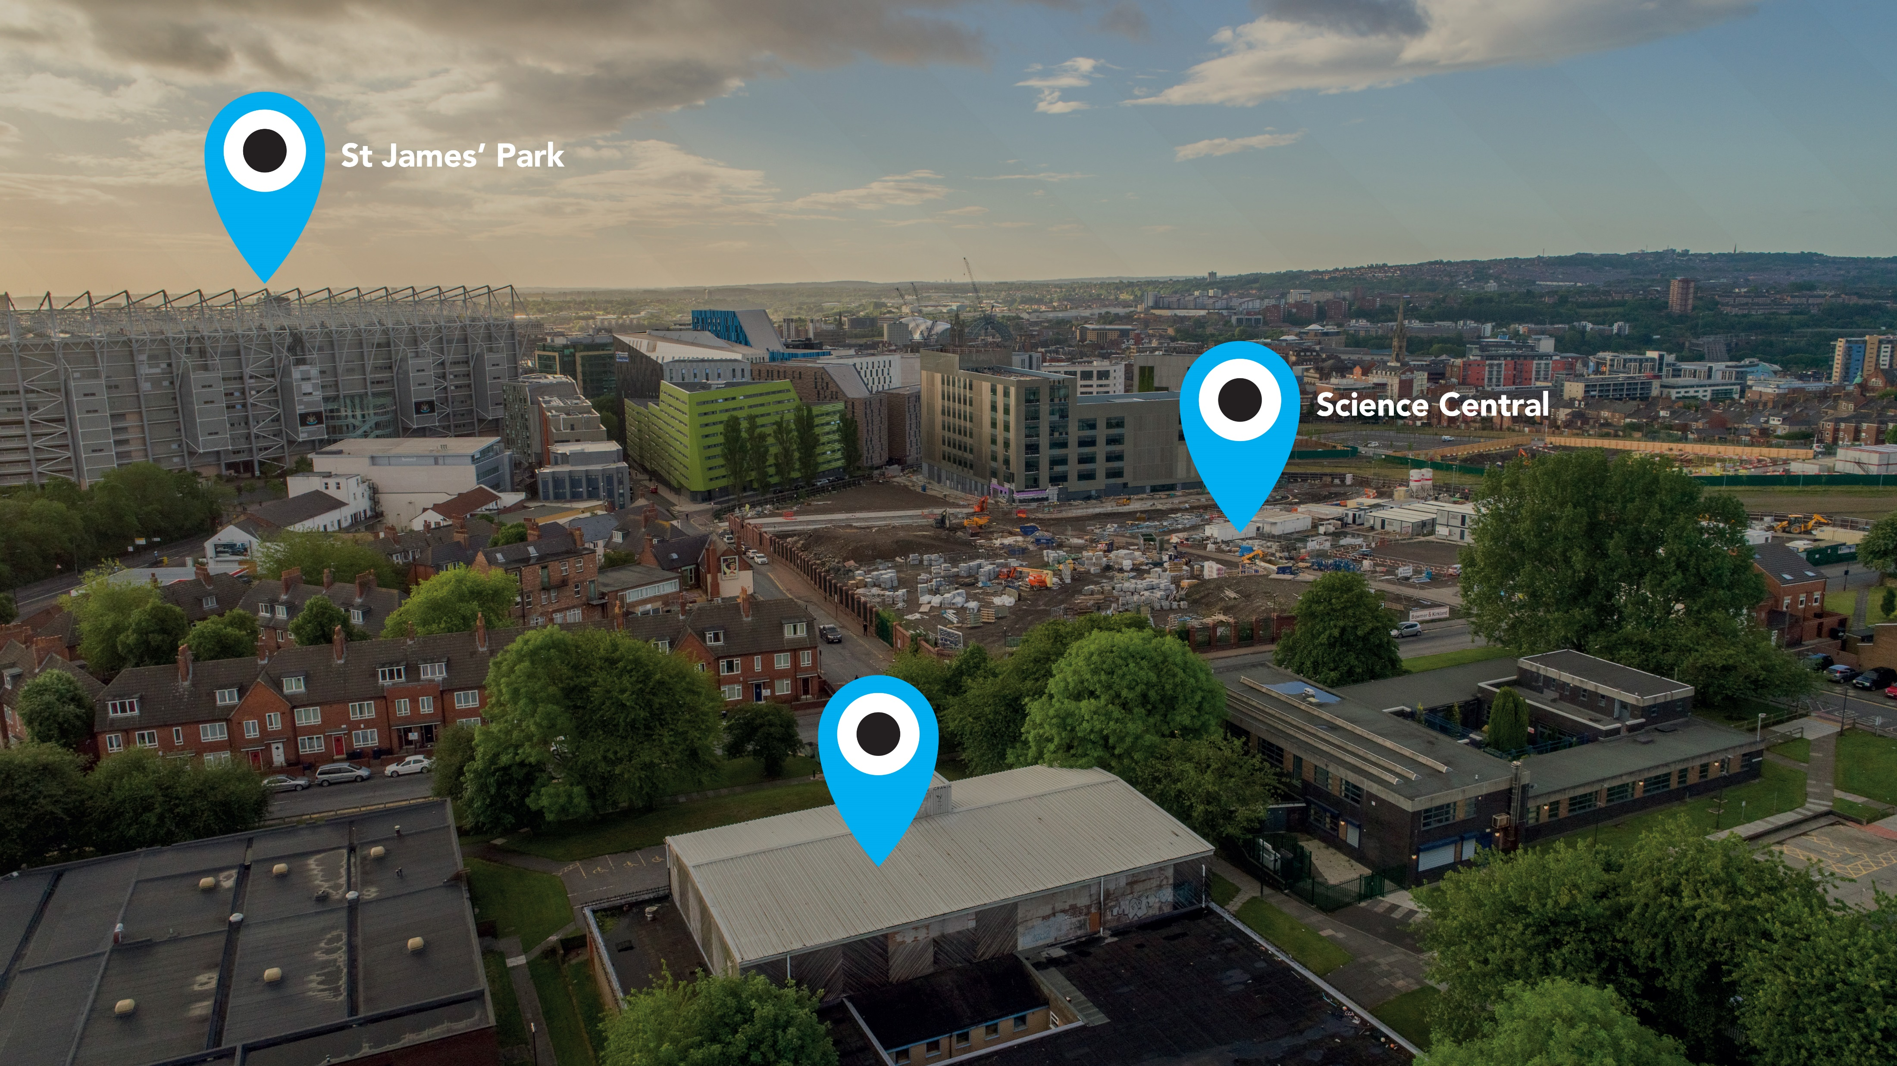

Slide 9
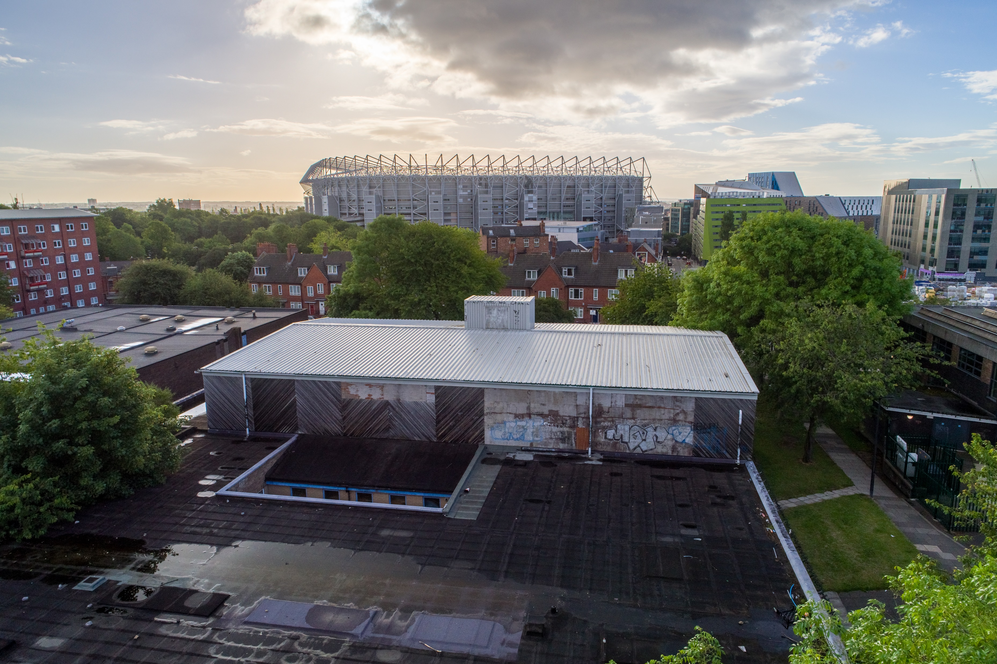

Slide 10
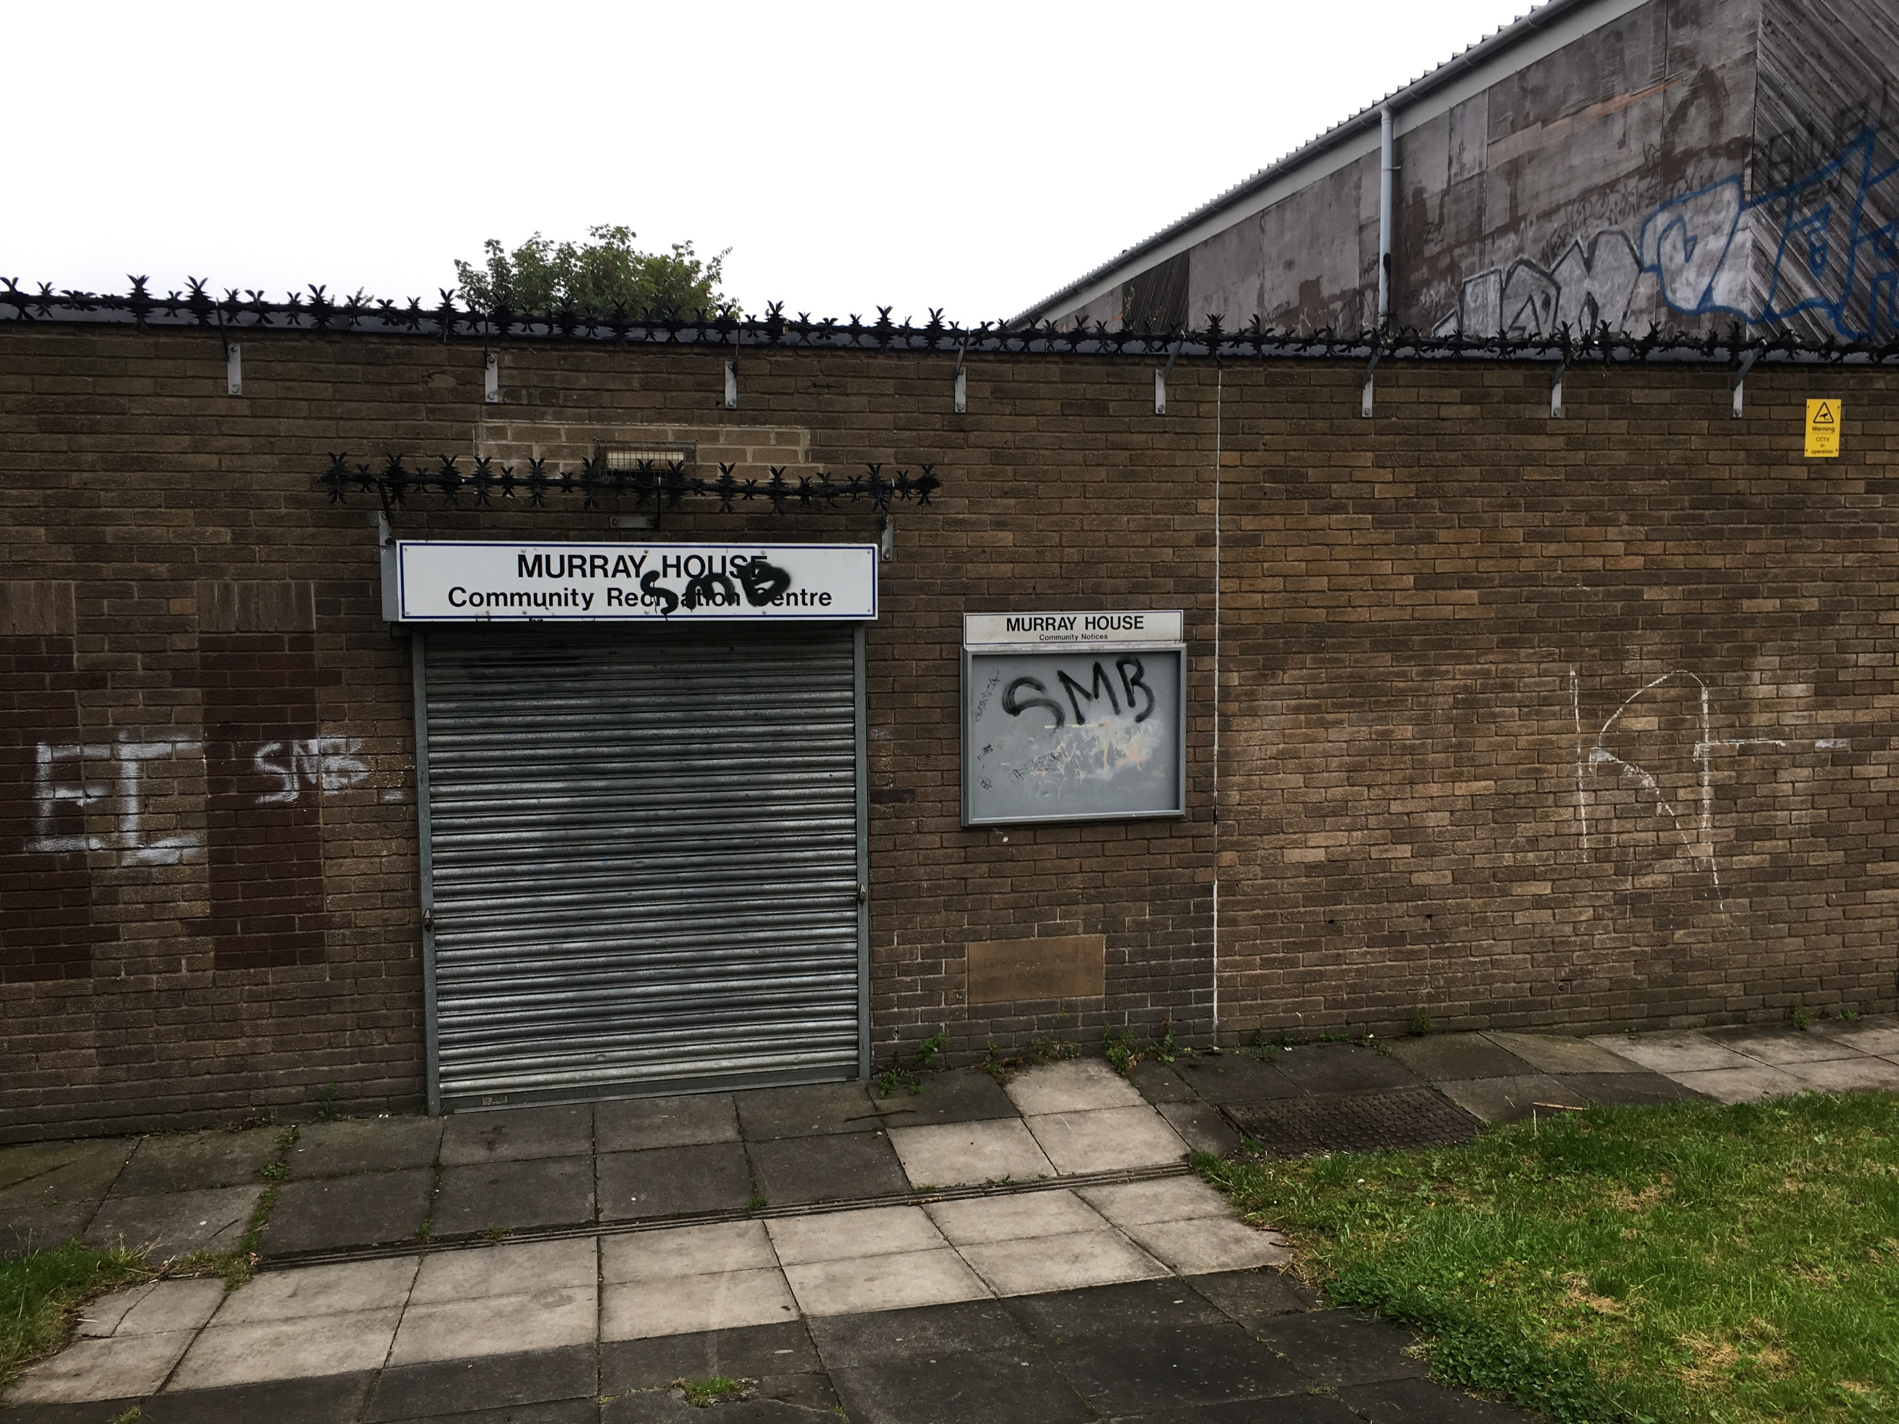

Slide 11
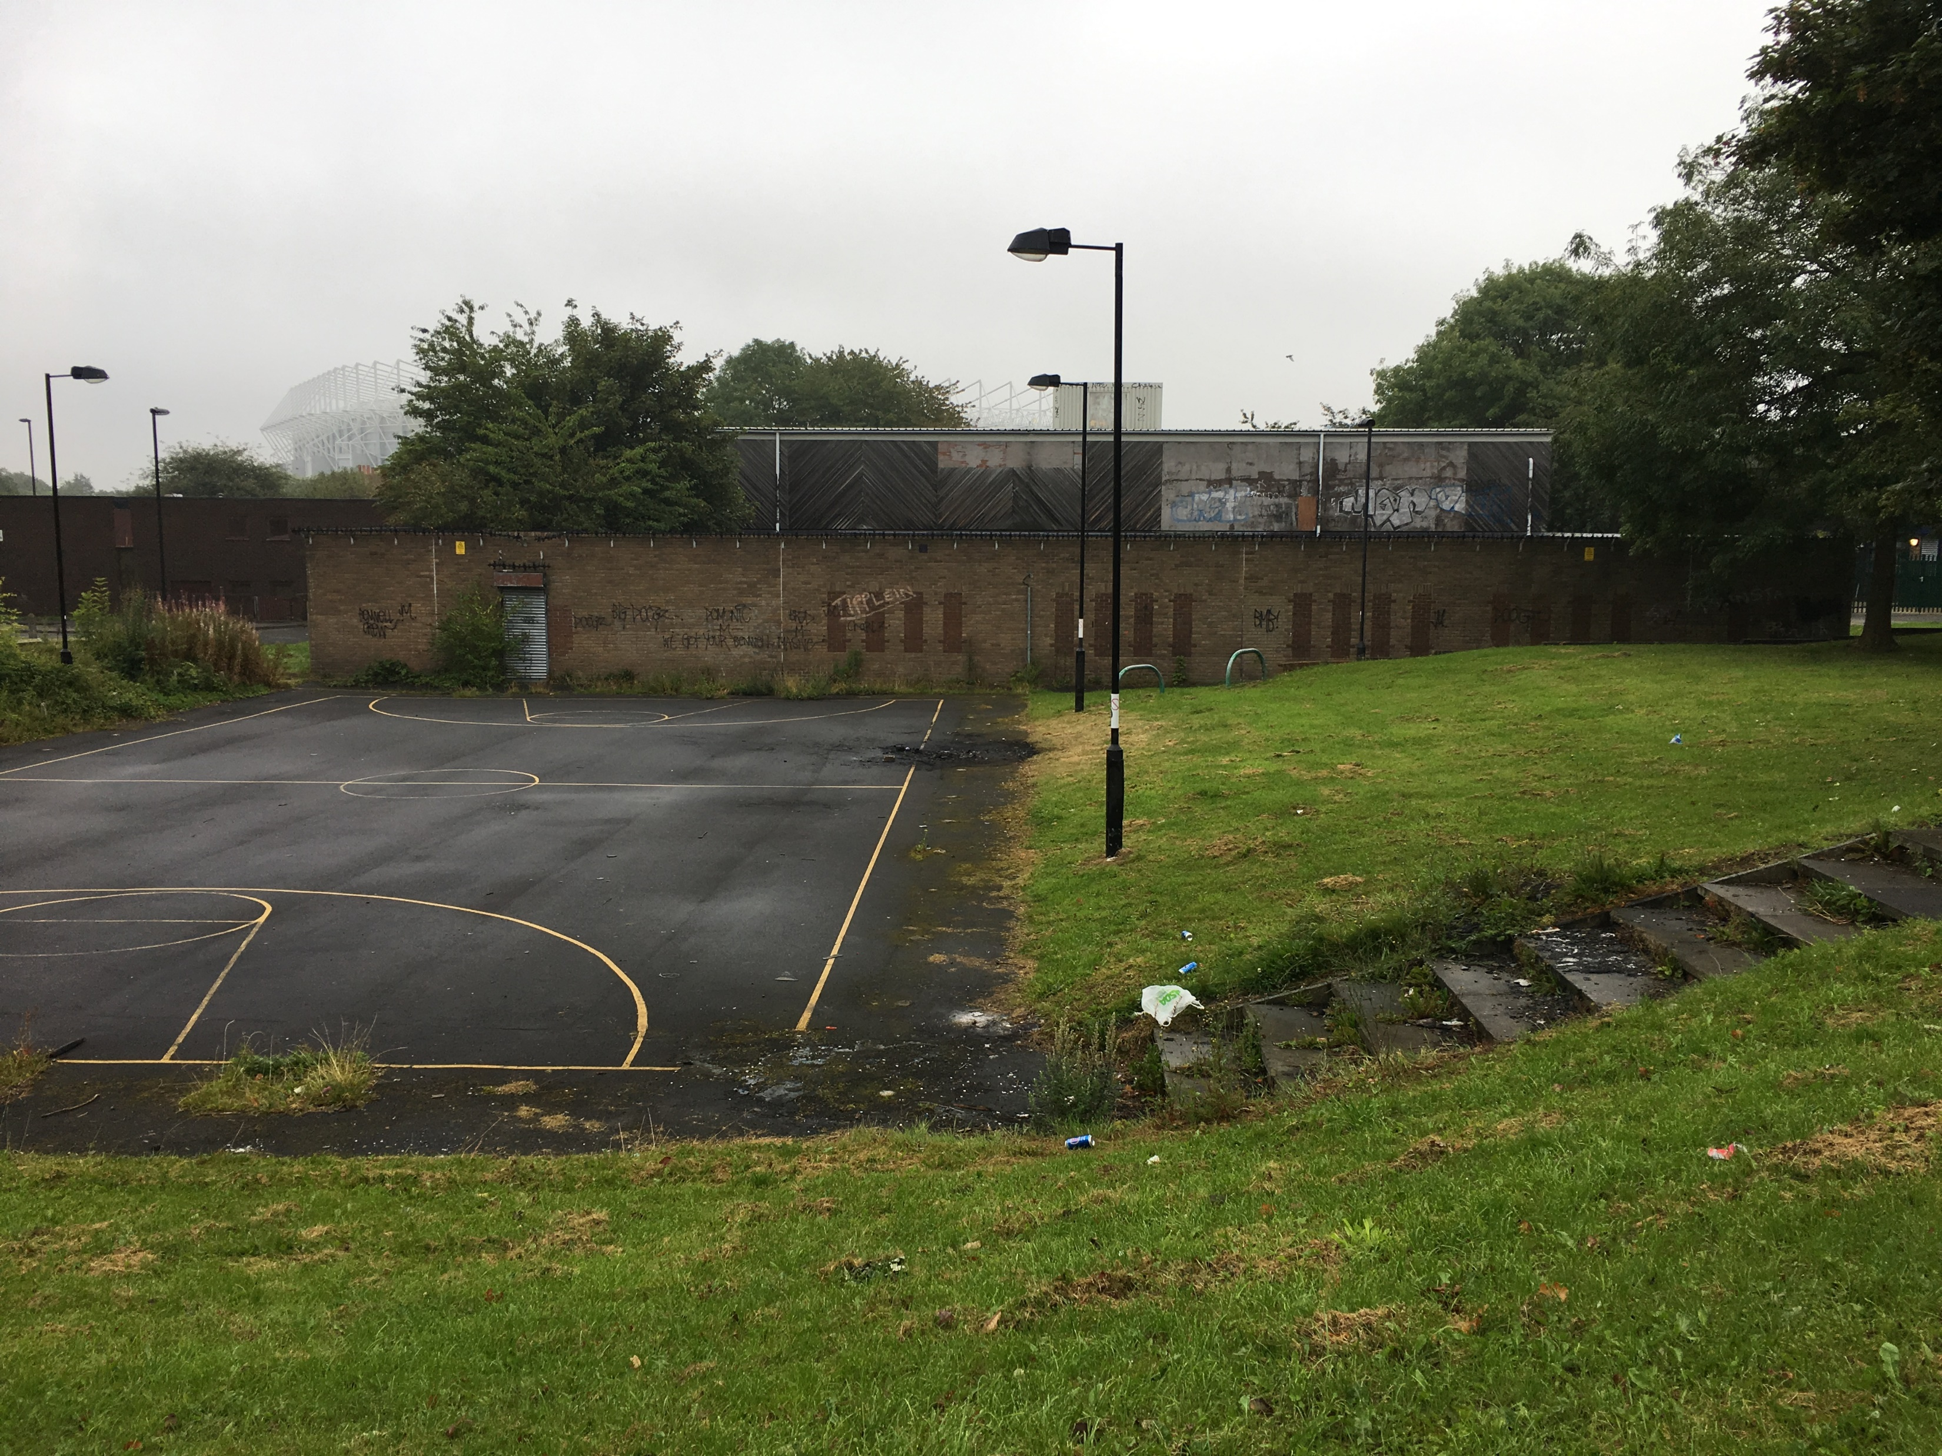

Slide 12
Buildings are made out of bricks and mortar, communities from pride, passion, ambition and hope.
Shola Ameobi, Patron of Newcastle United Foundation
https://www.youtube.com/watch?v=1GJ1w6lmsUU

Slide 13
Sarah Medcalf
Deputy Head of Foundation
Sarah.Medcalf@nufc.co.uk
07880 006 405

Slide 14
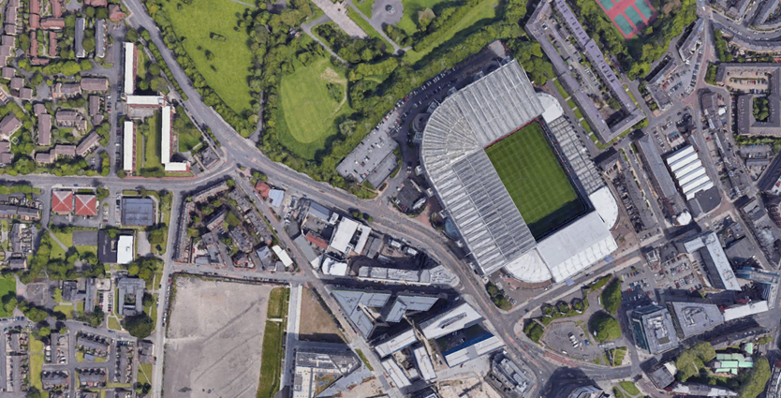

Slide 15






Procurement Process
Project Description
The demolition of the existing Murray House Community Centre, grouting works and a new build 3 storey sports facility. The new build facility includes a sports hall, spinning and activity studio along with changing rooms to the ground floor, office and teaching space to the second floor with a rooftop pitch at level 3. Externally there is a car park to the west and a soft landscaped area to the east.
Project Value
£6,500,000
Project Team
Single Stage Competitive Tendering
JCT Design and Build Contract 2016
12 month contract period

Slide 16

Procurement Process
Pre Qualification Process
Sent to 12 contractors : 10 returns
No social value questions in PQQ
Four contractors selected to receive ITT
Invitation to Tender
Cost / quality assessment : 70% / 30%
7 ‘quality’ questions
One question related to social value:
Provide your approach to Client and Community Engagement
Four tenders returned and scored 93% 92% 91% 81%
Social value question score (out of 4) 4 3.75 2 3
One contractor eliminated from further consideration to due low score

Slide 17
Procurement Process
Post Tender Interview
3 contractors interviewed by Foundation Board and lead consultants:
interest in the project,
approach to engagement with the Foundation to assist their core aim of “using the local passion for football to make a difference and help people achieve their goals, on the pitch, in the classroom, in life.”, and
post-handover support and aftercare.
Clarity on commitments
Delivery of specific outputs / key performance indicators
Main contractor and supply chain commitments

Slide 18
Employability on an Annual Basis
Number of supply chain employers supporting young people
Number of young people (YP) entering employment
Number of YP accessing apprenticeships through the NUF Nu:Futures programme
Number of YP accessing traineeships through NUF Nu:Futures programme
Number of employer site visits (main contractor and supply chain)
Number of employer work experience (main contractor and supply chain)
No of volunteer hours per annum
In kind support

Slide 19


Slide 20
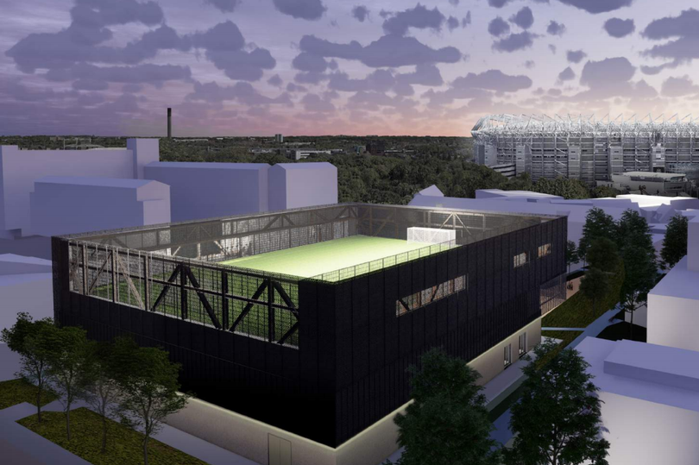
Murray House
21/04/2021
Terry Hanlon
Community Impact Manager
Notes:
Brief intro sector skills 10 yrs, Kier 6 yrs, Robertson 4 yrs responsible for delivery of SV on all projects in NE and leading two team members in rest of England

Slide 21
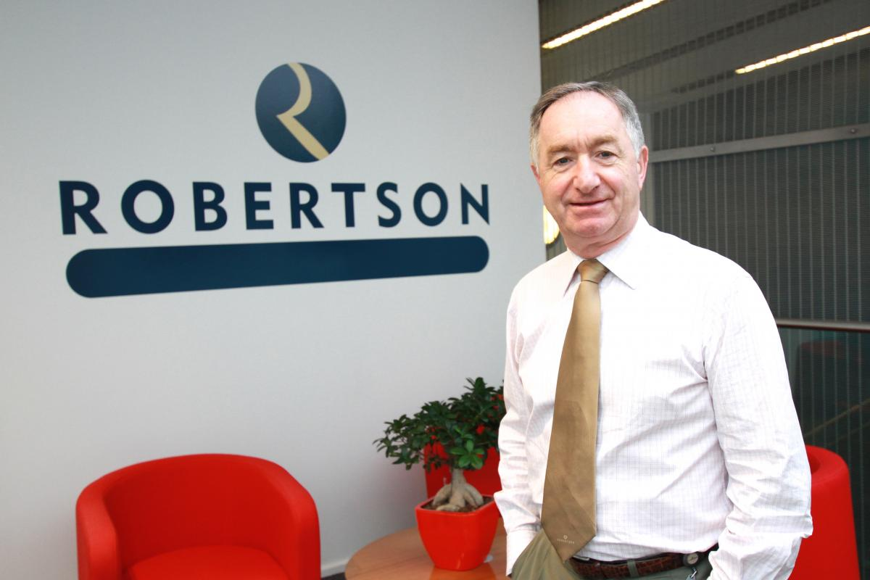
Notes:
Brief history of Bill

Slide 22
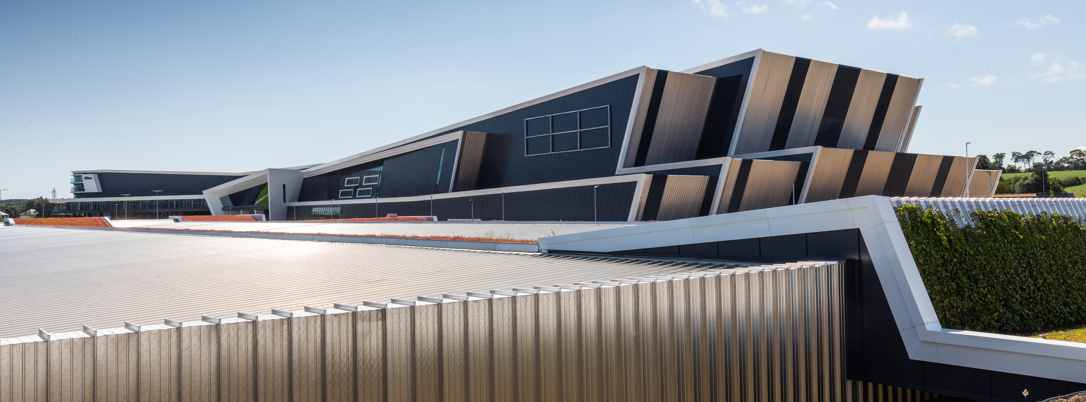

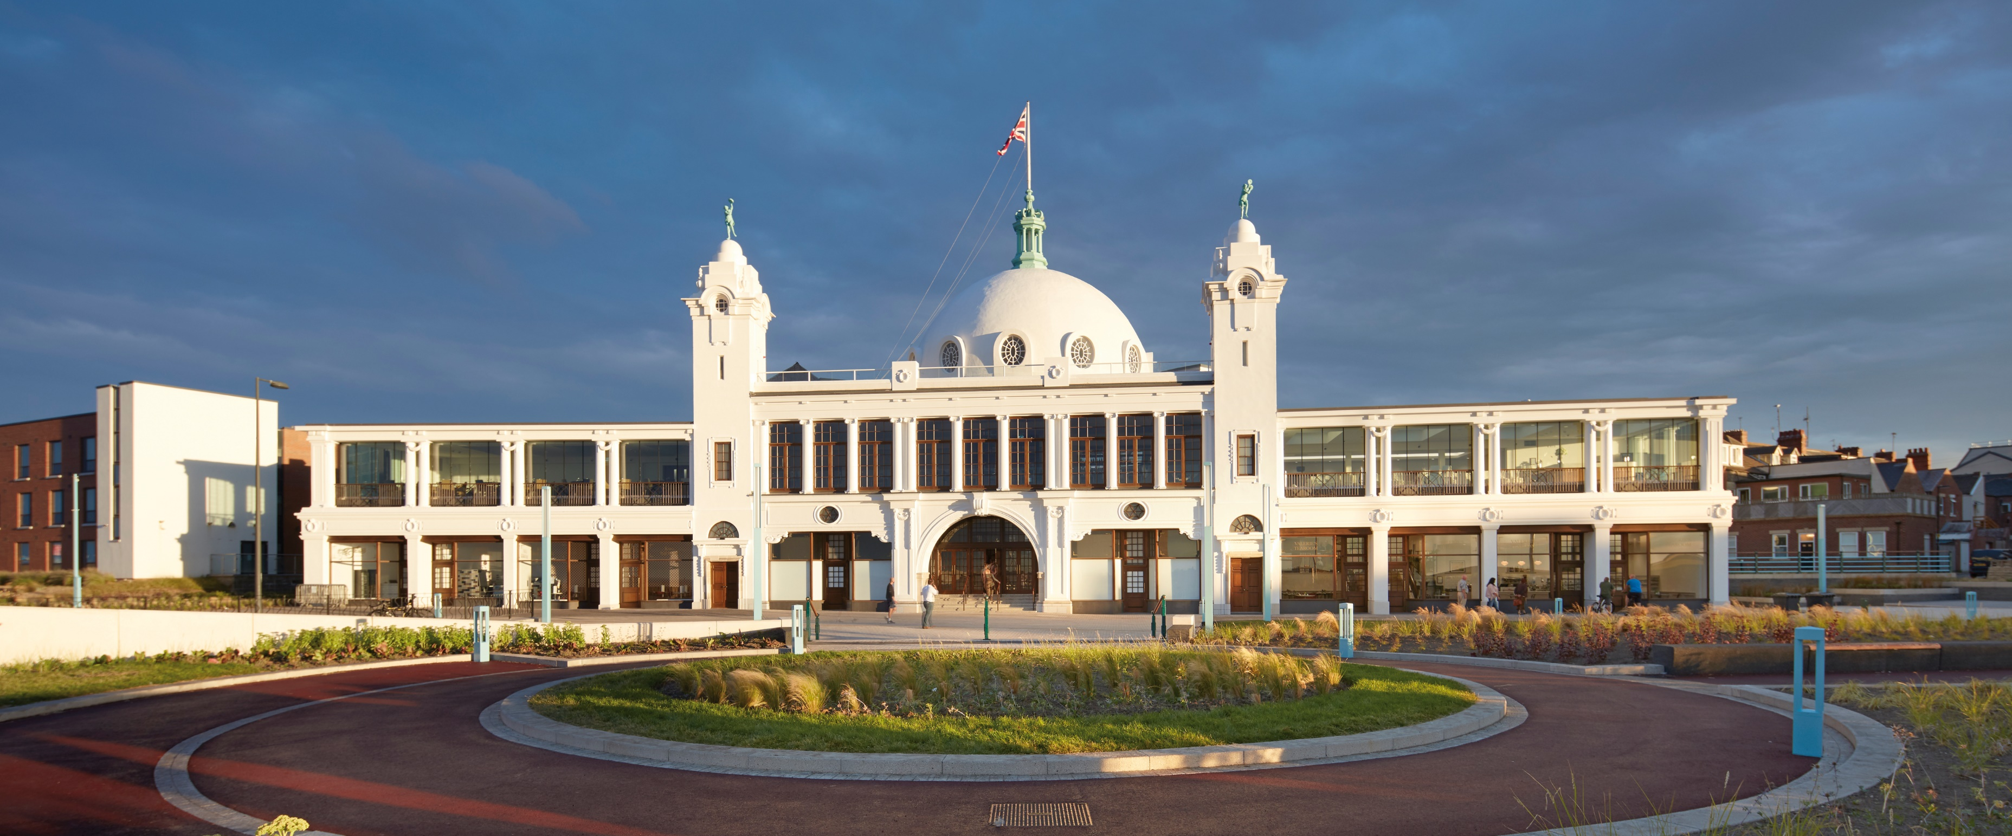
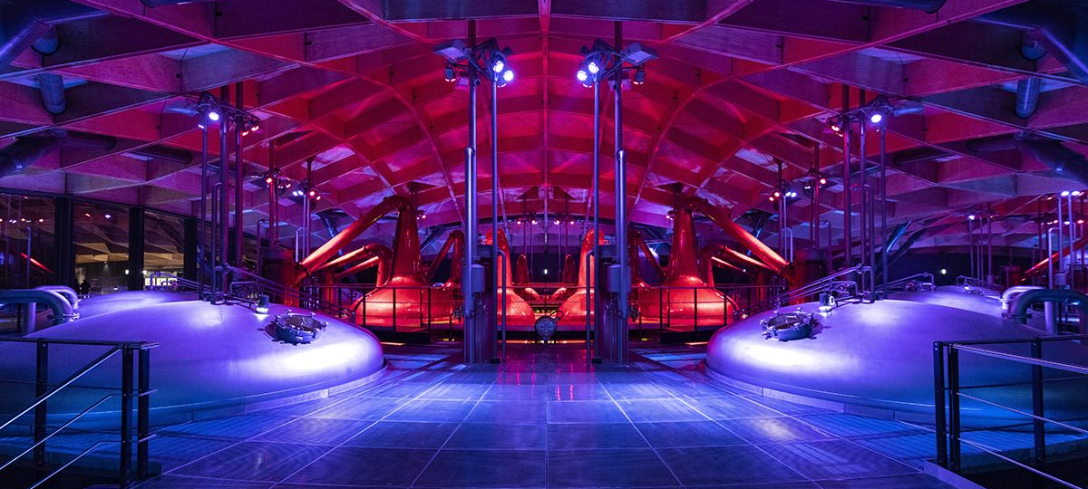
Introducing Robertson
Robertson is one of the largest family-owned construction, infrastructure and support services businesses in the UK.
3200⁺
dedicated and expert employees
75%
of group is Construction
Over five decades of experience since
1966
£900m
turnover
No debt
North East Office since
1999
Notes:
Founded in Elgin, Moray, Scotland in 1966 by Bill Robertson
One of the largest family-owned construction, infrastructure and support services groups in the UK
3200+ employees
£752m turnover 2017-2018
£950m target for 2018–2019
2bn forward order book – a sustainable business that gives our customers assurance and the certainty that we will deliver what we say we will.

Slide 23
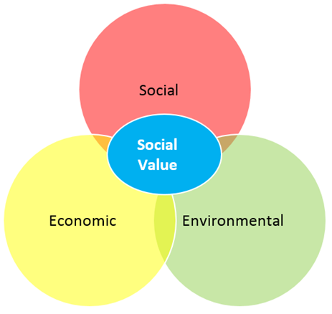
What is Social Value?
Social value or Social Impact simply put is
“The footprint of Robertson and it’s projects within society”
Notes:
CSR – CR – RB Based on Triple Bottom Line PPP
CR - How we govern ourselves internally and Social Rsponsibility how we are judged externally. Responsible business is looking at the whole spectrum and social value is the measurement of that impact

Slide 24
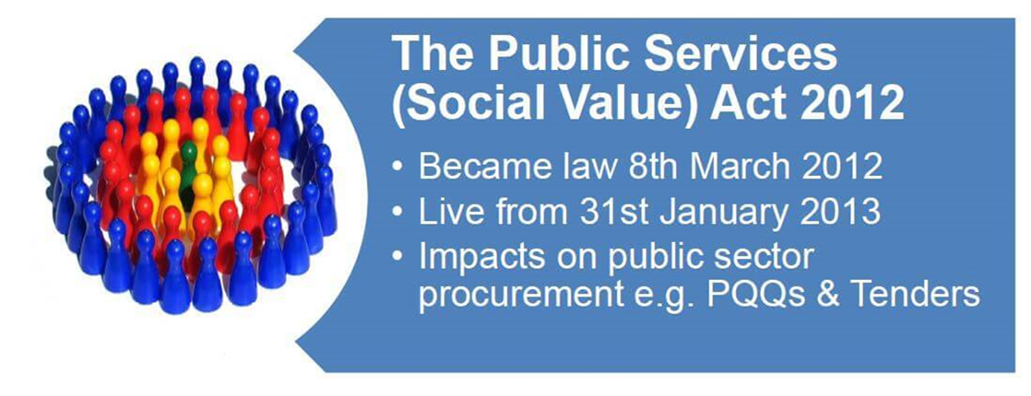
Legislation Procurement Policy Note 06/20
It requires that all public bodies in England and Wales, including Local Authorities, and NHS organisations to consider how the services they commission and procure which are expected to cost more than the thresholds provided for in the Public Contracts Regulations might improve the social, economic and environmental well-being of the area.
PPN 06/20 changes mean that central government will now be required to go further than the Public Services (Social Value) Act 2012 to ensure that all major procurements explicitly evaluate social value, where appropriate, rather than just consider it.
Notes:
Social value act asked commissioners of public sector procurement to consider social vale.
PPN6/20 requires rather than considers. 10-30% being the norm

Slide 25





Creating Impact for tomorrow
Local Priorities
Understanding local priority needs of client and stakeholders. Agreeing key Themes Outcomes and Measures
Procurement planning
Addressing procurement and local suppliers, SME’s, SE & Supported businesses.
Supporting Employability and Upskilling
Ensuring training & recruitment opportunities are identified to support highly skilled, inclusive and diverse workforce
Responsive & Proactive
Working with key stakeholders to share information and ensure that successes as well as challenges are learned from
Measurement & Reporting
Using our systems and tools we will ensure a robust approach is delivered to achieve collective goals for the projects sharing reports regularly.
Notes:
Local Priorities
Before we start working on any project we work with the client to understand the needs and priorities of the local stakeholders and their wishes for engagement. Agreeing key Themes Outcomes and Measures. These can be very similar but it’s also important we recognise and acknowledge the uniqueness of each project, client and local community.
Procurement Planning
When we have a full picture of the local requirements and any local spend measures it’s really important that the commercial teams are aware of these objectives to ensure that they and you can support this at the right times.
Supporting Employability & Upskilling
We work with a lot of partners when we are delivering employability and Upskilling in support of projects and to ensure that the best impact can be achieved through our sessions we need to plan them in advance and work in tandem with their programmes and initiatives where we can.
Responsive & Proactive
Being responsive and proactive is really important, we need to share information about our successes and challenges to ensure we learn for the future which we’ll talk a lot more about
Measurement & Reporting
This is a key piece of the puzzle. When we agree and understand local priorities for our projects we also agree with out clients what their reporting expectations are to ensure that these are met. Then we need to address our own internal measurement and reporting.

Slide 26



Response to Covid
Engaging with Education to provide curriculum enhancement
Providing Economic relief and sustained local employment for our suppliers and sub-contractors
Working with communities to create a lasting legacy
Notes:
The Global pandemic has required us to act and think differently as to how we can still deliver our social value commitment to the Foundation and joint stakeholders
Focus on lost generation of young people virtual wexp etc, local supply chain, enhancing communities through Action for Childrfen

Slide 27
Story So Far
Employer engagement events
Virtual Career events
Local economic spend
Sustained Local Employment
Van and driver donation for food parcels
Litter pickers for school environment day
Virtual work experience
Plan Bee KO
Foodbank donations
Selection box donations
Notes:
Overview of delivery

Slide 28
Measurement - Social value Portal TOMS
5 Themes
  JOBS – Promoting LOCAL skills and employment
  Growth – Supporting growth of responsible regional business
  Social Healthier and more resilient communities
  Environment – Protecting and Improving our environment
  Innovation – Promoting Social Innovation
18 Outcomes
38 Measures
Notes:
SV TOMS 2019 version

Slide 29
Social Value so far?
£1.3m
Notes:
When our local spend, sustained employment, virtual engagement, community donations etc are put through the SVP.. So far

Slide 30
Forward planning - Focus on Education and training
Action for Kids – Newbiggin Hall – community refurb
‘Tower City’ Projects for virtual and interactive learning
  8th wonder of Tyneside – Primary and secondary project
  So you want to be a bricklayer? - Secondary and pre employment
  Setting Up a construction site – FE and HE students
  Tower City Project – Supporting T levels and HE students
Journey into construction – NEET/LTU
Notes:
We are not finished yet

Slide 31
Forward Planning
Mental health Awareness campaigns
Site visits students
Work experience placements
Community engagement
Hard Hat Site tours
Long lasting partnership wider than Murray House
Putting an end to Youth Homelessness
Notes:
Talk through the opportunities once restrictions are lifted

Slide 32




















Murray House– Local Stakeholder Mapping
Project Partnership
Selection of local education/ employability partners
Selection of local charitable partners
Notes:
Thanks to our partners

Slide 33
Thank you
Questions?

Slide 34


