Slide 1
Juliet Smithson Head of Operations
Notes:
Thank you to the organisers for inviting me to speak today on behalf of LionHeart, the only charity that exists solely to support RICS professionals and their families
Other benevolent funds exist for other professions including the Solicitors’ Benevolent Society, Architect’s Benevolent Society – The Association of Charitable Organisations is a good starting point otherwise google your industry or profession followed by charity. The other key player in the property and construction industry is LightHouse.

Slide 2
What we do:
We offer personal, flexible support for all RICS professionals and their families to help them overcome life’s unexpected challenges.
Notes:
In a nutshell we offer flexible, personal support for RICS professionals and their families
Helping them deal with life’s challenges
All of our support is confidential and available to you and your life partners – forever
We’re completely separate from RICS and we don’t share information with them

Slide 3
LionHeart Services
TRAINING
HELPLINE
Notes:
Broadly two groups of services
First I am going to talk about our Training. We have a wide variety of webinars from financial insight to career development and regularly run mental health awareness webinars as well as webinars on stress, anxiety, sleep and breathing to relax.
All are bookable online and can count towards your CPD. They are free (although if you are able to contribute to the costs of running them we are always grateful)

Slide 4
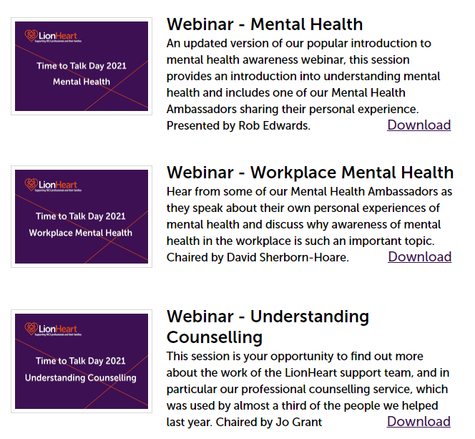
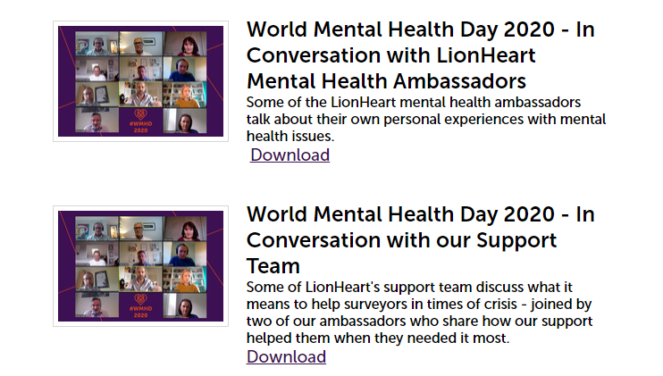
Notes:
There’s also an events library which currently features a number of recordings of our mental health webinars which are available for you to download ‘on demand’ from our website – and I will give you the link at the end
One of these features our team of ambassadors…

Slide 5
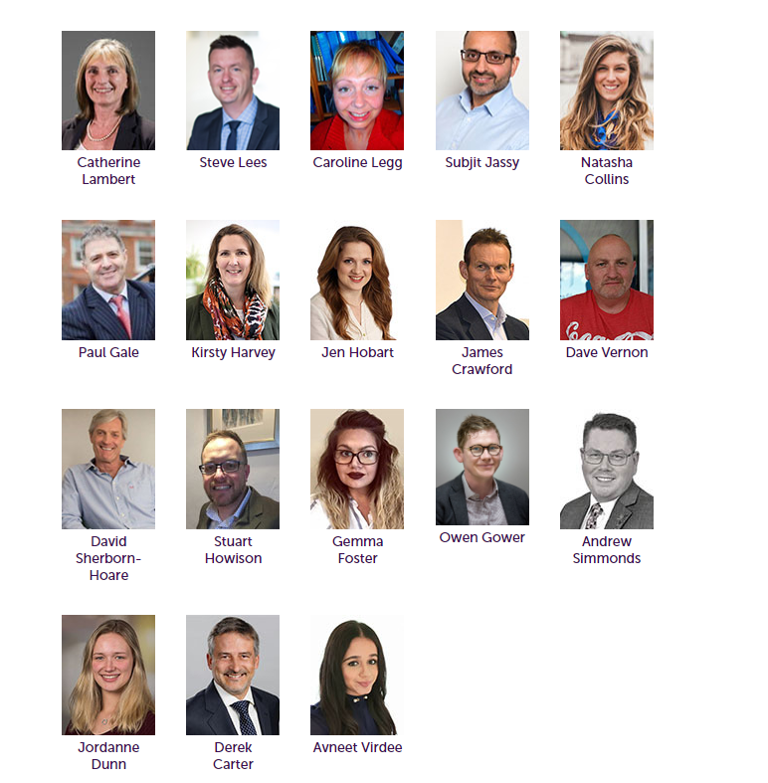
Our ambassador team
Notes:
Our mental health ambassadors are RICS professionals who have experience of mental ill health either personally or through a close relative or friend.
They have all agreed to bravely share their experiences in the hope it will break down the stigma often attached to mental health issues, and maybe encourage others to speak out or seek support if they need it.
There are some videos of our ambassadors which we can share if you like to use one to start conversations in your workplace and for larger groups we can often arrange a speaker from the team. It’s important to have conversations in our workplaces and our families – to normalize mental health and reduce the stigma that surrounds mental ill health. The property industry usually sits in or near the top 5 industries in the tragic table of suicides, with men over 40 at the highest risk and so it’s especially important in our industry to raise awareness.
Our ambassadors are our way of helping you to do that.

Slide 6
LionHeart Services
TRAINING
HELPLINE
Notes:
I’ve talked about our training and our ambassadors
Now I’m going to run through the services that are available via our helpline

Slide 7
Our services
Financial support
Counselling and Cognitive Behavioural Therapy
Back to work support
Legal advice
Coaching
Notes:
Financial support is available to members – regular ongoing grants to supplement low incomes for example due to unemployment or ill health – also disaster grants for domestic disasters such as storms, fires and flooding
Counselling and CBT is available, Our waiting time is currently under a week And we offer ten sessions rather than the 6 commonly offered by the NHS – would cost £800 - £1000 if you arranged it and we don’t charge. Cognitive behavioural therapy (CBT) is a talking therapy that can help you manage your problems by changing the way you think and behave.
CBT aims to help you deal with overwhelming problems in a more positive way by breaking them down into smaller parts.
You're shown how to change these negative patterns to improve the way you feel.
Unlike some other talking treatments, CBT deals with your current problems, rather than focusing on issues from your past.
It looks for practical ways to improve your state of mind on a daily basis.
Back to work support is available to members from APC upwards and partners – delivered by global experts and tailored to your precise needs – whether that’s mastering LinkedIn or being brilliant at interviews
Legal advice is available on everything from business to family law and from consumer law to neighbour disputes – and everything in between. Available to students, apprentices, members and partners
Coaching is available to all. Can be highly effective in working out strategies and setting goals for work or personal challenges. Available to students, apprentices, members and partners
All of this is free
All of this is available to your partners too

Slide 8
Our Covid-19 response
Requests for financial support doubled
So we released extra funds to pay more grants
Calls about mental health increased by 130%
So we increased flexibility on our counselling slots to give more space for professionals in need
We also commissioned new self help webinars to help those struggling with anxiety and stress
Calls about redundancy doubled
So we secured more resources from our back to work and legal advice suppliers
Our workshop programme was cancelled as venues had to close
So we moved our entire programme online overnight, commissioned more than a dozen new webinars including ones on Covid finances and job hunting and saw our audience rocket by 2600%
Notes:
This past year all our lives have been dominated by Covid-19. Even before the first lockdown we committed to be there for the profession. Over the 3 lockdowns: Requests for financial support doubled
So we released extra funds to pay more grants
Calls about mental health increased by 130%
So we increased flexibility on our counselling slots to give more space for professionals in need
We also commissioned new self help webinars to help those struggling with anxiety and stress
Calls about redundancy doubled
So we secured more back to work support from our global outplacement and legal advice suppliers
Our workshop programme was cancelled as venues had to close
So we moved online, commissioned more than a dozen new webinars including ones on Covid finances and job hunting and saw our audience rocket by 2600%

Slide 9
Notes:
I’m now going to share some stories about how we have helped - James
Married, self-employed chartered surveyor whose business contracts were badly hit by Covid 19 which left him without any income.
struggled to meet his mortgage & household expenditure.
He was getting into substantial debt and although he was able to get a mortgage holiday, he had no finances to pay for his day to day living expenses or general bills. He also couldn’t pay his RICS subscription and so felt that his career was under threat
He was overwhelmed by stress and anxiety and was wondering how he could possibly carry on
He wasn’t the only one struggling. His wife was also suffering with stress because of the situation.
Φιρστλψ ωε λιστενεδ – ανδ τηεν ωε πλαννεδ
Αδϖιχε ωασ γιϖεν ον βενεφιτ εντιτλεμεντ ωηιχη ϑαμεσ αππλιεδ φορ ανδ Υνιϖερσαλ Χρεδιτ ωασ αωαρδεδ.
ΛιονΗεαρτ γραντσ ωερε πυτ ιν πλαχε.
Α χαλλ ωασ πυτ τηρουγη το τηε ΡΙΧΣ το αδϖισε ϑαμεσ ωασ ιν ρεχειπτ οφ ΛιονΗεαρτ γραντσ ωηιχη μεαντ ηισ συβσχριπτιον ωασ ωαιϖεδ φορ τηε τιμε ηε ρεχειϖεδ γραντσ.
Χουνσελλινγ ωασ οφφερεδ βυτ ηε ινιτιαλλψ χηοσε το ρεχειϖε ωεεκλψ τελεπηονε χαλλσ φρομ τηε συππορτ οφφιχερ – τηεσε ωερε ρεδυχεδ το φορτνιγητλψ χαλλ ασ ηισ ανξιετψ ιμπροϖεδ. Ηοωεϖερ, ϑον’σ ωιφε ωασ αλσο στρυγγλινγ ανδ ωασ πλεασεδ ωηεν σηε ωασ οφφερεδ χουνσελλινγ ωιτη α ΛΗ χουνσελλορ ωηιχη σηε γλαδλψ αχχεπτεδ.
ϑαμεσ ισ στιλλ ιν ρεχειπτ οφ γραντσ ανδ τηε συππορτ οφφιχερ ισ ιν ρεγυλαρ χονταχτ. ϑον’σ ωιφε χοντινυεσ το ρεχειϖε ωεεκλψ χουνσελλινγ.

Slide 10
Notes:
Roger had various health conditions and was placed in the clinically extremely vulnerable or shielding category when Covid struck.
His employer, however, refused to furlough Roger which meant he was eventually made unemployed.
Roger was living in rented accommodation and he was at risk of becoming homeless because of his inability to keep up with rent payment.
Roger was depressed and struggling and, when he saw us on LinkedIn, he called us to see if there was anything we could do.
Βενεφιτ αδϖιχε γιϖεν ανδ Υνιϖερσαλ Χρεδιτ αππλιεδ φορ − τηισ ινχλυδεσ αν ελεμεντ οφ ηουσινγ βενεφιτ τηατ εναβλεδ Ρογερ το παψ ηισ λανδλορδ τηυσ σεχυρινγ ηισ τενανχψ.
ΛιονΗεαρτ γραντσ ωερε αωαρδεδ.
Ρογερ ρεχειϖεσ ρεγυλαρ συππορτ φρομ ηισ συππορτ οφφιχερ.
Ηε κνοωσ τηατ χουνσελλινγ ισ τηερε ιφ ηε φεελσ ηε νεεδσ ιτ
Ασ τηε σιτυατιον χοντινυεσ το ιμπροϖε ανδ Ρογερ ισ αβλε το χονσιδερ ρετυρνινγ το φυλλ τιμε εμπλοψμεντ, ηε ωιλλ βε οφφερεδ ηελπ φρομ ουρ Βαχκ το Ωορκ χονσυλταντσ το πυτ ηιμ ιν τηε βεστ ποσσιβλε ποσιτιον το αχηιεϖε τηισ.

Slide 11
Notes:
Jane suffered burn out from working long hours in a stressful role. Jane contacted LionHeart as she felt she needed support in taking the right steps to get back to working after being off for six months.
Τηε συππορτ οφφιχερ ωορκεδ ωιτη Jane ον πυττινγ στρατεγιεσ ιντο πλαχε τηατ ωουλδ ηελπ ηερ ωιτη α ηεαλτηψ−ωορκ λιφε βαλανχε.
Jane ωασ αλσο συππορτεδ το αππροαχη ηερ εμπλοψερσ αβουτ βεινγ εασεδ ιντο ωορκ − σταρτινγ ωιτη ωορκινγ α χουπλε οφ ηουρσ εϖερψ οτηερ δαψ
Jane is currently receiving coaching support to ensure she has a strategy for keeping herself safe and healthy as she is returns to work
You’ll note that all of these of cases called us before they reached crisis point. No concern is ever too small to contact us about.

Slide 12
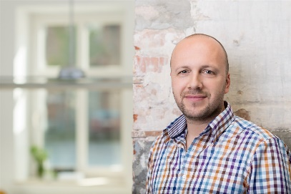
“I wish I had contacted LionHeart sooner - it probably would have meant that I would have sorted things out so much sooner”
FEEDBACK
“As a self employed sole trader, there is no support available to me … I didn’t even qualify for sickness benefit so the monthly grants I received from LionHeart were a real blessing.”
“I thought the service offered was excellent: it has changed my life and my family’s life, and I feel we are heading in a positive direction again”
Notes:
These quotes are just a few of the very many that we receive each year
I’ll give you a moment to read these

Slide 13
Our Funding
Legacies &
donations from members
Fundraising events
Investments
Corporate donations
Notes:
As you will imagine, the costs of all this support are significant. We’re lucky to have a number of income streams – shown here.
You’ll see that RICS isn’t one of them. We receive no financial support from the RICS and this enables us to operate independently. The RICS do generously support us in receiving donations from members renewing their subscriptions…

Slide 14
If you have already donated with your subs - Thank you!
Support Us
If you haven’t donated we ask for £25 annually or £2 per month
You can donate online now - www.lionheart.org.uk/support-us
Notes:
I know that many will have given £25 with the subs process. A deep, heartfelt thank you for those donations. You are supporting people like you, surveyors across the country.
If you haven’t had the chance to donate – perhaps your employer pays your subs directly - please consider supporting us now so that we can support your fellow professionals
You can donate online via the support us page on our website. You can make a one off donation or set up a direct debit for a regular payment - £2 a month would be great

Slide 15
www.lionheart.org.uk Tel: 0800 009 2960
Notes:
Thanks for listening – our website and helpline number are on this slide Please follow us on Twitter, LinkedIn or Facebook – you’ll see our news as it happens if you do
And please remember us and tell your partners and colleagues about us. Not only could we help them but they might be able to remind you that we’re here if ever you need us.
You never know when a phone call to our helpline might make a difference.

