Slide 1
Non-Executives in the Dock

Slide 2


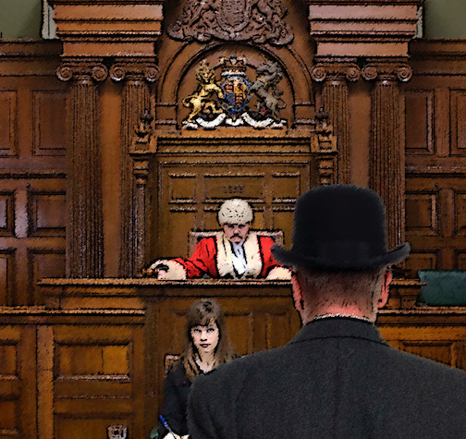
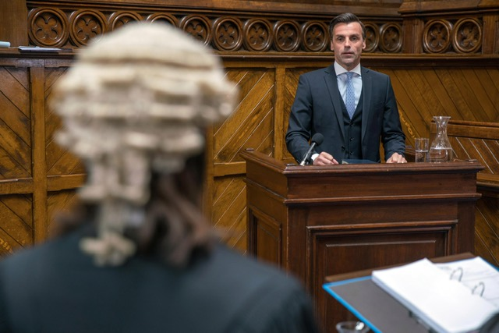
Non-Execs

Slide 3

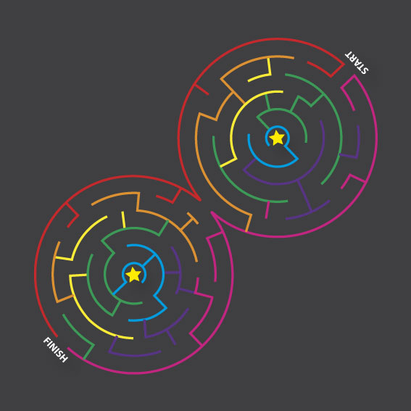

Where to Start

Slide 4
Challenging Mediocrity
My Benchmark

Slide 5
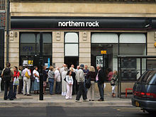
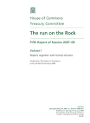

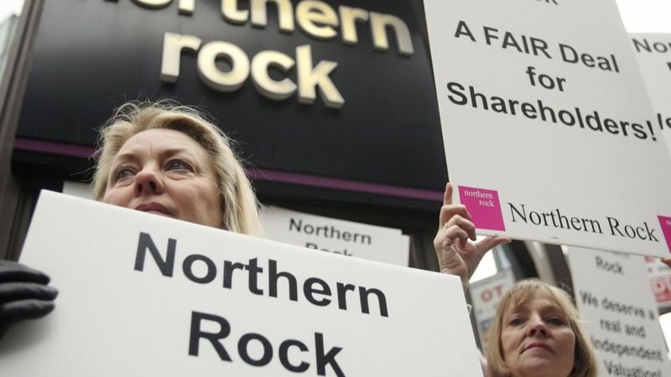
Northern Rock – flawed and reckless

Slide 6
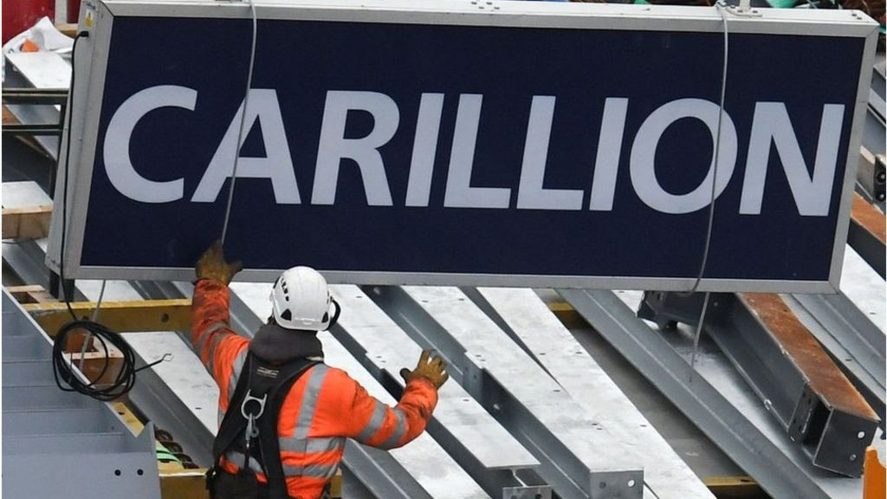
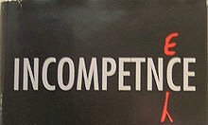

Carillion - incompetent

Slide 7
Carillion – ‘Our’ Principal Risks - but lets ignore them
1. Work-winning
2. Contract management
3. Pension liabilities
4. Brexit
5. People
6. New markets and services
7. Ethics and compliance
8. Systems and cyber security
9. Health and safety
10.Human Rights

Slide 8














Carillion – ‘proud to support’ who? Employees? Shareholders?

Slide 9
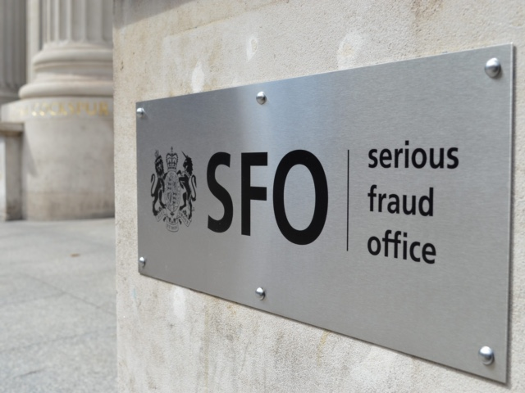



Sweetts – no substance no leadership
Sweett Group PLC
fined £2.25m after
Bribery conviction

Slide 10

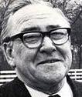
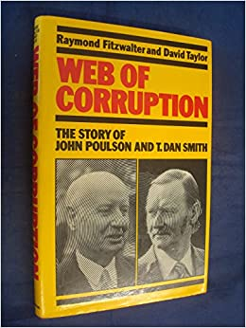

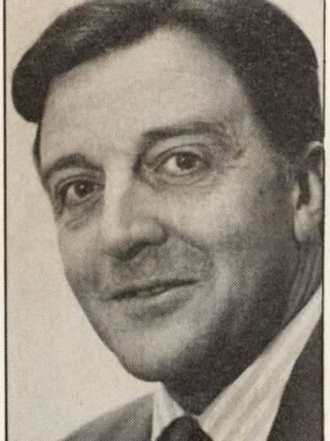
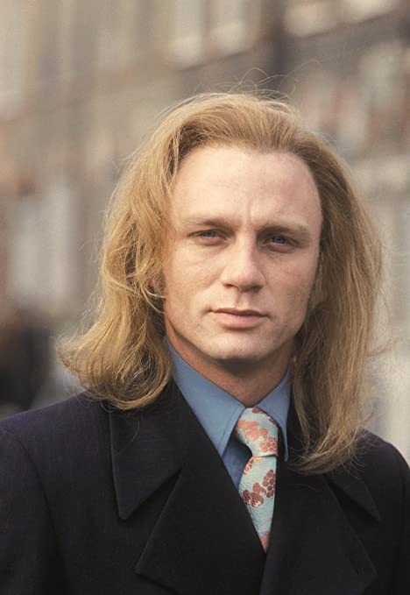
And not forgetting our friends in the North

Slide 11
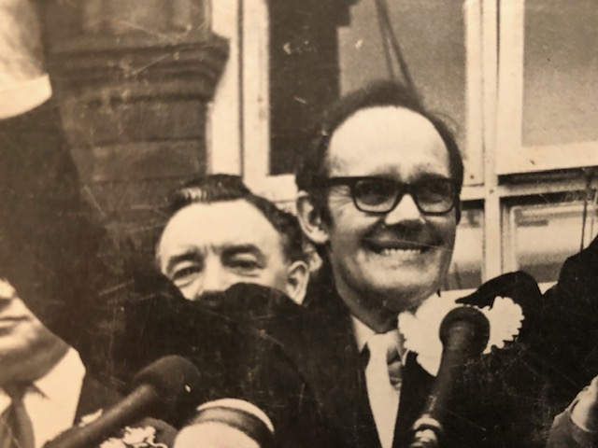
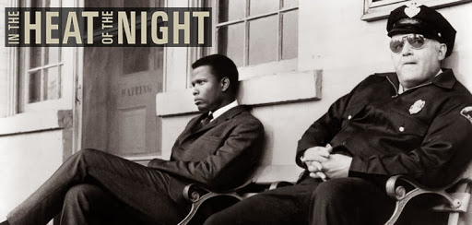

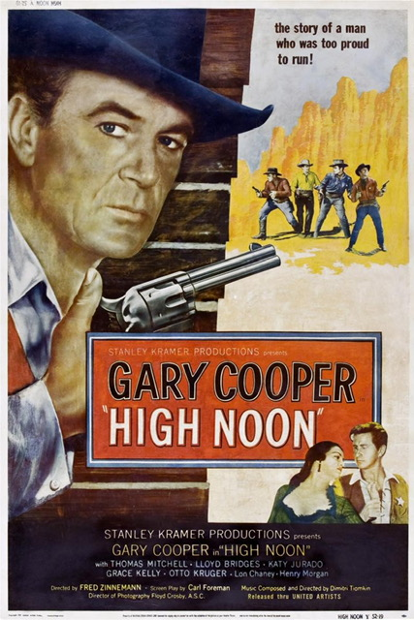

Heroes calling it out and doing the right thing

Slide 12

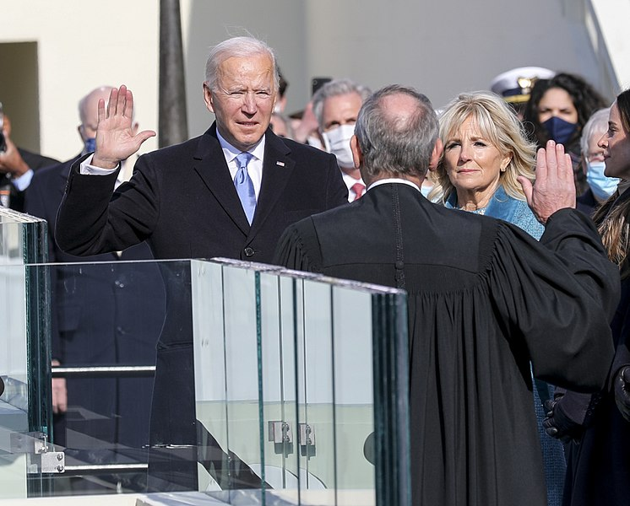
Doing the right thing

Slide 13
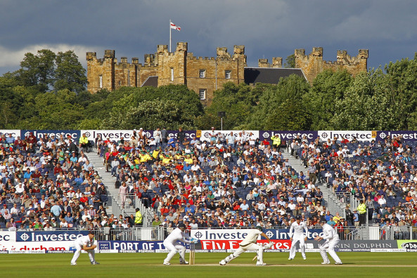
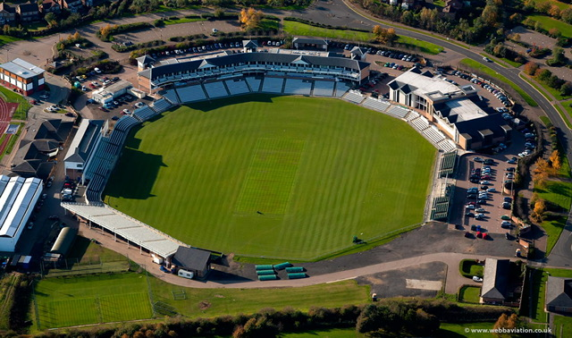

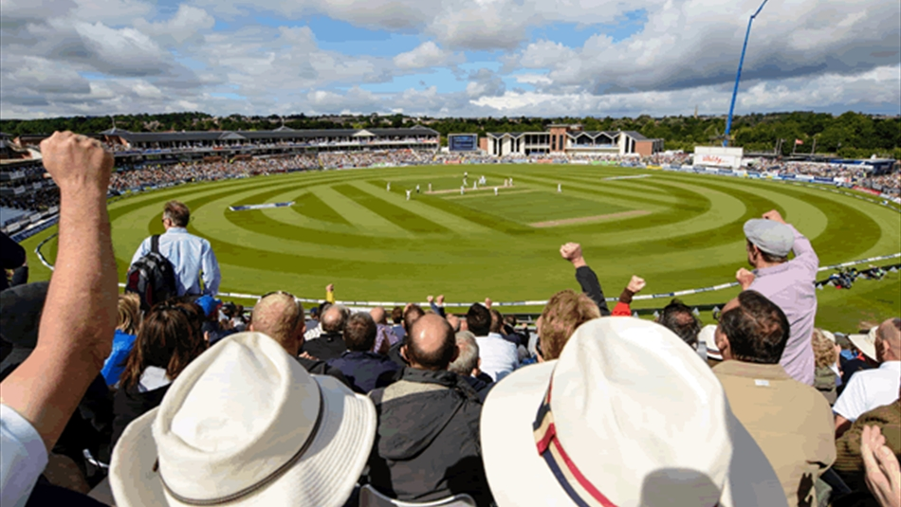
Durham County Cricket Club Success at what cost?
  Durham relegated to Division Two after financial issues
SPORT
30th June 2017
Chester-le-Street based Durham County Cricket Club announces £1.2m losses

Slide 14

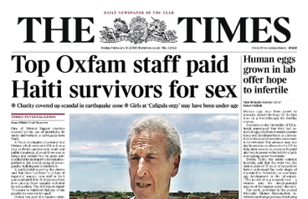


Moral Compass Gone Haywire

Slide 15

Non Execs
  What we have learnt from
  the stories

Slide 16

Auditors and their Performance

Slide 17
System - Checks and Balances
  What we have learnt

Slide 18
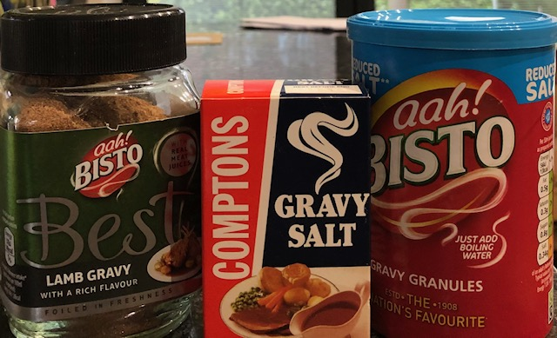

Reward - Gravy Train?

Slide 19
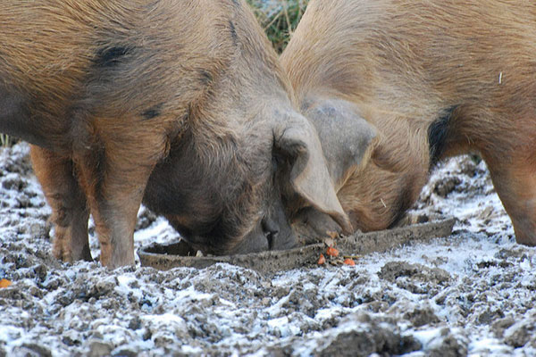
Reward - Snouts in the Trough?

Slide 20
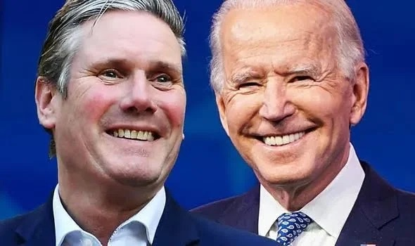

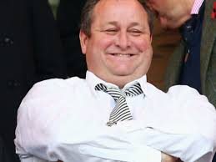
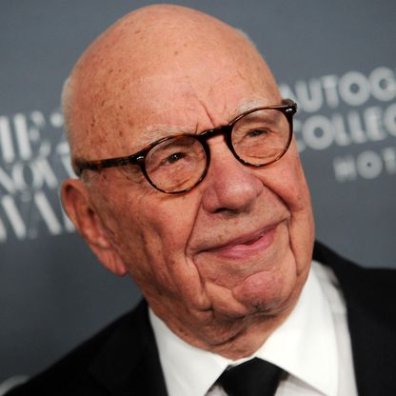


Non-Exec Criteria

Slide 21
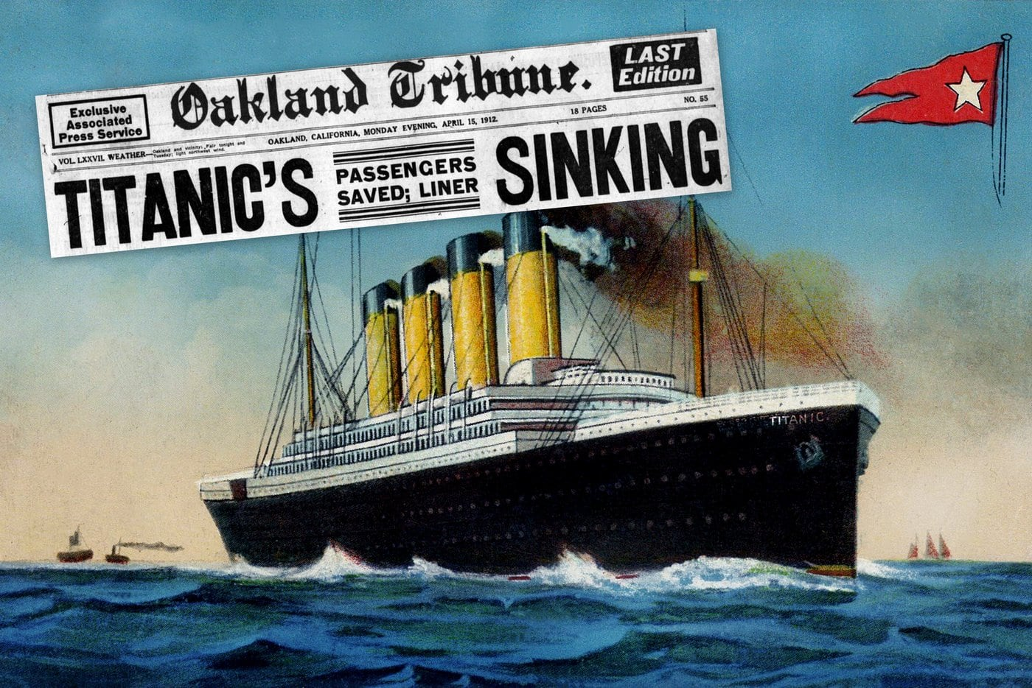
Northern Rock - an
Unsinkable mentality?

Slide 22
What to call my Book?
Non Executives in the Dock
Asleep at the Wheel!
It wasn’t me Guv!
Could they run a market stall?
Challenging Mediocrity
Suggestions welcome.

Slide 23


