Slide 2
Restrictions on CRAR and Forfeiture
Presented by Malcolm Davies Director, High Court & Civil Enforcement Officer at Elliott Davies

Slide 3
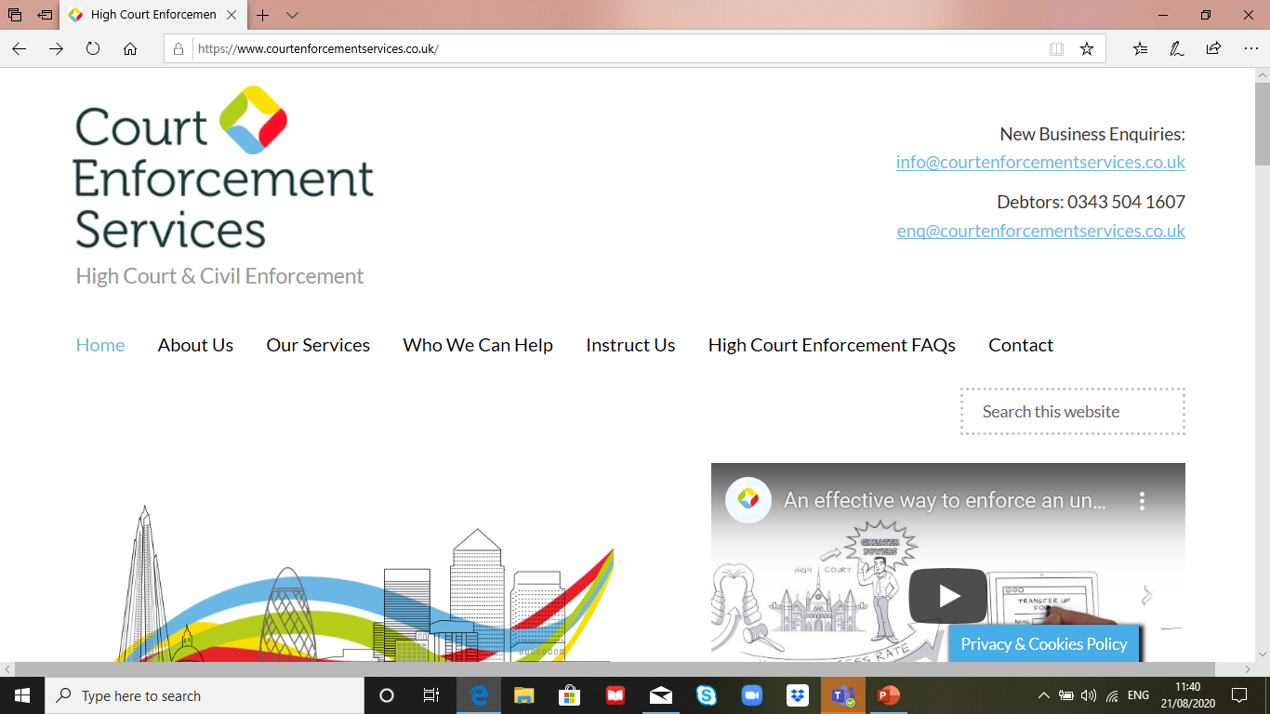

Slide 4
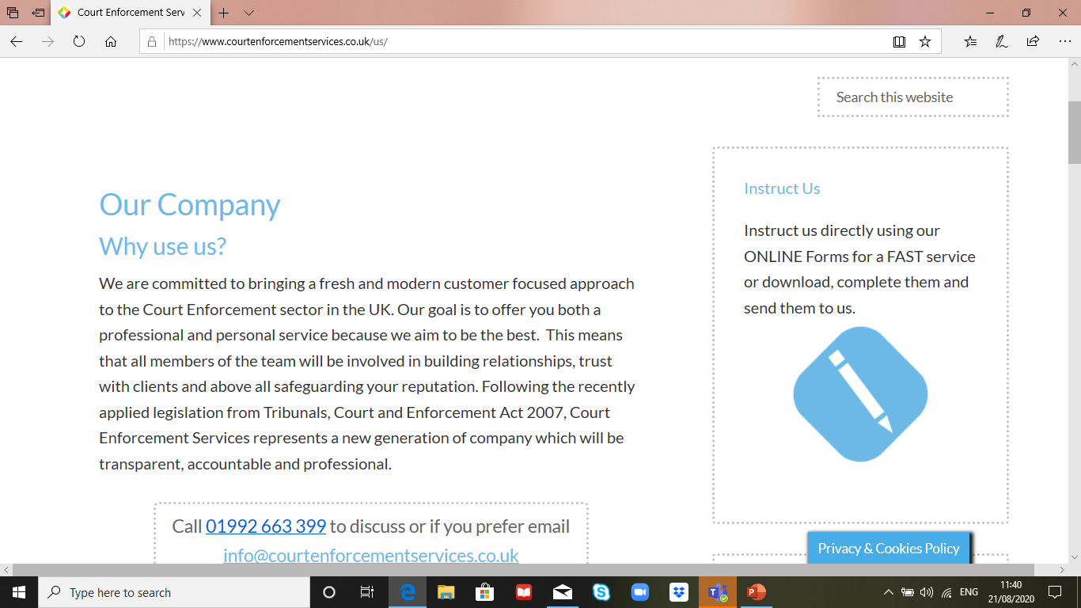

Slide 5
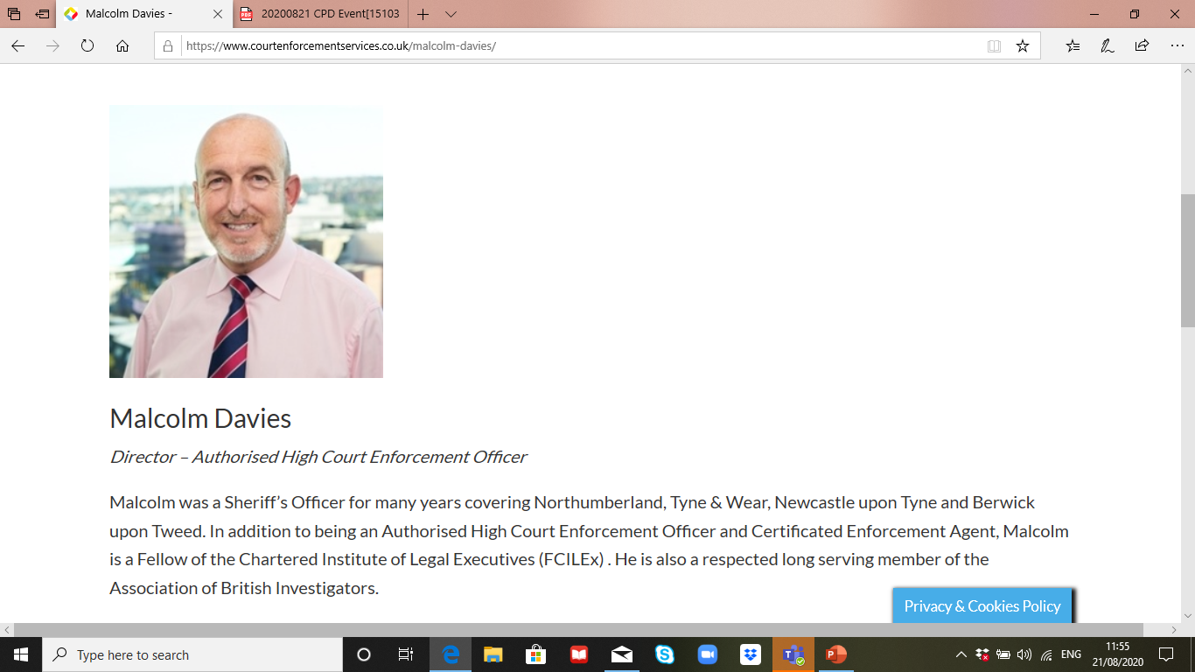

Slide 6
Tribunal Courts and Enforcement Act 2007

Slide 7
Commercial Rent Arrears Recovery (CRAR)

Slide 8
Effects of Covid-19 on CRAR and Enforcement

Slide 9
Effects of COVID-19 on Forfeiture

Slide 10
Enforcement Recommences

Slide 11
Thank you Questions

