Slide 1


Welcome
Thank you for joining. The event will begin shortly
Aims of the 1947 Club
• Furtherance of Social and Professional Contacts
• Providing assistance to Branch RICS matrics
• Preservation of the history and tradition of the 1947 Club

Slide 2
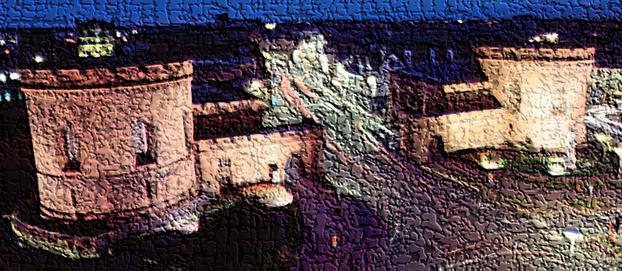

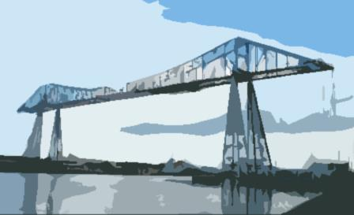
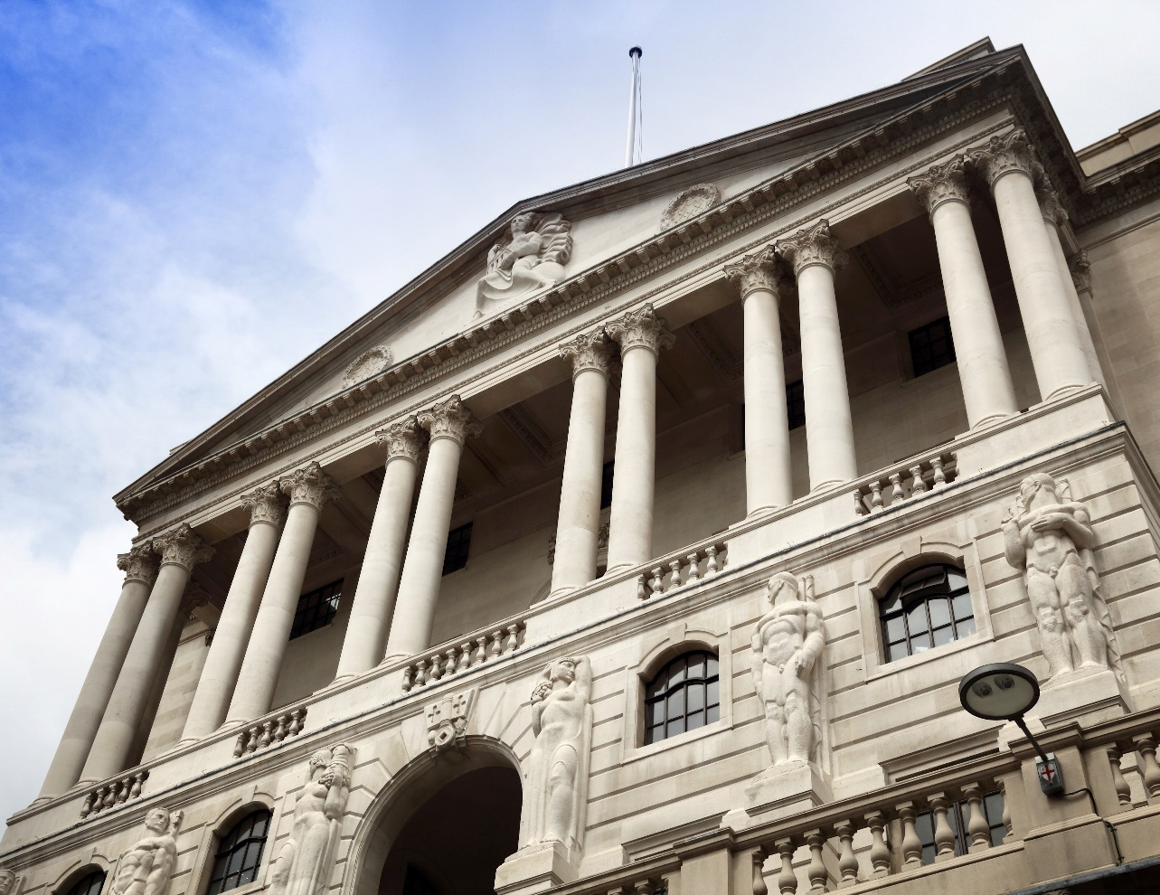

1947 Club
February 2022
Gareth Harrison
North East Agency
@BoENorthEast

Slide 3

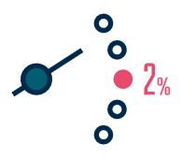

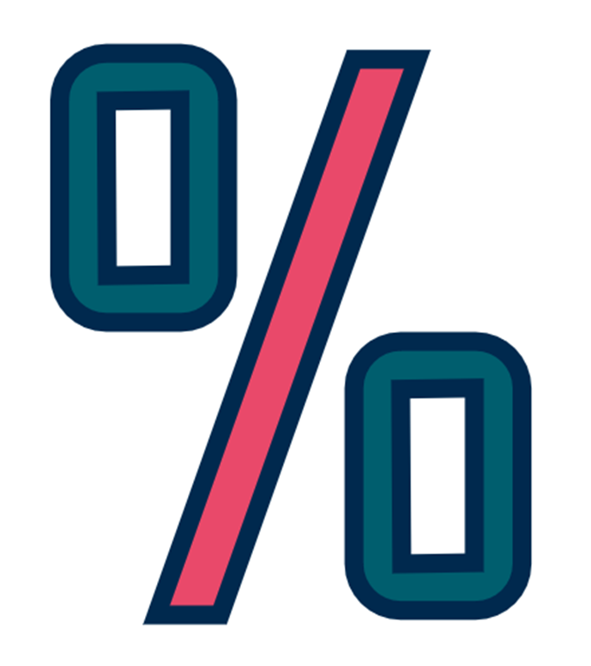
In a nutshell…
Higher energy and goods prices are pushing inflation above our 2% target
We expect inflation to rise to around 7% in the spring, but then fall back
The UK economy continues to recover
We have increased interest rates to return inflation to our 2% target

Slide 4
Demand and growth

Slide 5
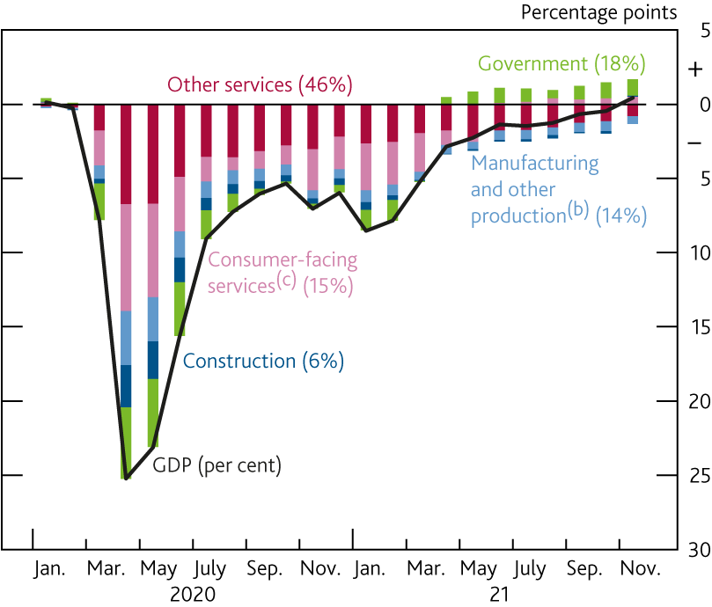
GDP recovered to its pre-pandemic level in November…
Contributions to change in monthly GDP since 2019 Q4
Sources: ONS and Bank calculations.
Notes:
Figures in parentheses are weights in gross value added in 2019. Weights and contributions may not sum to the total due to rounding.
Other production includes agriculture, mining and quarrying, and utilities.
Consumer-facing services includes accommodation and food services, arts, entertainment and recreation, and wholesale and retail.

Slide 6
Demand outlook will be affected by how households respond to the squeeze in their real incomes (the cost of living crisis in real world speak)
Employment
Nominal post-tax labour income per head
Real post-tax labour income growth per head (per cent)
Prices

Slide 7
Households do, in aggregate, have savings to spend
Savings rate

Slide 8
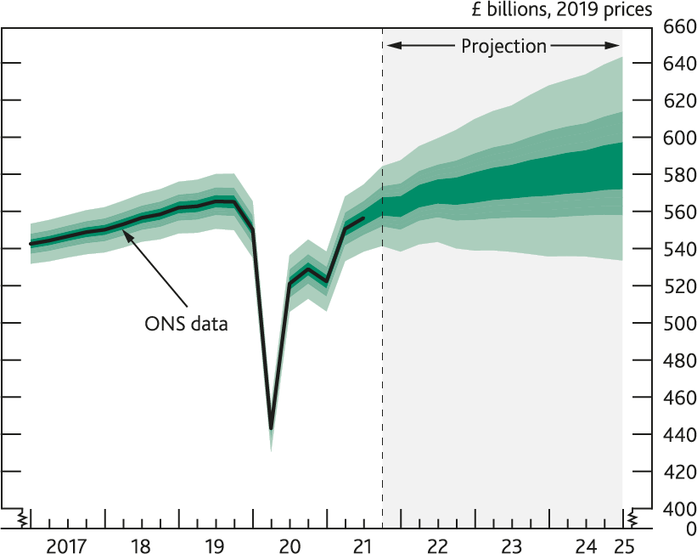
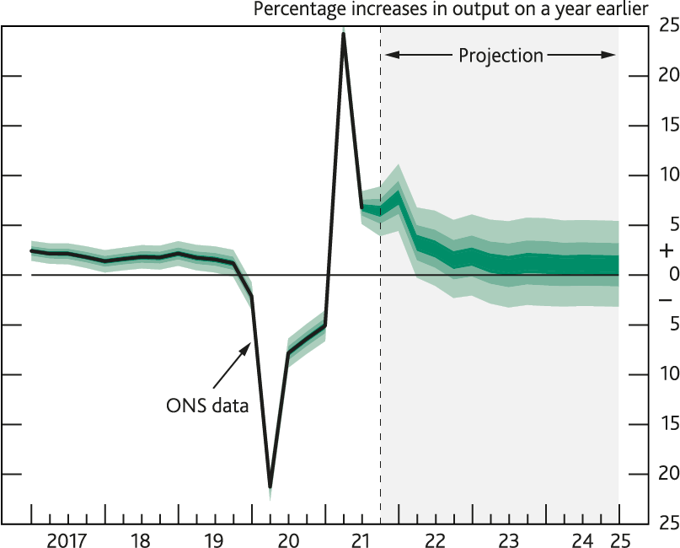
  GDP projection based on market interest rate expectations
Notes:
The fan charts depict the probability of various outcomes for GDP and GDP growth. They have been conditioned on the assumptions in Table 1.A footnote (b). To the left of the vertical dashed line, the distribution reflects uncertainty around revisions to the data over the past. To aid comparability with the official data, it does not include the backcast for expected revisions, which is available from the ‘Download the chart slides and data’ link at Monetary Policy Report – February 2022. To the right of the vertical line, the distribution reflects uncertainty over the evolution of GDP and GDP growth in the future. If economic circumstances identical to today’s were to prevail on 100 occasions, the MPC’s best collective judgement is that the mature estimate of GDP (in Chart 1.1) or GDP growth (in Chart 1.2) would lie within the darkest central band on only 30 of those occasions. The fan chart is constructed so that outturns are also expected to lie within each pair of the lighter green areas on 30 occasions. In any particular quarter of the forecast period, GDP or GDP growth is therefore expected to lie somewhere within the fan on 90 out of 100 occasions. And on the remaining 10 out of 100 occasions GDP or GDP growth can fall anywhere outside the green area of the fan chart. Over the forecast period, this has been depicted by the light grey background. See the box on page 39 of the November 2007 Inflation Report for a fuller description of the fan chart and what it represents

Slide 9
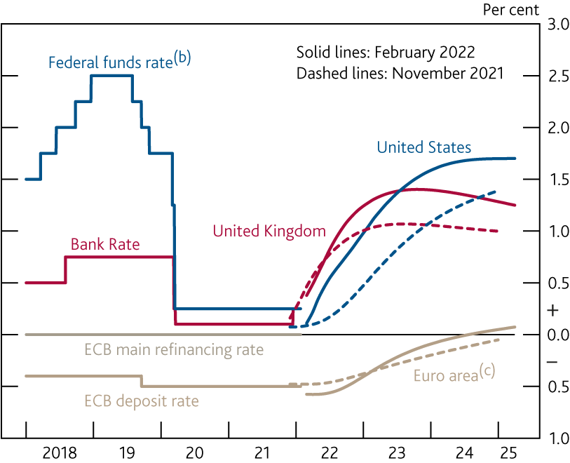
Market participants expect policy rates to increase
International forward interest rates
Sources: Bloomberg Finance L.P. and Bank calculations.
Notes:
All data as of 26 January 2022. The February and November curves are estimated using instantaneous forward overnight swap rates in the 15 working days to 26 January 2022 and 27 October 2021 respectively.
Upper bound of the target range.
From 3 January 2022, the euro-area curve is based on €STR swaps, whereas previously it was based on EONIA swaps. Given the spread between EONIA and €STR, this change alone would have caused the curve to shift down by around 8 basis points.

Slide 10
Labour market

Slide 11
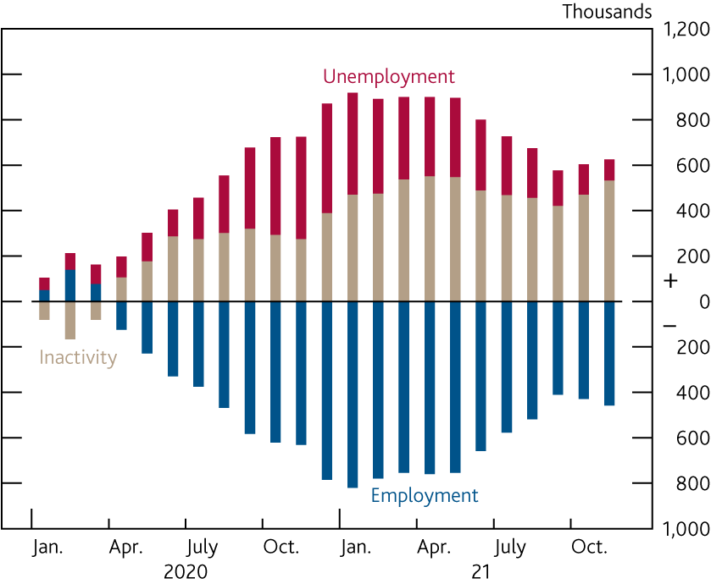
Unemployment is only a little above pre-pandemic levels, but inactivity remains markedly higher
Changes in employment, unemployment and inactivity since 2019 Q4^{(a)}
Sources: ONS and Bank calculations.
Notes:
Data from the Labour Force Survey and employment includes employees and self-employed. Changes do not sum to 0 as the population is estimated to have increased during the period

Slide 12
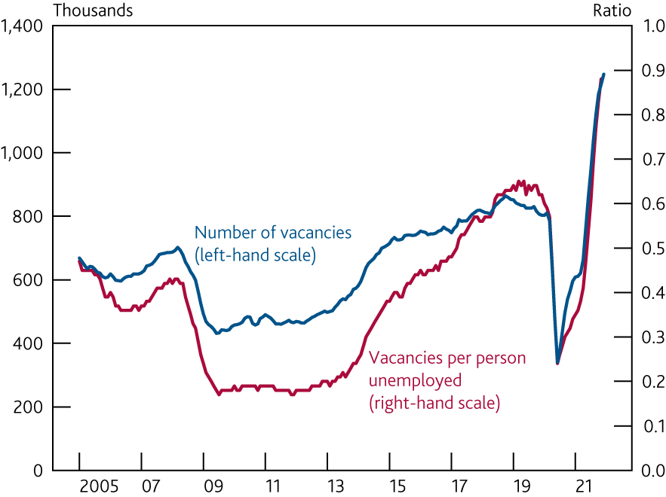
The number of vacancies has increased to a series high
Vacancies^{(a)}
Sources: ONS and Bank calculations.
Notes:
Three-month moving averages. Latest vacancy data are for December 2021, latest
unemployment data for November 2021

Slide 13
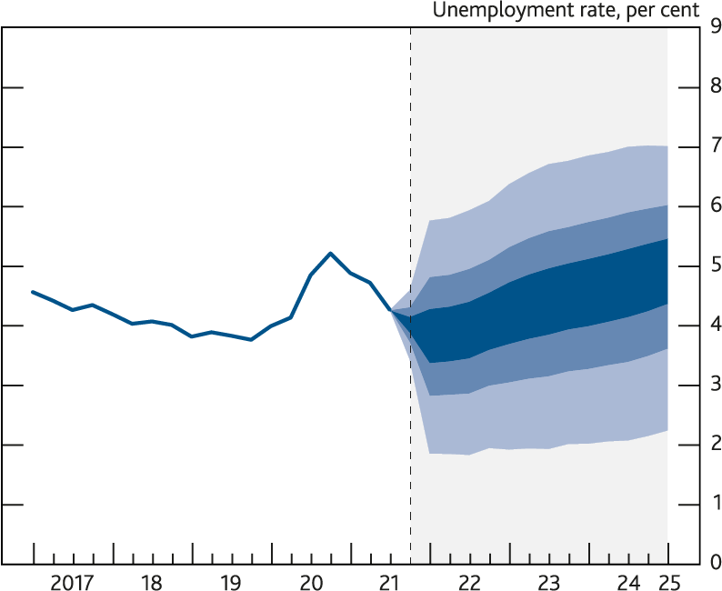
Unemployment projection
Notes:
The fan chart depicts the probability of various outcomes for LFS unemployment. It has been conditioned on the assumptions in Table 1.A footnote (b). The coloured bands have the same interpretation as in Charts 1.1 and 1.2, and portray 90% of the probability distribution. The calibration of this fan chart takes account of the likely path dependency of the economy, where, for example, it is judged that shocks to unemployment in one quarter will continue to have some effect on unemployment in successive quarters. The fan begins in 2021 Q4, a quarter earlier than for CPI inflation. That is because Q4 is a staff projection for the unemployment rate, based in part on data for October and November. The unemployment rate was 4.1% in the three months to November, and is projected to be 4.0% in Q4 as a whole. A significant proportion of this distribution lies below Bank staff’s current estimate of the long-term equilibrium unemployment rate. There is therefore uncertainty about the precise calibration of this fan chart.

Slide 14
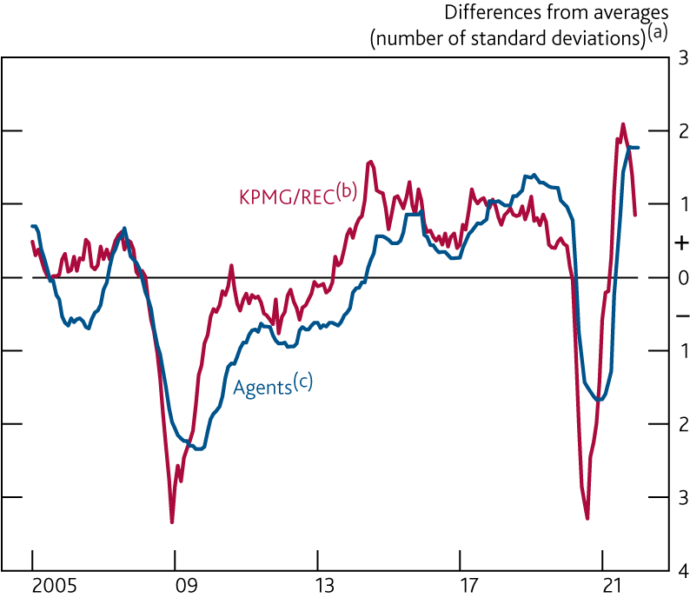
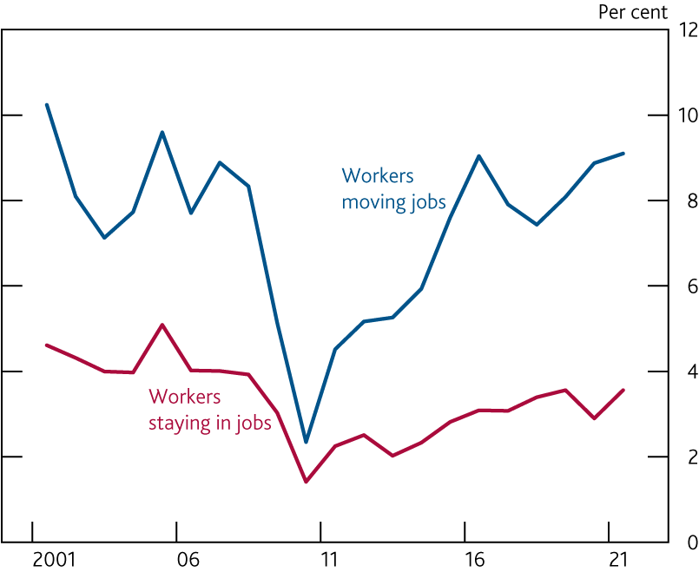
  Indicators of recruitment difficulties
Median annual growth rates of pay
Sources: Bank of England, KPMG/REC UK Report on Jobs and Bank calculations.
Sources: Annual Survey of Hours and Earnings and Bank calculations.
Notes:
(a) Differences from averages since 2000.
(b) KPMG/REC Staff Availability Index, inverted. Latest data point is for December 2021.
(c) Latest data point is for January 2022.

Slide 15
Costs and Prices

Slide 16
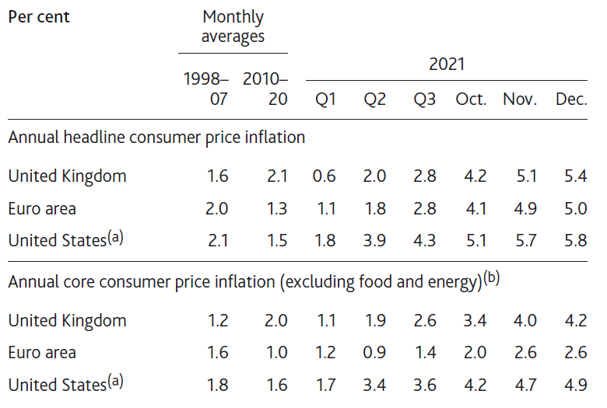
Inflation rates have risen further in advanced economies
Inflation in the UK, US and euro area
Sources: Eurostat, ONS, Refinitiv Eikon from LSEG, US Bureau of Economic Analysis and Bank calculations.
Notes:
Personal consumption expenditure price index inflation.
For the euro area and the UK, excludes energy, food, alcoholic beverages and tobacco. For the US, excludes food and energy.

Slide 17
We expect inflation to peak in April at 7¼%
CPI inflation (per cent)
Other goods (39%)
Food and non-alcoholic beverages (11%)
Services (43%)
Electricity and gas (3%)
Fuels and lubricants (3%)

Slide 18
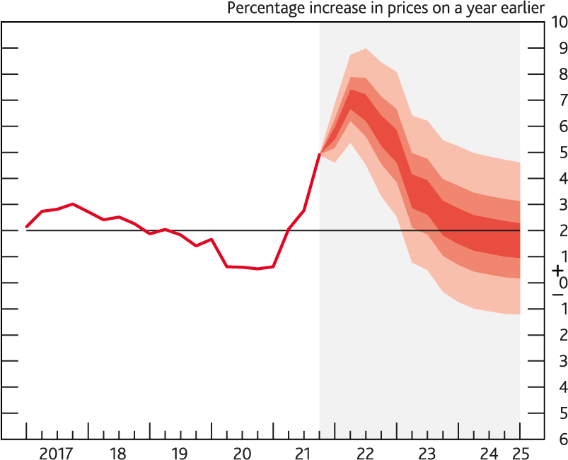
CPI inflation projection based on market interest rate expectations
Notes:
The fan chart depicts the probability of various outcomes for CPI inflation in the future. It has been conditioned on the assumptions in Table 1.A footnote (b). If economic circumstances identical to today’s were to prevail on 100 occasions, the MPC’s best collective judgement is that inflation in any particular quarter would lie within the darkest central band on only 30 of those occasions. The fan chart is constructed so that outturns of inflation are also expected to lie within each pair of the lighter red areas on 30 occasions. In any particular quarter of the forecast period, inflation is therefore expected to lie somewhere within the fans on 90 out of 100 occasions. And on the remaining 10 out of 100 occasions inflation can fall anywhere outside the red area of the fan chart. Over the forecast period, this has been depicted by the light grey background. See the box on pages 48–49 of the May 2002 Inflation Report for a fuller description of the fan chart and what it represents

Slide 19
Policy decision
(and implications)
Notes:
The fan chart depicts the probability of various outcomes for LFS unemployment. It has been conditioned on the assumptions in Table 1.A footnote (b). The coloured bands have the same interpretation as in Charts 1.1 and 1.2, and portray 90% of the probability distribution. The calibration of this fan chart takes account of the likely path dependency of the economy, where, for example, it is judged that shocks to unemployment in one quarter will continue to have some effect on unemployment in successive quarters. The fan begins in 2021 Q4, a quarter earlier than for CPI inflation. That is because Q4 is a staff projection for the unemployment rate, based in part on data for October and November. The unemployment rate was 4.1% in the three months to November, and is projected to be 4.0% in Q4 as a whole. A significant proportion of this distribution lies below Bank staff’s current estimate of the long-term equilibrium unemployment rate. There is therefore uncertainty about the precise calibration of this fan chart.

Slide 20
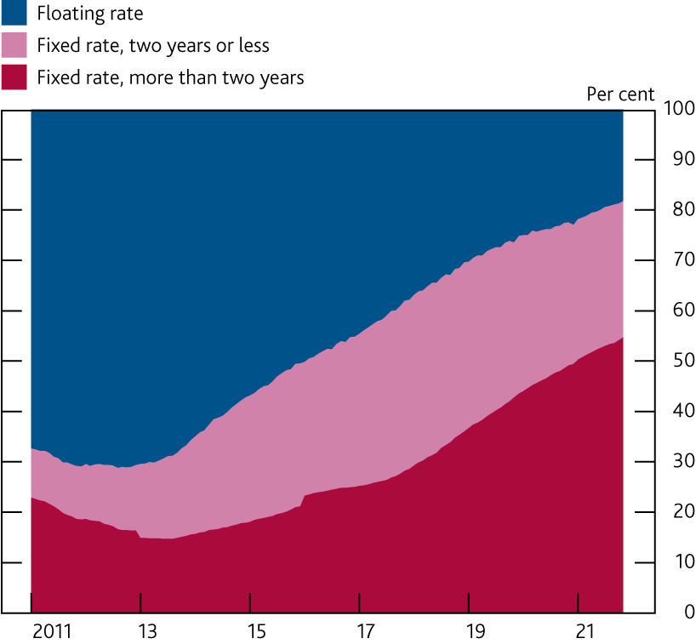
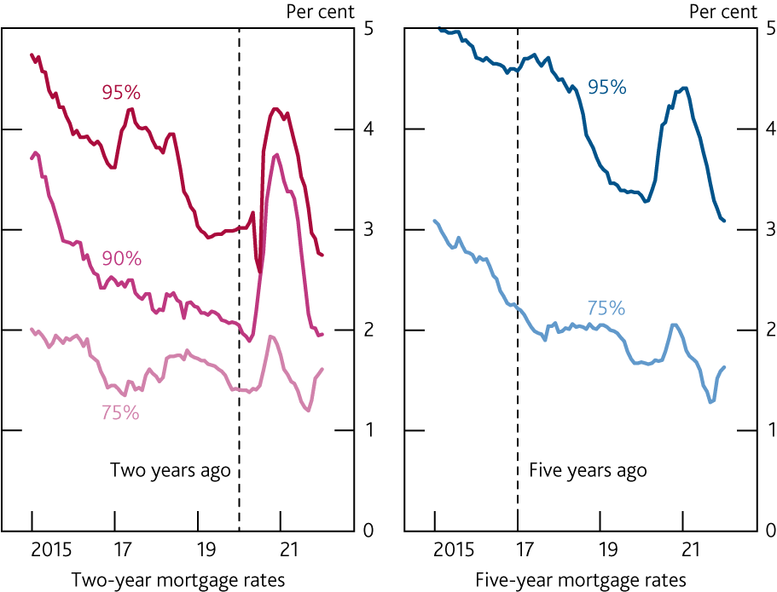
A growing majority of the stock of mortgages by value are fixed rate…
Distribution of mortgages by type of interest rate^{(a)}
…and many renewing fixed-rate mortgages will get a similar or lower interest rate
Two-year and five-year fixed-rate mortgage interest rates at selected loan to value ratios^{(a)}
Notes:
(a) Share of value of outstanding mortgages. Data from January 2016 are for individuals and individual trusts only. Latest data point is November 2021.

Slide 21
Q&A
Gareth Harrison
North East Agency
@BoENorthEast

