Slide 1

Welcome
Aims of the 1947 Club
• Furtherance of Social and Professional Contacts
• Providing assistance to Branch RICS matrics
• Preservation of the history and tradition of the 1947 Club

Slide 2



How ESG is driving change for developers, investors, companies and organisations of all sizes
Presented by
Ben Lawry, Associate Director, Roberts
Environmental Ltd
and
Tim Hill, Partner, Eversheds Sutherland
Introduced by
Jeff Roberts, Managing Director, Roberts Environmental Ltd

Slide 3

Ben Lawry
Associate Director
Head of ESG and Sustainability
Roberts Environmental Ltd
ESG Drivers and Benefits
A Real-Estate Perspective

Slide 4
ESG in Property - Context
80%
of buildings which will be around in 2050, already exist today. Therefore, need to retrofit
Owners, occupiers and investors are increasingly requiring transparent, comparable and detailed material information on ESG criteria.
42%
of the UK's carbon is caused by the built environment
Environmental
Materials and Resources
Energy sources and Efficiency
Climate Change
Waste Management
Biodiversity
Social
Occupier and Community Relations
Health and Wellbeing
Accessibility and Transport
Amenities
Indoor Environment
Governance
Property management
Culture
Reputation
Conduct
Diversity
Certification

Slide 5
What Are The Risks and Opportunities of ESG Implementation?
 | Risk | Opportunity
Compliance | Fines Lower Asset value Lower Occupier Attraction Stranded assets | Higher Asset Value Higher Occupier Demand Investment Attraction
Physical | Damage, e.g., Floods Operational Impact Increased insurance Premiums Stranded assets | Retained Asset Value Resilience – financial and operational
Transitional | Increased Operating Cost Lack of adaption to shifting market needs Reputational Stranded assets | Reduced operational costs and exposure to fuel prices Increased capital availability Reputational improvement

Slide 6

What Are The Drivers?
Owners
Increasing Occupier Demand
Limiting Regulatory Risk
Retaining Asset Value
Attracting Investors
Occupiers
Reducing Operational Costs
Improving Staff productivity and Retention
Meeting CSR Objectives
Supporting Corporate Reporting
Investors
Limiting regulatory Exposure
Reducing Investment Risk
Future Asset Protection

Slide 7
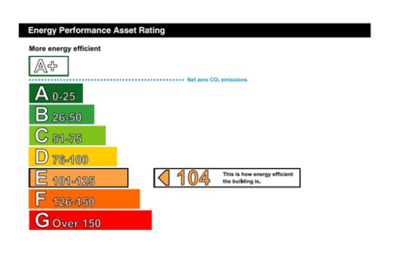
Example Regulatory Timeline
Key policy currently Minimum Energy Efficiency Standard (MEES).
Unlawful to let properties with an Energy Performance Certificate (EPC) rating below an 'E' rating
By 2027, properties required to meet minimum band C
By 2030, properties required to meet minimum band B

Slide 8
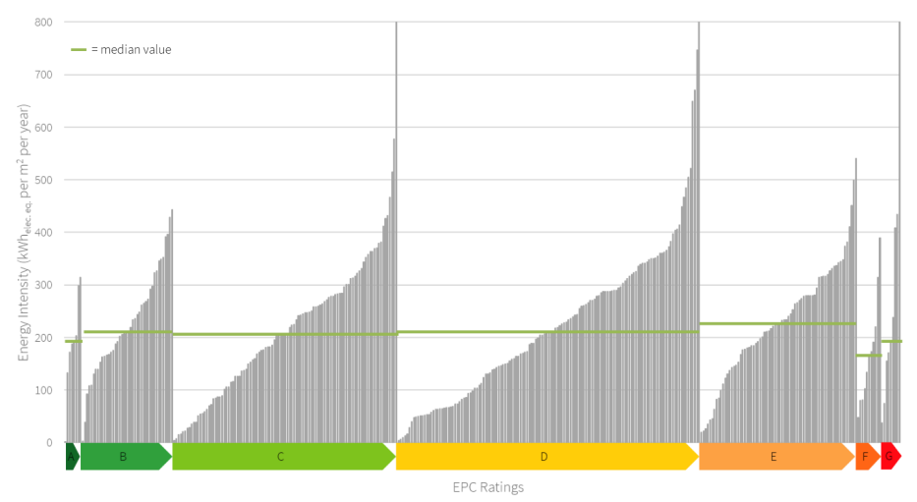

Slide 9

ESG Drivers and Benefits
A legal and client perspective
Tim Hill
Partner, Solicitor Advocate
Eversheds Sutherland (International) LLP

Slide 10
Why is ESG important?
Legal obligations: examples
Environmental | Social | Governance
The natural environment: | The rights, wellbeing and interests of your people and the wider community: | The governance of your organisation:
Streamlined Energy & Carbon Reporting (SECR) – large companies Taskforce on Climate Related Financial Disclosures (TCFD) Environmental Protection Act 1990 Competition and Markets Authority (CMA) Green Claims Code & Greenwashing | Modern Slavery Act 2015 Equality Act 2010 Human Rights Act 1998 (Draft EU legislation on supply chain due diligence for forced labour) | Bribery Act 2010 Data Protection Act 2018
Companies Act 2006 (Strategic Report & Section 172 statements) Health & Safety at Work etc Act 1974
Non-Binding Principles: UN Sustainable Development Goals: 2030 Agenda UN Guiding Principles on Business & Human Rights

Slide 11

Why is ESG important
Reputation and Value
Stakeholder pressure
Future-proofing the business
Funder pressure
Executive remuneration
Value chain management

Slide 12
ESG – Defining ESG for your organisation
Identifying what you already have in place, prioritise and plan
Identify key ESG issues/risks for your organisation – short/medium/long
Current position - Existing targets or obligations (own or externally imposed)/policies already in place?
Development of new policies? – Benchmarking
Delivery – embedding and bring to life in day to day operations
Management Reporting – review of performance /adjustment of targets or approach?
Assurance – how is performance and resilience assessed? Need for external audit?
Communication – with stakeholders on progress and any adjustments

Slide 13

International Horizons: where are global organisations on ESG?

Slide 14
Tim Hill
Partner, Solicitor Advocate
M: +44 7740 157 416
timhill@eversheds-sutherland.com
NEWCASTLE-#5704686
NEWCASTLE-#5704686
NEWCASTLE-#5704686
NEWCASTLE-#5704686

Slide 15
Next event
Friday 13th January 2023
Topic - TBC
www.the1947club.co.uk

