Slide 1
Building safety Regulator
Chris Ritchie MRICS MCABE

Slide 2
Today
Legislation
Role of BSR
High Rise Buildings (HRB) – ‘In-scope’
Building Control
Timeline

Slide 3
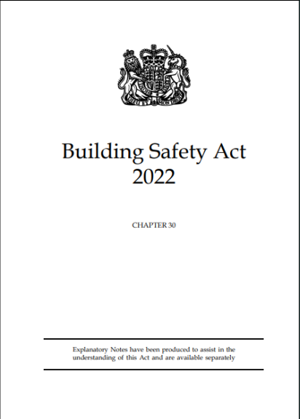
Legislation
Creates the Building Safety Regulator (BSR)
Creates a specific regime for ‘in scope’ HRB buildings
Gives BSR responsibility for whole building control system
Provisions relating to construction products

Slide 4
BSR Role
New regulatory framework for HRB
Oversee the safety and standards of ALL buildings
Help and encourage the construction industry and building control profession to improve its competency.

Slide 5
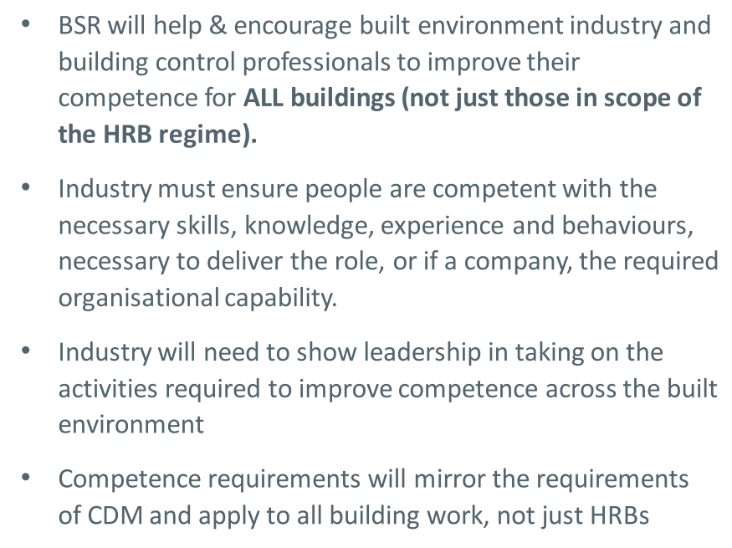
Competency

Slide 6
Register and Regulate
HRB – Existing and new build
Building Inspectors - Individuals
Building Control Approvers – Public and Private

Slide 7
High Rise Buildings
    7 or more storeys
Or
    18M in height
    And
        Contains 2 residential units
        Is a hospital and care home

Slide 8
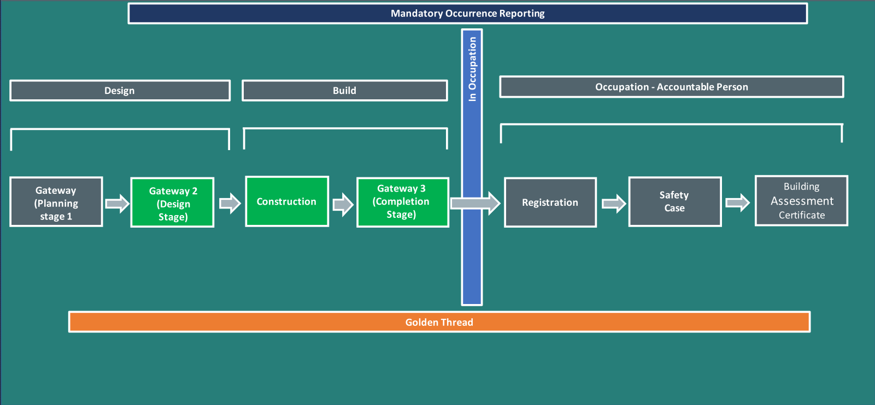
High Rise Buildings

Slide 9
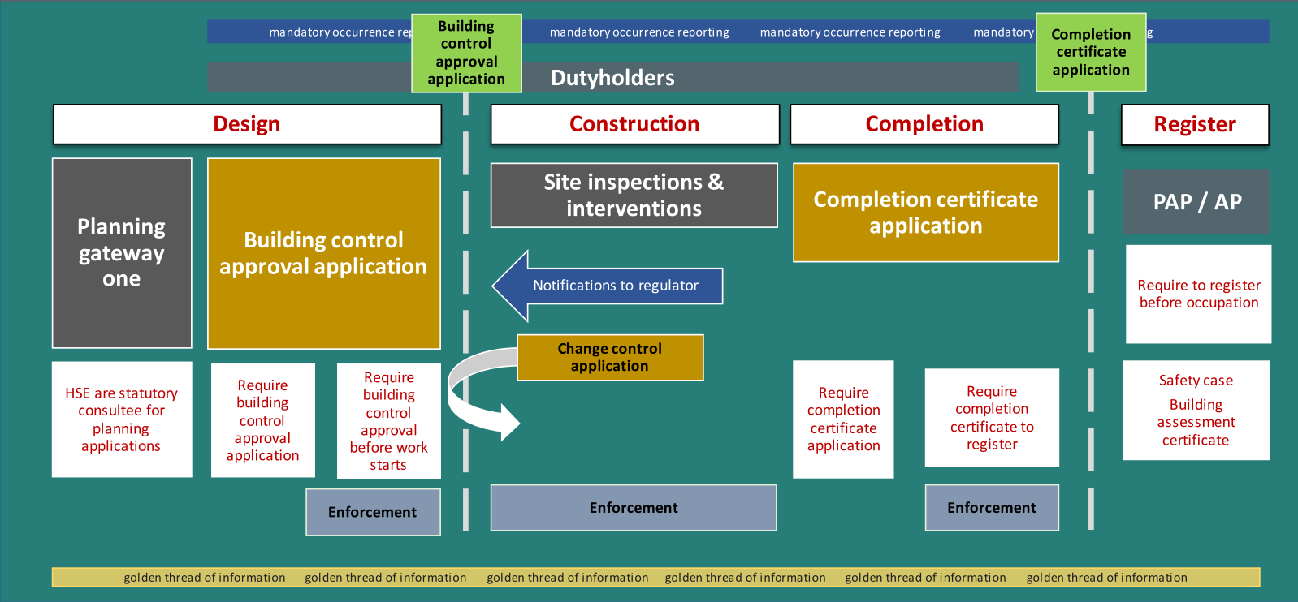
High Rise Buildings

Slide 10
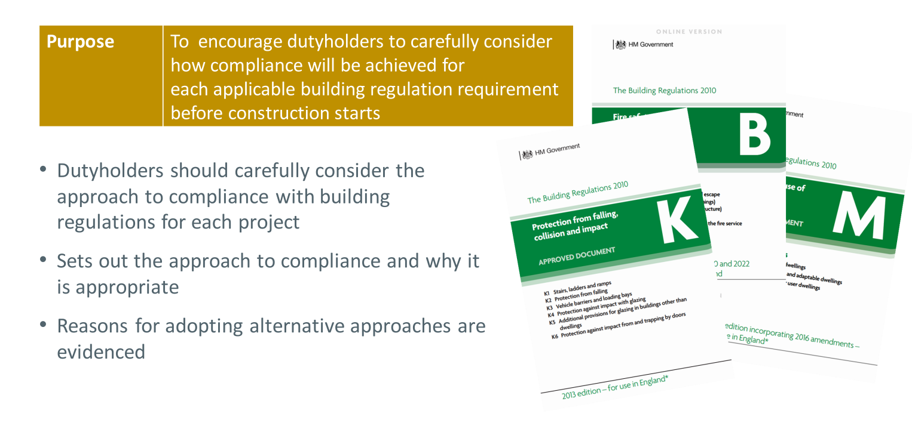
Plan Certificate

Slide 11
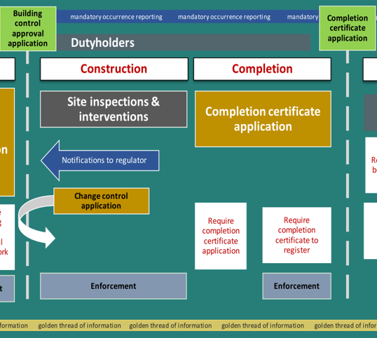
Site inspection and completion

Slide 12
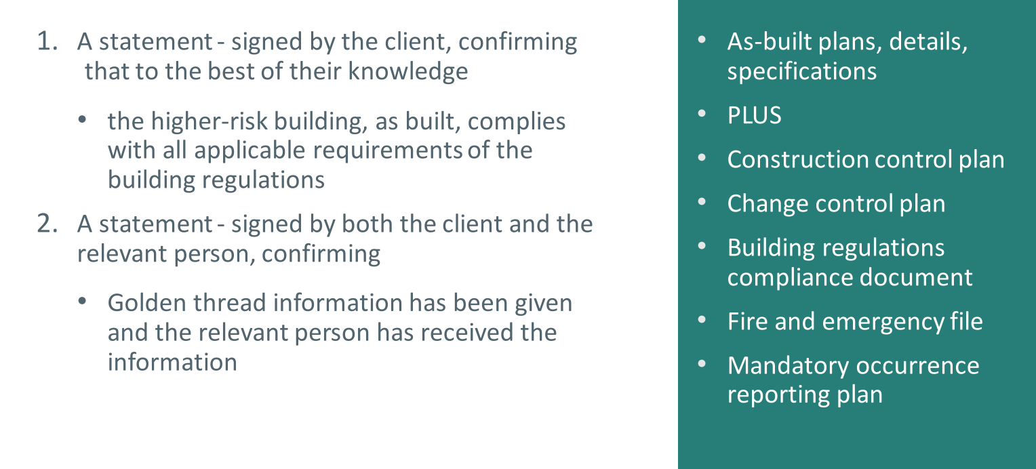
Completion Application

Slide 13
High Rise Buildigns

Slide 14
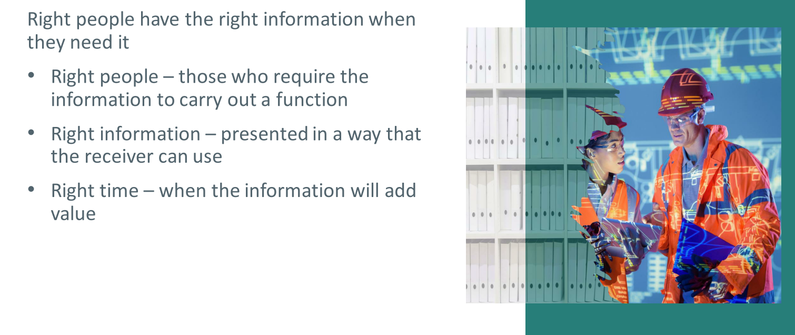
Golden Thread

Slide 15
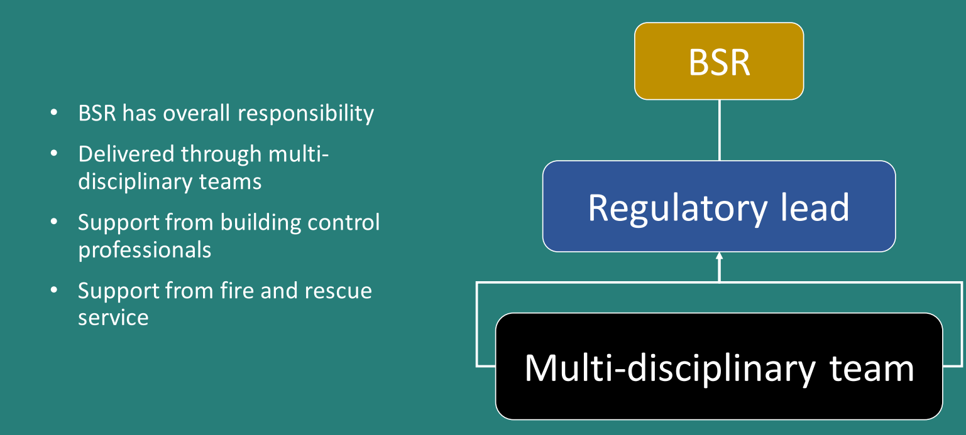
Multi-disciplinary team

Slide 16
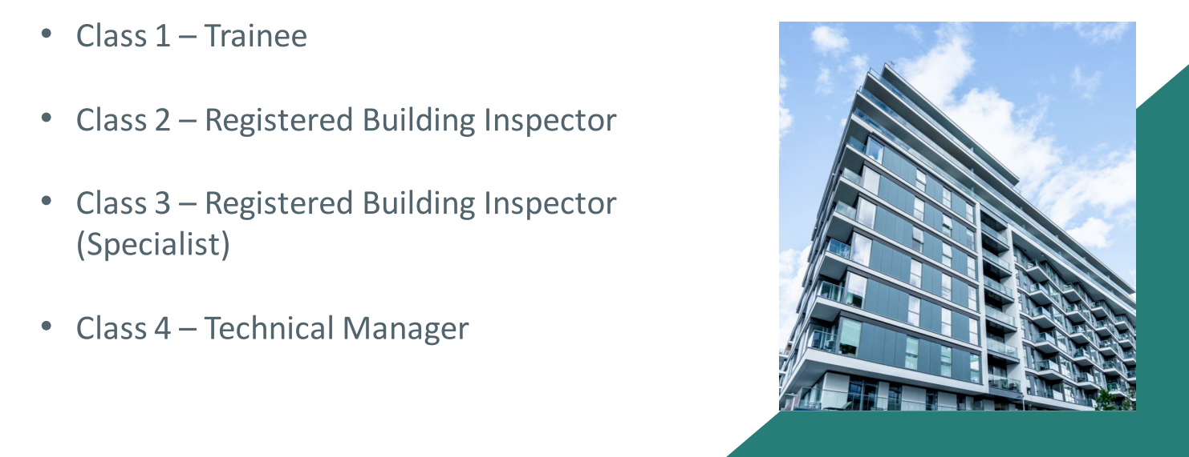
Building Inspectors

Slide 17
Building Control Approvers (BCA)
Private – Approved Inspectors
Public – Local Authorities

Slide 18
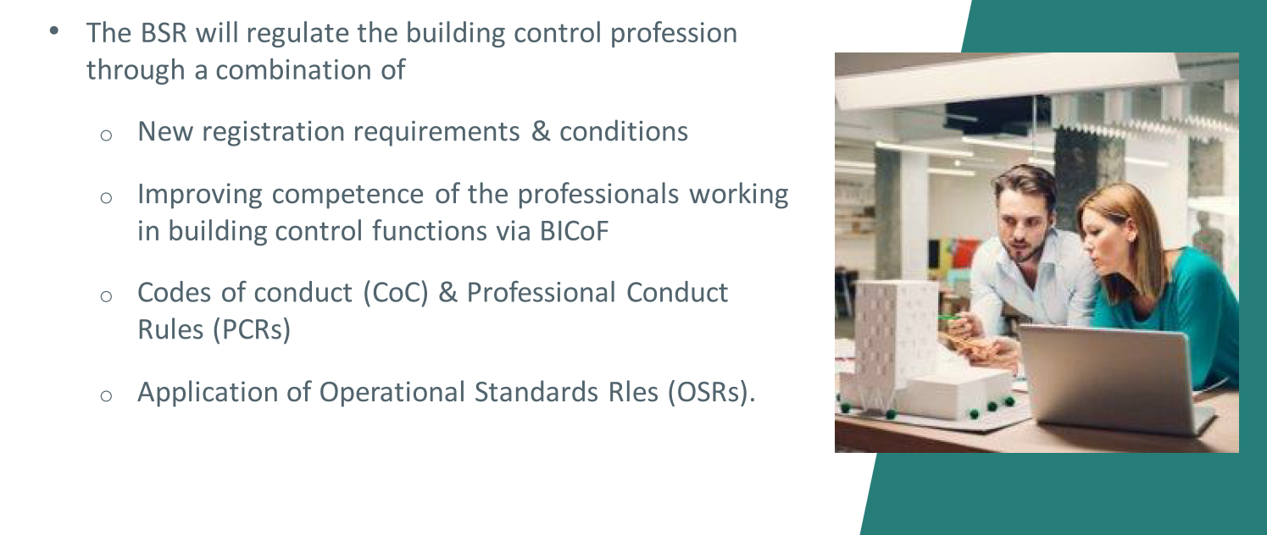
Building Control Regulation

Slide 19
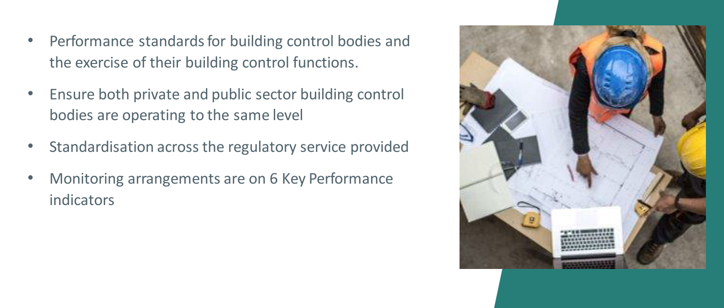
Building Control OSRS

Slide 20
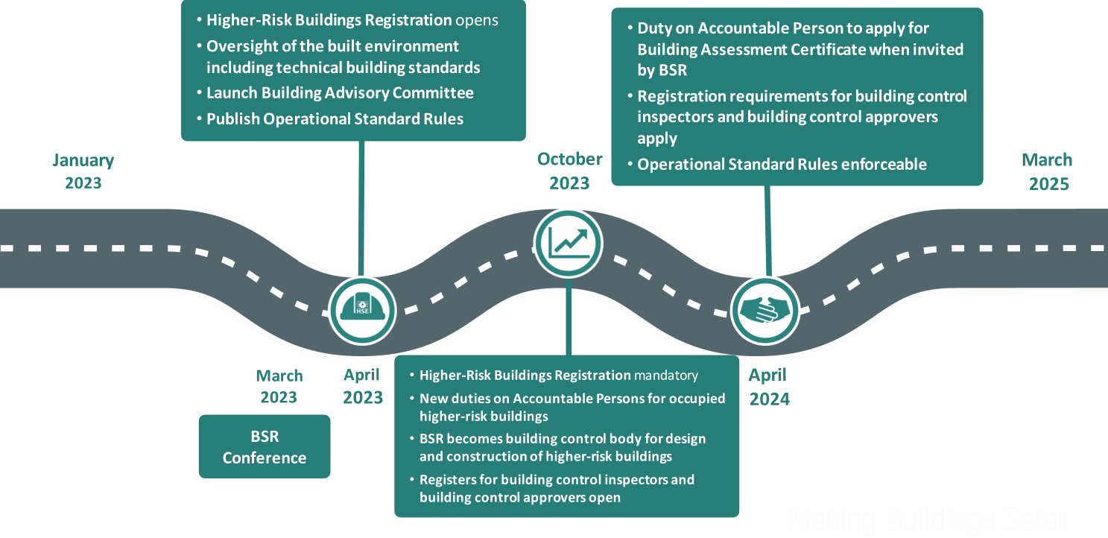
Timeline

Slide 21
Any Questions
Chris Ritchie MRICS MCABE

