Slide 1


Welcome
Aims of the 1947 Club
• Furtherance of Social and Professional Contacts
• Providing assistance to Branch RICS Matrics & 1947 Club NextGen
• Preservation of the history and tradition of the 1947 Club
Are you a Chartered Surveyor and interested in becoming a Member of the 1947 Club? – contact a Committee member or send a message through LinkedIn
www.the1947club.co.uk

Slide 2
1947 Club
September 2023
Gareth Harrison

Slide 3
Plan for today
-Current economic conditions
-Main forecasts
-Interest rates and impact on activity

Slide 4
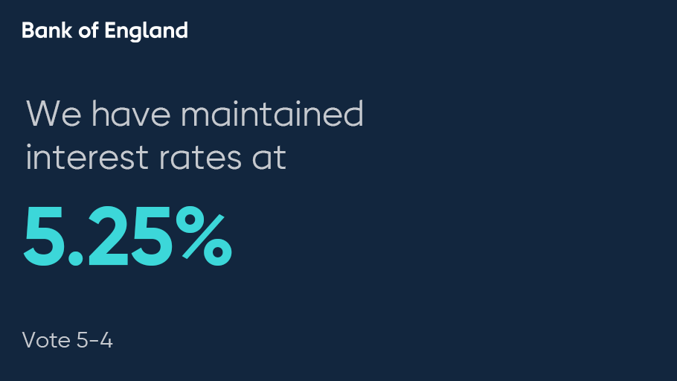

Slide 5
Current economic conditions

Slide 6
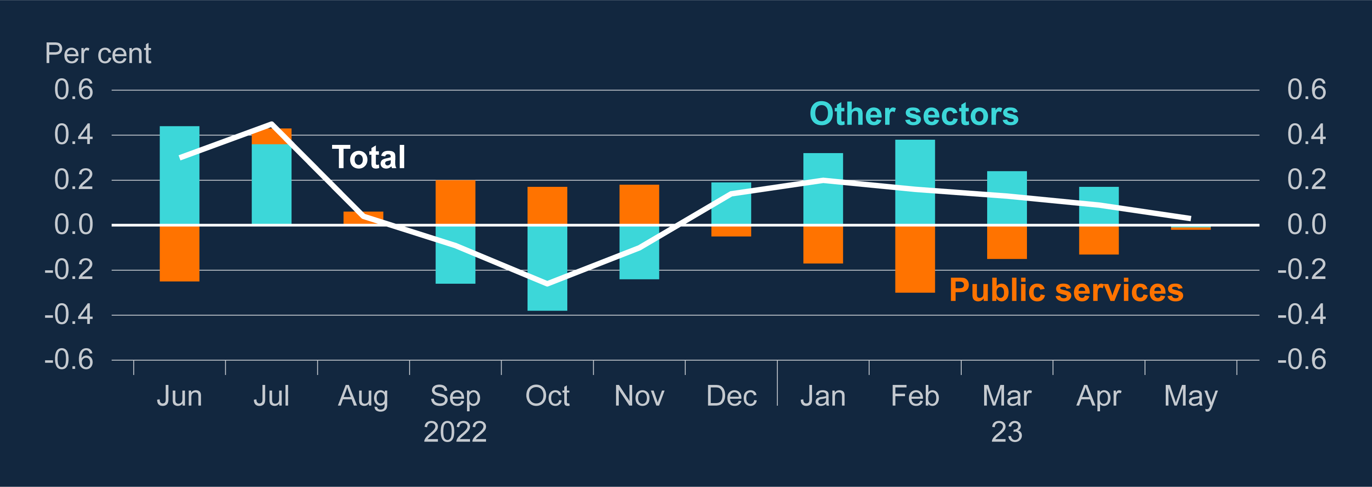
GDP growth has been slow but positive since the end of 2022 despite falling public sector output
Contribution to three-month on three-month GDP growth^{(a)}
Sources: ONS and Bank calculations.
Notes:
(a) Public services includes: public administration and defence; education; and human health and social work activities. Data do not sum to the total due to rounding.

Slide 7
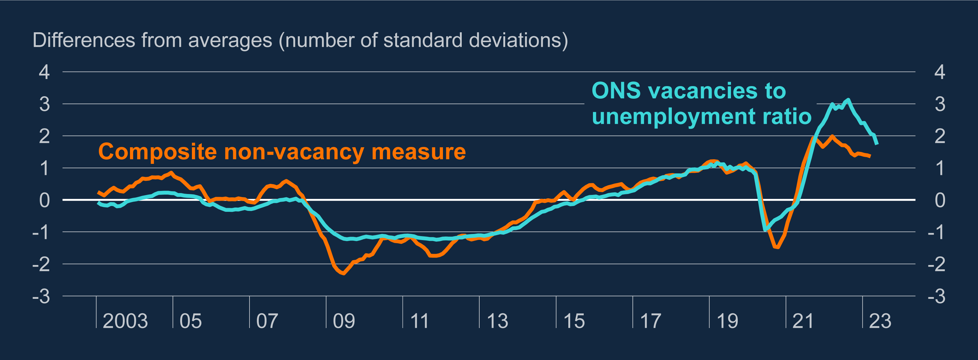
The labour market remains tight, although has loosened since mid-2022
Measures of labour market tightness^{(a)}
Sources: ONS and Bank calculations.
Notes:
(a) The composite non-vacancy measure is calculated as the first principal component of seven series: the short-term unemployment rate; quarterly resignations as a share of employment; the share of employed people who report wanting more hours in their current job; the number of redundancies as a share of employment; the Bank’s Agents composite company visit score for recruitment difficulty; and the rate of flows out of unemployment and inactivity into employment respectively. Quarterly series are linearly interpolated to monthly data. These measures can vary for reasons unrelated to a strict definition of labour market tightness however the first principal component is intended to capture the comovement of these series, which is likely to be similar to a measure of labour market tightness. The ONS vacancies and composite non-vacancy measure series are mean and variance adjusted using data from 2002 to 2023.

Slide 8
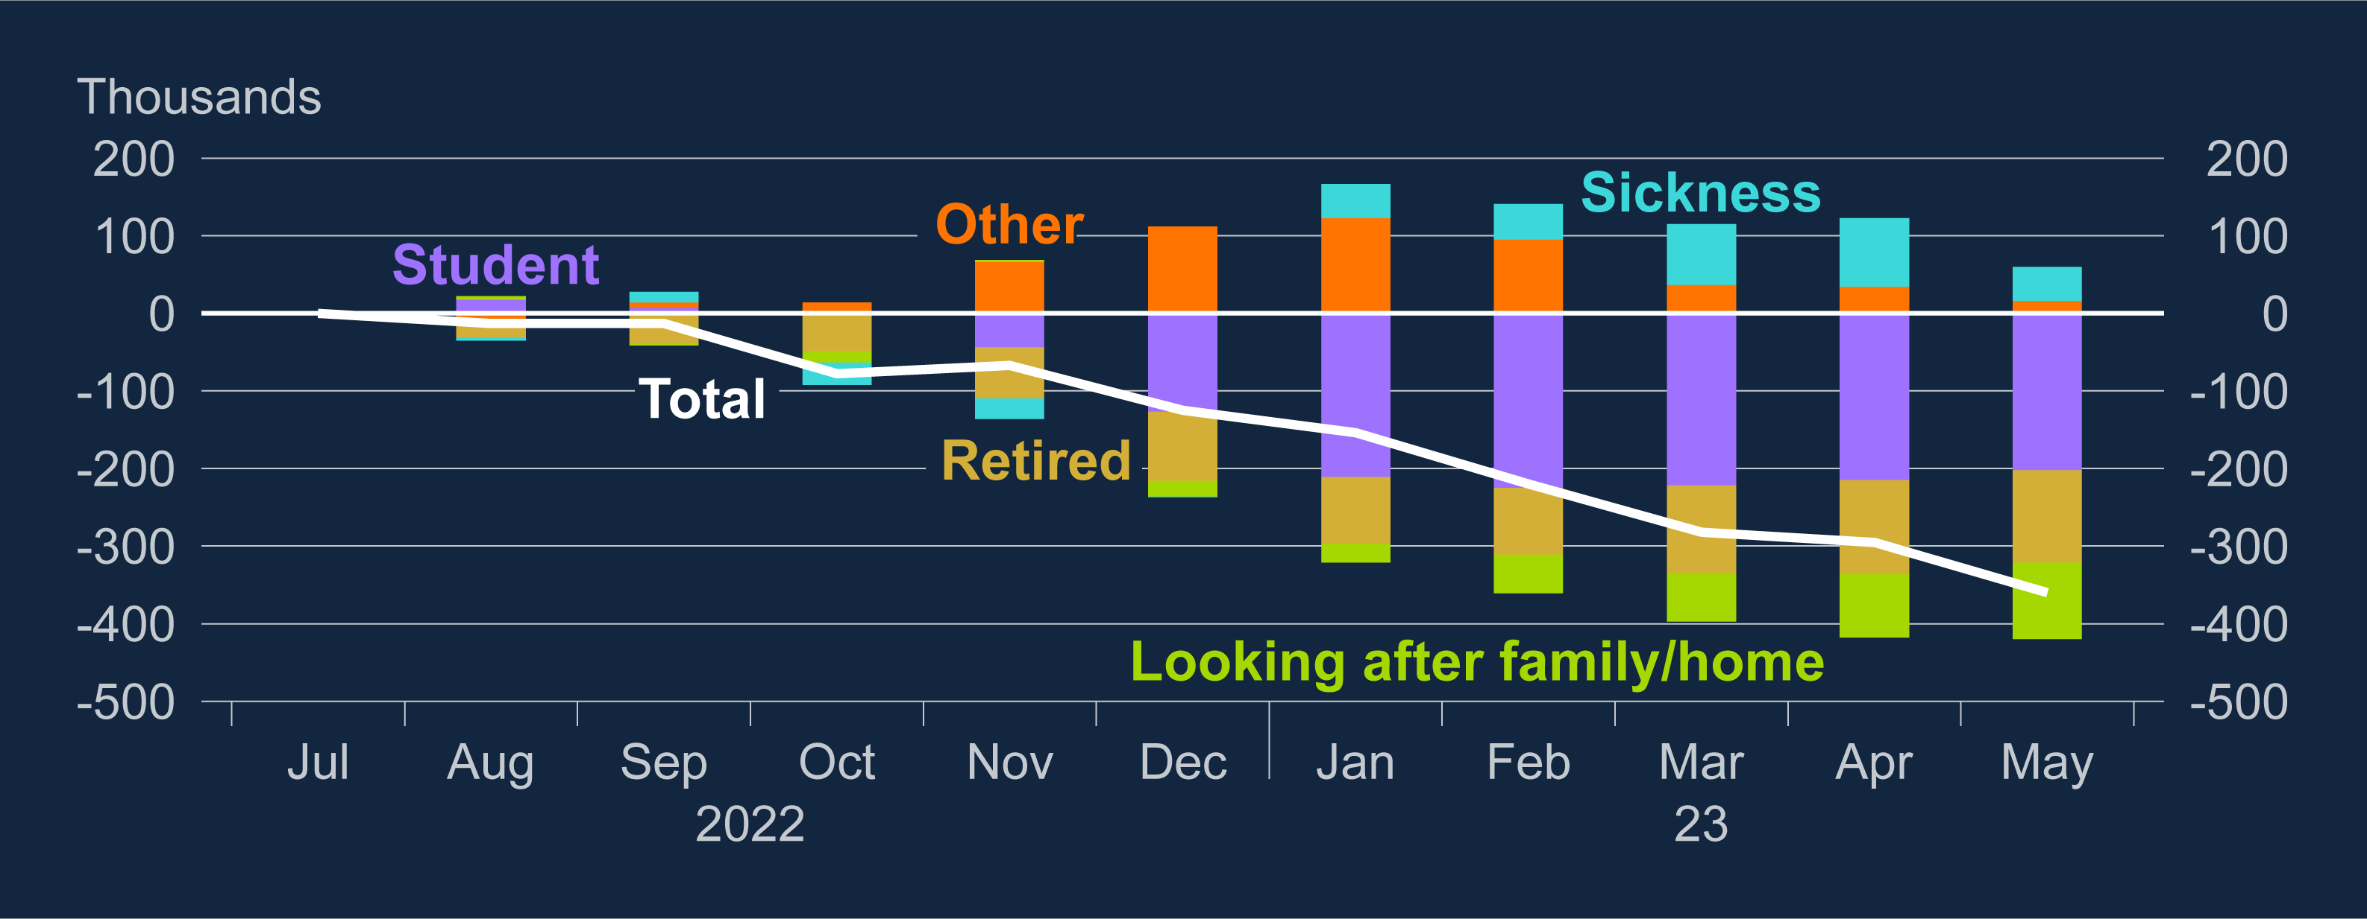
Labour force participation continues to improve, although more working-age people report sickness is preventing them from working
Change in inactivity since July 2022 by reason^{(a)}
Sources: ONS and Bank calculations.
Notes:
(a) Changes from the three months to July 2022, based on those aged 16–64. Other reasons include: discouraged workers; those awaiting the results of a job application; have not yet started looking for work; do not need or want employment; have given an uncategorised reason; or have not given a reason. Sickness includes both those long-term and temporarily sick.

Slide 9
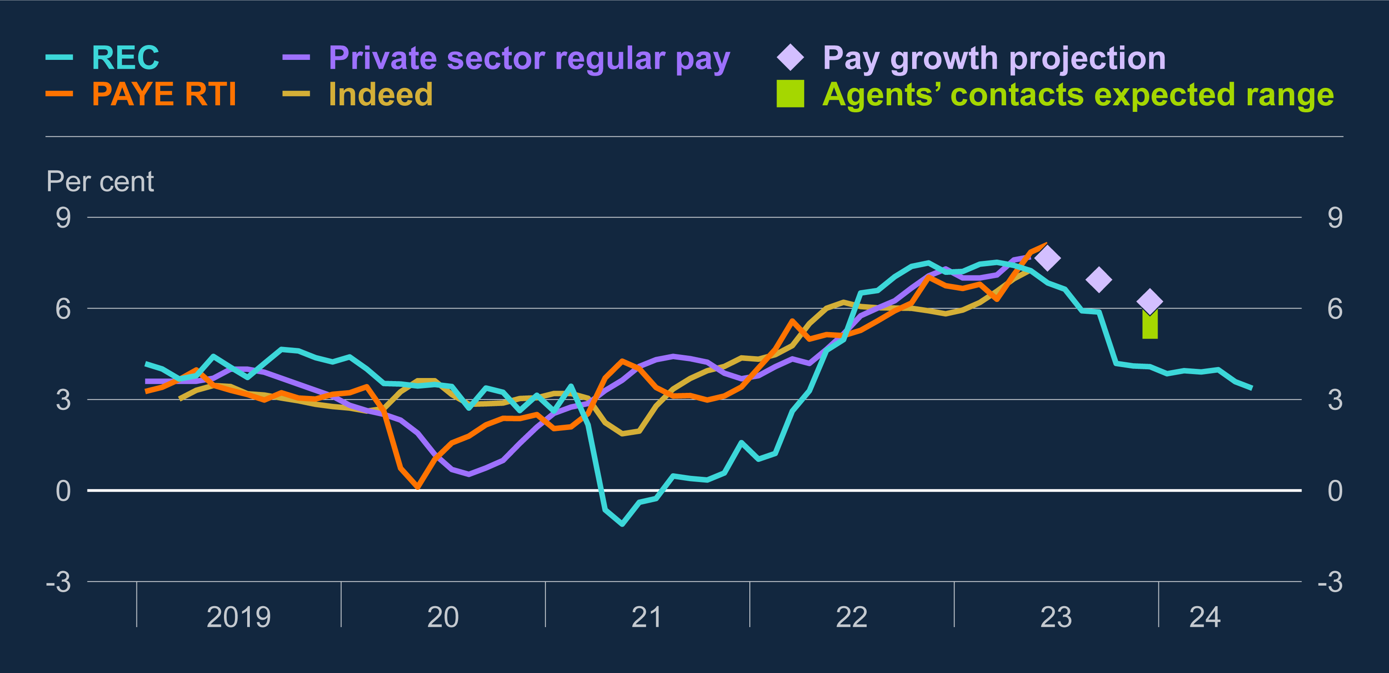
Private sector regular pay growth was 8.1% in 3 months to June but forward-looking indicators suggests growth will slow this year
Measures of annual wage growth^{(a)}
Sources: Indeed Hiring Lab, KPMG/REC/S&P Global UK Report on Jobs, ONS and Bank calculations.
Notes:
(a) Definitions of wage growth vary between each of the measures. Private sector regular pay growth is Bank staff’s estimate of underlying pay growth between January 2020 and November 2022 and ONS private sector regular pay growth otherwise. REC shows average starting salaries for permanent staff compared to the previous month. Pay as You Earn (PAYE) Real Time Information (RTI) shows median of employee pay growth. Indeed shows annual average job title matched pay growth for UK job vacancies. The REC index is mean-variance adjusted to ONS private sector regular pay growth over March 2001–19 and is advanced by 12 months, which coincides with the greatest correlation with private sector regular pay growth. Latest data points are June 2023 for Indeed, PAYE RTI and the REC index, and the three months to May 2023 for private sector regular pay.

Slide 10
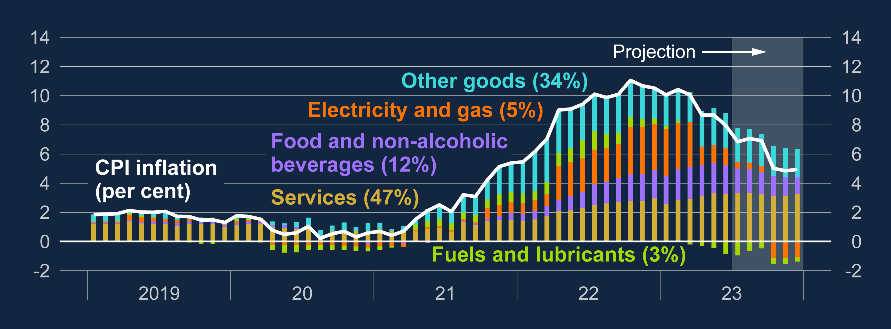
Consumer price inflation has fallen since last year’s peak and is projected to fall further
Contributions to CPI inflation^{(a)}
Sources: Bloomberg Finance L.P., Department for Energy Security and Net Zero, ONS and Bank calculations.
Notes:
(a) Figures in parentheses are CPI basket weights in 2023. Data to June 2023. Bank staff projections from July to December 2023. Fuels and lubricants estimates use Department for Energy Security and Net Zero petrol price data for July 2023 and then are based on the sterling oil futures curve.

Slide 11
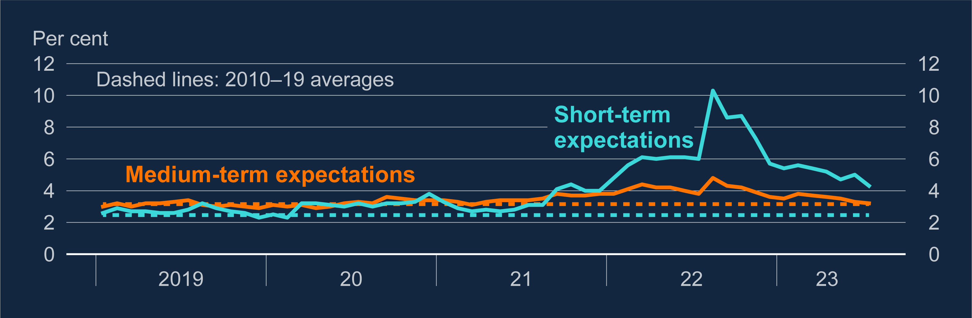
Household inflation expectations have fallen back from the peak in 2022
Household inflation expectations^{(a)}
Sources: Citigroup, YouGov and Bank calculations.
Notes:
(a) Data are not seasonally adjusted. ‘Short-term expectations’ refers to expectations in the next 12 months and ‘medium-term expectations’ refers to expectations five to ten years ahead. The household surveys ask about expected changes in prices but do not reference a specific price index. Summarised as a weighted median. The latest data points are for June 2023.

Slide 12
Main Forecasts

Slide 13
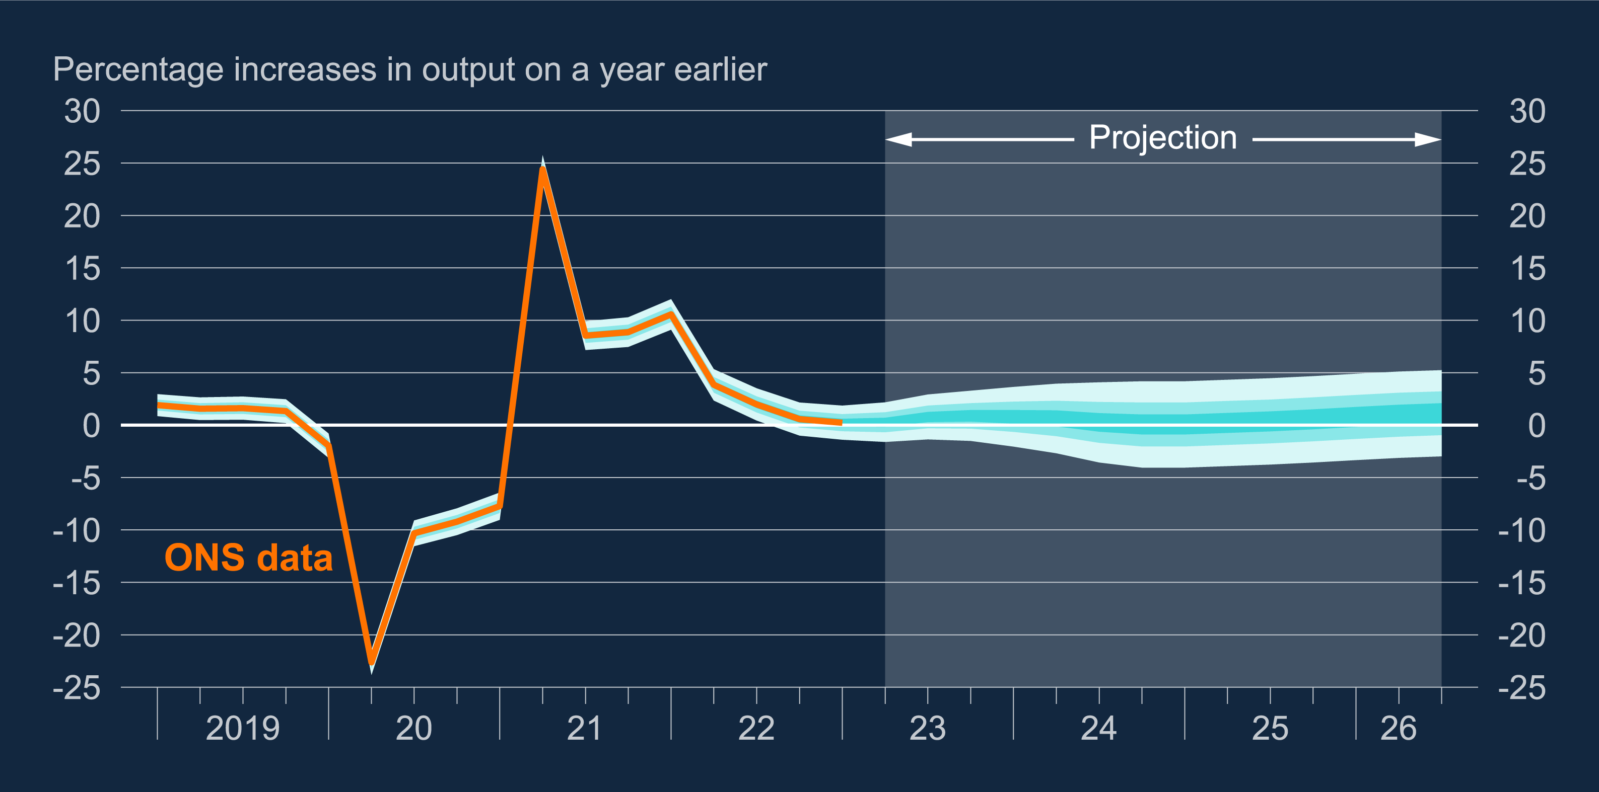
GDP growth projection
½
¼
1.1
Notes:
The fan chart depicts the probability of various outcomes for GDP growth. It has been conditioned on Bank Rate following a path implied by market yields, but allows the Committee’s judgement on the risks around the other conditioning assumptions set out in Section 1.1, including wholesale energy prices, to affect the calibration of the fan chart skew. To the left of the shaded area, the distribution reflects uncertainty around revisions to the data over the past. To the right of the shaded area, the distribution reflects uncertainty over the evolution of GDP growth in the future. If economic circumstances identical to today’s were to prevail on 100 occasions, the MPC’s best collective judgement is that the mature estimate of GDP growth would lie within the darkest central band on only 30 of those occasions. The fan chart is constructed so that outturns are also expected to lie within each pair of the lighter aqua areas on 30 occasions. In any particular quarter of the forecast period, GDP growth is therefore expected to lie somewhere within the fan on 90 out of 100 occasions. And on the remaining 10 out of 100 occasions GDP growth can fall anywhere outside the aqua area of the fan chart. Over the forecast period, this has been depicted by the grey background. See the Box on page 39 of the November 2007 Inflation Report for a fuller description of the fan chart and what it represents.

Slide 14
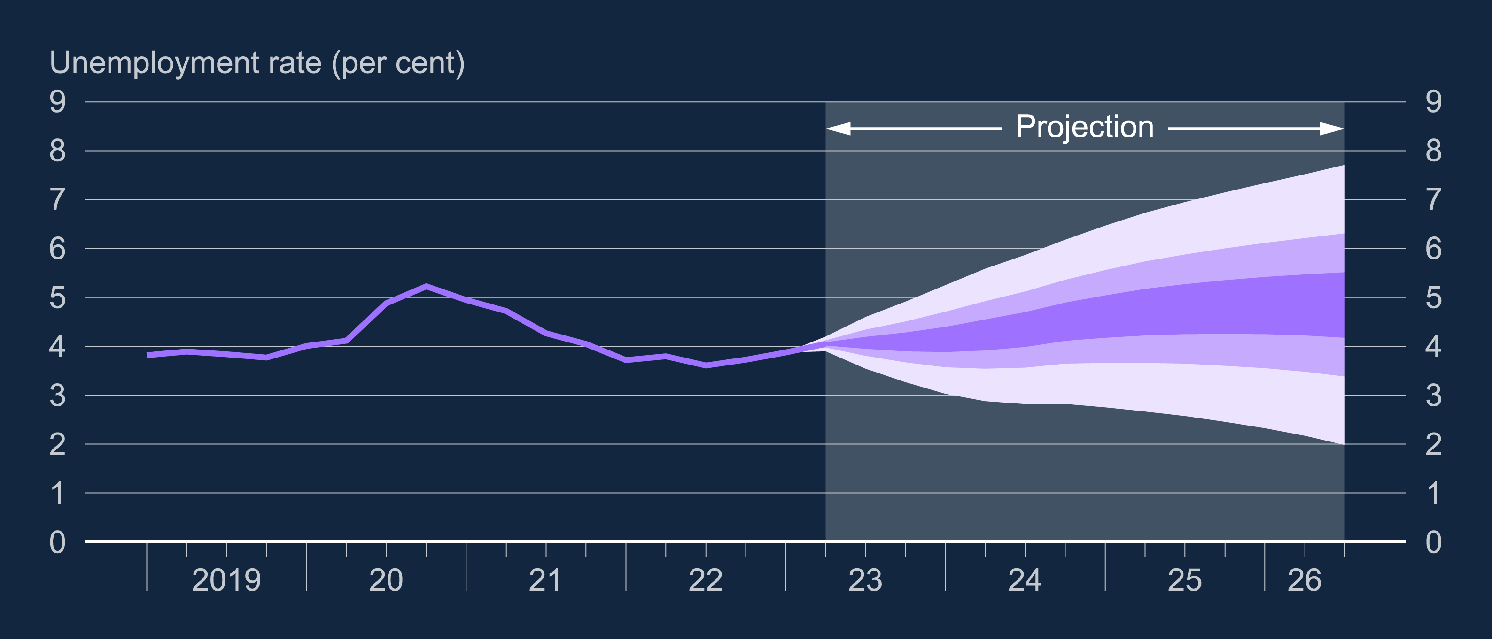
Unemployment rate projection
4 ½
4 ¾
4.8
Notes:
The fan chart depicts the probability of various outcomes for LFS unemployment. It has been conditioned on Bank Rate following a path implied by market yields, but allows the Committee’s judgement on the risks around the other conditioning assumptions set out in Section 1.1, including wholesale energy prices, to affect the calibration of the fan chart skew. The coloured bands have the same interpretation as in Chart 1.1, and portray 90% of the probability distribution. The fan begins in 2023 Q2, a quarter earlier than for CPI inflation. That is because Q2 is a staff projection for the unemployment rate, based in part on data for April and May. The unemployment rate was 4.0% in the three months to May, and is projected to remain at that level in Q2 as a whole. A significant proportion of this distribution lies below Bank staff’s current estimate of the long-term equilibrium unemployment rate. There is therefore uncertainty about the precise calibration of this fan chart.

Slide 15
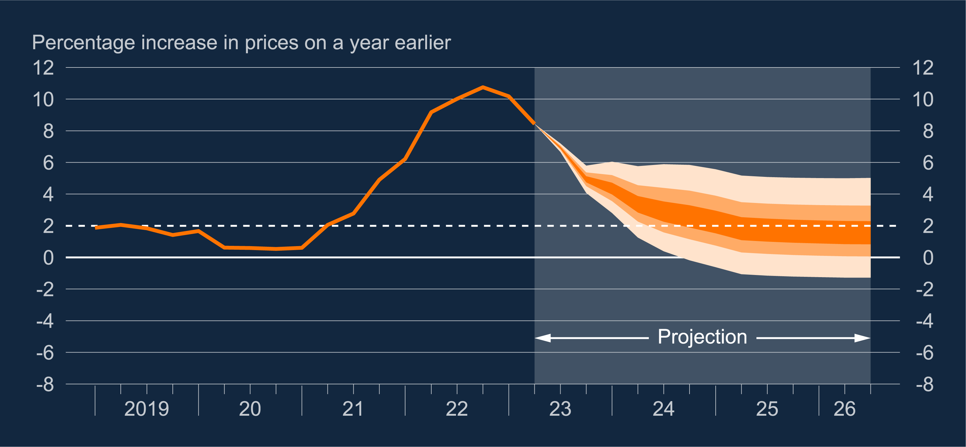
CPI inflation projection
2 ½
1 ½
1 ½
Notes:
The fan chart depicts the probability of various outcomes for CPI inflation in the future. It has been conditioned on Bank Rate following a path implied by market yields, but allows the Committee’s judgement on the risks around the other conditioning assumptions set out in Section 1.1, including wholesale energy prices, to affect the calibration of the fan chart skew. If economic circumstances identical to today’s were to prevail on 100 occasions, the MPC’s best collective judgement is that inflation in any particular quarter would lie within the darkest central band on only 30 of those occasions. The fan chart is constructed so that outturns of inflation are also expected to lie within each pair of the lighter orange areas on 30 occasions. In any particular quarter of the forecast period, inflation is therefore expected to lie somewhere within the fans on 90 out of 100 occasions. And on the remaining 10 out of 100 occasions inflation can fall anywhere outside the orange area of the fan chart. Over the forecast period, this has been depicted by the grey background. See the Box on pages 48–49 of the May 2002 Inflation Report for a fuller description of the fan chart and what it represents.

Slide 16
Interest rates and impact on activity

Slide 17
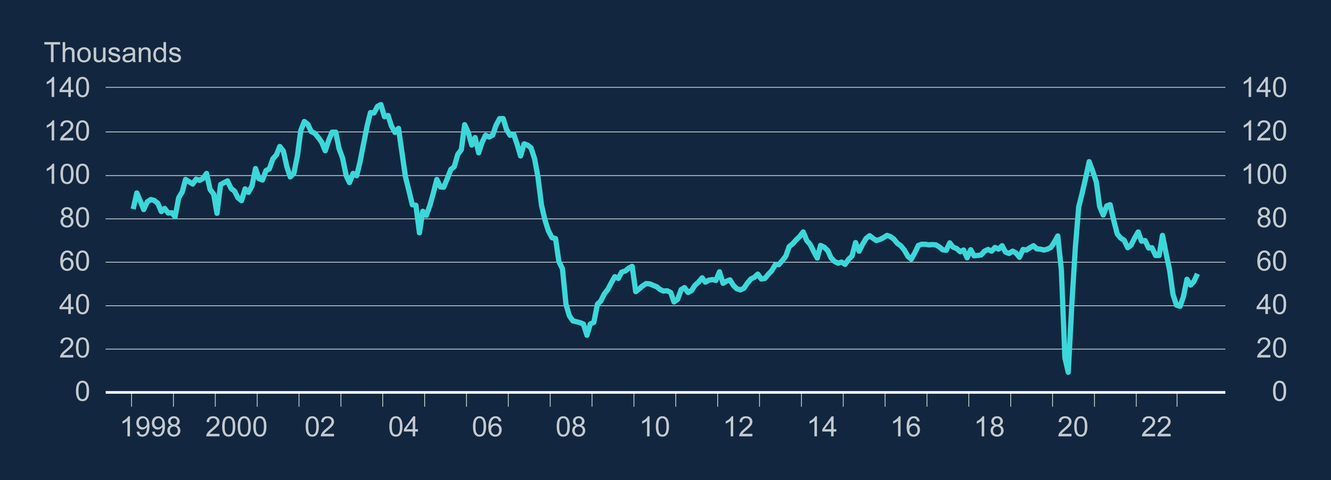
The number of mortgage approvals has fallen
Mortgage approvals for house purchases

Slide 18
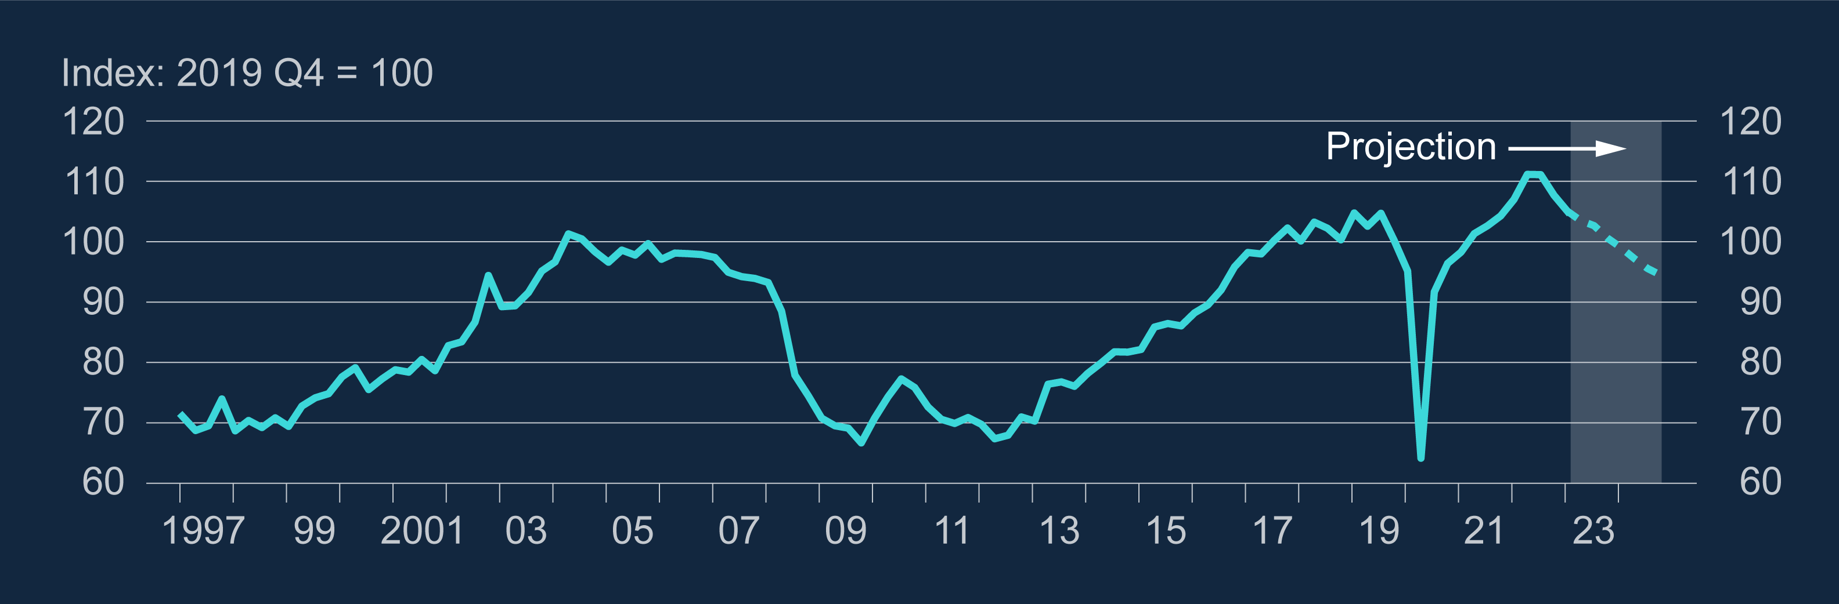
Housing investment is falling, which is projected to continue
Real housing investment^{(a)}
Sources: ONS and Bank calculations.
Notes:
(a) The last data outturn is 2023 Q1. The last data point for the forecast is 2024 Q4.

Slide 19
Some of the other ways in which higher rates affect the economy…
Business investment: Higher interest rates are weighing on business investment, which has not grown since 2022 Q2.
Exchange rate: Rate increases cause the pound to appreciate, making imports cheaper and exports more expensive. Net trade falls, affecting activity. But also, cheaper imports reduce UK inflation.

Slide 20
Welcome
Aims of the 1947 Club
• Furtherance of Social and Professional Contacts
• Providing assistance to Branch RICS Matrics & 1947 Club NextGen
• Preservation of the history and tradition of the 1947 Club
Are you a Chartered Surveyor and interested in becoming a Member of the 1947 Club? – contact a Committee member or send a message through LinkedIn
www.the1947club.co.uk

