Slide 1
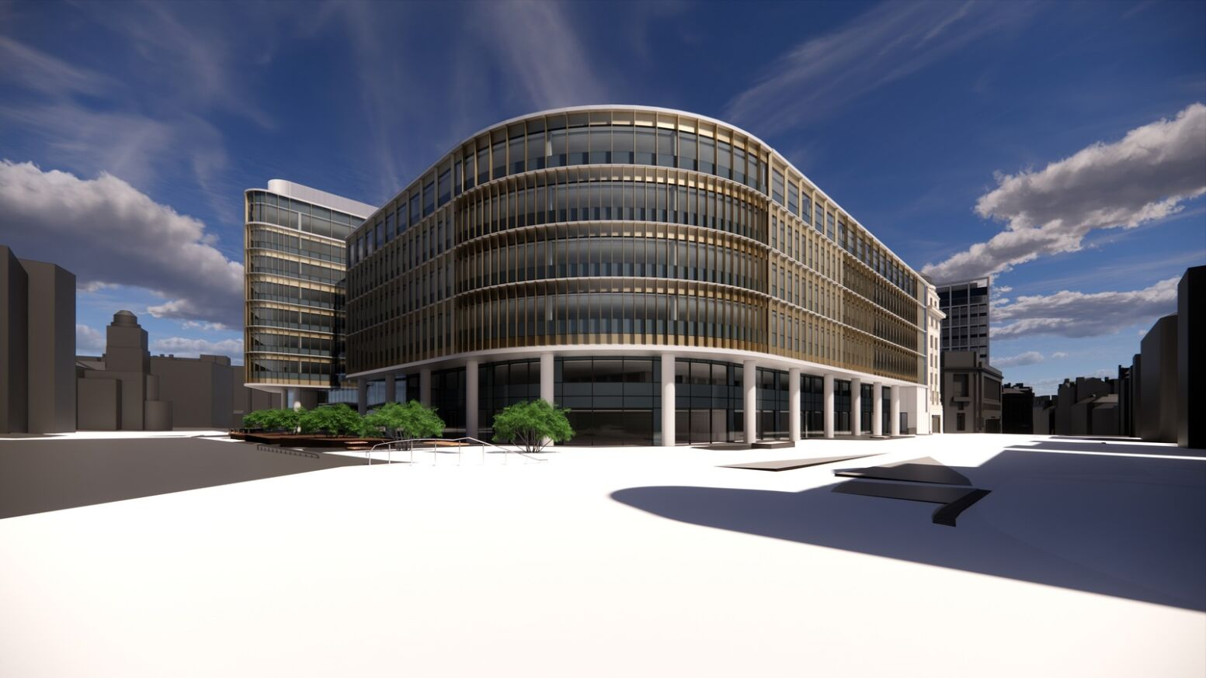
Pilgrims Quarter
How did we get here

Slide 2
Objective(s)
HMRC’s Strategy
THE Existing Estate
Our requirement
Process we followed
How we arrived at our decision
What Pilgrims Quarter gives us

Slide 3
HMRC’s Regional Centre Strategy
Provide our staff with modern & flexible working environments for the future
City Centre location - Good links to public transport and close proximity to amenities
Create greater collaboration across Lines of Business
Deliver greater opportunities for career development and recruitment.
Wider Governments estate strategy:
Regeneration of brownfield sites
Economic spend for local businesses – benefit to local economy
Sustainability in build design - construction playbook specification, inclusive design guide, built to BREEAM excellent etc.
Tackling economic inequality
Fighting climate change – driving greater use of public transport and reducing carbon emissions
Meeting government agendas including;
Levelling up/Build back better
Net zero carbon considerations
Commitment to social mobility and social value
Social value

Slide 4
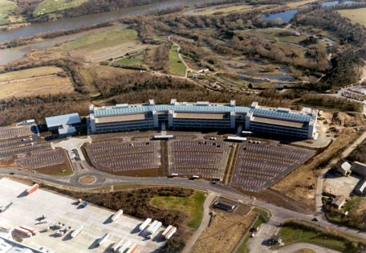
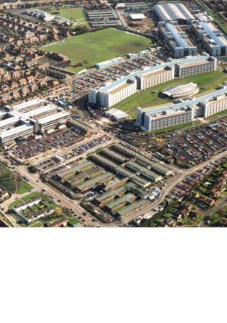
Moving from two sites – Benton Park View (Newcastle) and Waterview Park (Washington) – to a new purpose-built single building Pilgrims Quarter

Slide 5
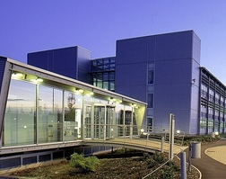
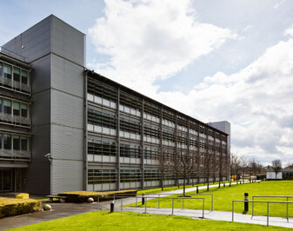
Existing Estate
Part of a PFI Agreement
No security of tenure (outside L&T 1954) – occupied under a series of Occupancy Agreements (OA’s) – one for each building
Expiry of OA staggered across sites/locations – starting January 2025 to October 2029
Expiry of OA dependent upon completion of construction and handover commensurate from January 2000 – October 2004
Ability to extend PFI – charge based on 50% of City Centre Rents – or negotiate new lease

Slide 6
Existing Estate - Longer Term Suitability
Existing infrastructure approaching or near to end-of-life necessitating costly replacement with associated works to do so
Provides for more space than we require – NIA of 85,603m²/921,423ft² at Benton Park View alone
Adaptability/Alignment to new design standards;
Inclusive design
Ceiling heights
Void space
Access to natural light etc.
Proximity to public transport and amenities – ongoing reliance on cars as means of transport

Slide 7
Our Requirement
Space for circa 9,000 full time equivalents i.e. staff
Office space of 54,000m² (NIA) equivalent to 6m² per FTE
Later revised down to 43,000m² (NIA) equivalent to 4.5m² per FTE following lessons learned exercise
Parking for blue badge holders and official vehicles
Good accessibility to public transport and amenities
Design and build in line with Government/HMRC guidance
25-year lease terms with break
Ready for service date to align with expiry of existing arrangements at Benton Park View and Waterview Park

Slide 8
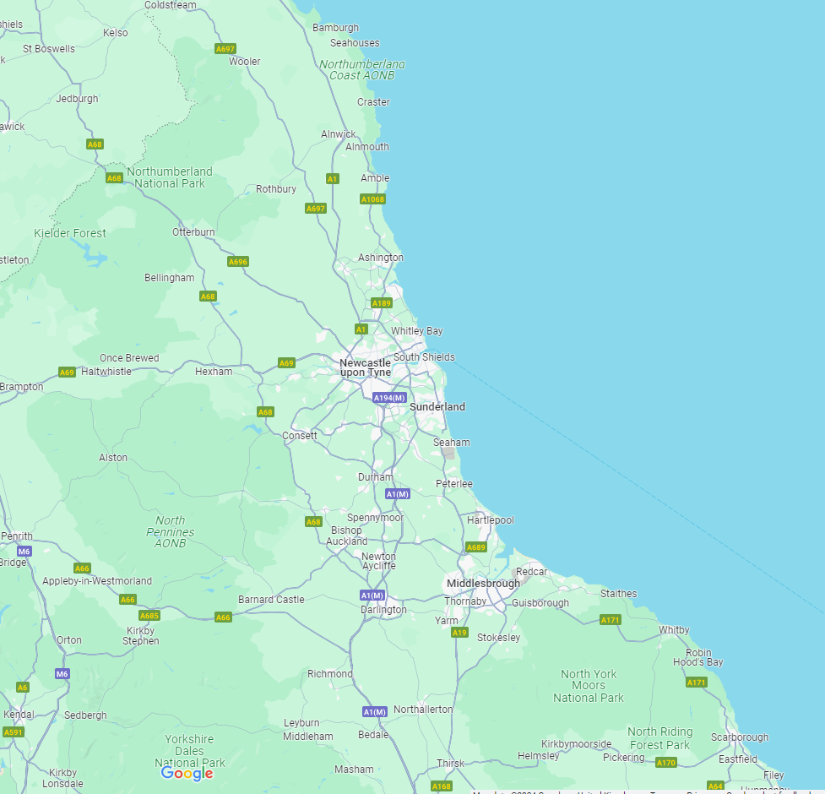
Process
Desk top search led by our agents
Search through-out the North East - not simply focused on Newcastle
Size of requirement impacted search – largely new builds
Campus approach or single building
Review results of search to shortlist
Issued Request for Proposal(s) together with design guidance
Non-Disclosure Agreements to ensure confidentiality and avoid information leaking to staff

Slide 9
Process (cont)
Evaluated responses to RFP’s – qualitative criteria given greater precedent
Evaluators provided the technical expertise – legal/commercial experts on due diligence & transaction, construction capability, commercial checks on developer/entities, internal design team, finance etc.
Second round of shortlisting to two schemes (retain competitive tension)
Detailed round of workshops with both parties to;
Ensure requirements understood/providing clarifications
Design proposals reflect these
Identify and agree derogations etc.
Negotiation of draft terms
Invitation to submit final proposals
Final round of evaluation to selected preferred and reserve options
Submission(s) for internal approvals – Ministerial/HM Treasury

Slide 10
How we arrived at our decision
Detailed round of workshops with both parties to;
Ensure requirements understood/providing clarifications
Design proposals reflect these
Identify and agree derogations etc.
Negotiation of draft terms
Invitation to submit final proposals
Final round of evaluation to selected preferred and reserve options
Pilgrims Quarter best met our requirement criteria
Submission(s) for internal approvals – Ministerial/HM Treasury

Slide 11
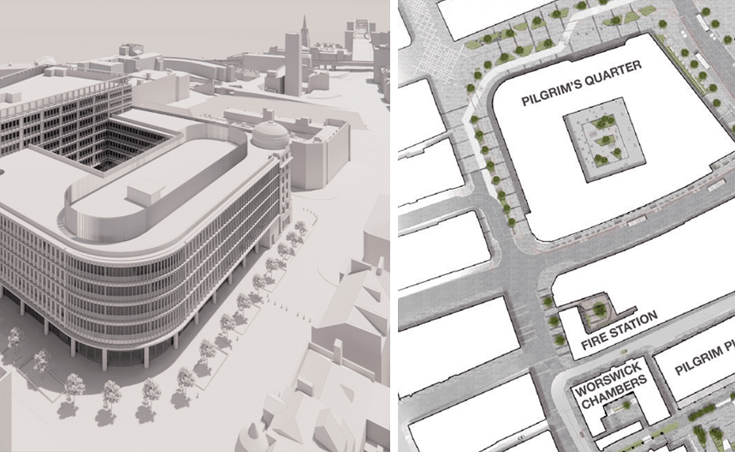
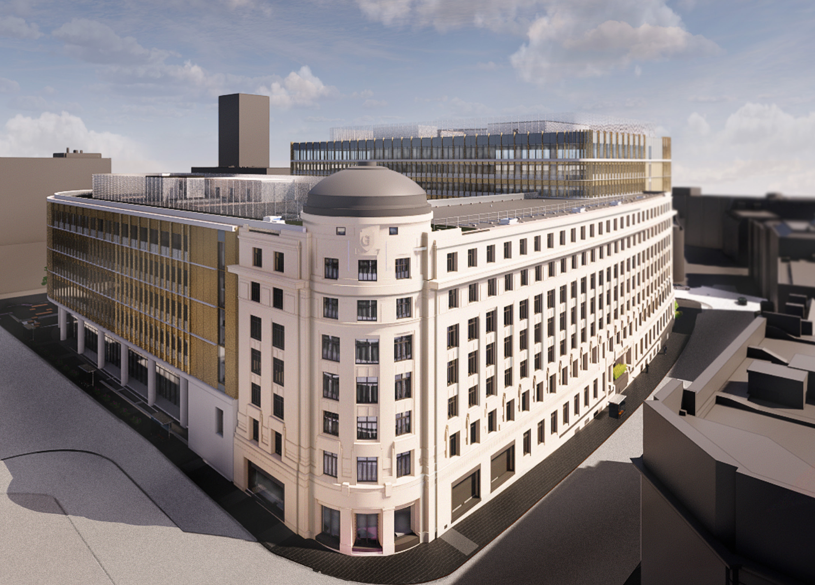
What Pilgrims Quarter gives us
Provides a cost-effective solution meeting longer term office requirement – ready for 2027 in line with expiry of existing arrangement
43,000m² (NIA) of office space
Single location for circa 9,000 HMRC staff plus a number of smaller Government Departments
Provides staff with close-proximity to public transport and amenities – ease of access
Delivers wider regional economic benefits – increased footfall etc.

Slide 13
Questions?

