Slide 1


Welcome
Thank you for joining. The event will begin shortly
Aims of the 1947 Club
• Furtherance of Social and Professional Contacts
• Providing assistance to Branch RICS matrics
• Preservation of the history and tradition of the 1947 Club

Slide 2




How To Maximise Land Values and Biodiversity Net Gains Through Strategic Use of Soil Surveys and Analysis
Presented by
Lauren Manning
Principal Consultant, Roberts Environmental
Vicki Mordue
Managing Director, Biodiverse Consulting

Slide 3
What is Soil?
For the purpose of this presentation, we refer to ‘soil’ in terms of:
Natural soil, eg mineral soil, such as clay or silt; OR,
Artificially derived soils, eg Made Ground or disturbed/engineered natural soils
Soil is a finite resource, which should be treated as such.
Government policy and guidance documents now encourage the protection and suitable handling of soils during construction works to maximise the potential of the material for reuse on or off site.
Soil is an asset - How can we maximise land values?
Biodiversity Net Gain Units and land banks could create revenue for undeveloped land.

Slide 4
Available Geo-Environmental Tools
Phase 1 Geo-Environmental Assessments
Coal Mining Risk Assessment (CMRA)
Phase 2 Geo-Environmental Investigations
Detailed Quantitative Risk Assessment (DQRA)
Remediation Strategy
Materials Management Plans (MMPs)
Verification Inspections
Validation Reporting
Agricultural Land Classification surveys (ALCs)
Soil Resource Surveys (SRSs)
Soil Management Plans (SMPs)

Slide 5
Soils Analysis Techniques – What Can We Learn?
Techniques
Agricultural Land Classification (ALC) Surveys
Land Quality/Land Contamination Assessments
Soil Resource Surveys (SRSs)
Biodiversity Net Gain (BNG) Assessments
Soil Management Plans
Opportunities
Assess land value/worth
Regulatory/legislator compliance
Create new/improved habitats
Assess potential for BNGs
Create Habitat Banks?
Find/create BNG Units to sell?
Increase land value?

Slide 6
Soil Resources – Joined Up Thinking
Agricultural Land Classification/
Soil Resource Surveys
THE KEY AIM
How can we enhance land ‘value’?
Soil Management
Plans
Biodiversity
Net Gain

Slide 7
Agricultural Land Classification (ALC) Surveys – What are they?
Pre-1988 surveys conducted at national scale (1:250,000)
Grades split across 1 – 5, with Sub-grade 3a/3b added after 1976
Determination of site-specific ALC Grade – detailed (post-1988) survey
Intrusive survey required for planning in accordance with MAFF and Natural England TIN049, BSSS Consultant recommended
Entire development site/land to be surveyed
What is the most limiting factor for the site soils and what grade does this give the land?
  Description of soil profile
  Limitations on soil type? Eg wetness, droughtiness, stoniness
  Site-wide limitations? Eg climate, shallow rock, topography
Soil/ALC Grade pattern provided on accompanying maps

Slide 8
Agricultural Land Classification (ALC) Surveys – Why do we need them?
NPPF/DMPO/Planning requirement
Pre-1988 (1:250,000 scale) mapping only used for indicative/strategic use
Determination of ALC Grade – is the land ‘BMV’ (Best and Most Versatile – NPPF Footnote 58)
  BMV land classed as ALC Grades 1, 2 and 3a
  Current estimates indicate ~21% of farmland in England is Grades 1+2, another ~21% is Grade 3a
Is the site suitable for development?
Remove BMV land from planning proposals/BNG proposals
Determine the available soil resources/revenue sources
Put a value on the land – can we increase the ALC Grade/value with an ALC survey?
Is the land valuable in terms of BNG potential (Units)?

Slide 9
Soil Resource Surveys (SRSs) – What are they? Why do we need them?
Outline available soil resources with spatial distribution on the site
Carry out soil nutrient (Mg/P/K) / suitability (organic matter etc) testing
Inform site Soil Budget
  Identifies useful soil resources
  Identifies possible future ‘waste’/surplus soil
Use to calculate land value
  Monetary
  BNG credits?
  Habitat bank?
Repurposing land - potential income streams
  Sell soil/materials
  BNG credits?
  Habitat bank?

Slide 10
Soil Management Plans (SMPs) – What are they? Why do we need them?
Outline how soil can be managed on site to ensure the soil resource is not damaged during construction works
Information required:
  ALC / SR survey - to create a soil budget
  Soil chemical testing – to confirm suitability for use
  Topographic survey / proposed site plans
Assist with budget development / Soil Budget
  Identifies useful soil resources
  Identifies possible future ‘waste’/surplus soil
Feeds into design of build programme
Earthworks design
Planning requirement

Slide 11
Key Considerations
Agricultural Land Classification
Determine ALC grade of land across a farm/landholding
Mapping tool
Highlight BMV land – maintain for farming
  Increase land value
Identify non-BMV land – chance to diversify?
  Habitat Bank creation
  BNG Units to sell
Soil Resource Survey
Determine soil resources available across a farm/landholding
Mapping tool
Baseline data set – site limitations, future problems
Assess potential for BNGs
  Create new/improved habitats
  Create Habitat Banks
  Find/create Units to sell
Potential income streams
Monitoring survey

Slide 12
WHAT IS BIODIVERSITY NET GAIN?
The Basics!
  Takes habitat information from field surveys
  Plugs it into a metric
  The output is quantified into “Biodiversity Units”
  Information on post construction landscape plugged into metric
  2 elements pulled together to establish whether development will be positive or negative and by how much.
  Each Unit has a monetary value.
  Allowing a means to speak the language of developers!
Simply put, ‘Biodiversity Net Gain is development that leaves biodiversity in a better state than before,’ CIEEM 2018

Slide 13

WHY BNG?
THE SIXTH MASS EXTINCTION
    Nature in the UK is still seriously declining: We are already one of the most nature-depleted countries in the world.
    ‘The UK itself has lost much of its wildlife, ranking 189th for biodiversity loss out of 218 nations in 2016,’ London Zoological Society 2018
    The UK has now legally binding targets to halt species decline by 2030 and international targets in the Global Biodiversity Framework to protect 30% of land and seas by 2030

Slide 14
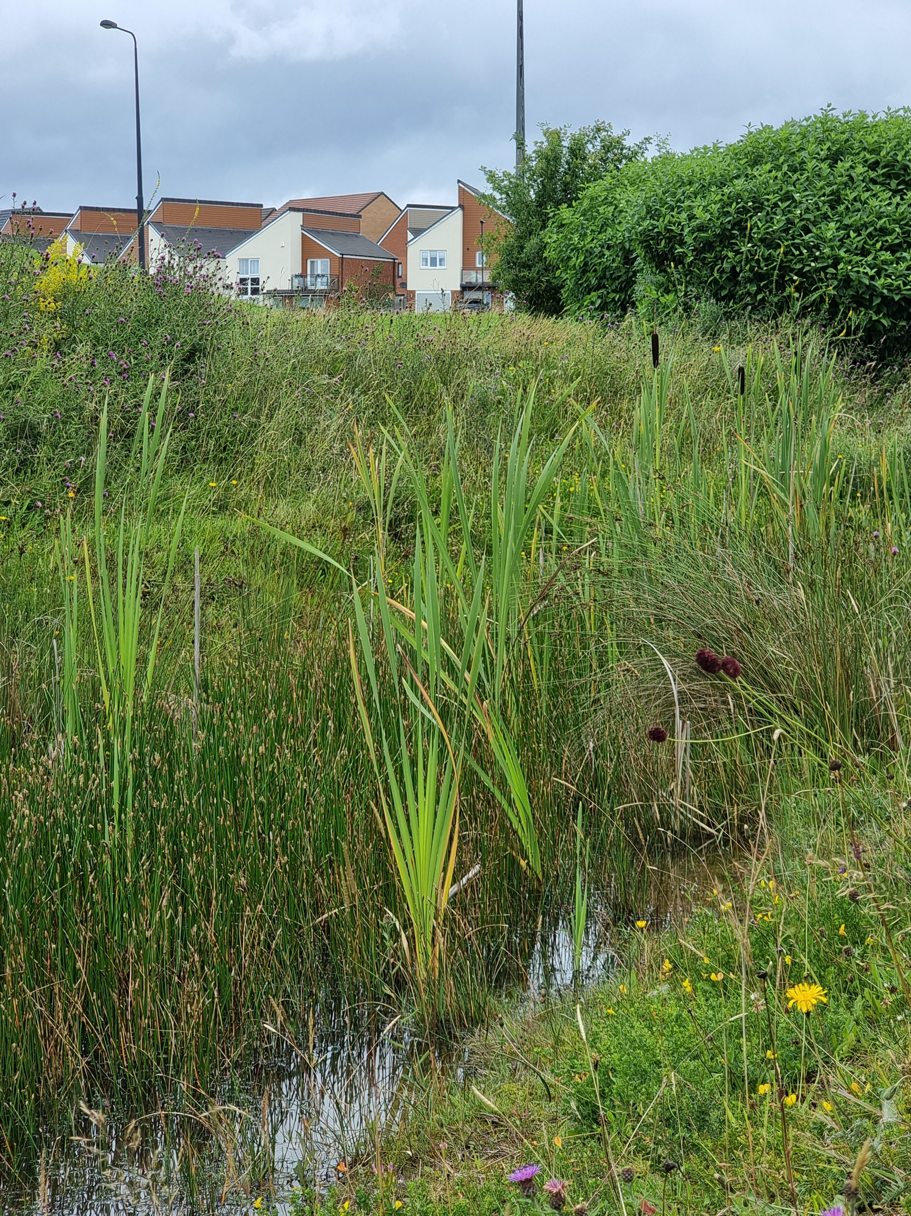
AS OF TODAY
Mandatory Net Gain: 12th February 2024
Small Sites: 2nd April 2024
NSIPS: November 2025 Guidance Published: September 2024
Biodiversity Regulations now live https://www.legislation.gov.uk/uksi/2024/47/contents/made
In England, biodiversity net gain is required under a statutory framework introduced by Schedule 7A of the Town and Country Planning Act 1990 (inserted by the Environment Act 2021).

Slide 15

STATUTORY FRAMEWORK FOR BIODIVERSITY NET GAIN HEADLINES
Under framework every planning permission granted will be granted subject to a general biodiversity gain condition i.e. “a 10% Gain as a pre-commencement condition”
Only applies to Applications made after 12th Feb

Slide 16
Desk Top Study
Appoint Ecologist
Is Site located within Local Nature Recovery Strategy or other Locally Significant Environmental corridor
Baseline Survey
Complete Survey within optimal time (May - Sept end)
Establish whether site cleared recently (Degradation issues)
Biodiversity Statement
Establishes whether a Biodiversity Gain Condition will be applied
Statutory Biodiversity Metric completed and submitted with baseline Habitat Map
PLANNING GRANTED
Biodiversity Gain Plan
Habitat Management & Monitoring Plan
Commence Project
Red Line Boundary of development provided
Agree Baseline Assessment Date with LPA
Report submitted at Planning Application Stage establishing Baseline Biodiverisity Value (Units) of site pre-planning (i.e. pre-works)
Pre-Commencement Biodiversity Gain Condition applied if:
Significant onsite BNG proposed
And/Or Biodiversity offsite required to achieve 10%
Biodiversity Gain Plan (BGP) sets out HOW Biodiversity Gain Objective (min 10%) achieved (template).
Includes information on how Biodiversity Mitigation Hierarchy followed & explains any deviations
Pre & Post Biodiversity Unit Value of site including Habitat Plans
Legal documentation evidencing securement of Registered Offsite Biodiversity Gain & Biodiversity Unit value inc. Statutory Credits
Finalised Metric
Required for "Significant" onsite Gains (which covers most things)
HMMP sets out HOW you will deliver, manage & monitor the Onsite gains proposed
Template available but don't have to use
Requires detail/evidence of whether Habitat type/condition is achievable
Submit BGP & HMMP to LPA for approval
LPA approves (possibly with additional requirements) and discharges condition
Works commence
LPA may require more detail depending on local requirements
REMEMBER PLANNING COMMITTEE FOIBLES
Check LPA requirements including at Pre-App.
BIODIVERSE’S STEP BY STEP GUIDE FOR DEVELOPERS

Slide 17
Work out your units
Price your units
Legally secure units
Find a buyer
Sell your units
Register your site
Record units to a development
Manage habitat
Appoint Ecologist
Is Site located within Local Nature Recovery Strategy or other Locally Significant Environmental corridor
Create and enhance habitats that are appropriate to your site conditions and are in demand
Unit providers set their own price
It is important to ensure that the pricing covers all of the costs to register, create, manage and monitor units over a minimum of 30 years
Planning obligation with the local authority (section 106) or conservation covenant with a responsible body (Natural England)
Prepare a Habitat Management and Monitoring Plan (HMMP) and agree this with the LPA or responsible body
Consult a land agent, broker or other consultant
Speak with the LPA
Speak with developers
Price and payment terms to be agreed between the provider and buyer
Developer may not want to complete the sale until they are confident their gain plan will be approved
Seek legal advice
Register your land as a biodiversity gain site on the national register operated by Natural England
Used to prevent double counting, is not a matchmaking service
Record the allocation of land to a development on the register
Units must be maintained for at least 30 years following the completion of habitat enhancement works as defined in your legal agreement
BIODIVERSE’S STEP BY STEP GUIDE FOR OFFSITE UNIT PROVIDERS

Slide 18
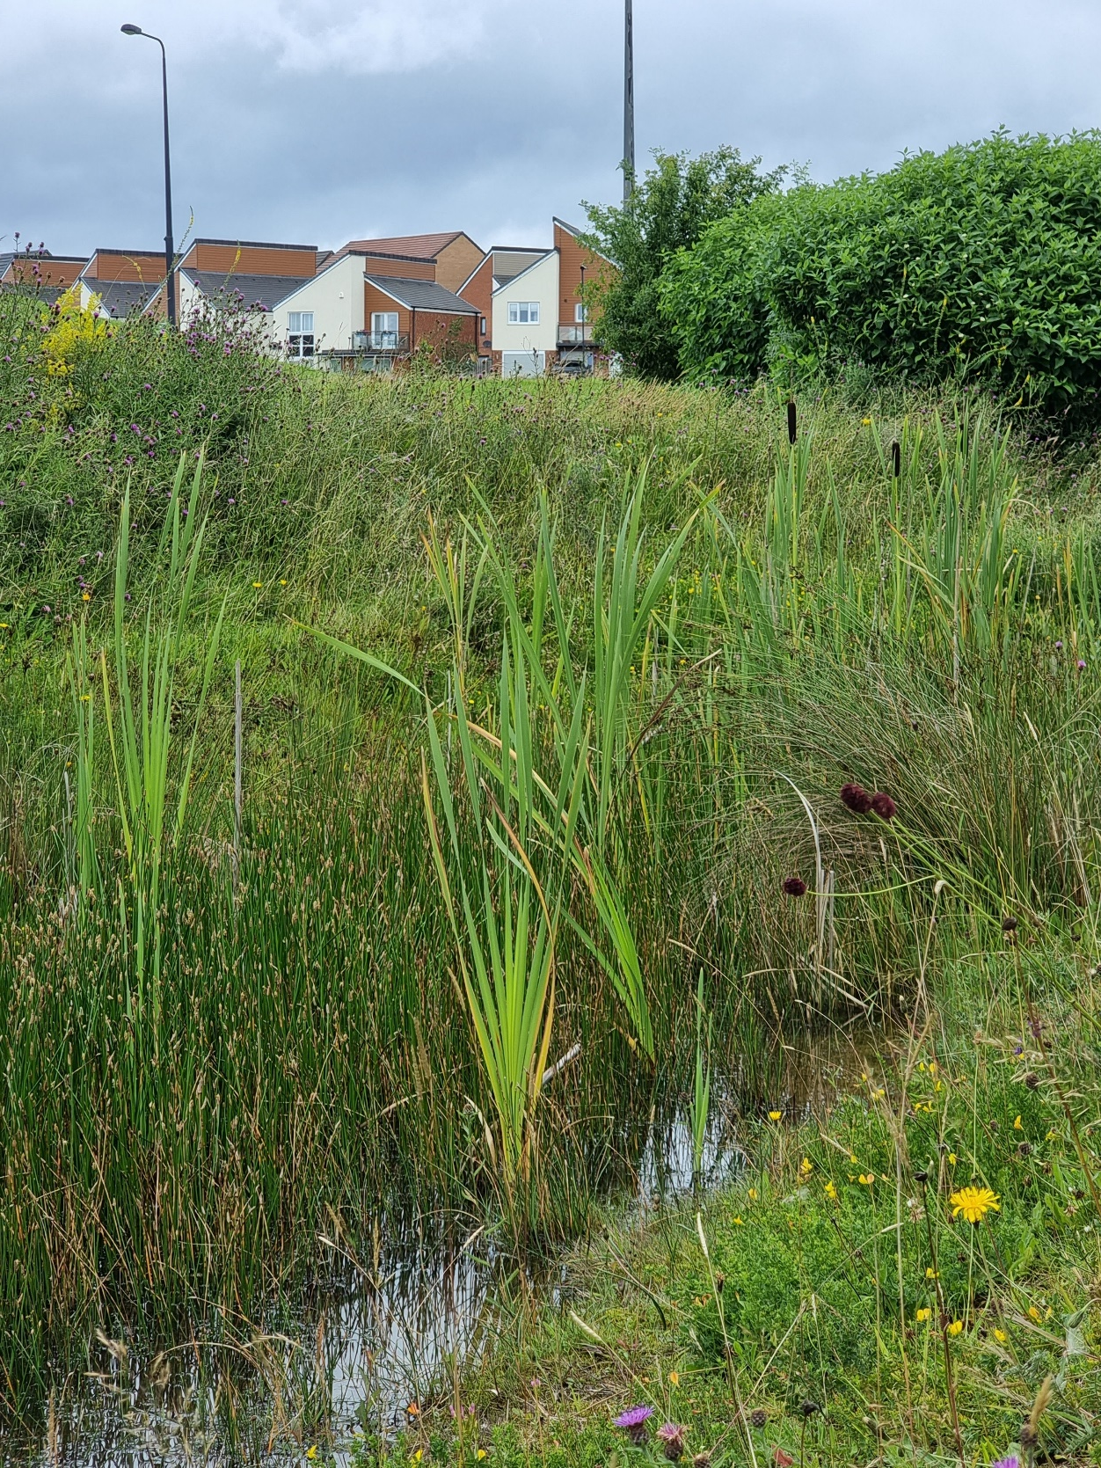
LANDOWNER DETAIL – STOP THE PRESS!!
Biodiversity Unit Price Alert
Guidance published in October states that landowners should “come up with a price for your units”.
Based on:
Management of the land covering at least 30 years
Monitoring and reporting
Ecologist or other experts’ costs
LPA’s enforcement costs
Insurance
Costs to cover work if the habitat fails
Machinery, tools and other staff to carry out the tasks
Inflation and market competition costs
The cost of experts to review your legal agreement
ROBGs need to agree payment terms i.e. lump sum, staged payment, results

Slide 19
What is a Biodiversity Unit??
Min. 10% for each!!
Remember Trading Rules..
“Like for Like or Better”
Biodiversity Unit (BU)
Habitat Unit (Area)
Hedgerow Unit
Watercourse Unit

Slide 20
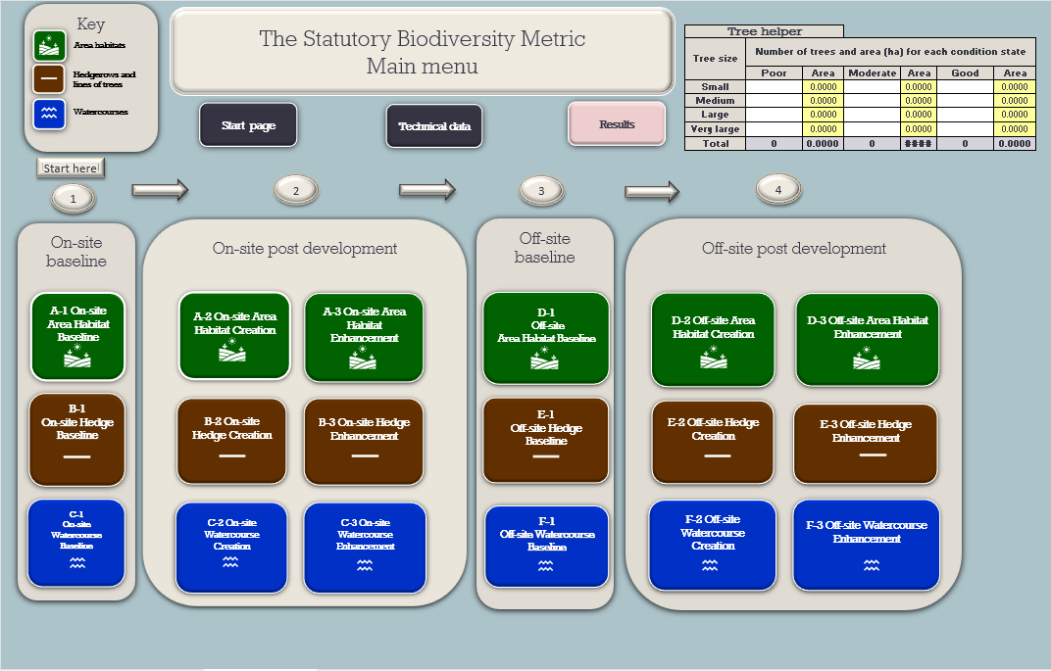
THE METRIC

Slide 21
The Metric Multipliers
BNG
LNRS
Condition (poor, fairly poor, moderate, fairly good, good)
Distinctiveness (low – very high & irreplaceable)
Strategic significance (Green Infrastructure corridors, wildlife corridors, Local Nature Recovery Strategy Area)
Spatial Risk (proximity to site)
Temporal Risk (when will you start creating/enhancing habitats)
Difficulty Risk (some habitats harder to create / establish than others)
Spatial Risk Multiplier 1BU onsite = 1BU offsite but within LPA or NCA = 1.5BU offsite but in neighbouring LPA or NCA = 2 BU beyond and nationally The Metric will favour Units created/gained within a LNRS area (15% increase)

Slide 22
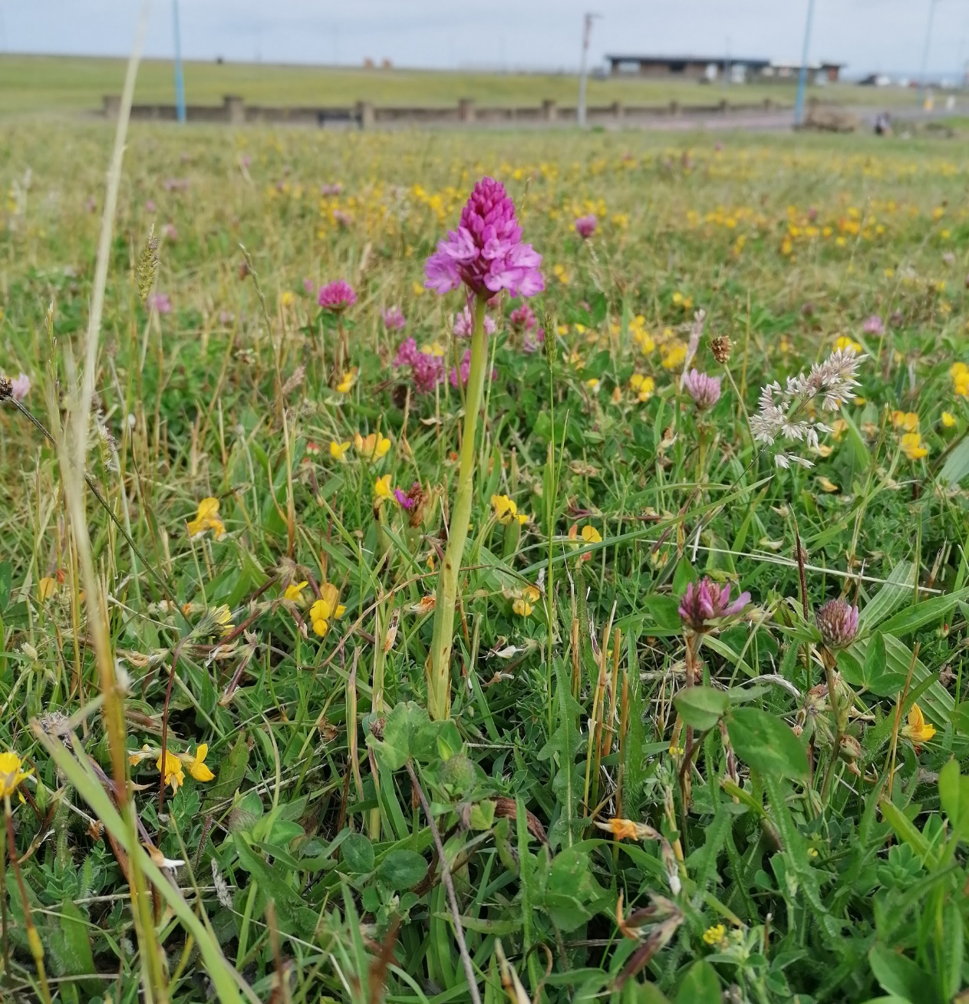
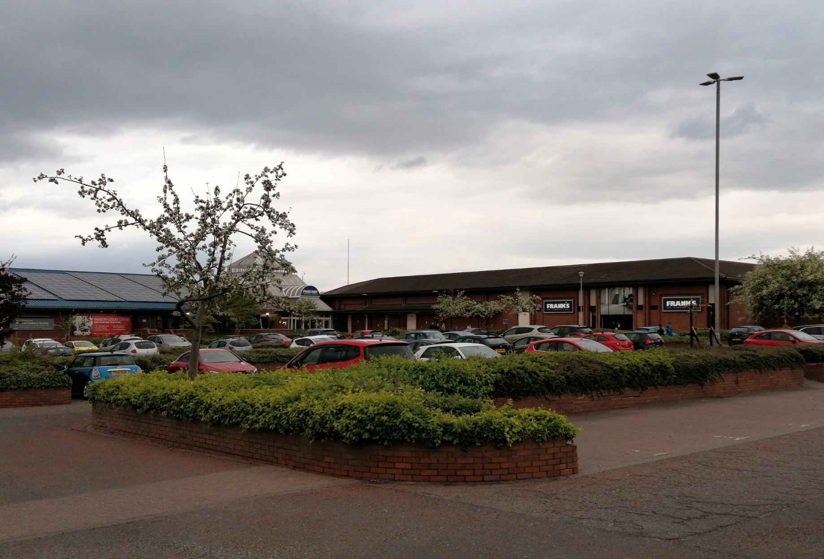
The Trading Rules – LIKE FOR LIKE OR BETTER
Rule 3: Trading rules are automatically applied by the metric and set the minimum habitat creation and enhancement requirements to compensate for specific habitat losses (up to the point of no net loss). These requirements are based on habitat type and distinctiveness.

Slide 23
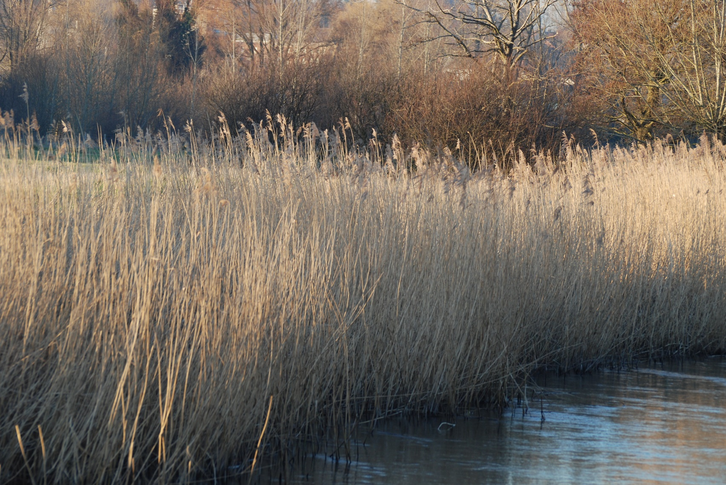
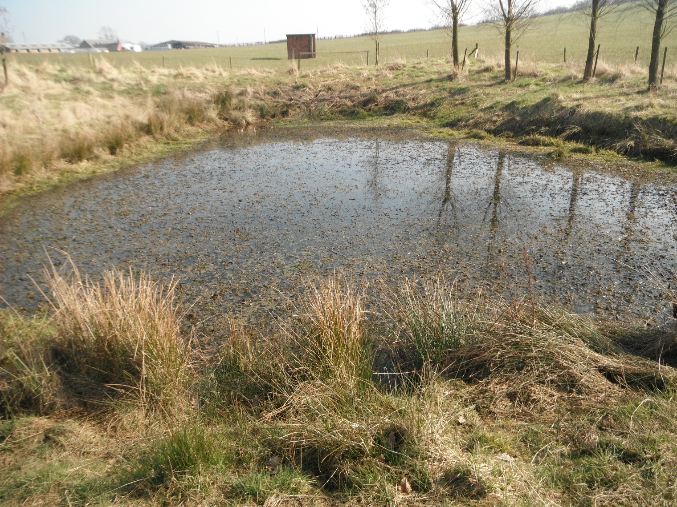
TRADE OR NOT TO TRADE??
No
Reedbed
Pond (non-priority)

Slide 24
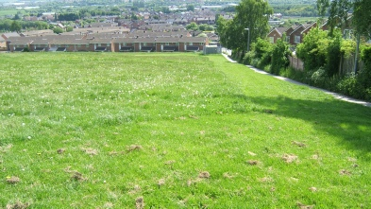
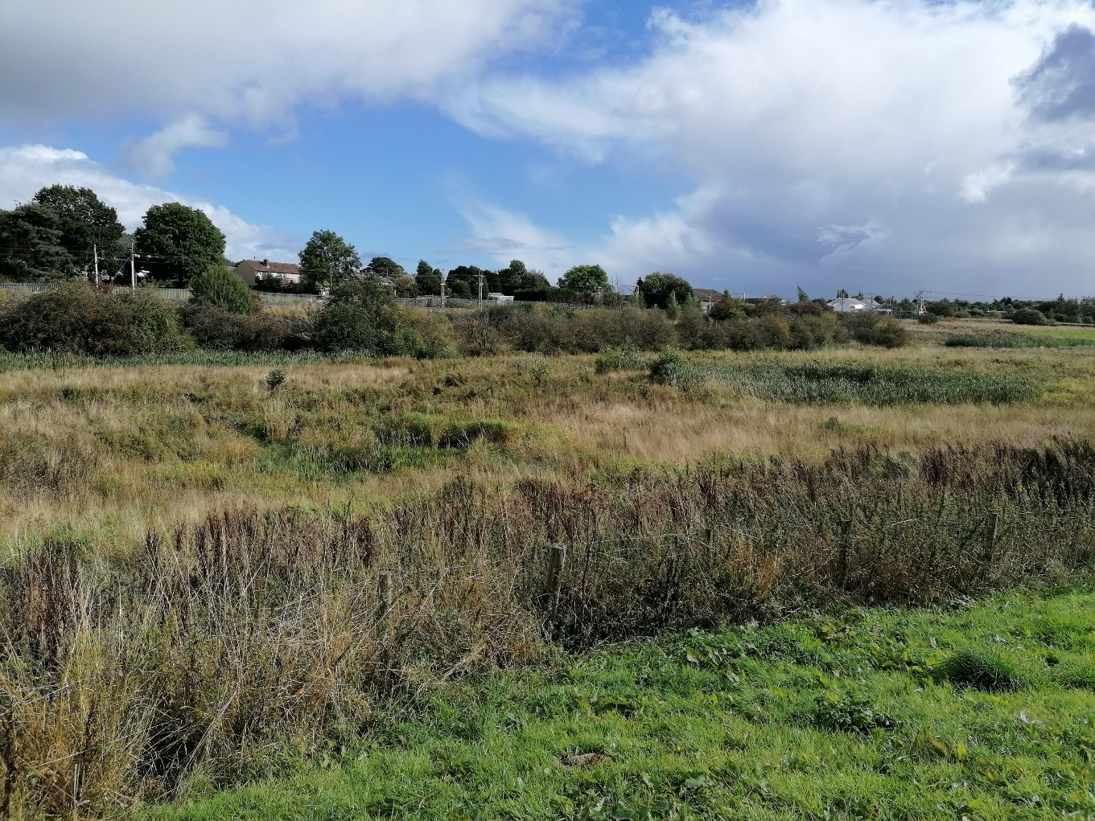
Yes
Modified Grassland
Other Neutral Grassland

Slide 25
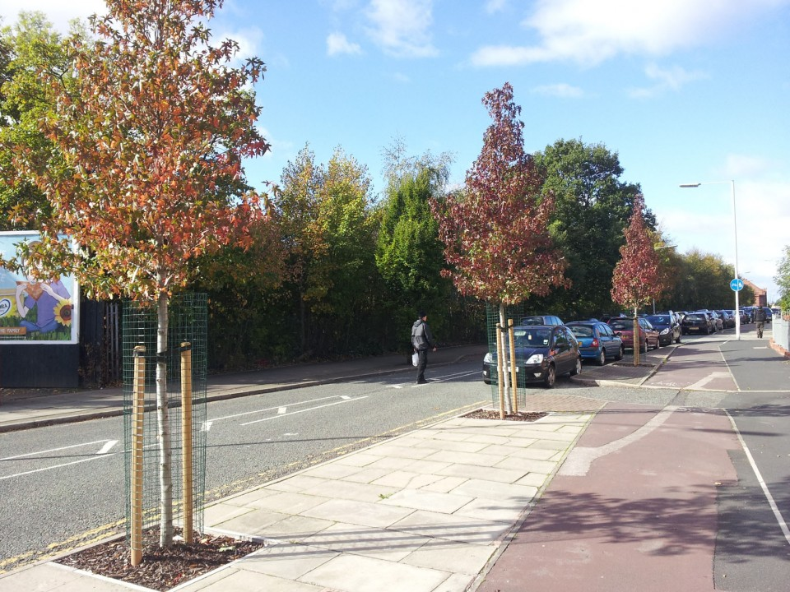
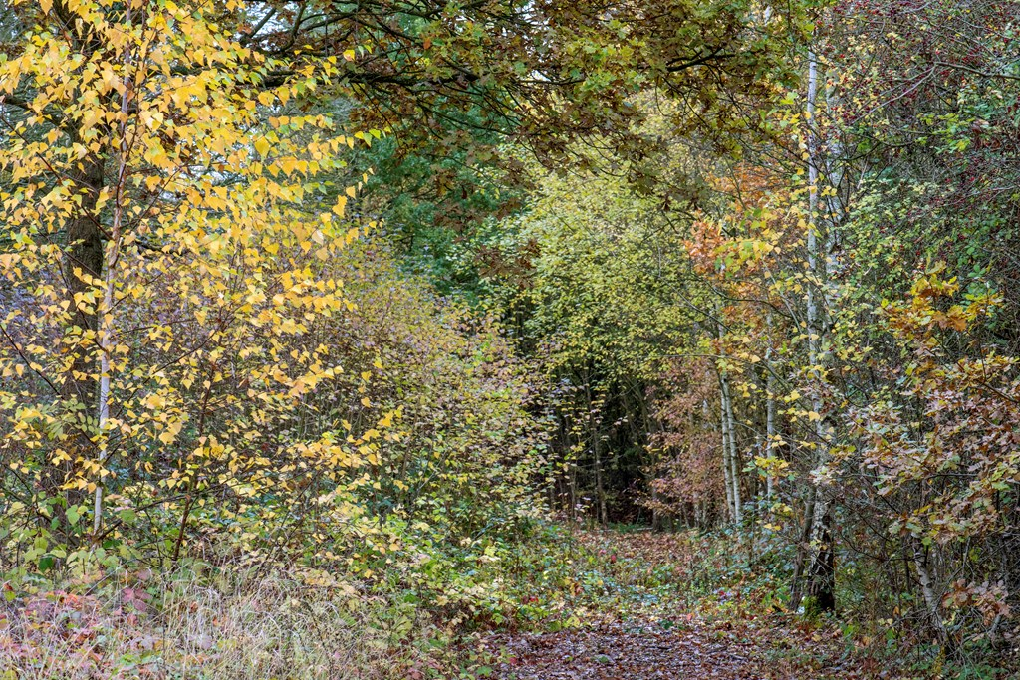
NO
Urban Trees
Broadleaved Woodland

Slide 26
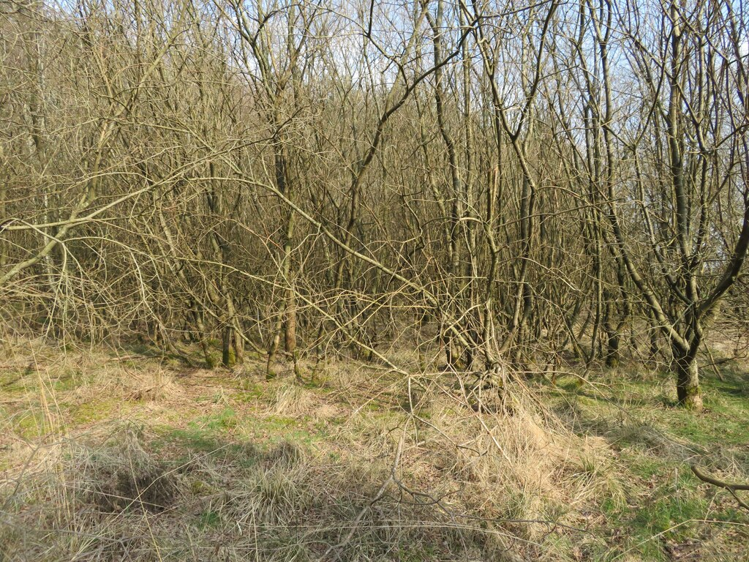
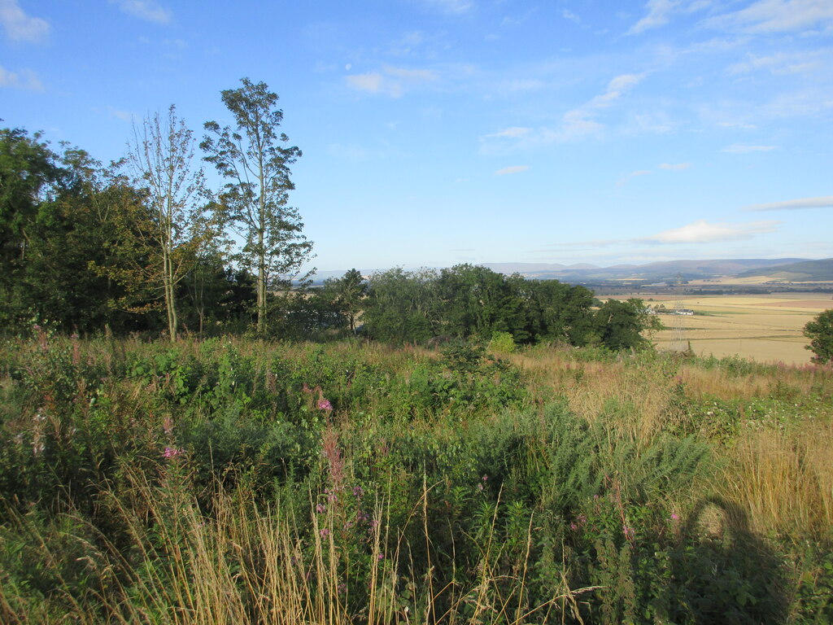
Yes
Willow Scrub
Mixed Scrub

Slide 27
So What Does All This Mean?
Soil Resource Survey for development & habitat banks to:
  Inform what habitats can be created where realistically
  Evidence within HMMP to convince LPAs
  As a management/monitoring tool to understand where habitats are falling short of expectation (adjust HMMP) or exceeding expectation (sell more Units)
ALCs may be required if a habitat bank requires a planning permission
Biodiversity Units on average between £15,000 - £30,000 per Unit, but River in excess of £100,000 etc
North/South market split
Rural/urban divide
People/Nature

Slide 28
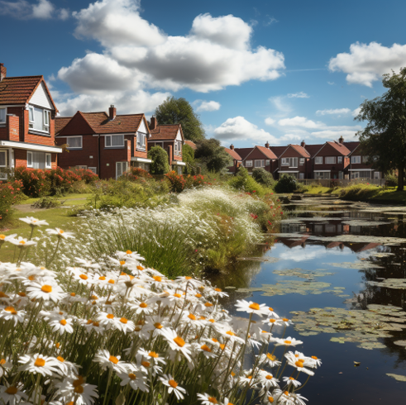
BNG & Land Values
Land values are usually determined by development potential and the cost of fulfilling it.
BNG could substantially affect the financial value of land allocated for development and protected land.
  Negatively for development
  Positively for nature, parks and unproductive/undevelopable land
Ultimately, value will be determined by the market, but data will take many years to collate.
BNG could be considered as a form of land value capture in itself;
And what about stacking income? E.g. Nutrients + Biodiversity + Solar

Slide 29
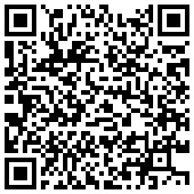
Any Questions?
Vicki Mordue MSc MIoD AIEMA
Managing Director
0191 303 7805
07920 239121
enquiries@biodiverseconsulting.co.uk
www.biodiverseconsulting.co.uk
Lauren Manning
Principal Consultant, Roberts Environmental
Vicki Mordue
Managing Director, Biodiverse Consulting

Slide 30
Next event
Friday 26th April
Backworth: A Holistic Approach to Ageing Well;
An ambitious care and support scheme offering a new approach for later living.
Presented by Katie Shepherd, Associate Director, P+HS Architects
Are you a Chartered surveyor and interested in becoming a Member of the 1947 Club? – contact a Committee member or send a message through Linkedin
www.the1947club.co.uk

