Slide 1
December 2024
1947 Club
Gareth Harrison
Bank of England – Agency for the North East

Slide 2
Main points
MPC voted 8-1 to cut Bank Rate to 4.75% and signalled a gradual approach to rate cuts
Inflation is just above target and will increase slightly in the coming months
Labour market showing signs of loosening and wage increases moderating
Growth outlook next year is stronger on the back of the Budget, but that will also affect the labour market and inflation
Notes:
We wanted to start with the main headlines before we go on to cover them in more depth.
Firstly, as I’m sure you’ll all know, we cut rates on Thursday by 0.25% to 4.75%. Interestingly, the vote this time was 8-1. We kept rates on hold in September at 5% and again the vote to do so was 8-1, so most of the committee have moved in tandem. We’ll explain why in the coming slides.
Inflation came in at 1.7% in the most recent reading, but we expect it to pick up from there – Mauricio will explain more on that.
The labour market is certainly showing signs of cooling, although it’s still tight by historical standards. I’ll cover that and Mauricio will talk about pay growth, which is showing signs of moderating.
Finally, we’ve upgraded our growth outlook for next year after the Budget, although as we’ll explain, that will also have a bearing on inflation and the labour market.

Slide 3
Demand and Output

Slide 4
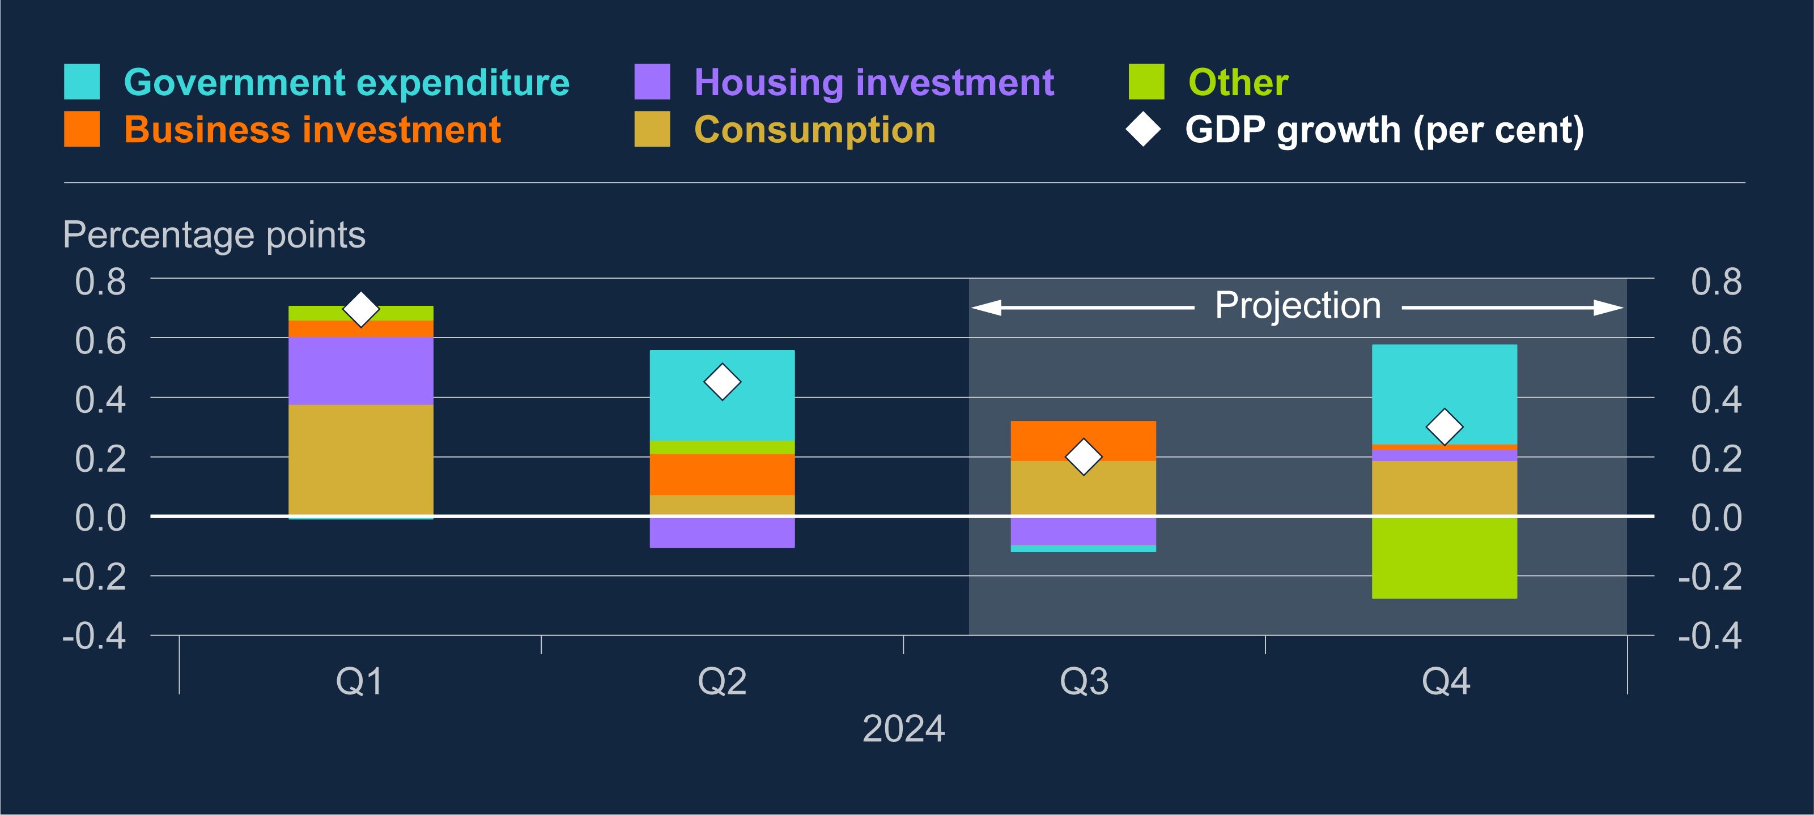
GDP growth has been positive in 2024 but has weakened in the second half of the year Contributions to quarterly GDP growth^{(a)}
Notes:
Growth has been weaker than we forecast at the time of the August report. Q2 growth came in at 0.5% and we expect growth to slow to 0.2% in Q3 and 0.3% in Q4.
Our contacts across the country report that although the August rate cut improved business sentiment, the uncertainty in the lead up to the Budget affected confidence and could have contributed to weaker activity in the near term.
Going into Q4, we expect government expenditure and consumption to drive growth and recent retail sales figures have been slightly ahead of expectation.

Slide 5
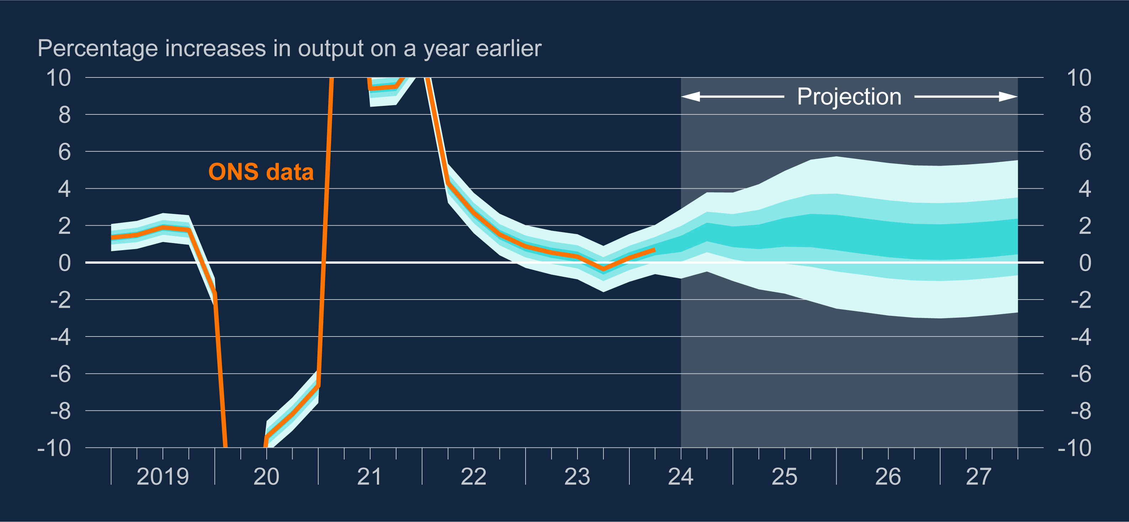
GDP growth projection
Notes:
In terms of how that growth is expected to move over our forecast period, we expect GDP growth to be 0.75% higher next year as the Budget initially boosts growth through looser fiscal policy in the short term, before that becomes fiscal tightening from 2026 which coupled with our own restrictive monetary policy stance will mean that our GDP growth forecasts are slightly lower from that point.
Next year, we expect GDP growth of 1.7% before that falls back to just over 1% in 2026 and around 1.4% in 2027.

Slide 6
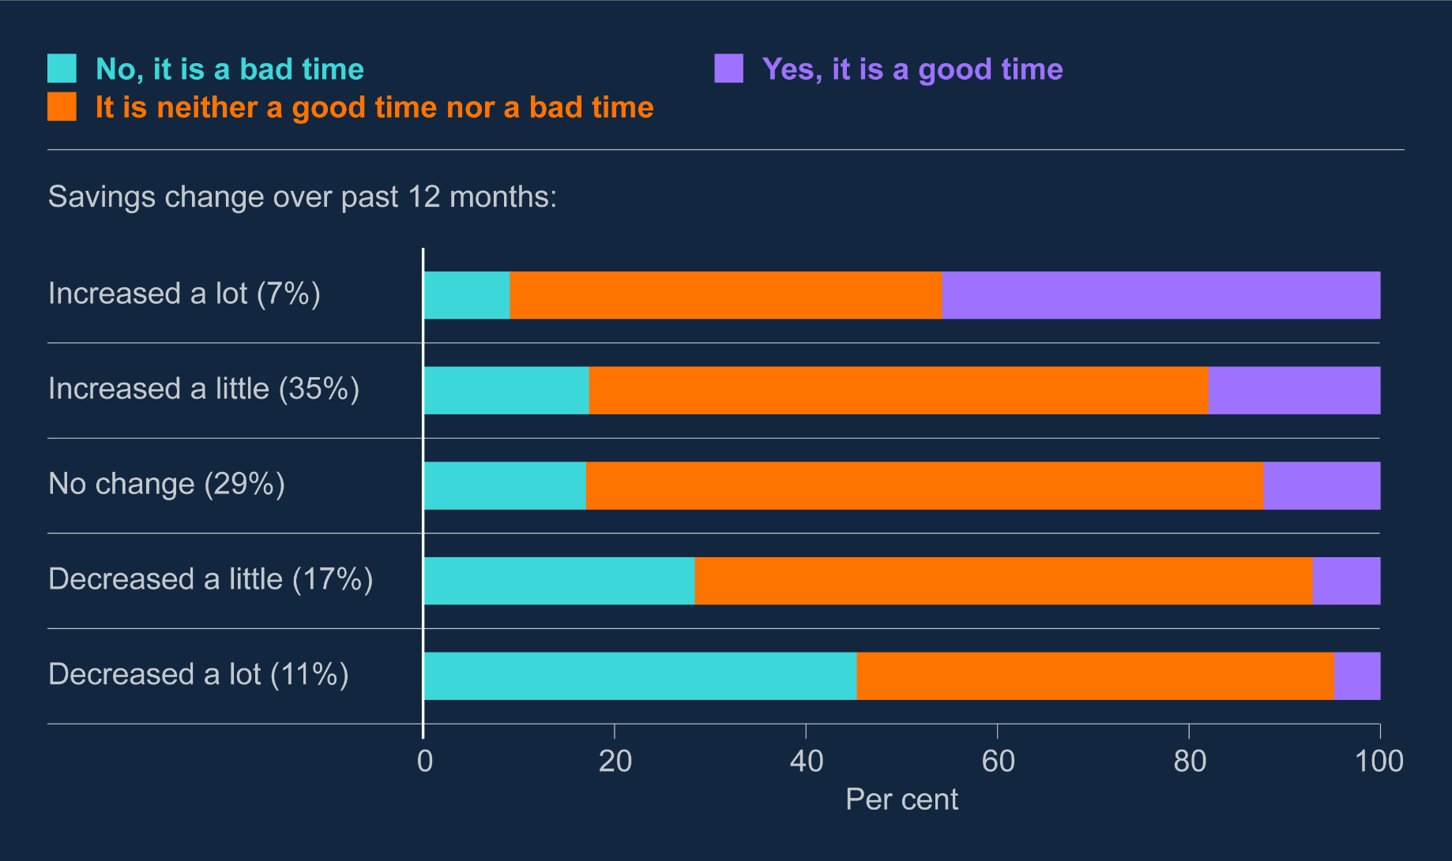
Few households report that it is a good time to make a major purchase Household views on whether it is a good time to make a major purchase, by change in savings^{(a)}
Notes:
We’ve gone through a series of economic shocks in recent years, which might also have increased the level of precautionary saving from households – in other words, holding money back for a rainy day.
Offical data on consumer confidence around major purchases remains low and this graph shows a recent Bank survey of consumers.
It shows that other than for the 7% who have increased savings by a lot, the other 93% of respondents don’t’ think that now is a good time to make a major purchase, which as you might expect becomes more pronounced for those that have needed to run down savings in the past year.

Slide 7
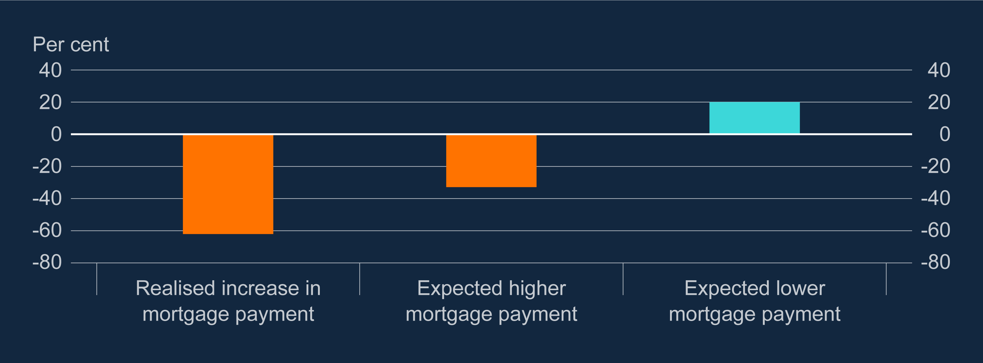
Mortgagor households expecting higher mortgage interest payments are saving in anticipation of future payment increases Estimated average change in consumption as a share of changes in mortgage payments^{(a)}
Notes:
Around 2/3rds of all mortgages in the UK are on 5 year fixed deals. That means that many households that took out fixed rate mortgages before we started increasing rates in late 2021 are still to face an increase in mortgage costs. Around 800,000 mortgages on a rate of below 3% are due to be refinanced on average each year to 2027.
Some of those households will have adjusted their saving and consumption as a result of those higher rates. Our survey showed that those households that have already experienced higher mortgage costs have cut consumption by 60% of the increased costs in payment. So in other words, if costs have gone up by £100 a month, they have cut consumption by £60.
And those that are anticipating higher mortgage costs have already cut consumption by 30% of that extra cost. So taken together, you can see the effect that higher mortgage rates have had on consumption.

Slide 8
Labour Market

Slide 9
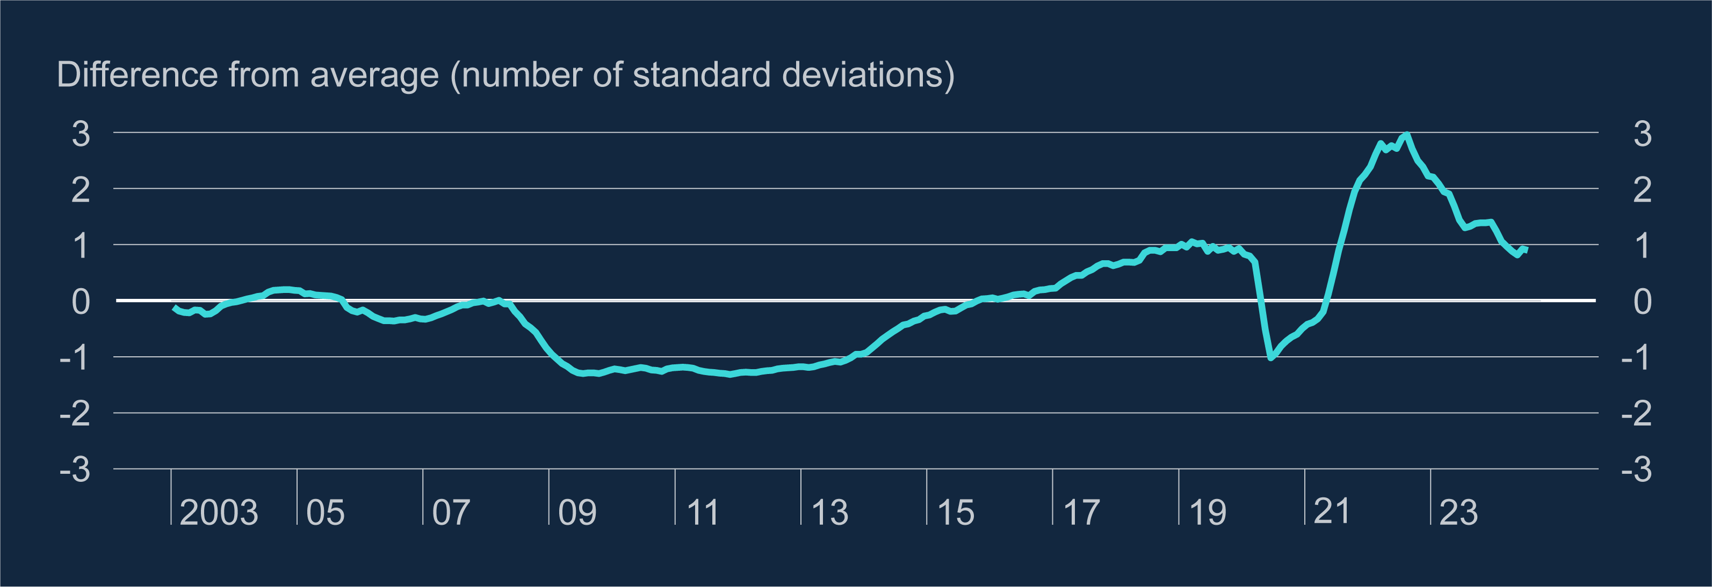
Tightness in the labour market continues to ease, although at a slower pace than in 2023 Vacancies to unemployment ratio
Notes:
This graph shows the vacancies to unemployment ratio, which is a key measure of labour market tightness. As you can the ratio has fallen back since the start of 2024 and is now roughly at it’s 2019 level, although that is still tight by historical standards.
Data suggests that the rate of decline in vacancies has slowed more lately and of course, there are still labour supply challenges which I’ll cover in a coming slide which still mean that recruitment is difficult for a number of contacts. That comes from both high inactivity levels but also the fact that the number of workers that said that they would like to work more hours in their current role remains much lower than historical averages.

Slide 10
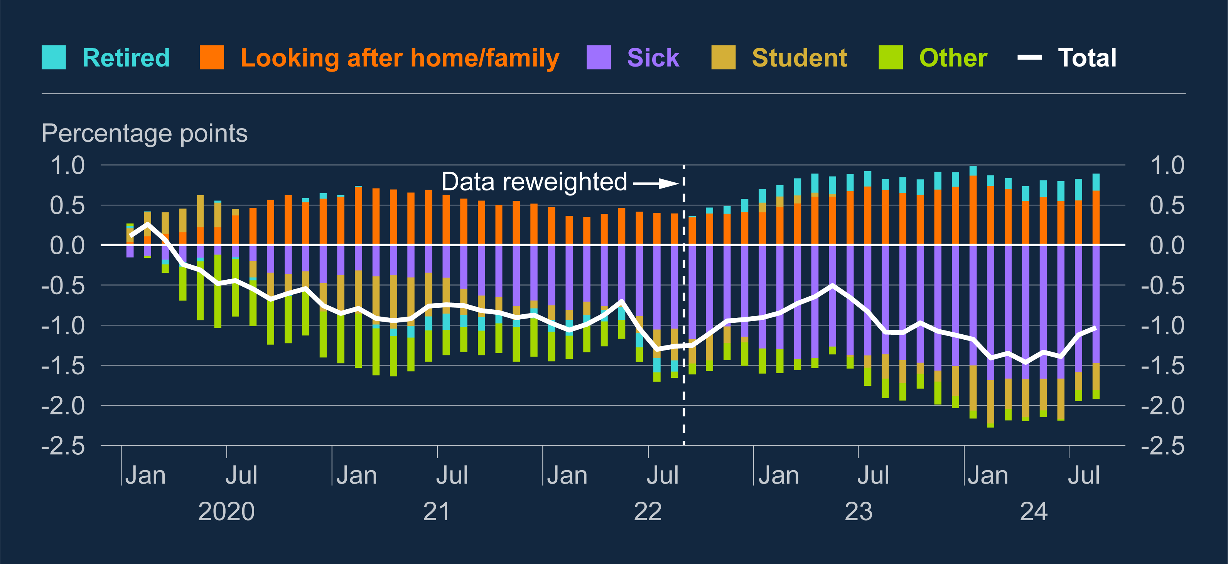
Increasing levels of reported sickness since the pandemic have driven a fall in the economic activity rate, based on LFS estimates Contribution to change in economic activity rate since 2019 Q4, by main reason for economic inactivity^{(a)}
Notes:
Although demand for labour has weakened, as we’ve talked about for a good while now, we have seen a fall in the economic activity rate since the pandemic which has remained persistent for a number of years now. Indeed, on the latest reading from the ONS the number of economically active (either in a job or looking for one) fell again to 78%.
As you can see by this chart, by far the largest driver of that fall in activity has been sickness in the purple and that hasn’t come down. On the other side of the line, ‘looking after home and family’ has become less of a driver of economic inactivity due to much greater working from home.

Slide 11
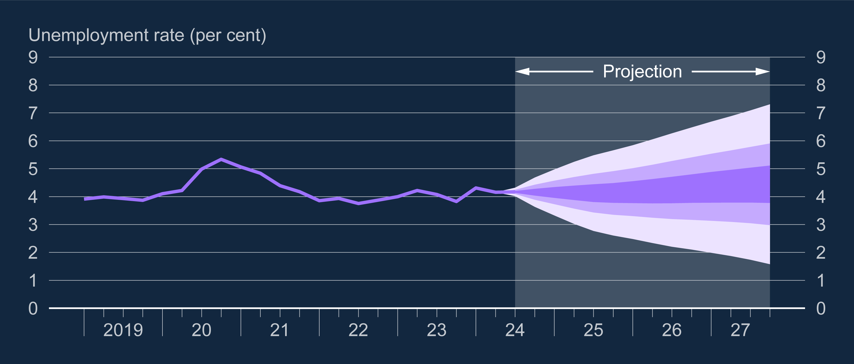
Unemployment rate projection based on market interest rate expectations, other policy measures as announced
Notes:
Largely due to the reasons we’ve just discussed, we expect the rate of unemployment to remain relatively flat over our forecast period, picking up slightly from the current 4% to 4.4% in three years time.
However, of all of our forecasts this one is subject to more uncertainty on both the upside and downside. It could be the case that greater certainty around fiscal measures gives confidence which could see unemployment rise by less. However, it could also be the case that increased costs for employers from the Budget see firms cut back on employment plans and this is something that we are monitoring very closely and always very keen to hear your thoughts on.

Slide 12
Labour Market
Pay

Slide 13
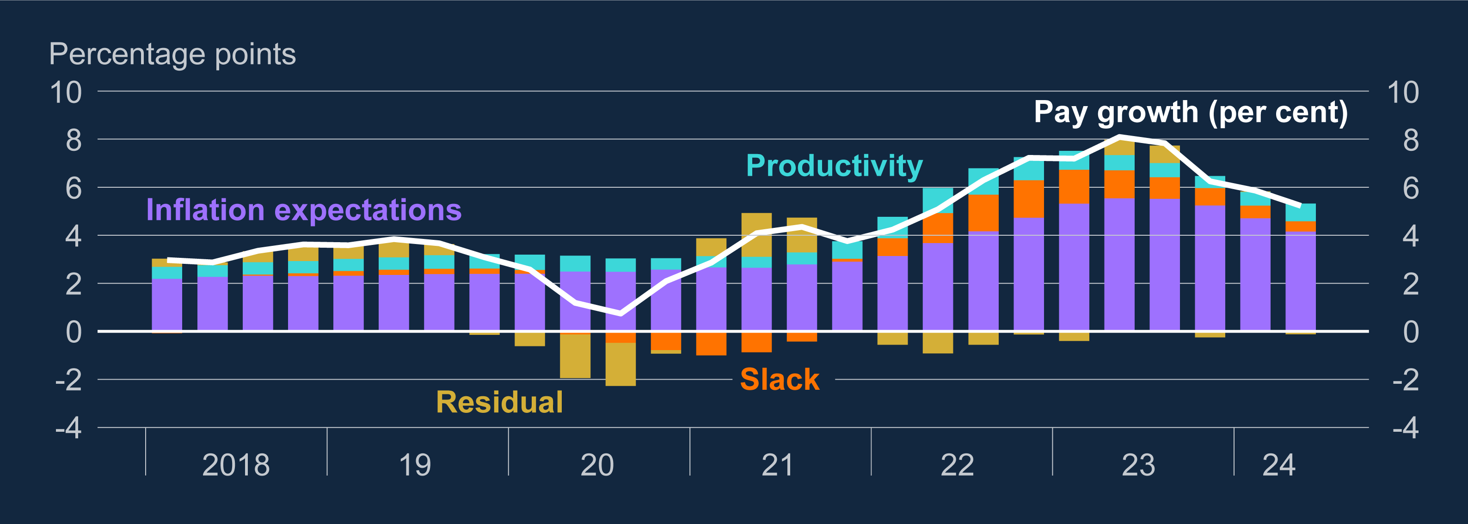
Falling inflation expectations and a looser labour market have contributed to lower wage growth Contributions to annual private sector regular pay growth^{(a)}
Wage growth since 2021 can largely be explained by the rise in inflation expectations and tightness in the labour market
The easing in the labour market and normalisation of inflation expectations will moderate wage growth in coming quarters
Notes:
Sources: Barclays, Citigroup, ONS, YouGov and Bank calculations.
(a) Wage equation based on Yellen (2017). Pay growth is Bank staff’s estimate of underlying pay growth between January 2020 and March 2022 and the ONS measure of private sector regular AWE growth otherwise. Short-term inflation expectations are based on the Barclays Basix Index and the YouGov/Citigroup one year ahead measure of household inflation expectations and projected forward based on a Bayesian VAR estimation. Slack is based on the MPC’s estimates, informed by the vacancies to unemployment ratio. Productivity growth is based on long-run market sector productivity growth per head. The final data point is 2024 Q2.

Slide 14
Some regulatory/public sector driven pressures on labour costs
National Living Wage (NLW) to increase 6.7% on April 2025 (April 2024 was 9.8%)
Increase in public sector pay announced in July (timing and implementation uncertain) -> 1/5 of the whole UK employment, so it is impactful on the overall market
The increase in employer NICs announced at Autumn Budget 2024 is expected to have a small downward effect on wages (but not on labour costs), but there is uncertainty over the size and timing of this effect
On the impact of the NICs, there are at least four potential margins of adjustment:
Firms could pass on higher costs to consumer prices
Firms could absorb the increase through lower margins or higher productivity
Firms could increase wages by less
Firms could respond by reducing employment.
Overall, private sector pay growth is projected to rise slightly in Q4 24, at an annualised rate of 3.6% and then to just over 3.2% by the end of 2025, as past falls in inflation expectations and the easing in the labour market feed through to lower wage growth

Slide 15
Inflation

Slide 16
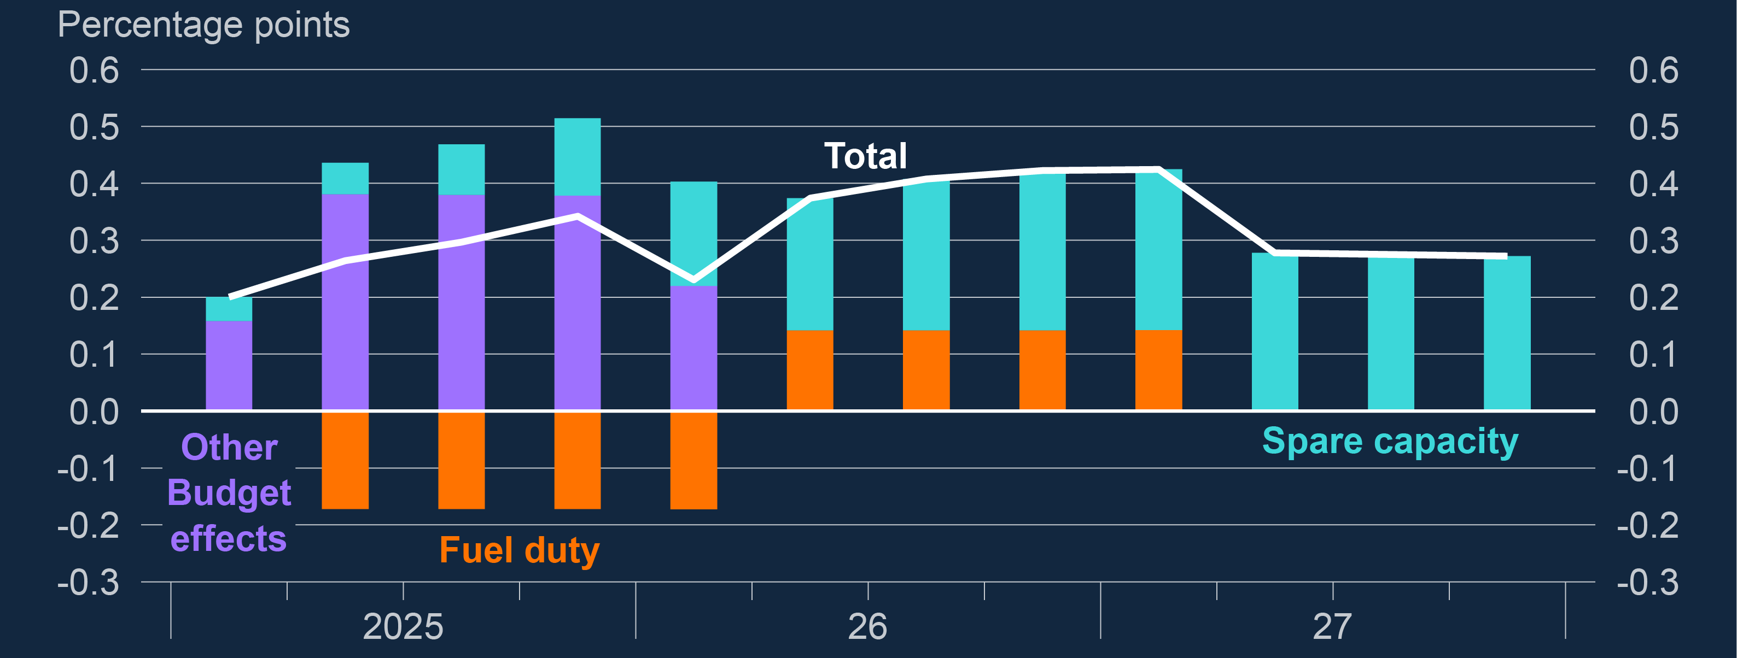
Policies included in the Budget are expected to raise CPI inflation by just under ½ of a percentage point at their peak Impact of Budget on CPI inflation forecast^{(a)}
(a) The ‘other Budget effects’ bars account for the effects of the rise in the cap on single bus fares (£2 to £3), the rise in vehicle excise duty, the introduction of VAT on private school fees and Bank staff’s estimates for the CPI impact of the change in employer NICs. The ‘fuel duty’ bars account for the extension of the freeze and the 5p cut to fuel duty rates, followed by the assumption that the 5p cut will expire and fuel duty will rise in line with RPI from 2026 Q2. The ‘spare capacity’ bars capture the impact on inflation of changes to excess supply as a result of fiscal policy. [Higher NICs -> lower wages -> lower labour market participation -> lower supply capacity -> less spare capacity -> more inflationary pressures]
Notes:
(a) The ‘other Budget effects’ bars account for the effects of the rise in the cap on single bus fares, the rise in vehicle excise duty, the introduction of VAT on private school fees and Bank staff’s estimates for the CPI impact of the change in employer NICs. The ‘fuel duty’ bars account for the extension of the freeze and the 5p cut to fuel duty rates, followed by the assumption that the 5p cut will expire and fuel duty will rise in line with RPI from 2026 Q2. The ‘spare capacity’ bars capture the impact on inflation of changes to excess supply as a result of fiscal policy.

Slide 17
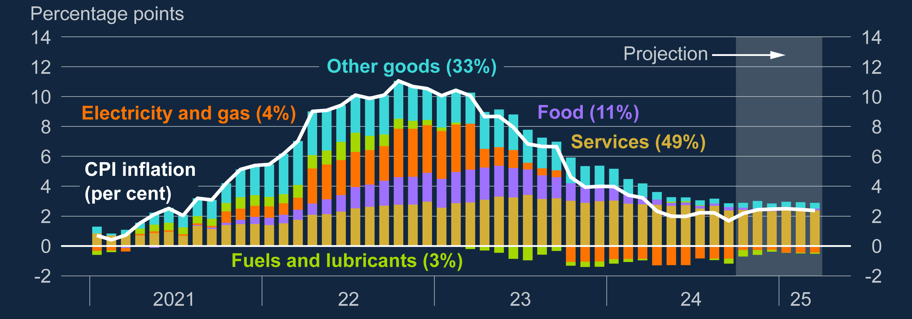
CPI was at 2.3% in October and expected to rise before the end of the year Contributions to CPI inflation
Notes:
Sources: Bloomberg Finance L.P., Department for Energy Security and Net Zero, ONS and Bank calculations. (a) Figures in parentheses are CPI basket weights in 2024. Data to September 2024. Component-level Bank staff projections from October 2024 to March 2025. The food component is defined as food and non-alcoholic beverages. Fuels and lubricants estimates use Department for Energy Security and Net Zero petrol price data for October 2024 and are then based on the sterling oil futures curve.

Slide 18
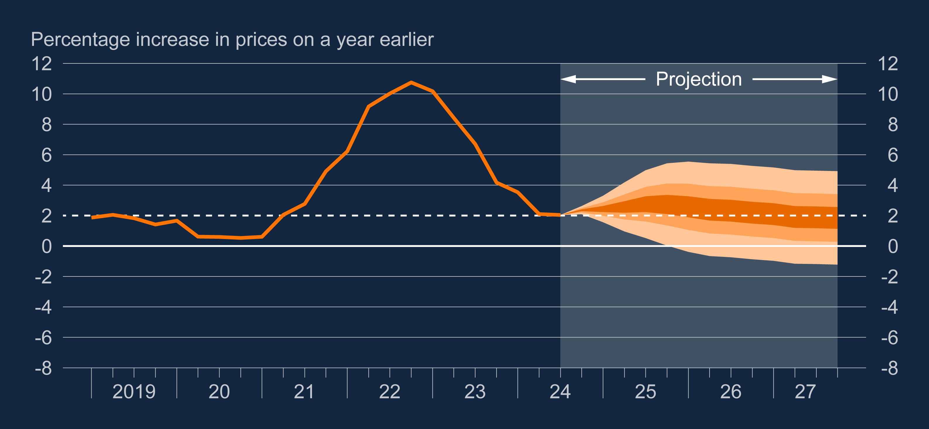
CPI inflation projection
Notes:
The fan chart depicts the probability of various future outcomes for CPI inflation and begins in 2024 Q4. It has been conditioned on Bank Rate following a path implied by market yields, but allows the Committee’s judgement on the risks around the other conditioning assumptions set out in Section 1.1, including wholesale energy prices, to affect the calibration of the fan chart skew. If economic circumstances identical to today’s were to prevail on 100 occasions, the MPC’s judgement is that inflation in any particular quarter would lie within the darkest central band on only 30 of those occasions. The fan chart is constructed so that outturns of inflation are also expected to lie within each pair of the lighter orange areas on 30 occasions. In any particular quarter of the forecast period, inflation is therefore expected to lie somewhere within the fans on 90 out of 100 occasions. And on the remaining 10 out of 100 occasions inflation can fall anywhere outside the orange area of the fan chart. Over the forecast period, this has been depicted by the grey background. See the Box on pages 48–49 of the May 2002 Inflation Report for a fuller description of the fan chart and what it represents.

Slide 19
December 2024
1947 Club
Gareth Harrison
Bank of England – Agency for the North East

