Slide 1
Planning – The here, now and future 1947 Club 14 November 2024

Slide 2
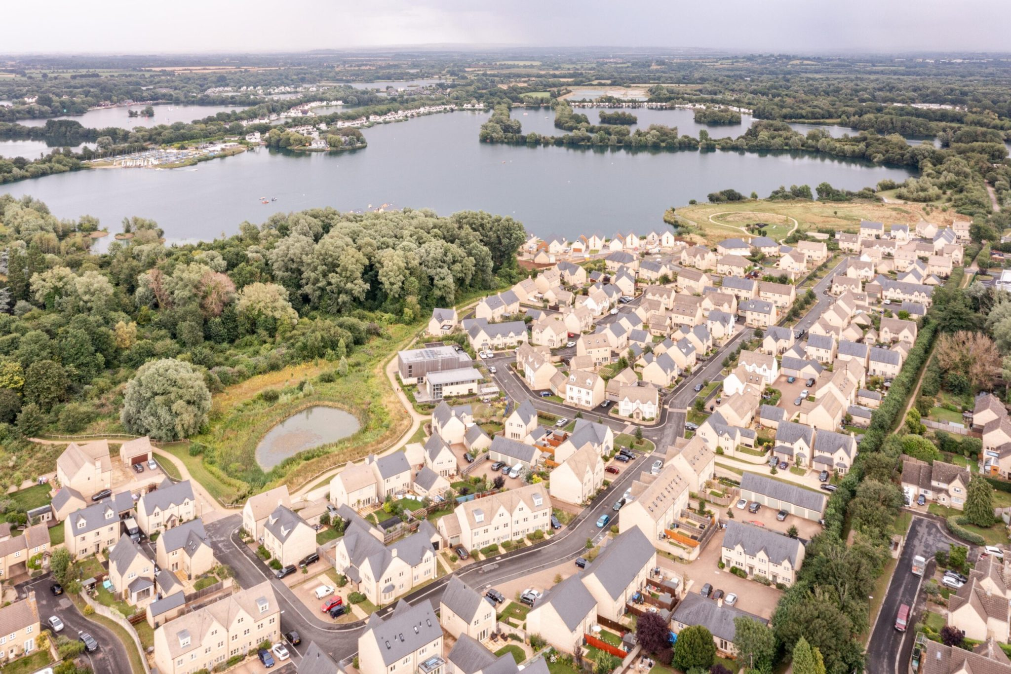
Who are Pegasus?
Founded in 2003, we have 420+ strong workforce of skilled and experienced people operating from multiple offices throughout the UK.
Our reputation is bigger than it ever has been over the 20+ years of the company’s existence offering multidisciplinary services across our seven Areas of Expertise:
Planning;
Design;
Transport & Infrastructure;
Land & Property (inc. GIS);
Environment (inc. Landscape);
Heritage; and
Economics.

Slide 3
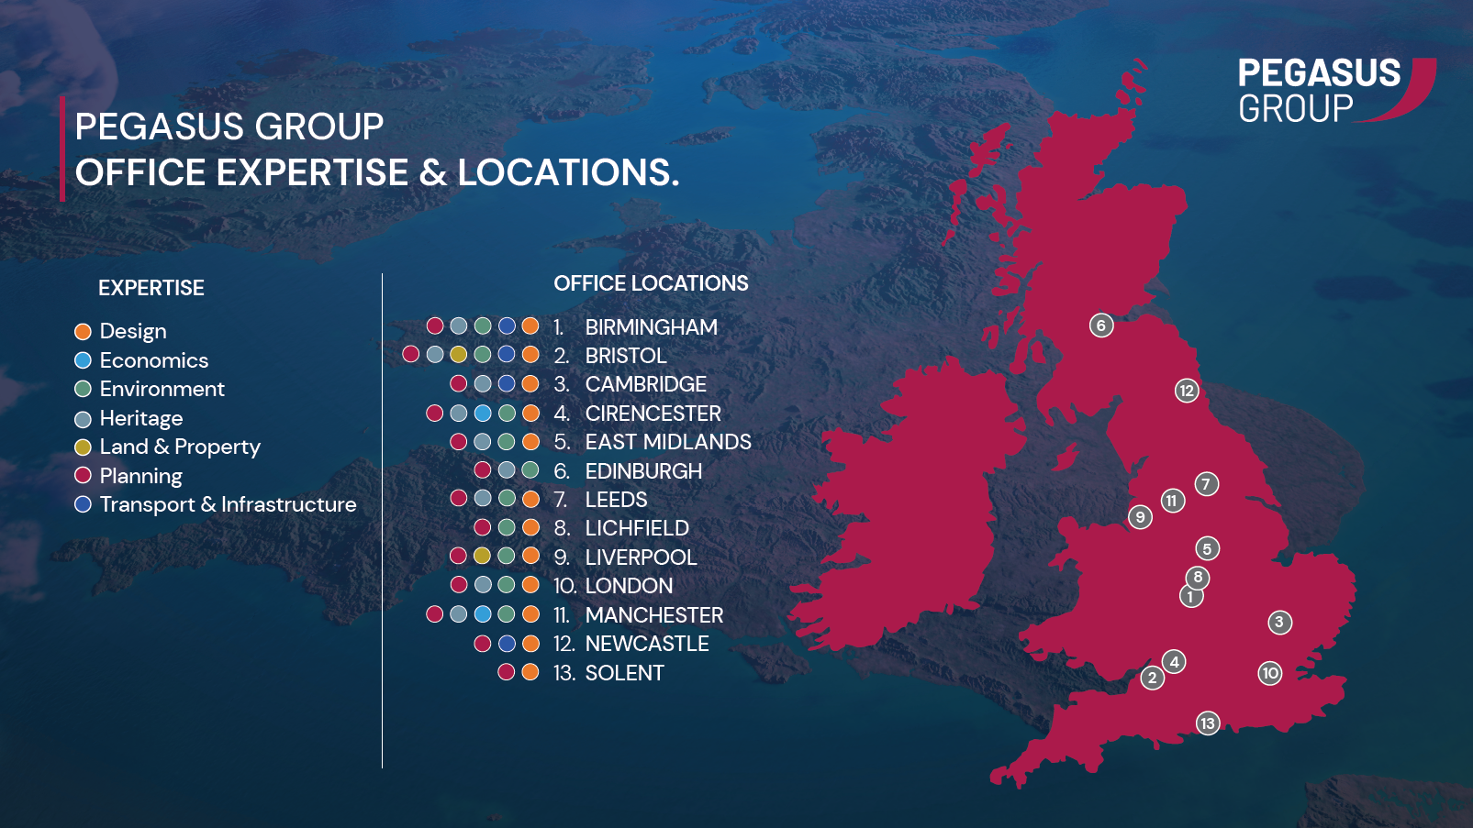

Slide 4
What do we do?
Stages we support
Project Inception
Detailed
Design
Tender and Contract Procurement
Pre-construction Planning
Construction
Handover, Maintenance
& Operation
Concept
Design,
Feasibility and Viability
Masterplanning
Preliminary Design
Outline & Detailed Planning Applications
Take development sites from initial site identification to completion/handover
Add value during early feasibility/planning stages providing robust, cost-effective solutions

Slide 5
Background and Context

Slide 6
The story so far…
Labour won election with a sizable majority.
Manifesto was big on ambition (although light on detail).
1.5 million new homes over the first term (300,000 a year).
Reversing the December 2023 changes to the NPPF including re-introducing ‘mandatory housing targets’.
Social housing.
Accepting that the growth needed will involve looking at Green Belt Release.
Concept of ‘grey belt’.
New Towns.
Facing down ‘nimbys’ and wishing to create ‘yimbys’.
Why? – Lever for growth and recognition of housing crisis.

Slide 7
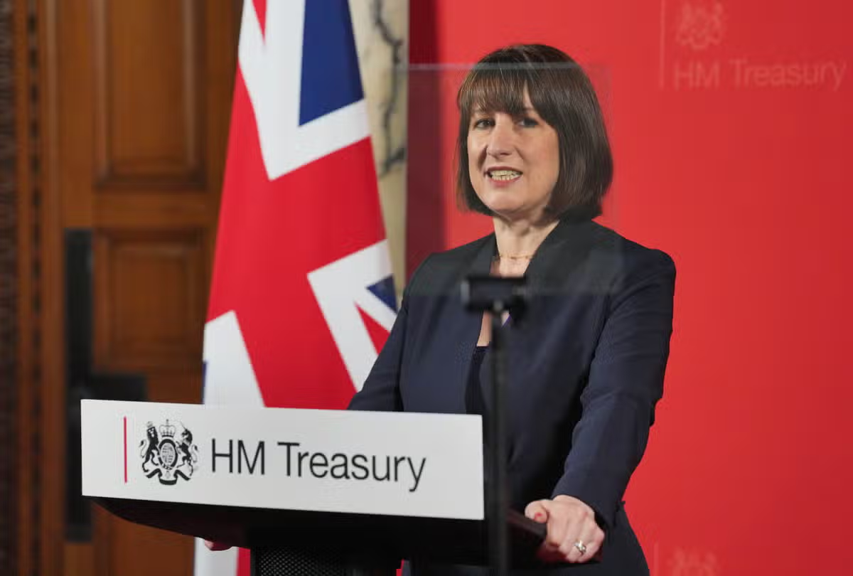
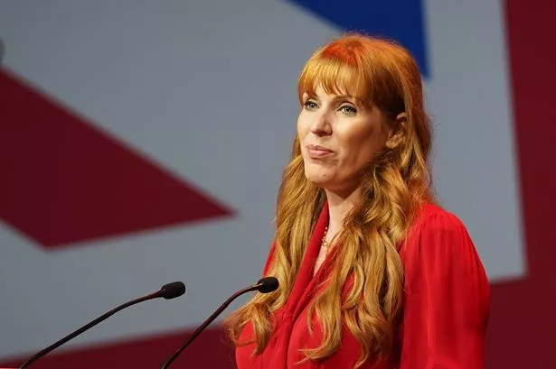
Early Actions….
Levelling up name gone (now MHCLG)
Rachel Reeves speech – Commits to revised NPPF and other planning changes with an emphasis on growth and addressing housing need (golden rules).
Angela Rayner letter to LPAs about what is expected of them – growth, meeting housing targets, Green Belt reviews etc.
Angela Rayner writing to Environmental NGOs reminding them that environmental protections need to be balanced with growth.
Planning and Infrastructure Bill in King’s Speech.

Slide 8
Proposed Reforms to the NPPF

Slide 9
Overview.
Accompanying Written Ministerial Statement.
Released for consultation 30 July 2024.
Ran until 26 September 2024.
Also seeks views on:
Planning fees.
Local plans.
NSIP thresholds.
Expected to be released before Christmas
Predominantly focused on housing and Green Belt.

Slide 10
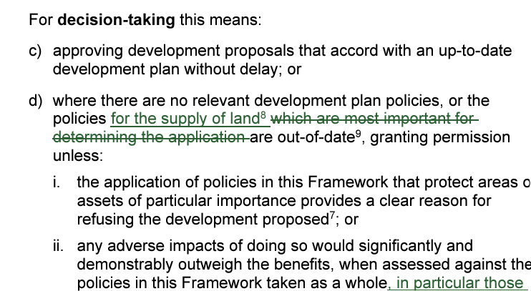
Key Headlines – Sustainable Development
‘Presumption in Favour of Sustainable Development’ remains as the NPPF’s cornerstone.
However, the wording of this has been tweaked:
Clarifies about ‘tilted balance’ linking it to ‘supply of land’.
Focusses on NPPF sections on affordable homes and design.
5 year housing land supply (plus buffers) restored to situation pre-December 2023). 4 year supply removed.
Housing Delivery Test also restored to previous version.
Enhanced protections for Neighbourhood Plans still in place – oversight?

Slide 11
Key Headlines – Housing/Standard Method
Housing Targets are to become ‘mandatory’ – all LPAs will need to demonstrate that they have taken ‘all possible steps’.
Standard Method is retained but now subject to a new methodology (breaking with household projections)
New method is ‘stock-based’ with an uplift in authorities where house price out of step with local incomes.
Most cases this results in an uplift compared to the current standard method.
Important when looking at 5YHLS

Slide 12
Local Planning Authority | Current LHN based on current Standard Method (per annum). | LHN based on proposed Standard Method (per annum). | Change | Average Annual Net additions (2020/21-2022/23)
Newcastle | 1,417 | 1,345 | -72 | 1,132
Gateshead | 417 | 909 | +492 | 370
North Tyneside | 745 | 1,075 | +330 | 544
South Tyneside | 306 | 706 | +400 | 176
Sunderland | 512 | 1,208 | +696 | 888
Northumberland | 549 | 1,769 | +1,220 | 1,461
Durham | 1,129 | 2,210 | +1,081 | 1,572

Slide 13
Local Planning Authority | Current LHN based on current Standard Method. | LHN based on proposed Standard Method | Change | Average Annual Net additions (2020/21-2022/23)
Middlesbrough | 251 | 589 | +338 | 542
Stockton | 444 | 861 | +417 | 514
Hartlepool | 157 | 388 | +231 | 330
Darlington | 152 | 500 | +348 | 512
Redcar and Cleveland | 45 | 642 | +597 | 425

Slide 14
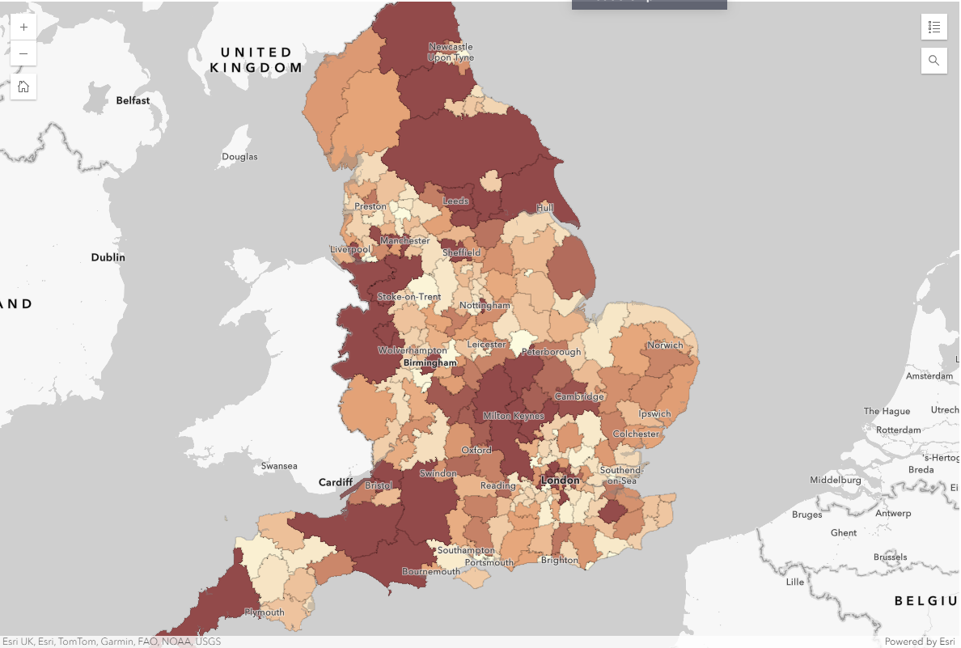
https://www.pegasusgroup.co.uk/nppf-july-2024/

Slide 15
Key Headlines – Affordable Housing
Emphasis on ‘multi tenure’ across sites (inc. elderly accommodation).
Planning policies to specify the type of affordable housing to include minimum proportion of Social Rent.
10% home ownership removed.
First Homes watered down.
Much more emphasis on meeting affordable housing needs (ie. the mix the mix of affordable housing required meets identified local needs, across both affordable housing for rent and affordable home ownership tenures)

Slide 16
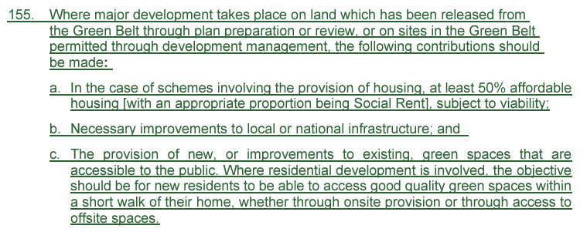
Key Headlines – Green Belt
Expectation that if LPA should explore Green Belt release as a way to meet its standard method figure (it is now an ‘exceptional circumstance’).
Tiered approach – brownfield, ‘Grey Belt’ and then greenfield.
Subject to ‘Golden Rules’/quid pro quo approach (para 155).
Seen as making Green Belt more politically palatable.
Approach to viability now in Annex 4 – does not ease concerns.

Slide 17
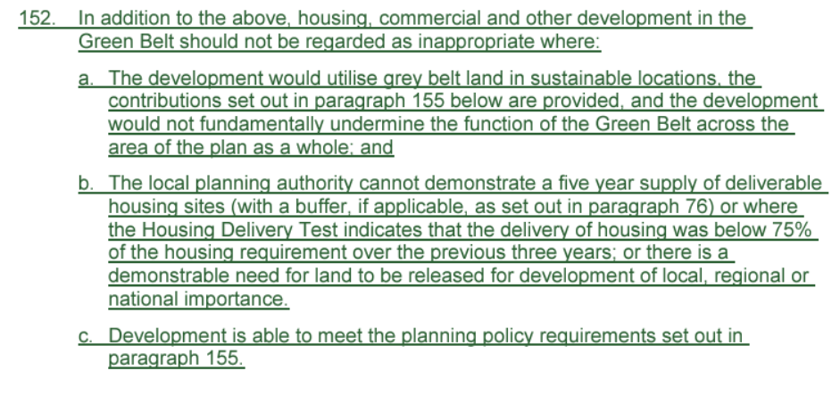
Key Headlines – Grey Belt
Talked about pre-election but not defined until this NPPF (Annex 2).
Seems to be linked to the purposes of the Green Belt.
Seems a bit of a fudge? Subjective?
House of Lords Grey Belt Inquiry (Sept and Oct 2024)
However important as provides another avenue to delivery housing (para 152).
Would allow housing to come forward on ‘Grey Belt’ outside of the plan making process under certain circumstances.
‘Golden Rules’ still apply in this case.
Viability Concerns.

Slide 18
Key Headlines – Cooperation
Duty to Cooperate remains and is reinforced on cross boundary cooperation (esp. meeting housing needs).
Unmet development needs from neighbouring areas will need to be accommodated unless there is a clear justification not to.
Sets the scene or regional planning.
Could be based on Combined Authorities? Presumption towards devolution?
Will it mandatory or voluntary?

Slide 19
Key Headlines – Other changes worth noting……
Need to identify appropriate sites for uses such as labs, gigafactories, data centres, digital infrastructure, freight and logistics.
Changes to enable renewables to come forward more easily (windfarms, solar) and weight to be attached to ‘net zero’.
Vision led approach transport – raising the importance of Travel Plans as mitigation.
Design still seen as importance but vague term ‘beauty’ is removed.
Design code approach is retained.
Brownfield sites within settlements ‘acceptable in principle’ – consultation on Brownfield Passports.

Slide 20
Key Headlines – Transition Period.
Contentious issue amongst developers.
Relatively short transition period.
In force on date of publication for development management purposes (ie. planning applications).
For plan-making it is publication date plus one month and only if plan is well advanced.
Regulation 19 (Submission/Publication Draft) – providing annual housing requirement is no more than 200 dwellings below the new standard method.
Regulation 22 (has been submitted for examination) – if housing requirement is 200 dwellings below the new standard method there will need to be a review of policies at the earliest opportunity.
Plan that does not contain strategic policies setting housing requirements (e.g. an allocations plan).

Slide 21
Other Changes

Slide 22
Key Headlines – Not just the NPPF……
Planning Fees
Acknowledge recent increase in 2023 but outlines that it is not enough to cover costs.
Ideas includes higher fee for Section 73, charging for free applications (e.g. TPO, LBC).
Localisation of fees or variation from national default?
Linking this to development management and wider planning services (plan-making, heritage, enforcement etc).
No mention of charging for planning appeals?

Slide 23
Legislative Changes
Levelling up and Regeneration Act (2023)
Still in place (many provisions not into force).
‘Cherry picking’
National Development Management Policies.
Section 73B.
Accelerated plan-making (inc. Gateways).
However….no Infrastructure Levy.
Planning and Infrastructure Bill
Announced in King’s Speech.
Details still to be provided.
Key element is ‘national scheme of delegation’.
Aim to reduce the amount of schemes going in front of Councillors.
Elevating position of planning officer.
Separately…..New Towns – Government inviting submissions. Will be a ‘New Towns Taskforce’.

Slide 24
What does this mean?
Radical set of changes (inc. reframing of Green Belt).
Labour serious about growth through planning system.
Likely see a glut of local plan reviews – can Planning Inspectorate resource this? Can LPAs resource this?
Does the house building industry have the capacity?
Is this achievable? Not got over 300,000 homes per annum since 1977 (and that involved significant LA housebuilding).
Typical figure is around 200,000 per year (so step change needed).
Political difficulties – new Labour seats in historically ‘nimby’ areas – housing and renewable schemes.
Clearly Government is going to be much more interventionist.
Viability?

Slide 25
Sandra Manson Executive Director sandra.manson@pegasusgroup.co.uk 07881 406437
Chris Martin
Associate
chris.martin@pegasusgroup.co.uk
07971 531921

