Slide 1
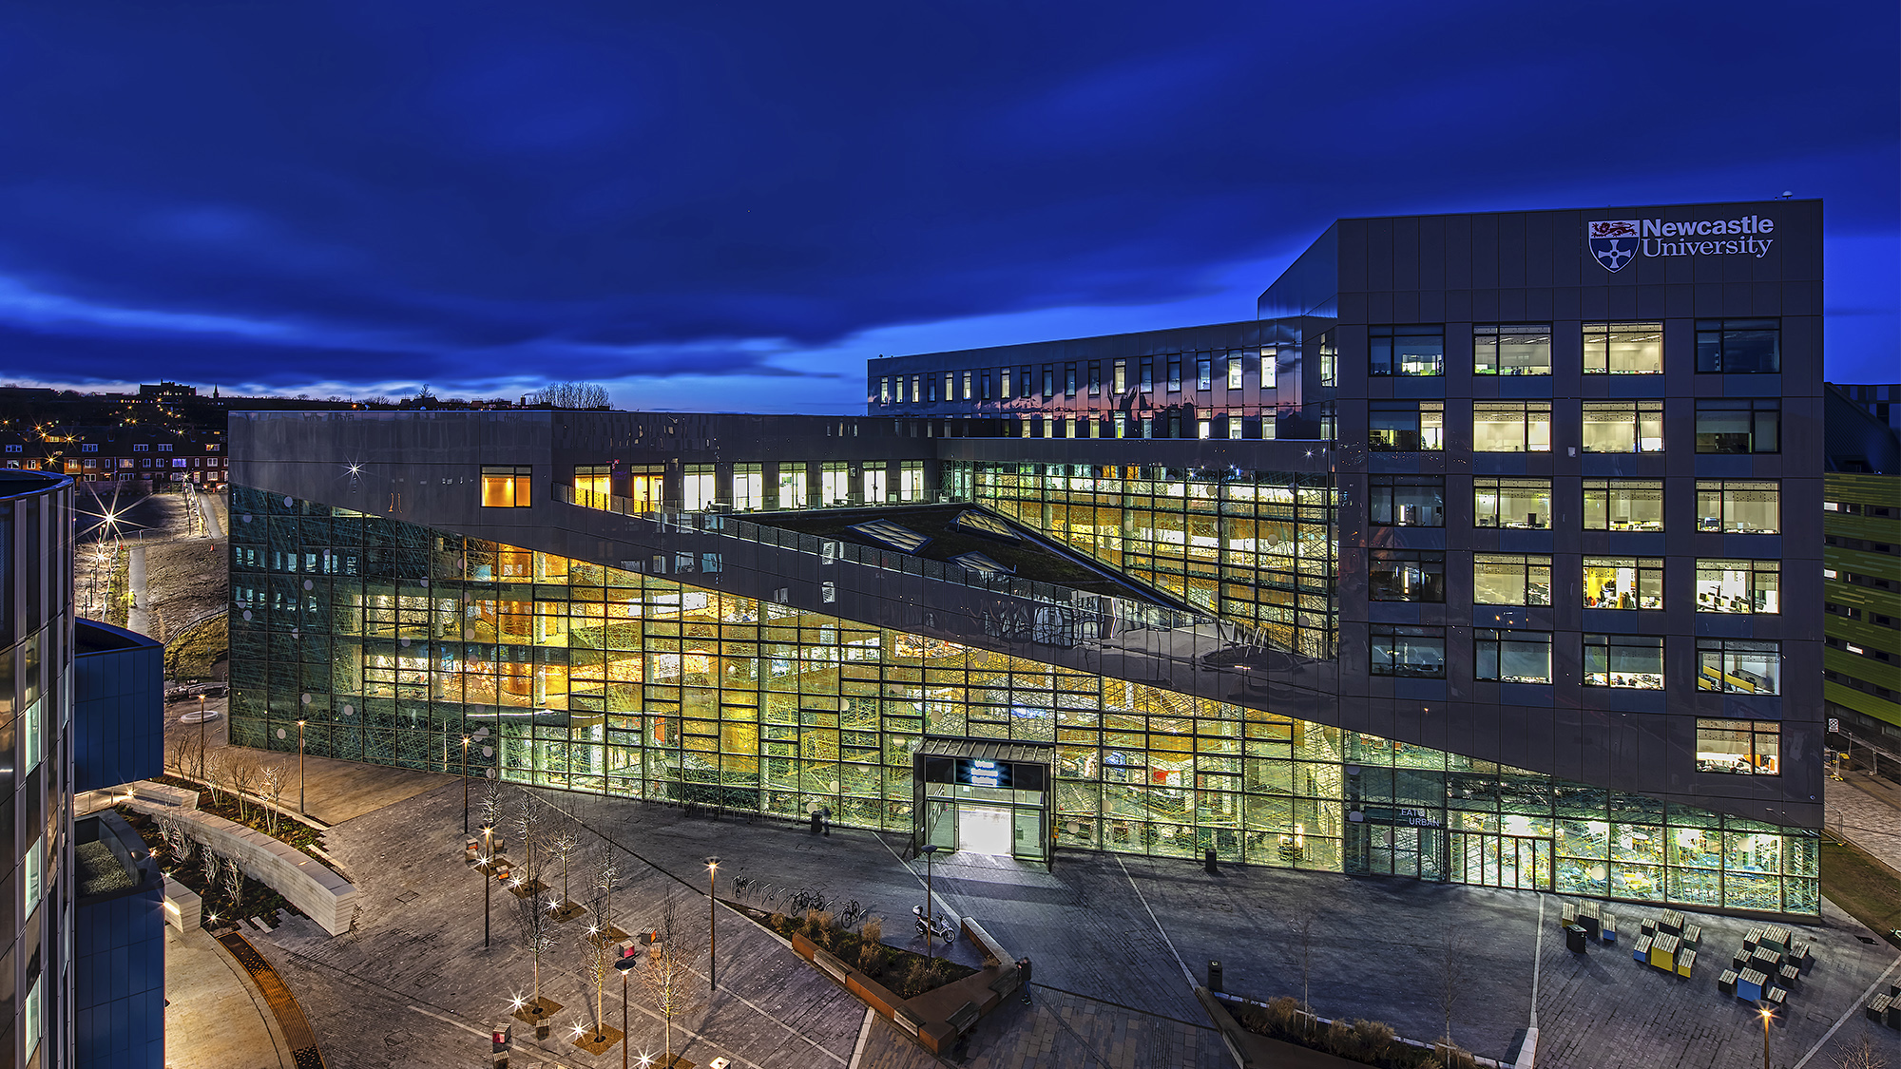


Newcastle Investment Market Update

Slide 2
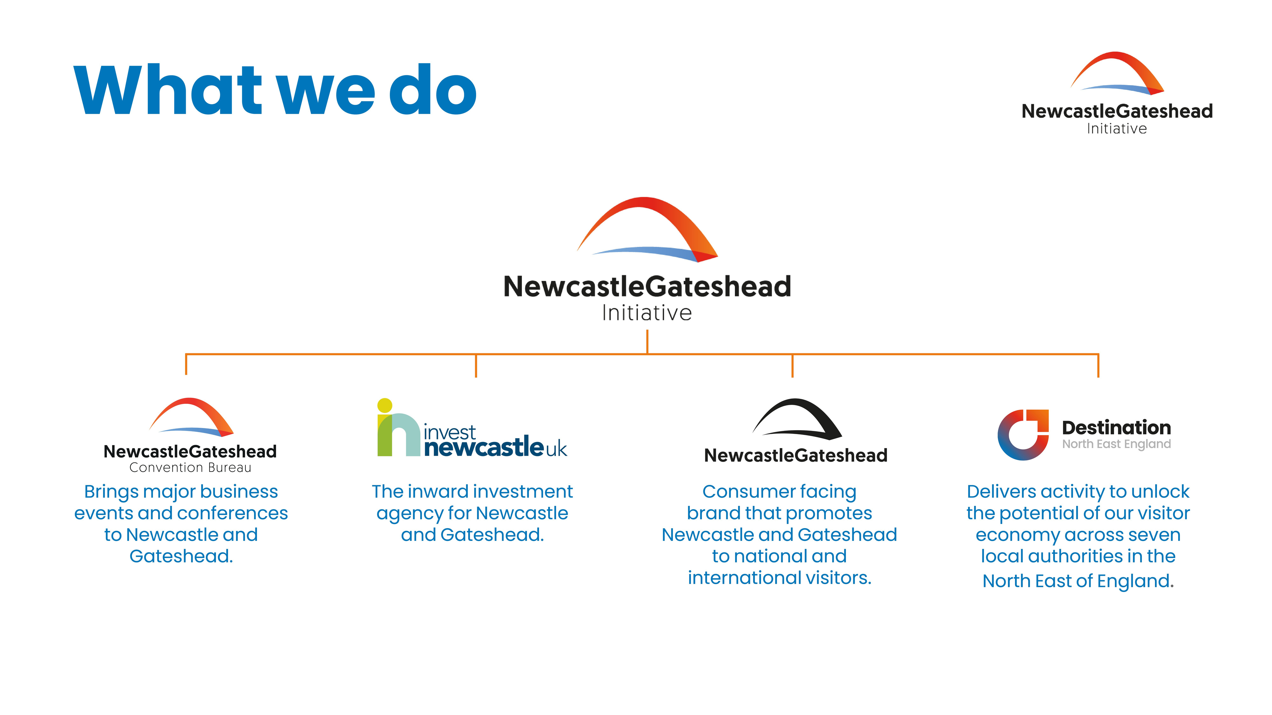


About NGI

Slide 3
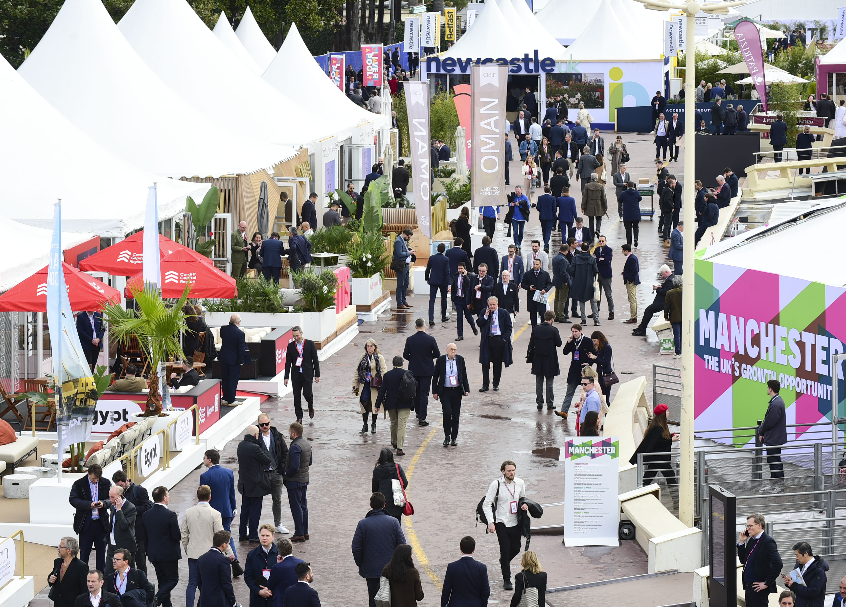
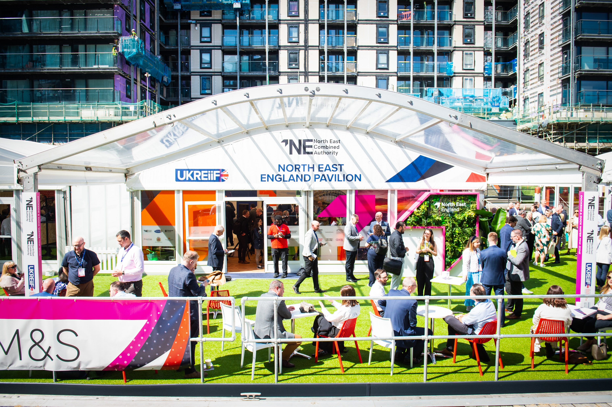
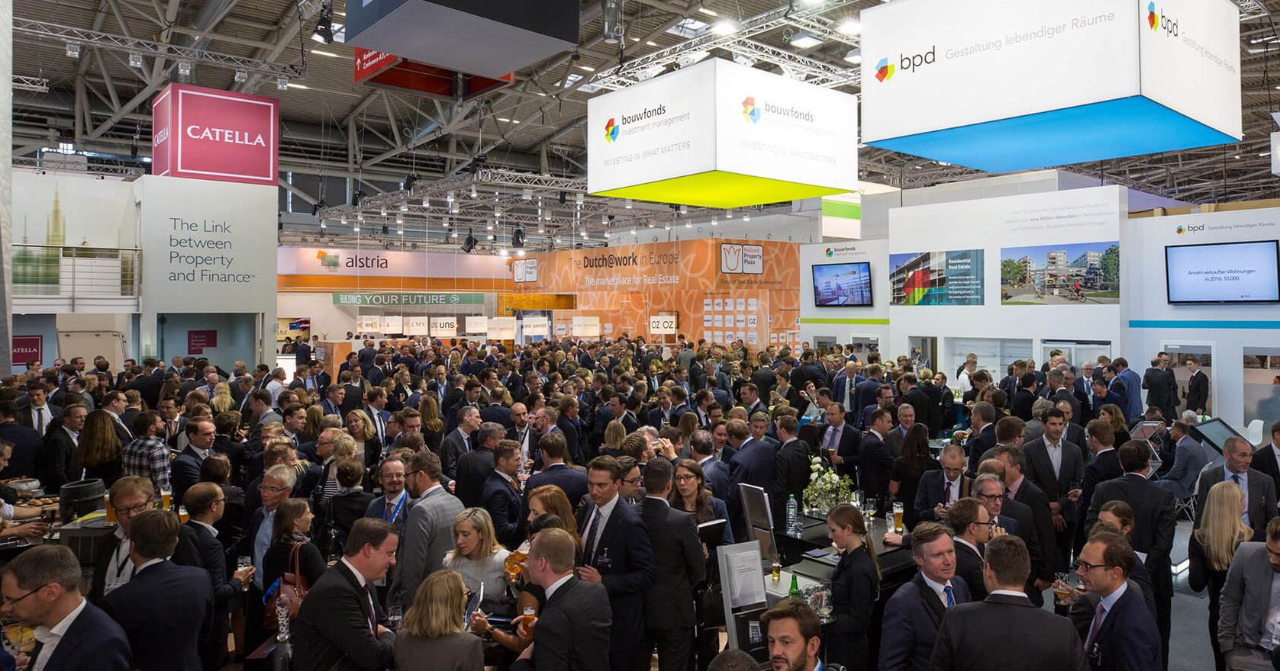
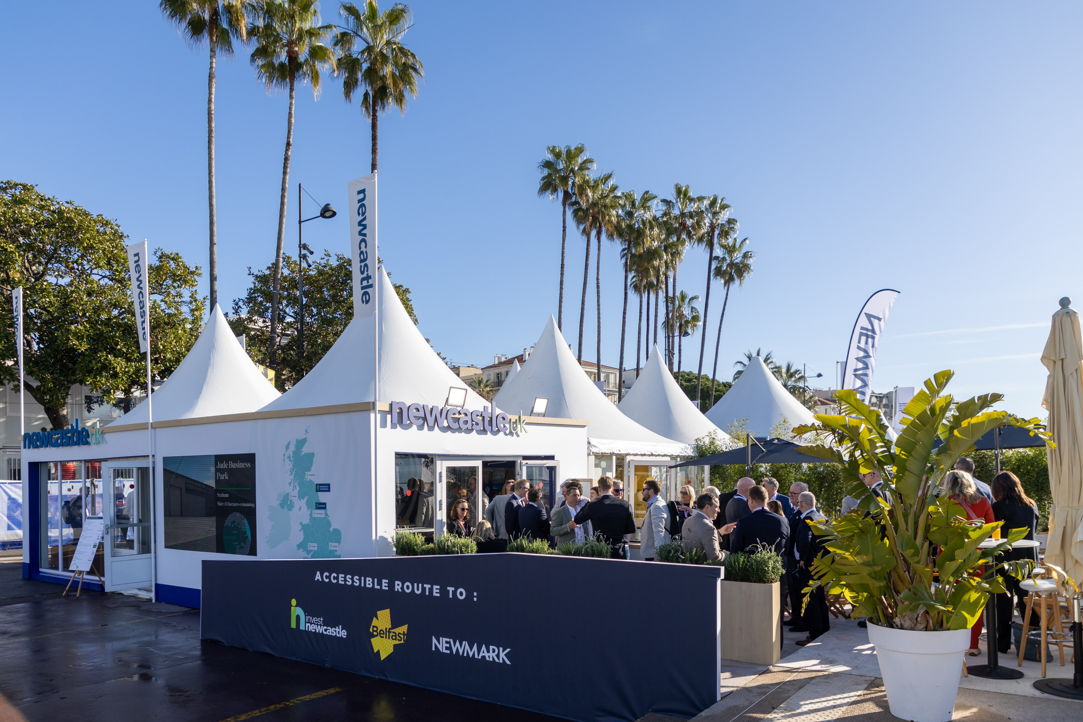
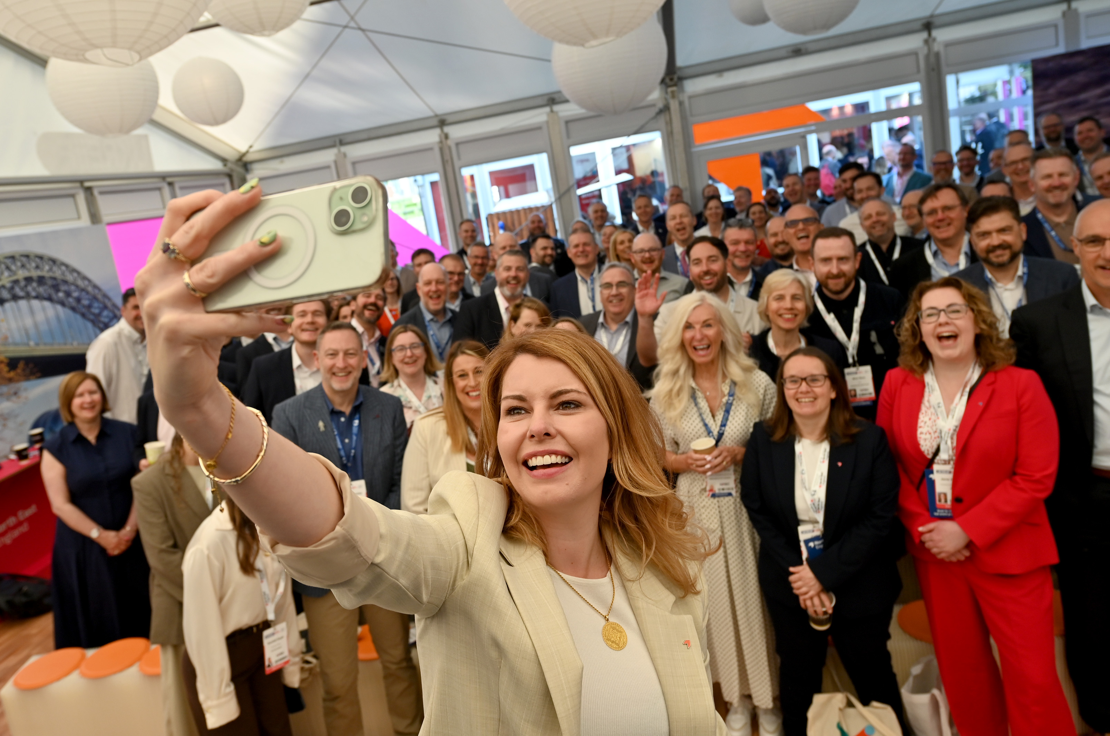
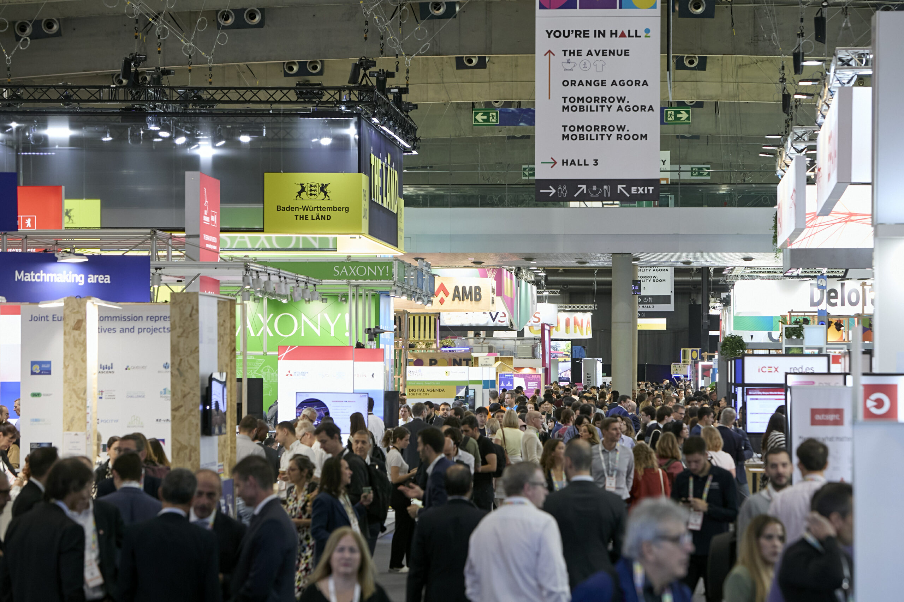
Capital Investment

Slide 4
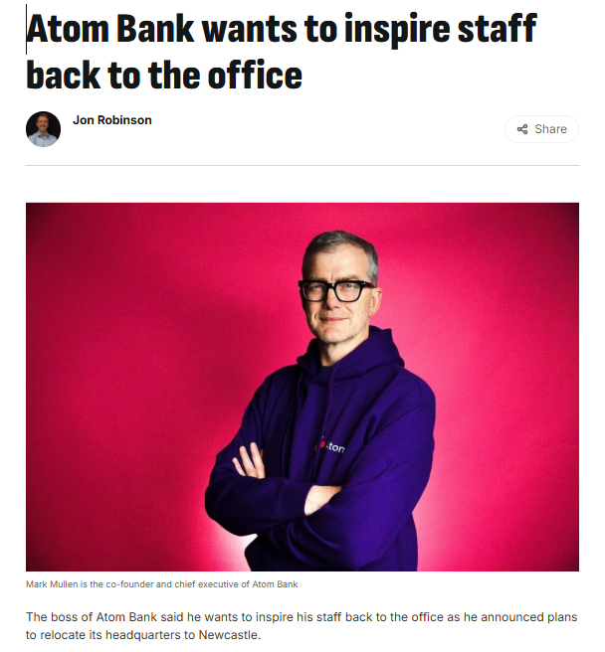
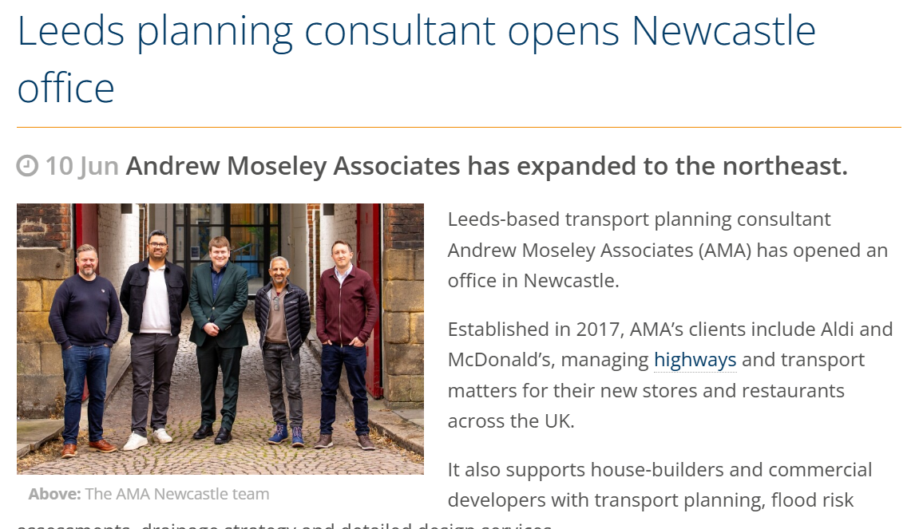
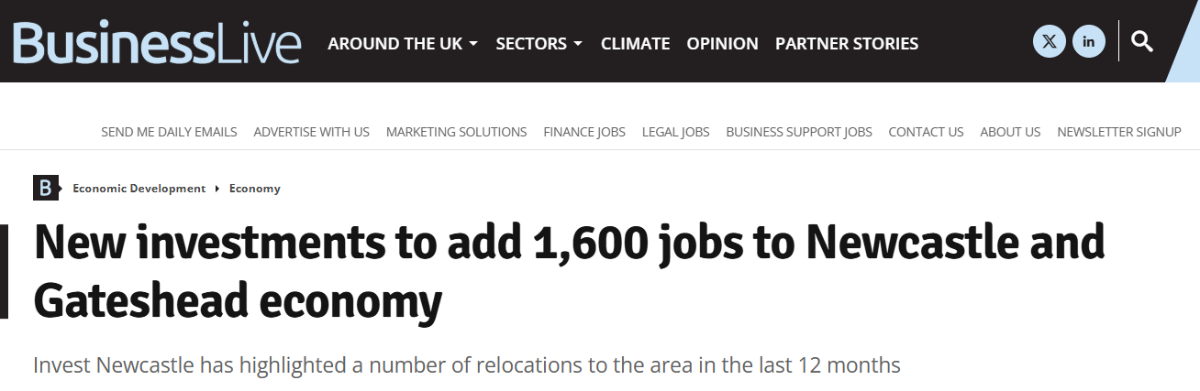
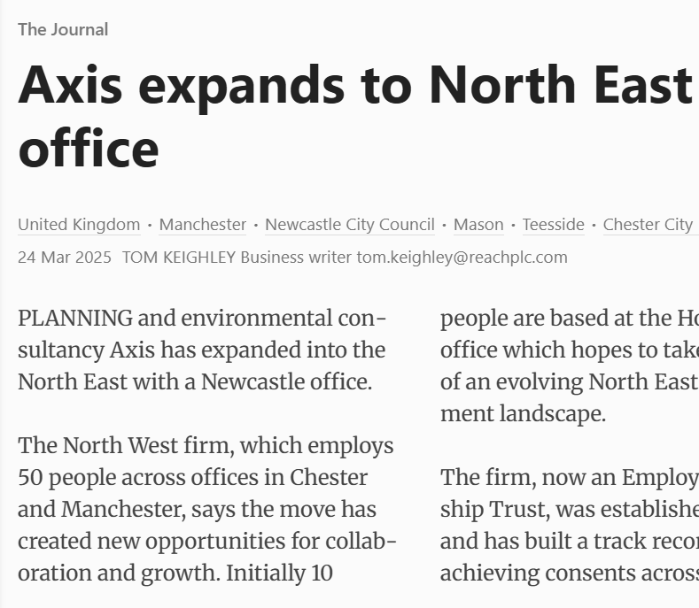
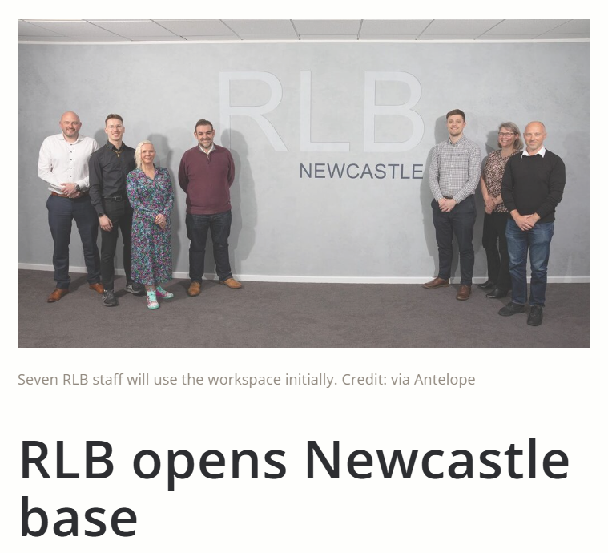
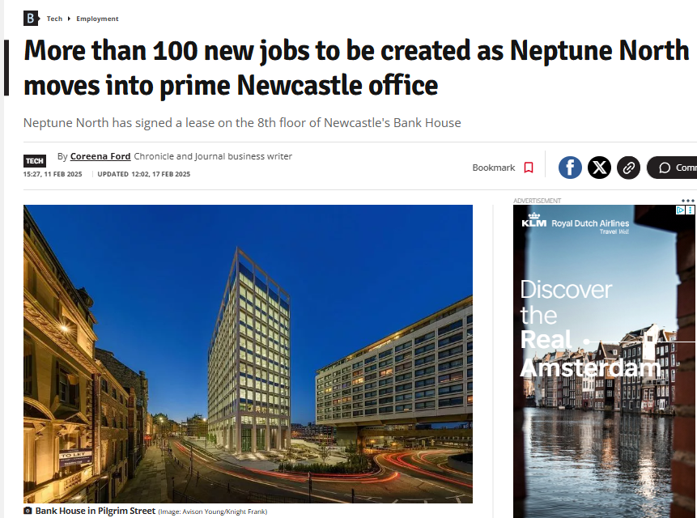
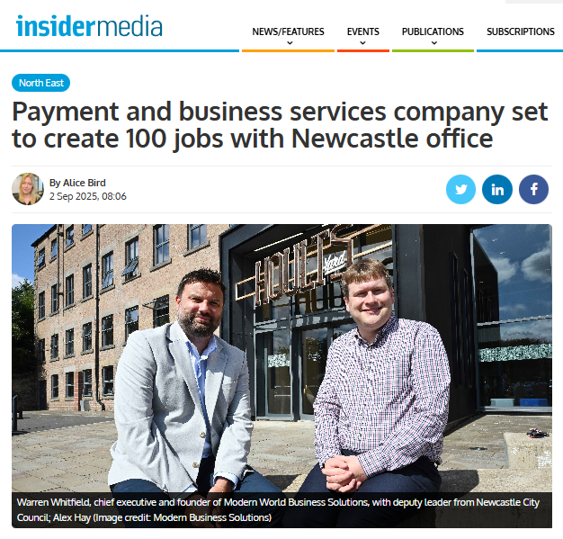
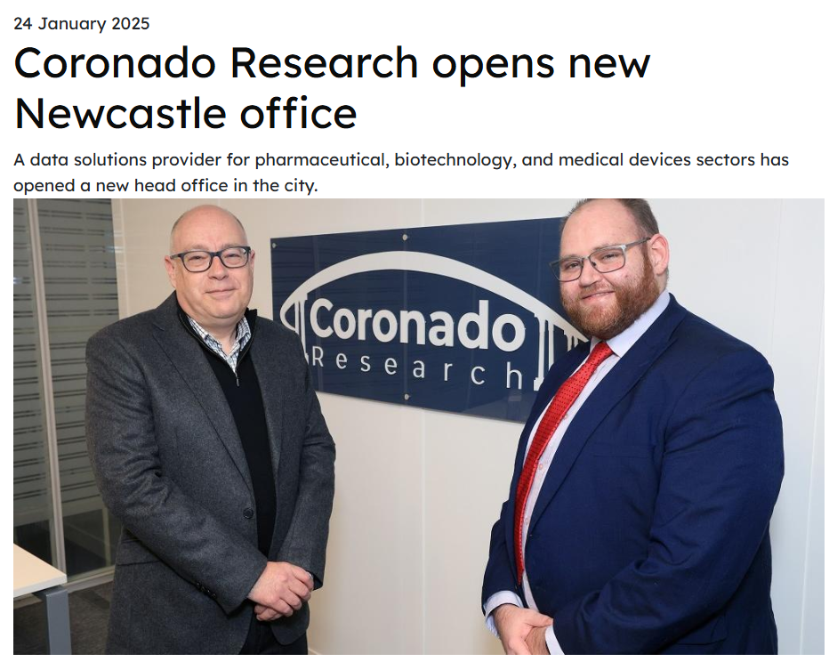
Newcastle Investment Market

Slide 5
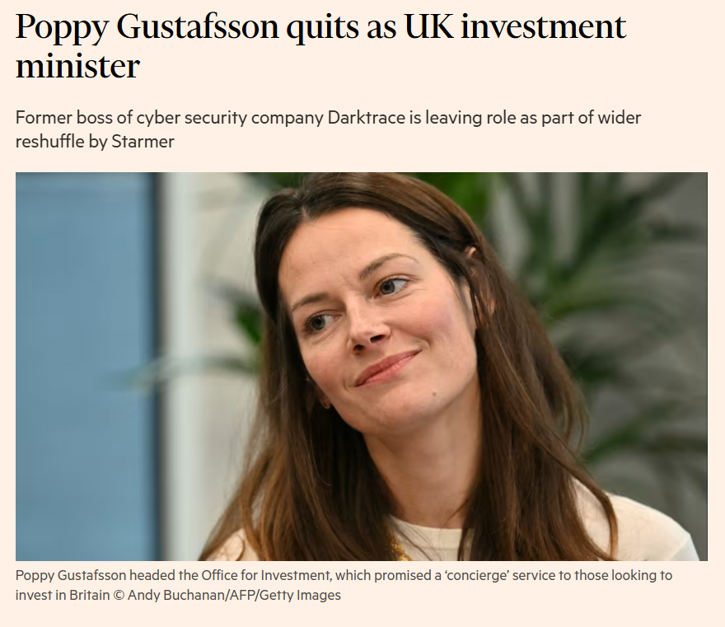
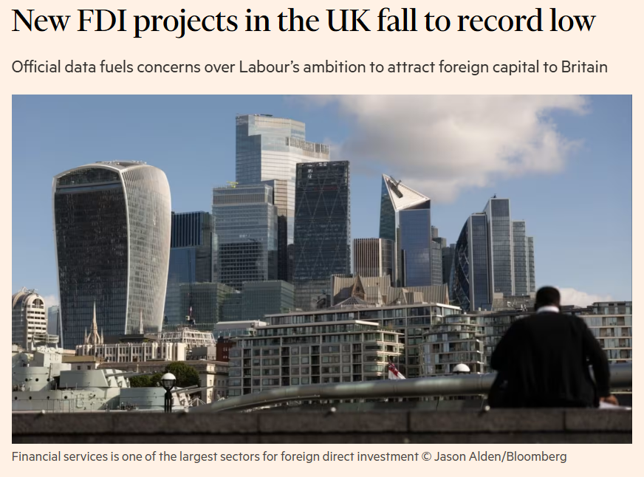
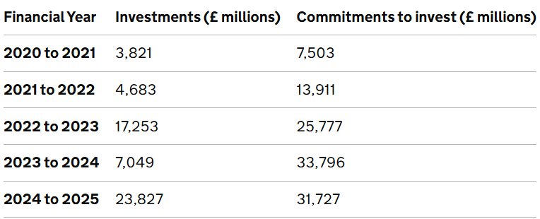
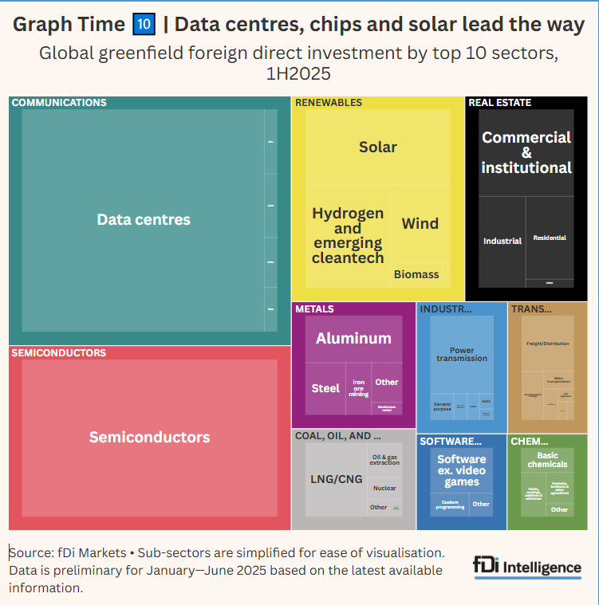
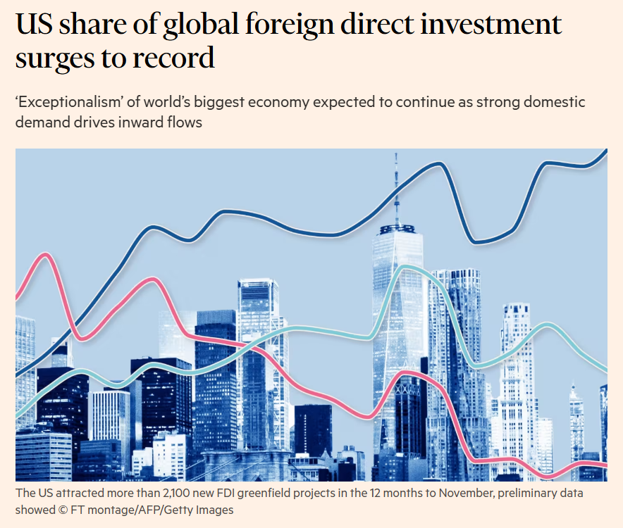
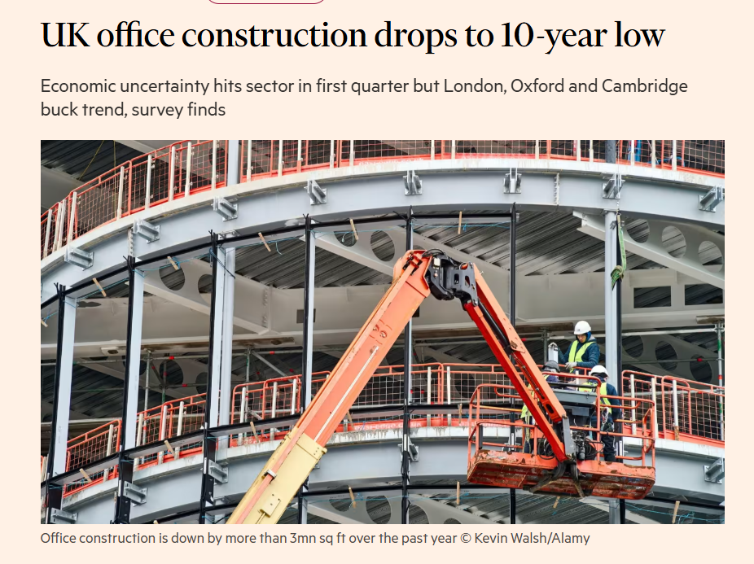
UK/Global Context

Slide 6
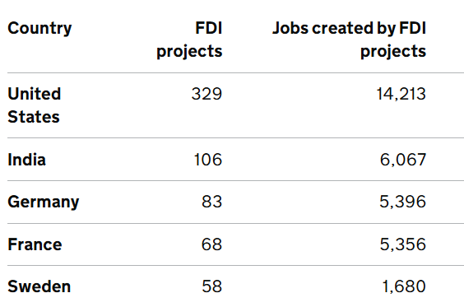
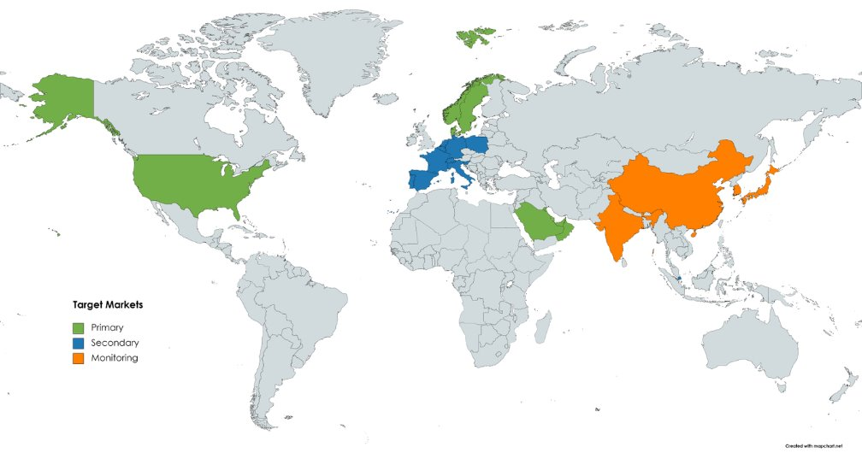
International markets

Slide 7
Newcastle CRE
£6.7bn development pipeline
£32 per sq. ft prime rents
9.1% vacancy rate
481,000 sq. ft take up in H1 2025

Slide 8
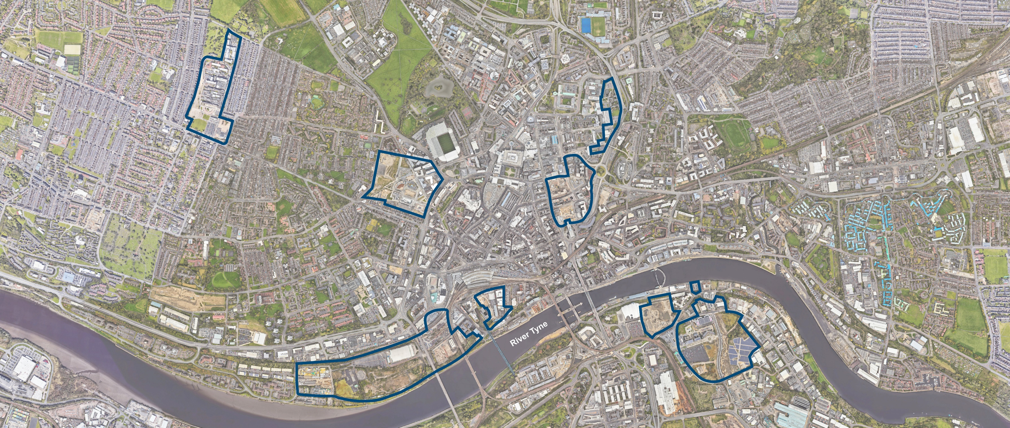
Our Newcastle
Our People
Our Future
Opportunities

Slide 9
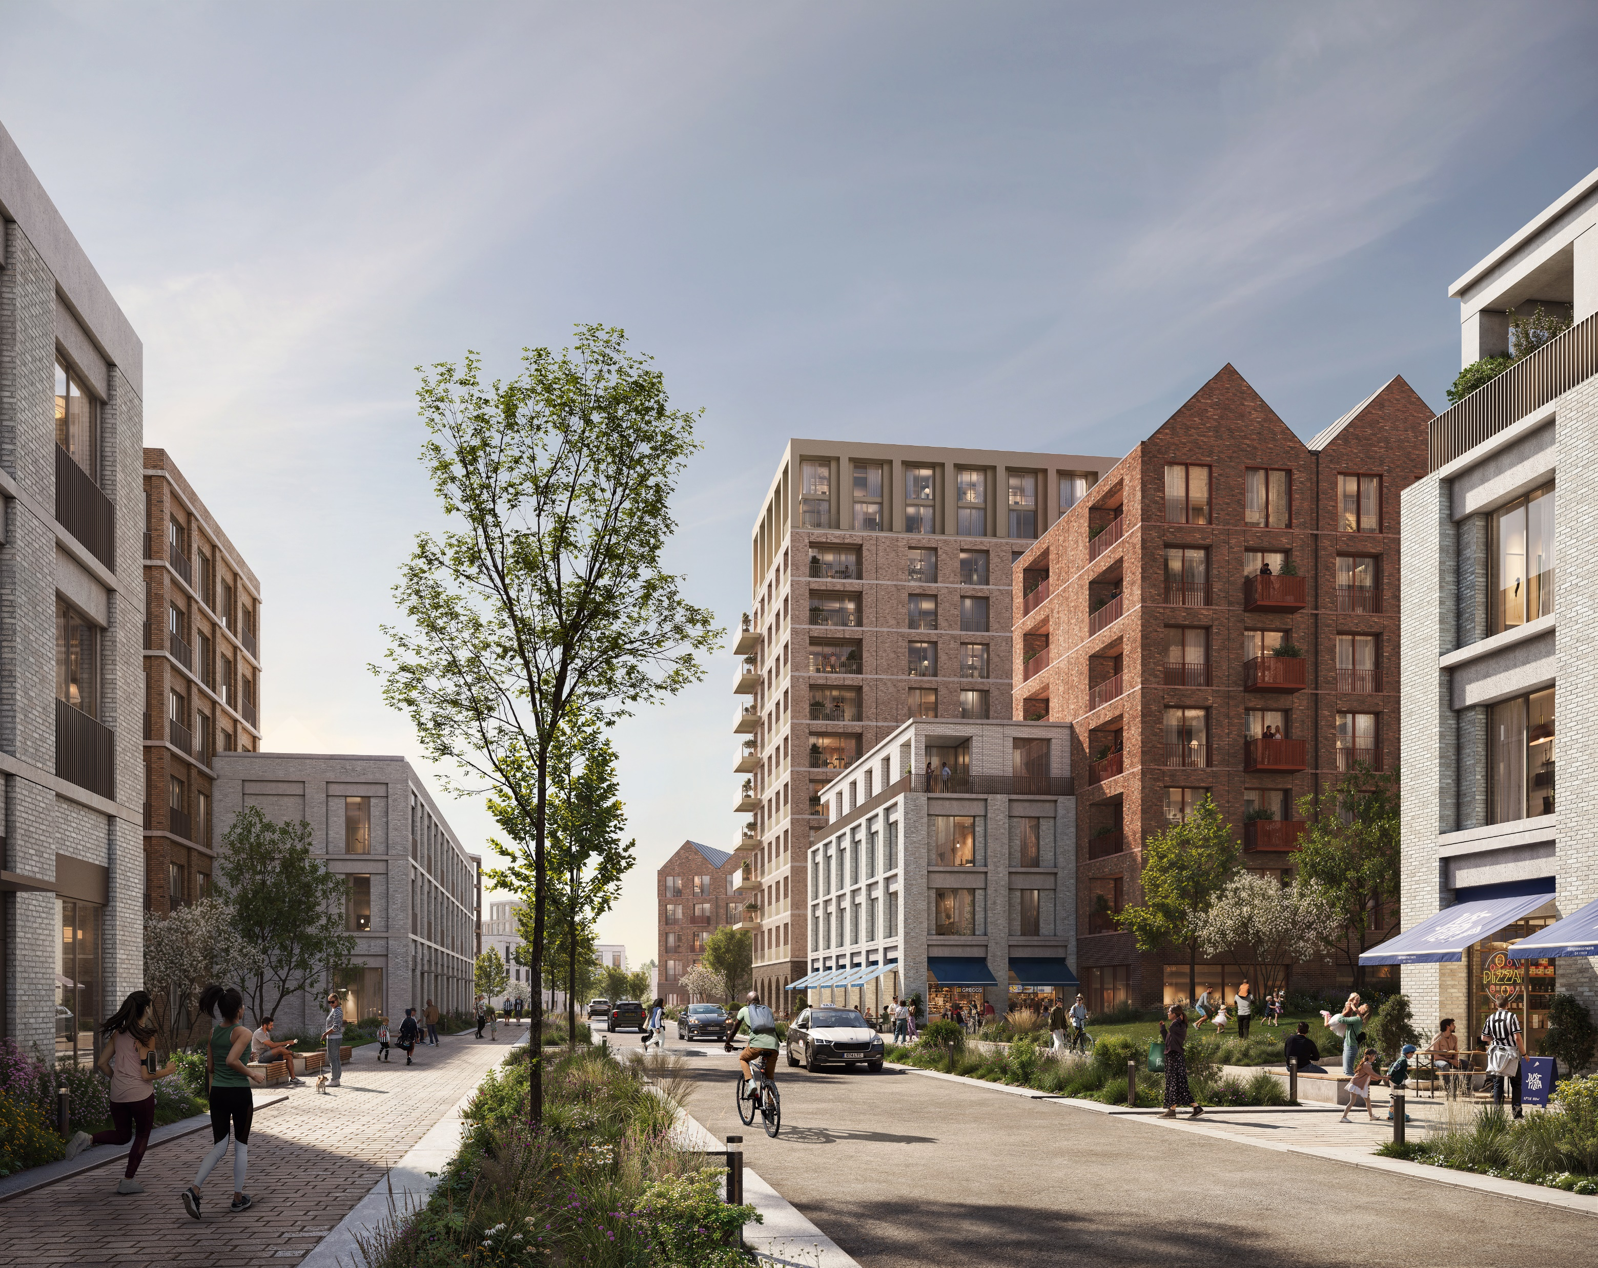
Forth Yards
21 ha brownfield site
Last major undeveloped water frontage plots in the city​
Western gateway to city centre via pedestrian and cycle ‘highline’
Potential for 2,500 new dwellings​
Challenging site comprising fragmented land ownerships​​
Significant infrastructure requirements​
Gross development value £925m (est.)
500 net zero homes under construction on Pottery Lane site

Slide 10
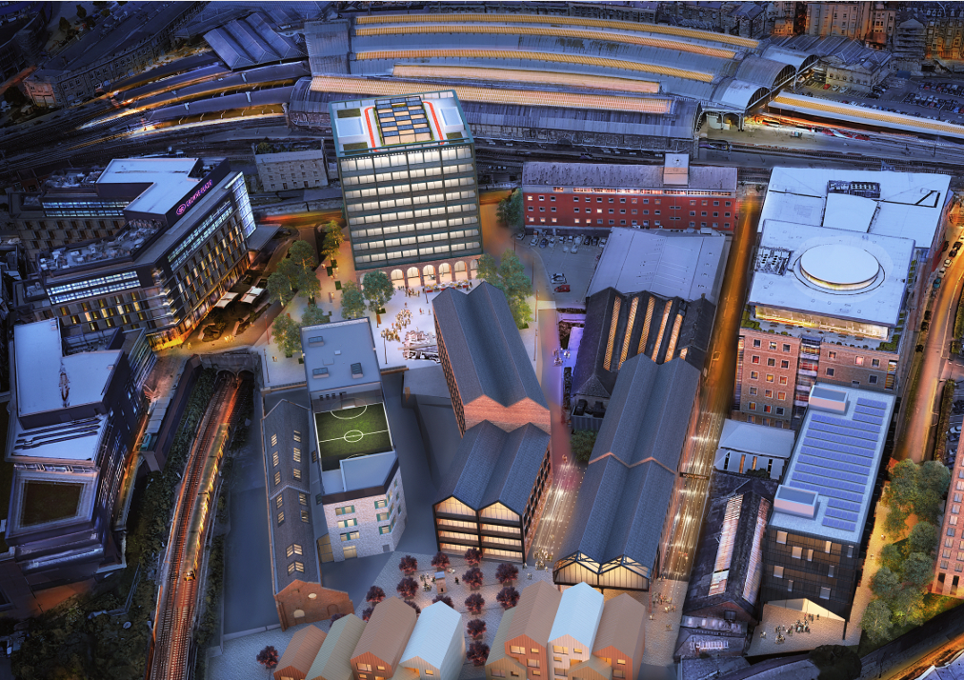
Founders Place
10-acre site
Mixed-use destination within the historic city core
Originally the location of the workshops and site offices of Robert Stephenson & Company
Located on the south side of the city’s central railway station
£137m gross development value
Successful restoration of the Pattern Shop now home to Atom Bank
Pre-let occupiers sought for 100,000 sq. ft One Founders Place

Slide 11
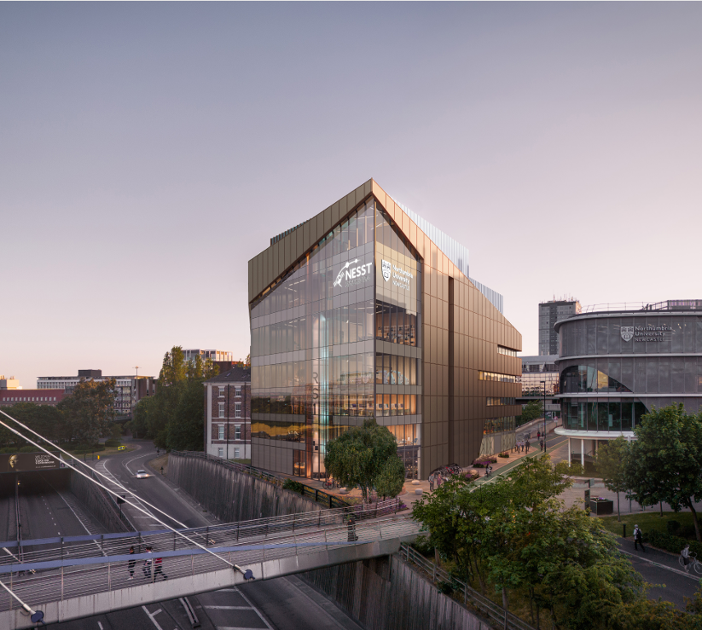
City Gateway East
£50m North East Space Skills and Technology Centre (NESST)
NESST will provide state-of-the-art R&D and educational facilities for the space sector
160,000 sq. ft Centre for Health and Social Equity (CHASE)
CHASE is projected to deliver a Net Present Social Value of over £250m
Northumbria and Newcastle City Council working in partnership
Requirement for at least 1,000 student accommodation units
Seeking capital investment, development partners, co-investment from organisations interested in co-location

Slide 12
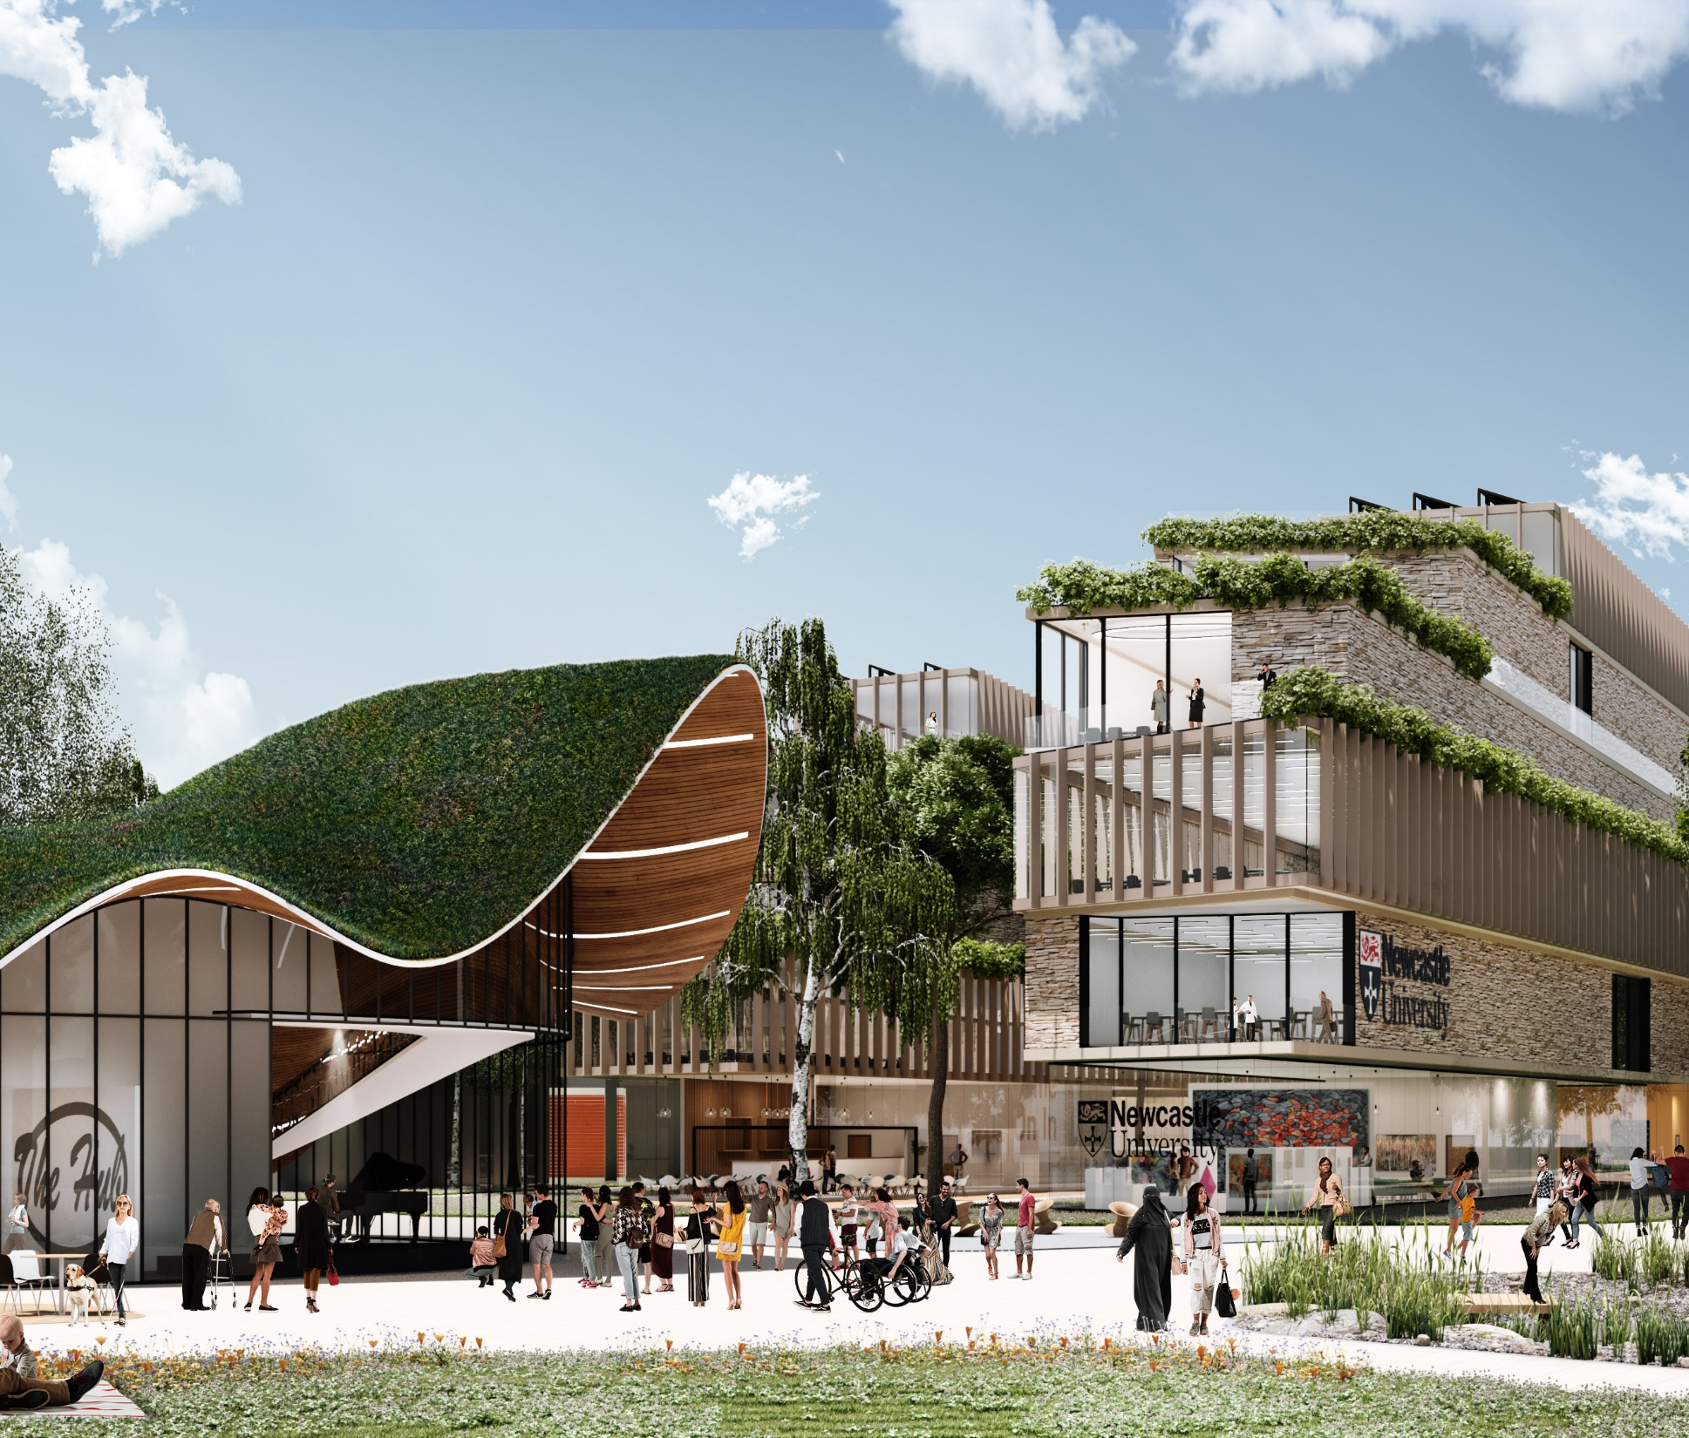
Health Innovation Neighbourhood
29-acre site
Led by Newcastle University
Blending later living with research facilities and student accommodation to deliver an intergenerational residential offer
£500m gross development value
Leveraging Newcastle’s reputation for healthy ageing and longevity
Planning approval secured
Groundbreaking took place in 2024
Seeking capital investment for commercial, research, and residential opportunities (buy-to-rent, later living, key worker, student accommodation)

Slide 13
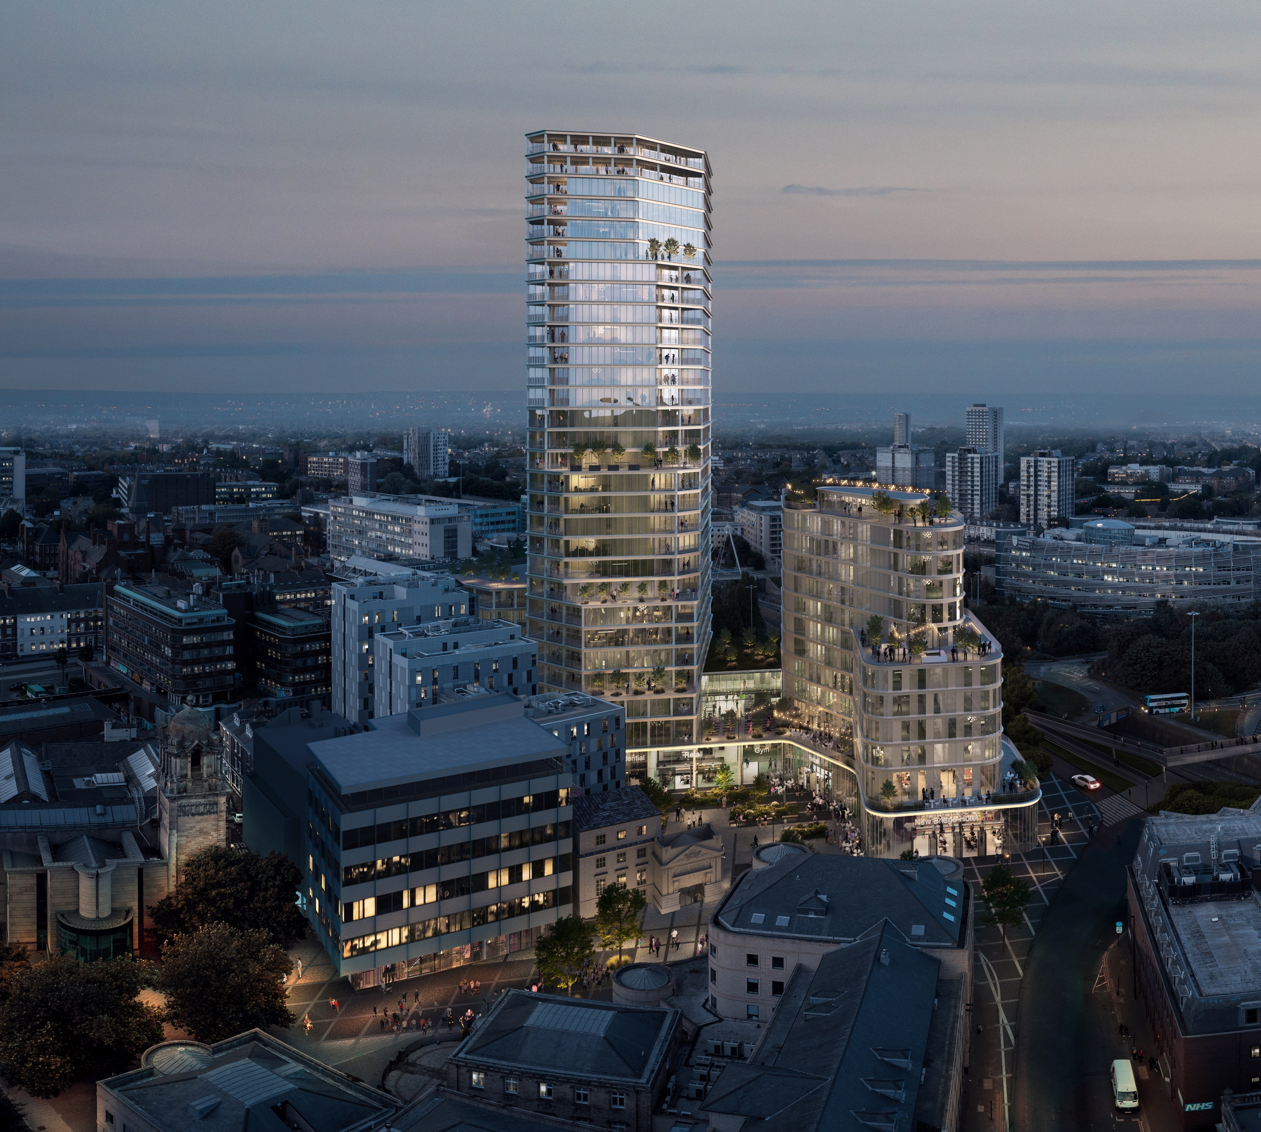
New Bridge Project
£170m gross development value
Taking Newcastle to new heights with a 29-storey high-rise residential tower
Led by leisure and hospitality operator Gainford Group
Transforming the eastern gateway to Newcastle city centre
185 homes in the residential skyscraper
150-bed hotel to compliment the scheme
Multiple bars, restaurants and a health club
Significant public realm and connectivity improvements

Slide 14
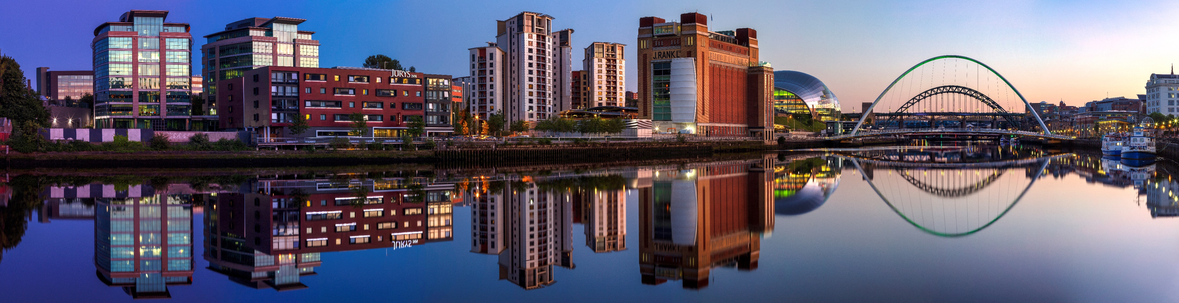
Our Newcastle
Our People
Our Future

