Slide 1
January 2026 1947 Club
Gareth Harrison
North East Agency

Slide 2
Financial Stability

Slide 3




Risks to financial stability have increased during 2025
Global risks remain elevated and material uncertainty in the global macroeconomic outlook persists. Key sources of risk include geopolitical tensions, fragmentation of trade and financial markets, and pressures on sovereign debt markets.
Many risky asset valuations remain materially stretched, driven by AI companies, whose links with the broader financial system are deepening.​
Credit spreads remain compressed despite intensified focus on weaknesses in credit markets after high-profile defaults. Recent US corporate defaults underline the need for robust risk management.
Elevated geopolitical tensions increase the likelihood of cyber-attacks and other operational disruptions. ​

Slide 4
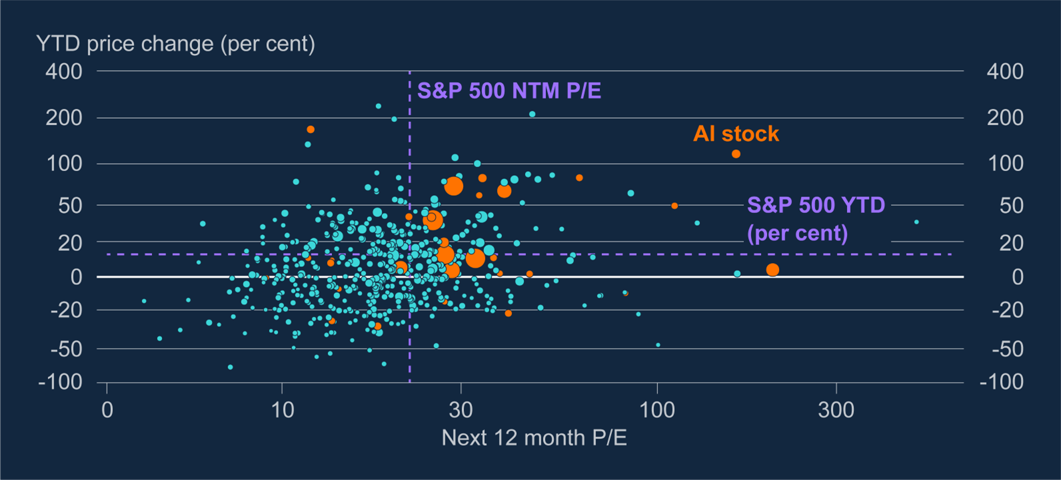
AI stocks have driven the high valuation and growth of the US stock market
These AI company valuations are partly underpinned by the expectation of high future earnings growth
Notes:
Sources: Refinitiv Workspace and Bank calculations.
(a) The chart uses a pseudo-log scale with base 10 and a sigma of 20 for visualisation purposes.
(b) The size of dots corresponds to the market capitalisation of firms as of 24 November 2025.
(c) ‘AI stocks’ are those which appear in the JPAIM equity basket

Slide 5
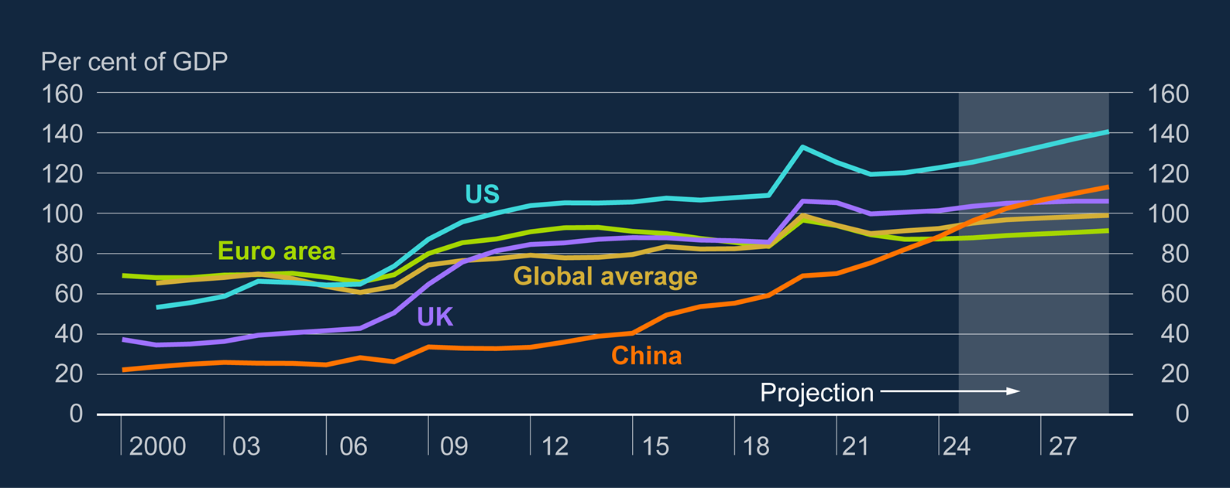
Debt-to-GDP ratios are projected to continue to increase
Sovereign debt (percentage of GDP)^{(a)}
Notes:
Sources: International Monetary Fund and Workspace from LSEG.
(a) Use of IMF Content and Data is subject to the IMF’s terms of Copyright and Usage.

Slide 6
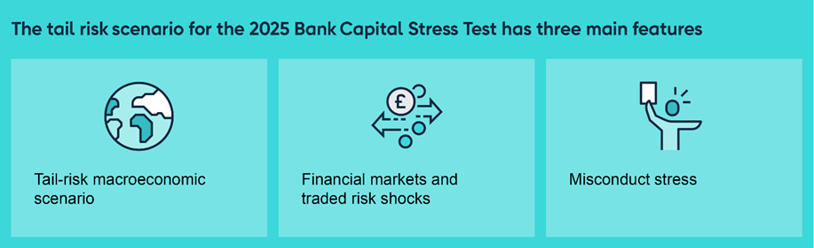
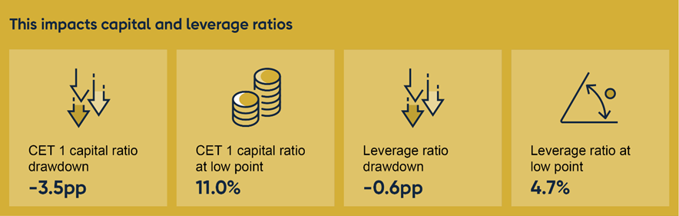
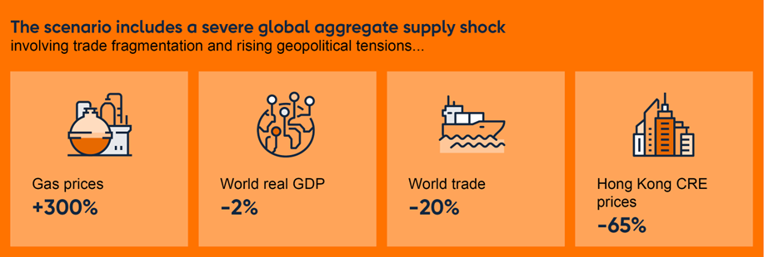
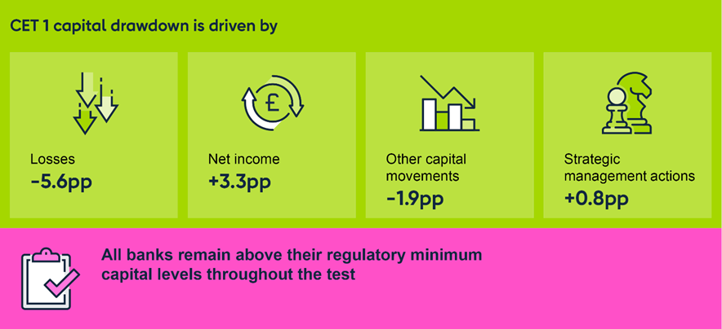
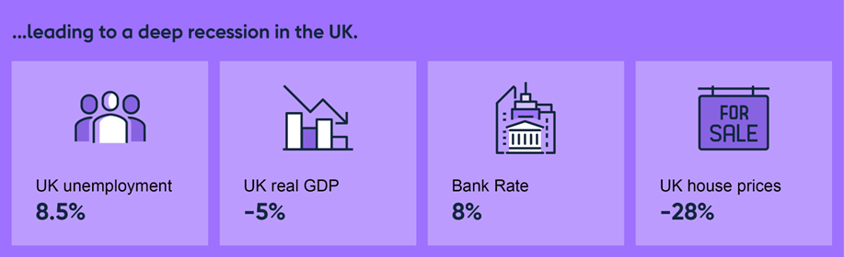
Summary of the 2025 Bank Capital Stress Test
Notes:
Sources: Refinitiv Eikon from LSEG, Rating and Valuation Department, the Government of the Hong Kong Special Administrative Region Bank, Participating banks’ Stress Test Data Framework submissions (STDF), Bank analysis and Bank calculations.
(a) Unemployment rates and Bank Rate are shown as their peak percentage values in the scenario. Other variables are shown as percentage or percentage point changes from the start of the scenario to the peak or trough values for each variable. Except for Hong Kong commercial real estate prices which are shown as percentage changes relative to their peak level in 2018 Q4.
(b) Gas prices defined as UK natural gas prices in pence per therm. The value has been rounded to one significant figure.
(c) World trade defined as the market exchange rate-weighted volume of world imports. Regional import volumes aggregated using the dollar value of imports as a share of the world total.
(d) World real GDP defined as purchasing power parity-weighted world real gross domestic product (chained volume measure).

Slide 7
Economic Outlook

Slide 8
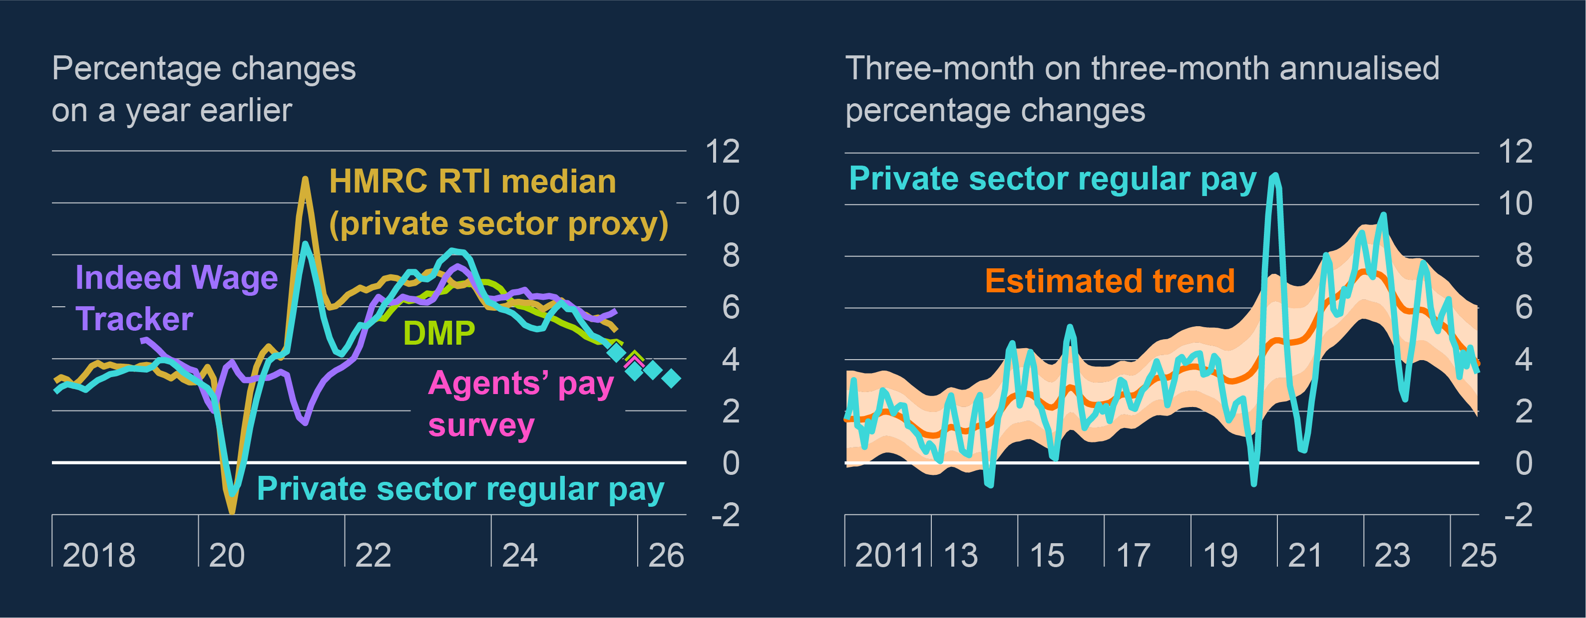
Wage growth has moderated
Measures of private sector wage growth ^{(a)} and higher-frequency wage growth with estimated trend ^{(b)}
Wage growth has continued to decline – to 4.2% for private sector in October 2025
Business surveys suggest that wage growth will edge down further over coming months

Slide 9
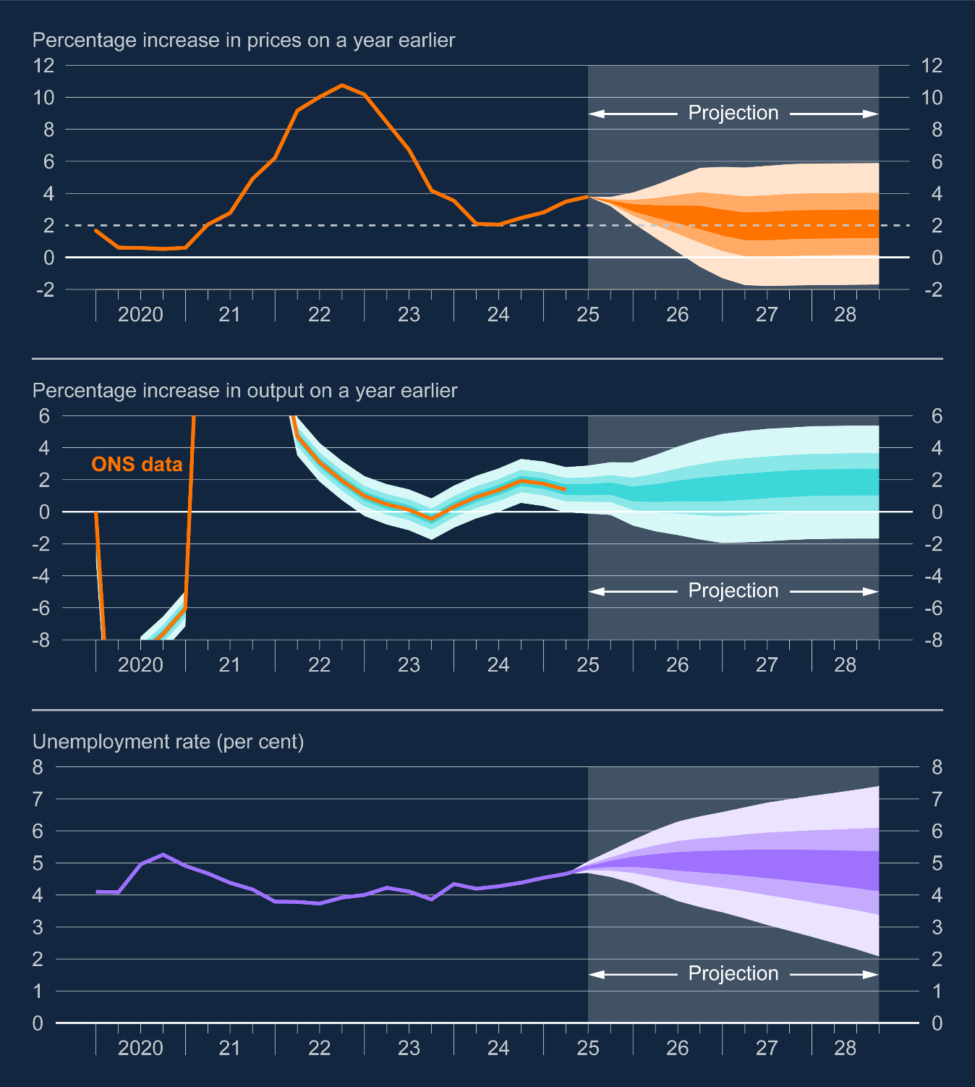
Unemployment rate expected to pick up to just above 5% by mid-2026
Notes:
(a) The fan charts depict the probability of various outcomes for GDP growth, the International Labour Organization (ILO) definition of unemployment, and CPI inflation. The uncertainty parameters determining the width of the fan charts have been calibrated to match the historical forecast errors since 2004 and now up to 2025 Q2 for each variable at different horizons but exclude errors during the pandemic given its exceptional nature. The fan charts are constructed so that outturns are expected to lie within each pair of lighter areas on 30 occasions, with outturns expected to lie within the fan on 90 out of 100 occasions. On the remaining 10 out of 100 occasions, outturns can fall outside the respective aqua, orange or purple areas of the fan chart, depicted by the grey background. For GDP growth, the distribution reflects uncertainty around past data revisions and future evolution, so that the mature estimate would lie within the darkest central band on only 30 out of 100 occasions. The Committee no longer uses the calibration of the fan chart skew to reflect judgements on the balance of risks to the central projection.

Slide 10
 |  | North East |  |  | UK
 |  | Aug-Oct 2024 | Aug-Oct 2025 | Change | Aug-Oct 2024 | Aug-Oct 2025 | Change
Employment | Number | 1,212,204 | 1,254,960 | 42,755 | 33,778,235 | 34,226,340 | 448,105
 | Rate (%) | 69.3% | 70.5% | 1.2% | 74.9% | 74.9% | 0.0%
Unemployment | Number | 67,519 | 74,789 | 7,270 | 1,505,022 | 1,831,890 | 326,868
 | Rate (%) | 5.3% | 5.6% | 0.3% | 4.3% | 5.1% | 0.8%
Inactivity | Number | 960,388 | 935,316 | -25,072 | 20,536,154 | 20,337,243 | -198,911
 | Rate (%) | 26.9% | 25.0% | -1.9% | 21.7% | 21.0% | -0.7%

Slide 11
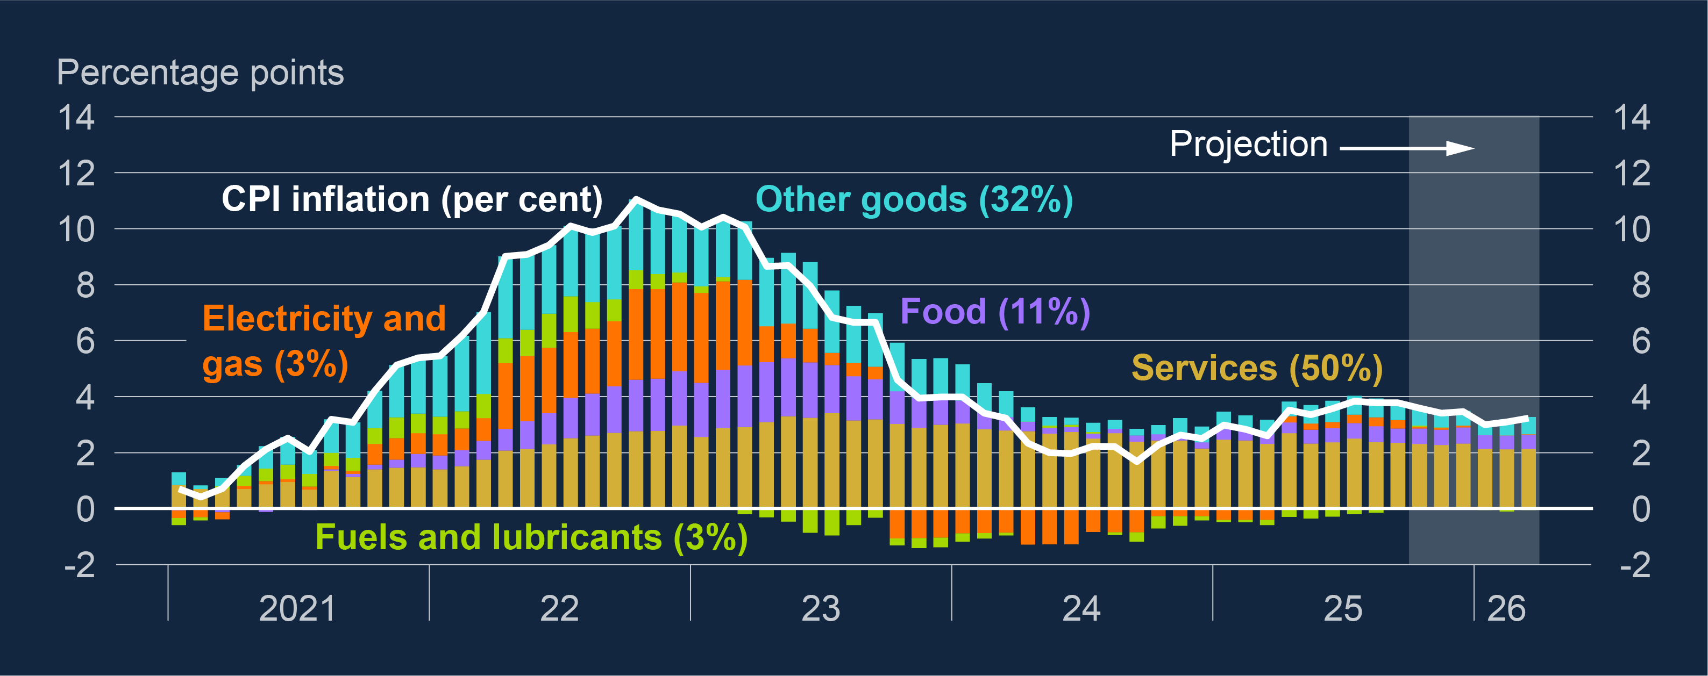
CPI inflation was 3.2% in November
Contributions to CPI inflation ^{(a)}
Headline inflation was 3.6% in October, down from 3.8% in August and September – lower than expected, due to services prices, and likely to be the peak. MPC expects inflation to fall to around 3% in January
Administered prices (largely in services) account for 0.4pp of the current overshoot, food 0.4pp and much of the rest is the indirect effects of labour costs growth.

Slide 12
Inflation is expected to return to target this year
Notes:
(a) The fan charts depict the probability of various outcomes for GDP growth, the International Labour Organization (ILO) definition of unemployment, and CPI inflation. The uncertainty parameters determining the width of the fan charts have been calibrated to match the historical forecast errors since 2004 and now up to 2025 Q2 for each variable at different horizons but exclude errors during the pandemic given its exceptional nature. The fan charts are constructed so that outturns are expected to lie within each pair of lighter areas on 30 occasions, with outturns expected to lie within the fan on 90 out of 100 occasions. On the remaining 10 out of 100 occasions, outturns can fall outside the respective aqua, orange or purple areas of the fan chart, depicted by the grey background. For GDP growth, the distribution reflects uncertainty around past data revisions and future evolution, so that the mature estimate would lie within the darkest central band on only 30 out of 100 occasions. The Committee no longer uses the calibration of the fan chart skew to reflect judgements on the balance of risks to the central projection.

Slide 13
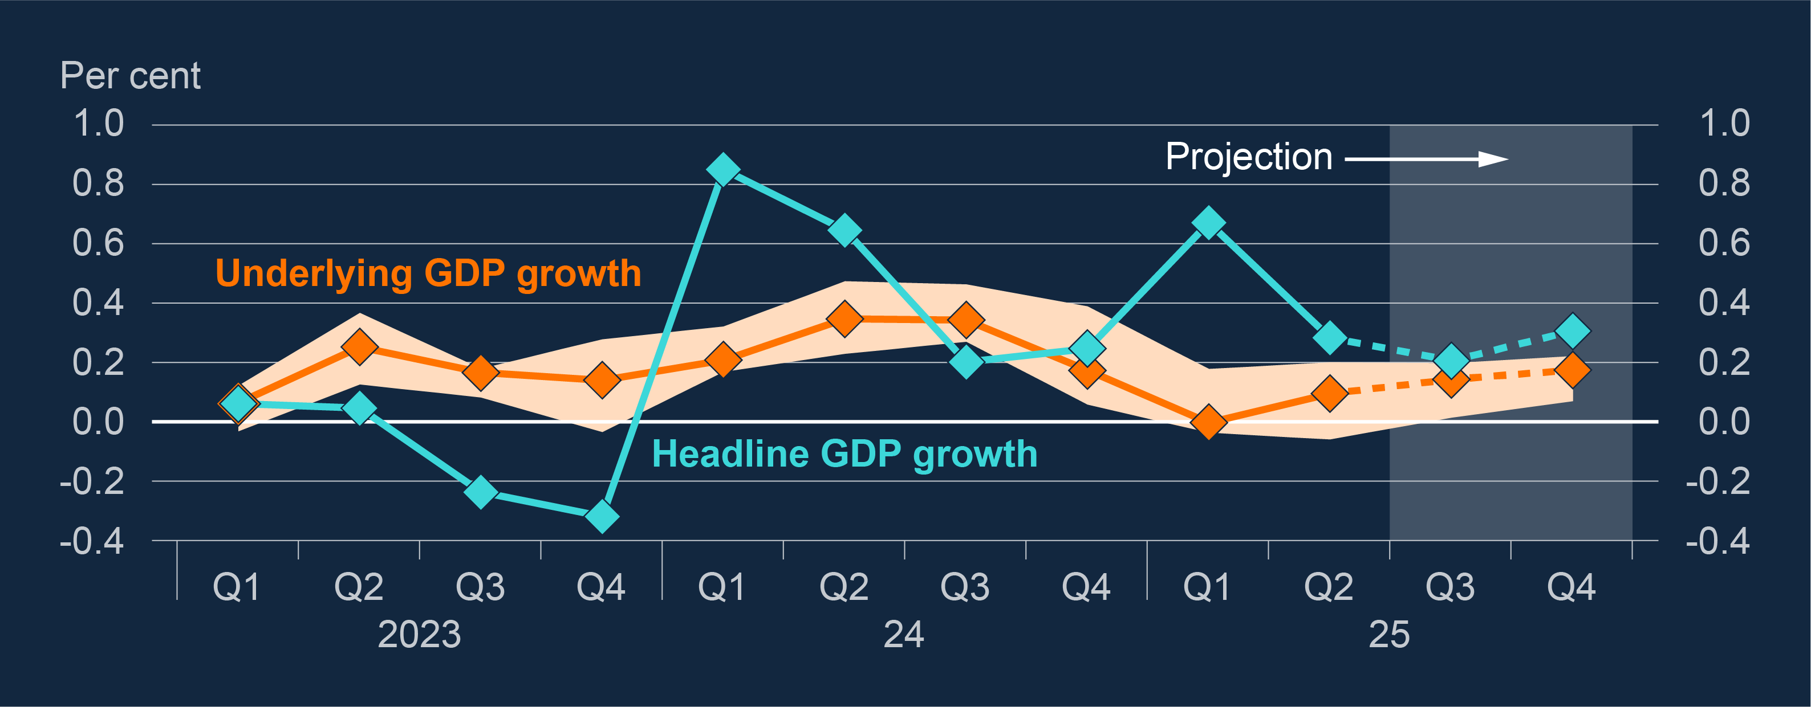
Underlying GDP growth was subdued in 2025 – similar expected this year Quarterly growth in headline GDP and underlying growth implied by business surveys^{(a)}
Notes:
When we look at underlying GDP growth in the UK, which we interpret from a range of business surveys, we thing the picture is a bit weaker than the headline forecasts. We expect underlying growth to be 0.1% in Q3, with uncertainty over the upcoming Budget weighing on sentiment for both households and businesses.
Although headline GDP has been slightly higher than the underlying picture in recent quarters, we think it will be still weaker in Q3 than we were forecasting in our August MPR at 0.2% in Q3. Exports to the US have been weaker than forecast and the ongoing issues at Jaguar Land Rover and it’s supply chain have also had a downward effect on GDP growth in the quarter.

Slide 14
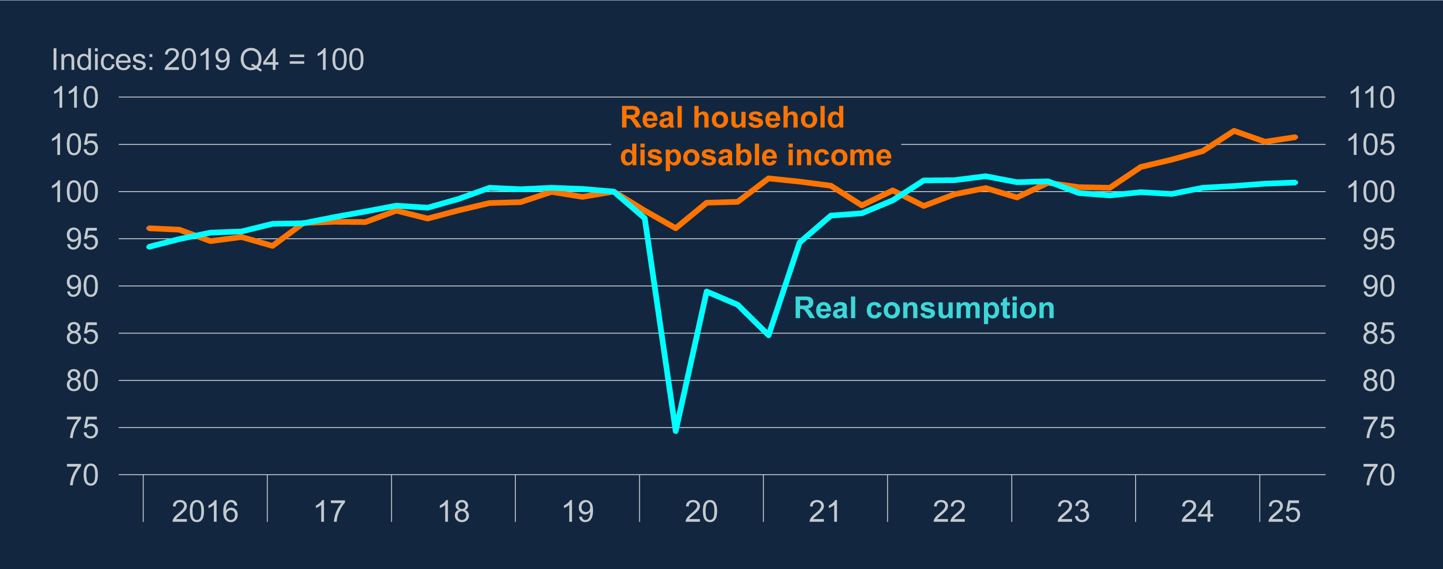
Real consumption growth has been very weak Real household consumption and disposable income^{(a)}
Notes:
Household consumption accounts for 60% of GDP in the UK but has been very weak in recent years and has risen by just 1% since Q4 2019, despite the recent increase in real household disposable income.
In large part, that has been down to higher interest rates but we would expect consumption to start to pick up in the coming quarters as rates have fallen back from their peak and are expected to fall further. We think that the restrictiveness of higher interest rates on consumption is now close to their peak.

Slide 15
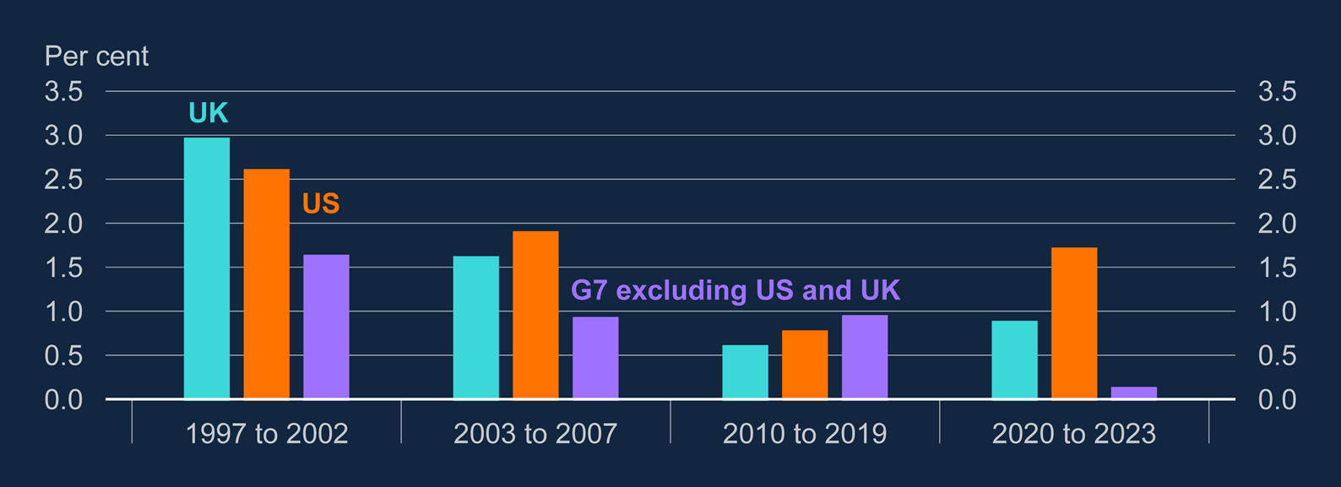
UK productivity growth in recent years has been low by historical standards, and relative to some other advanced economies
Average growth in GDP per hour worked, UK, US and G7 excluding US and UK (weighted average) ^{(a) (b)}
Notes:
Sources: OECD and Bank calculations.
(a) Average YoY growth in GDP per hour worked in 2020 US dollars, chain linked volume (rebased), PPP
converted. G7 excluding US and UK is weighted by total GDP in 2020 US dollars, chain linked volume
(rebased), PPP converted. Weighted average excludes Canada for 1997 due to unavailable 1996 data.
(b) This chart is not directly comparable to Chart 4.1 of the July FSR due to an update to the underlying OECD database.

Slide 16
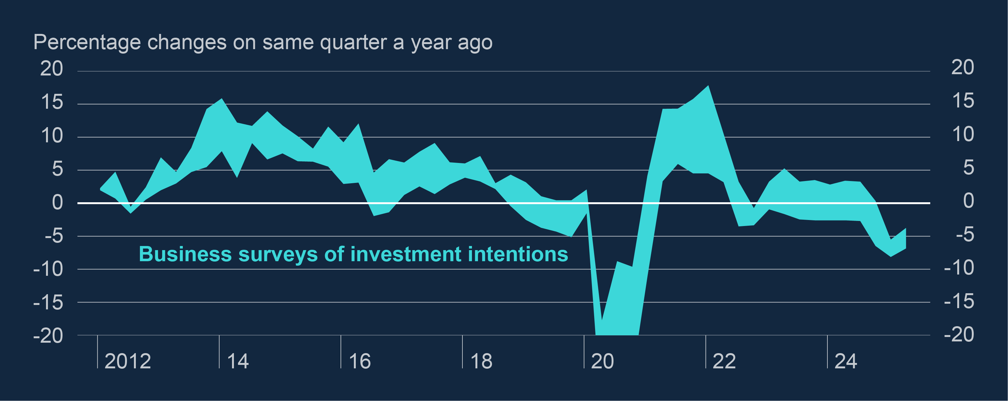
Business investment intentions are weak Range of survey indicators of investment intentions^{(a)}
Notes:
A big part of that tepid GDP growth picture comes from weakness in business investment. This graph shows a range of indicators on business investment intentions, including what you as our contacts tell us. And what we have picked up more noticeably in recent weeks in intelligence suggesting that businesses are putting investment on hold in the lead up to the Budget. As you can see from the graph, investment intentions have been lower than historical averages for the past two or three years but surveys on business uncertainty have also ticked up further recently.
While business investment fell on the quarter in Q2 by 1%, it was 3% higher than a year ago so there is some volatility in the data but along with the general uncertainty, challenges from higher labour costs also act as an anchor on investment.

Slide 17
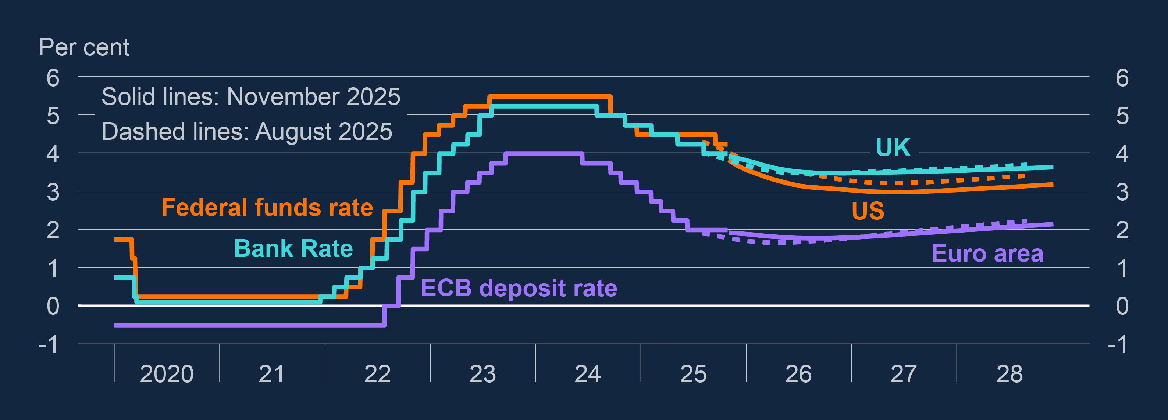
Financial markets are pricing in one more cut this year Policy rates and instantaneous forward curves for the UK, US and euro area^{(a)}
Notes:
And as to the interest rate graph, which we always show and is market expectation of interest rates, there has been little change in market expectations for the UK over the next three years and they expect us to cut further to 3.5% by Q2 2026.
Expectations for the US have fallen by around 0.25% since August, on the back of the latest Fed meeting when they voted to cut, albeit with language that suggested that further cuts in the near term are not certain.

Slide 18
Q&A

