Slide 1


Welcome
Thank you for joining. The event will begin shortly
Aims of the 1947 Club
• Furtherance of Social and Professional Contacts
• Providing assistance to Branch RICS matrics
• Preservation of the history and tradition of the 1947 Club

Slide 2
Unlocking Lab potential
Transforming Vacant Spaces into Commercial Labs in the North East

Slide 3
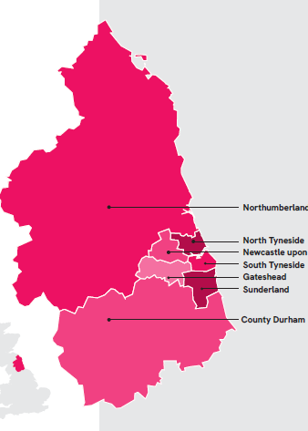
Background to the North East CA
Who we are
One of four established Mayoral Strategic Authorities
Powers and funding to grow the region’s economy, skills, transport, housing and public services.
Built on a trailblazing £4.2bn devolution deal
Strong national and international role – giving the North East a clear voice through North East Mayor Kim McGuiness

Slide 4
Background to the North East CA
What we do
Transport: Coordinate and invest £1bn+ in the network.
Economy: Manage a £1.4bn investment fund to drive local growth.
Skills & People: £100m/yr adult skills; £50m devolved work & health; focus on child poverty and PSR.
Housing: Accelerate development incl. £50m+ brownfield fund.
Innovation & Investment: £180m Investment Zone from Sedgefield to Blyth linking key innovation assets.

Slide 5
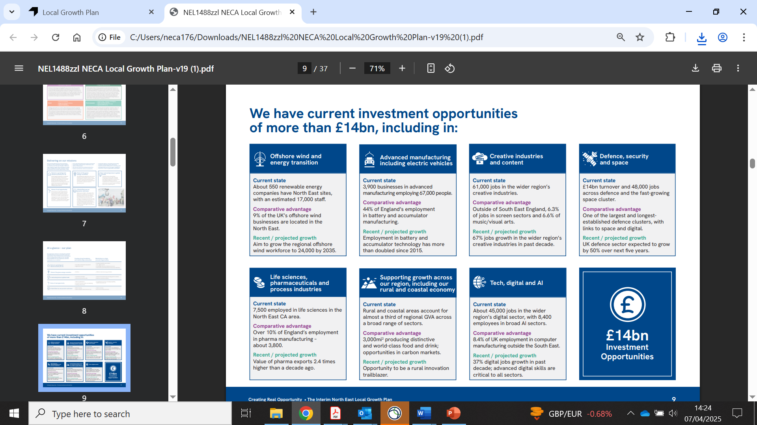
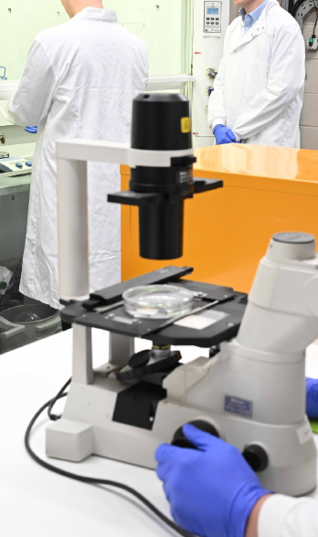
Growth Plan

Slide 6
Life Sciences – what’s the opportunity?
£43.3 billion in GVA to GDP in the UK (PwC Life Sciences Future50)
£1.7b value to the North East economy
584,000 jobs nationally supported by the sector
7,500 employed in NECA area
18% of all R&D investment in the UK
We have an ambitious plan to support the sector through our Inward Investment Team, and with our partners

Slide 7
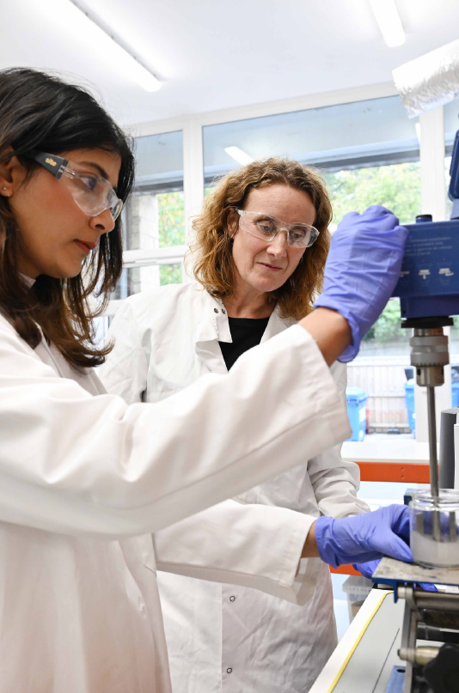
The Study: Unlocking Lab Space for Growth
Why do this?
Critical undersupply of lab space hindering growth and inward investment
Appetite for aggregation and clustering to support companies at all stages
Need for practical tools to tackle barriers and build on previous experience
Proven case studies of ‘what works’
Improve communication, networking and myth-busting
Delivered in partnership with Naylors and Ryder Architecture

Slide 8
Key Deliverables and Recommendations
The study delivers a step by step guide to finding and fitting out lab space, which is available online as a tool for businesses and developers.
Key findings:
The North East has a thriving and growing life sciences cluster, supported by leading research institutions, innovative businesses, and strong collaboration.
A major barrier to further growth is the shortage of suitable lab space for organisations from spinouts to established firms.
With limited purpose‑built labs and high immediate demand, the North East CA can play a pivotal role in enabling growth
Converting underused or vacant buildings into high‑quality, flexible lab space presents a significant opportunity for the region.

Slide 9
Key Deliverables and Recommendations
Key recommendations
Accelerate conversion of suitable vacant spaces into flexible, high‑quality labs for companies at all stages.
Promote flexible leasing to lower upfront risk for early‑stage and scaling businesses.
Create shared infrastructure (utilities, equipment pools, modular layouts) to reduce costs and encourage landlord participation.
Provide a single “front door” on the NECA website with tools, guidance, and access to expert support (incl. Ryder Architecture and Naylors).
Share case studies and guidance to de‑risk development and support fit‑out decisions.
Run a communications campaign to promote the toolkit, raise awareness, and signal regional readiness to investors and occupiers.

Slide 10
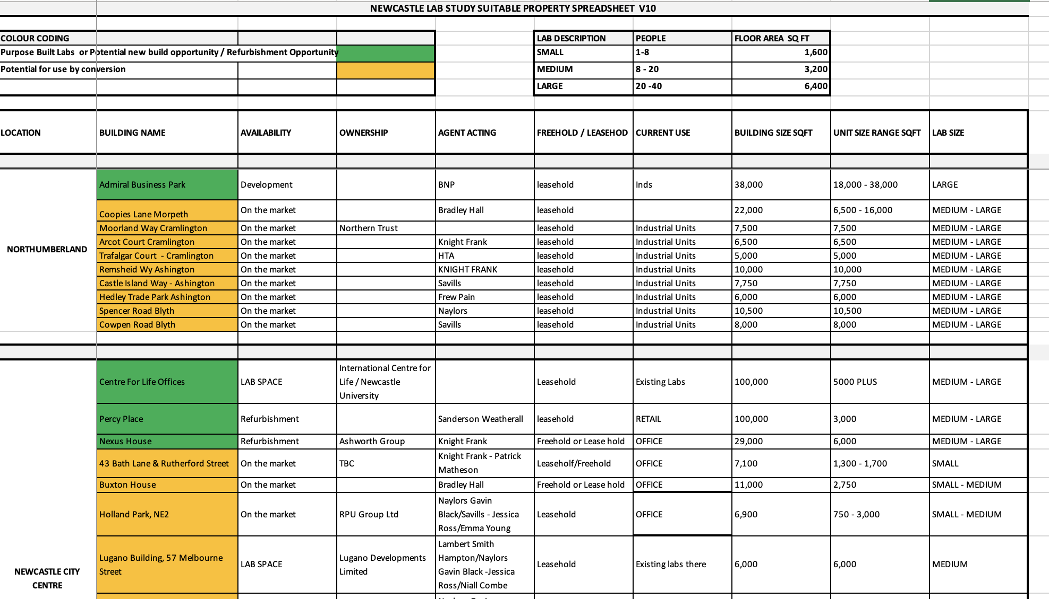
Lab Property Suitability Sheet
PREPARED BY NAYLORS

Slide 11
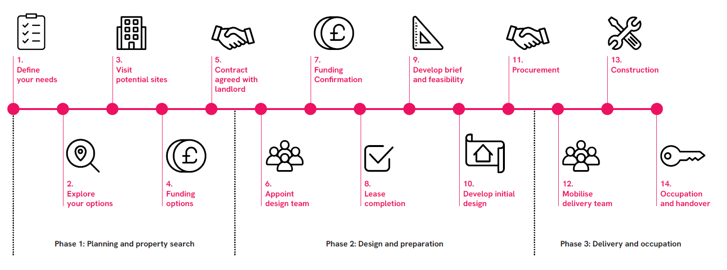
Finding and fitting out space – a step by step guide

Slide 12
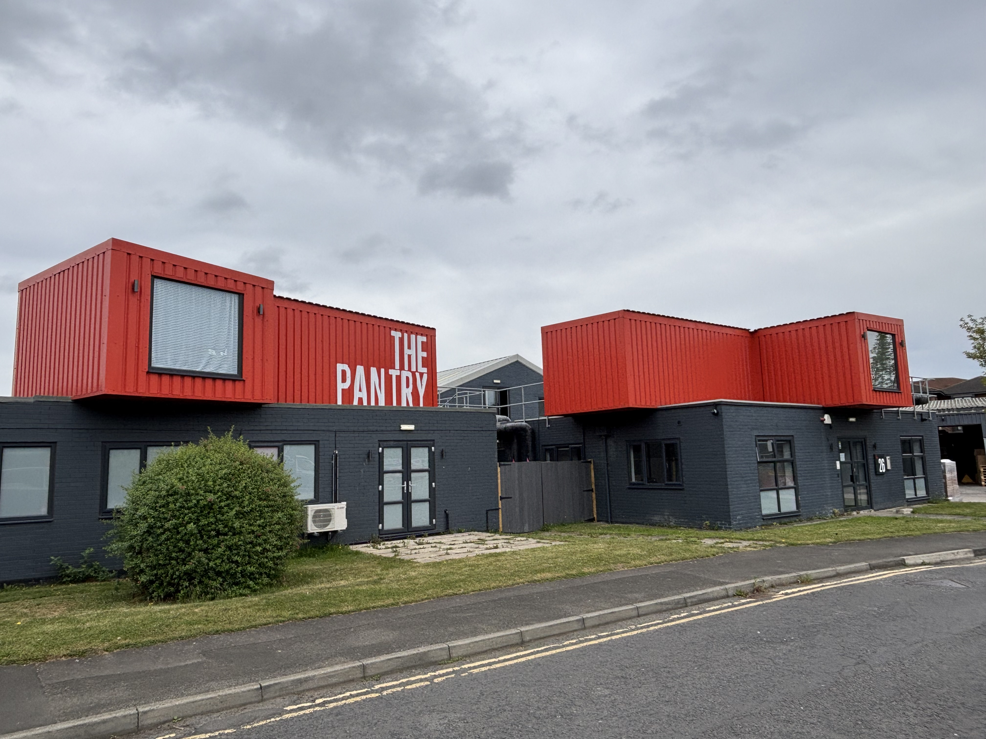
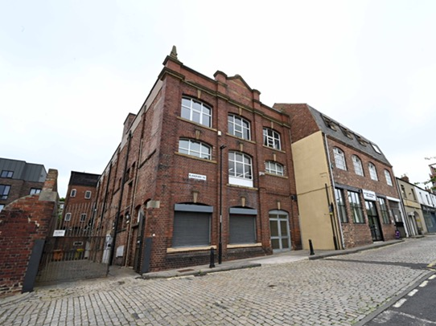

Case Studies

Slide 13
Thank you

Slide 14
Next event
April TBC – keep an eye on LinkedIn and make sure you’re on our mailing list
Are you a Chartered surveyor and interested in becoming a Member of the 1947 Club? – contact a Committee member or send a message through Linkedin
www.the1947club.co.uk

